Slide 1
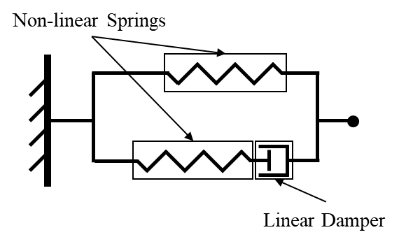
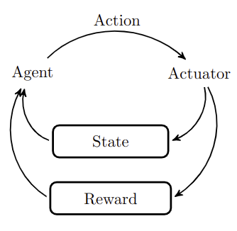
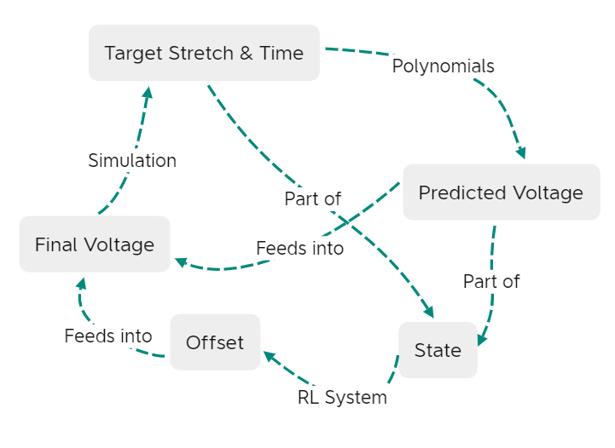
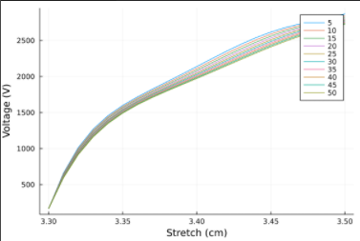
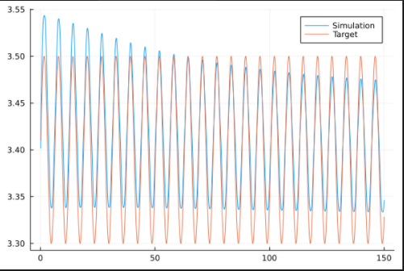
A Reinforcement Learning based Control System
for Dielectric Elastomer Actuators
Isaac Hanna, Carson Farmer, Dr. Hector Medina
TRACER Lab
Abstract and/or Background
Methods
Background: Dielectric Elastomer Actuators show beneficial properties for use in soft robotics and synthetic muscle. Because of their nonlinear deformation curves and hysteresis, traditional control methods are inadequate for the control of the elastomers. A 2019 study by Li et al. utilized polynomial fitting and reinforcement learning to predict the voltage necessary to yield a target displacement. We begin by replicating their study and hope to then extend their results through the use of recurrent networks, varied offset values, and different model architectures, among other things. Methods: In order to hasten the development process, we utilized a simulation of the elastomer to obtain data on the displacement shown by the elastomer over time after a given voltage was applied. We then fit curves to these data, mapping, for each timestep, the displacement seen to the voltage applied. These curves were then used to generate the initial approximation of the voltage required to generate a desired displacement. To this initial estimation was added an offset output by a reinforcement learning system
frame
Data Generation and Polynomial Fitting:
In order to accelerate the process, a simulation of the dielectric elastomer actuator was used in place of an actual elastomer to generate data
Data was generated for 31 voltages from 0 to 3000 in increments of 100 volts
The voltage was applied and the displacement measured at timesteps with dt = .01
For each timestep, a fourth-order polynomial was fit, mapping displacement to voltage (fig. 5)
Epochs
The system was trained for 100 epochs, each with a randomly generated trajectory
After every 5 epochs, starting with the tenth, the system was tested with each of six test trajectories—two sine waves, two square waves, and two triangle waves
The root mean square error over the course of the tests was used to measure the model performance
Timesteps (Fig. 4)
At each timestep, a system of differential equations modeling the system was simulated to find the actual displacement
This displacement was then passed, along with the current time, previous voltage, the desired displacements 1, 6, and 11 timesteps in the future, and the voltage predicted by the polynomials, to the reinforcement learning system
The system predicted an offset and stored the state, action, reward, and next state in the trajectory
It then selects a sample from the trajectory and updates the policy parameters according to the difference between the predicted Q-values and the “actual” Q-values found by adding to the reward a portion of the maximum Q-value predicted by the target network for the next state
The target network parameters are then updated by taking a weighted mean of the target network parameters and the current policy parameters
V
+
-
A
B
Figure 1: The elastomer: Subfigure A is pre-voltage activation, and B is activated state.
Created By Tracer Lab
Figure 1: The elastomer: Subfigure A is pre-voltage activation, and B is activated state.
Figure 2: The Maxwell Model of the Dielectric Elastomer Actuator
Created By Tracer Lab
Research Question
How can reinforcement learning be used to create an effective control system for a dielectric elastomer actuator?
Reinforcement Learning (Fig. 4):
Reinforcement Learning views the environment as a Markov decision process-one in which the next state is dependent only upon the previous state and the action taken.
At each timestep, an action is taken based upon the current state, according to a policy for choosing the action
This policy is then updated
Q-Learning:
Our policy is a table mapping (state, action) pairs to expected (Q) values
This Q-value is a weighted average of the current and future states, assuming the best action is taken at each successive timestep
An epsilon-greedy approach is used to choose, with decaying probability epsilon, a random action or the action with the best Q value for the current state
The Q-table is then updated based on the obtained reward
Deep Q-Learning:
Since many environments have an impractically large number of (state, action) pairs, a neural network is used to approximate the Q-value given a state
The previous state, action chosen, reward, and next state are stored in a trajectory
During the update phase, a random sample is taken from the trajectory and used to update the network according to the difference between the predicted Q-value and an estimated “actual” Q-value
Target Network:
The estimated “actual” Q-value is calculated by adding to the current reward a portion of the highest predicted Q-value for the next state
If this Q-value for the next state is predicted by our primary network, it can introduce high volatility
Instead, we use a target network to predict this value
The target network is updated by a weighted mean of the current target network parameter values and the current policy network values
This allows the target network to follow the Q-network but with less volatility
DEA
Dielectric Elastomers display hysteresis and non-linear stretching
We used a maxwell model to approximate the system and generate the differential equations that were simulating the material (Fig. 2)
Our elastomer was configured in a circular geometry (Fig. 1)
Fig. 3: Reinforcement Learning
Created By Tracer Lab
Fig. 4: Our Complete Algorithm
Created By Isaac Hanna
Preliminary Results
Even without the reinforcement learning system in place, the polynomials are able to provide a reasonable control system for the DEA (Fig. 6). The polynomial-only approach initially overshoots and then undershoots the necessary voltage because of the effects of hysteresis causing the model to think it needs initially a higher voltage and later on a lower voltage than is necessary. Still, the performance is reasonably good considering that we are only using fourth-order polynomials.
1 2 3 4 5 6 7 8 9 10 11 12 13 14
1 2 3 4 5 6 7 8 9 10 11 12 13 14
Future Work
Our next step is to add in the reinforcement learning system to provide adjustments for the voltages predicted by the polynomials. After repeating the success of Li et al. we hope to explore a variety of model architectures, for example using recurrent neural networks to help account for the hysteresis. We also hope to experiment with other geometries.
4 4.5 5 5.5 6 6.5 7
References and/or Acknowledgments
Fig. 6: Preliminary Results using fourth-order polynomials to estimate the necessary voltage
Created By Isaac Hanna
Li, L., Li, J., Qin, L., Cao, J., Kankanhalli, M., & Zhu, J. (2019). Deep Reinforcement Learning in Soft Viscoelastic Actuator of Dielectric Elastomer. IEEE Robotics and Automation Letters, 2094-2100.
Fig. 5: Plots of voltage vs. displacement for
t = 0.1 to 3.0 seconds
Created By Isaac Hanna

