Slide 1

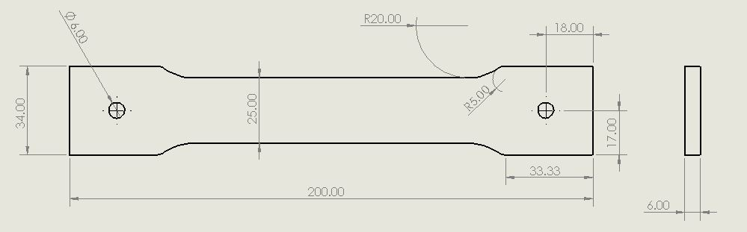
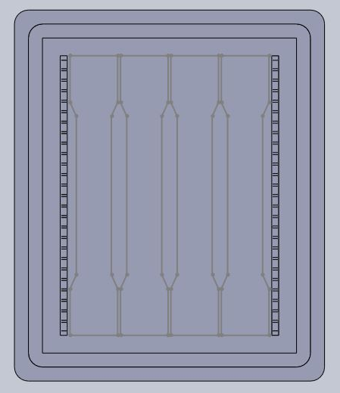
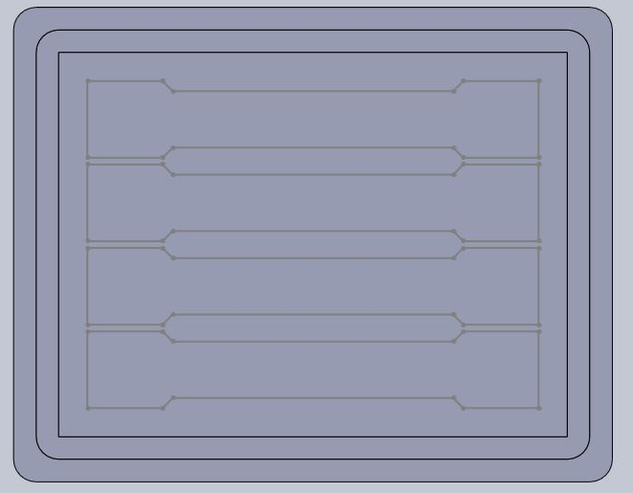
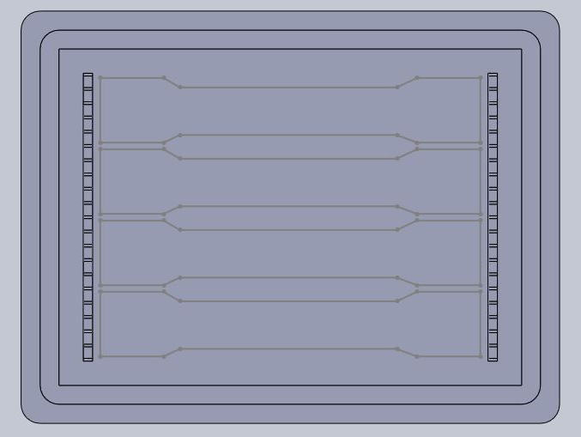
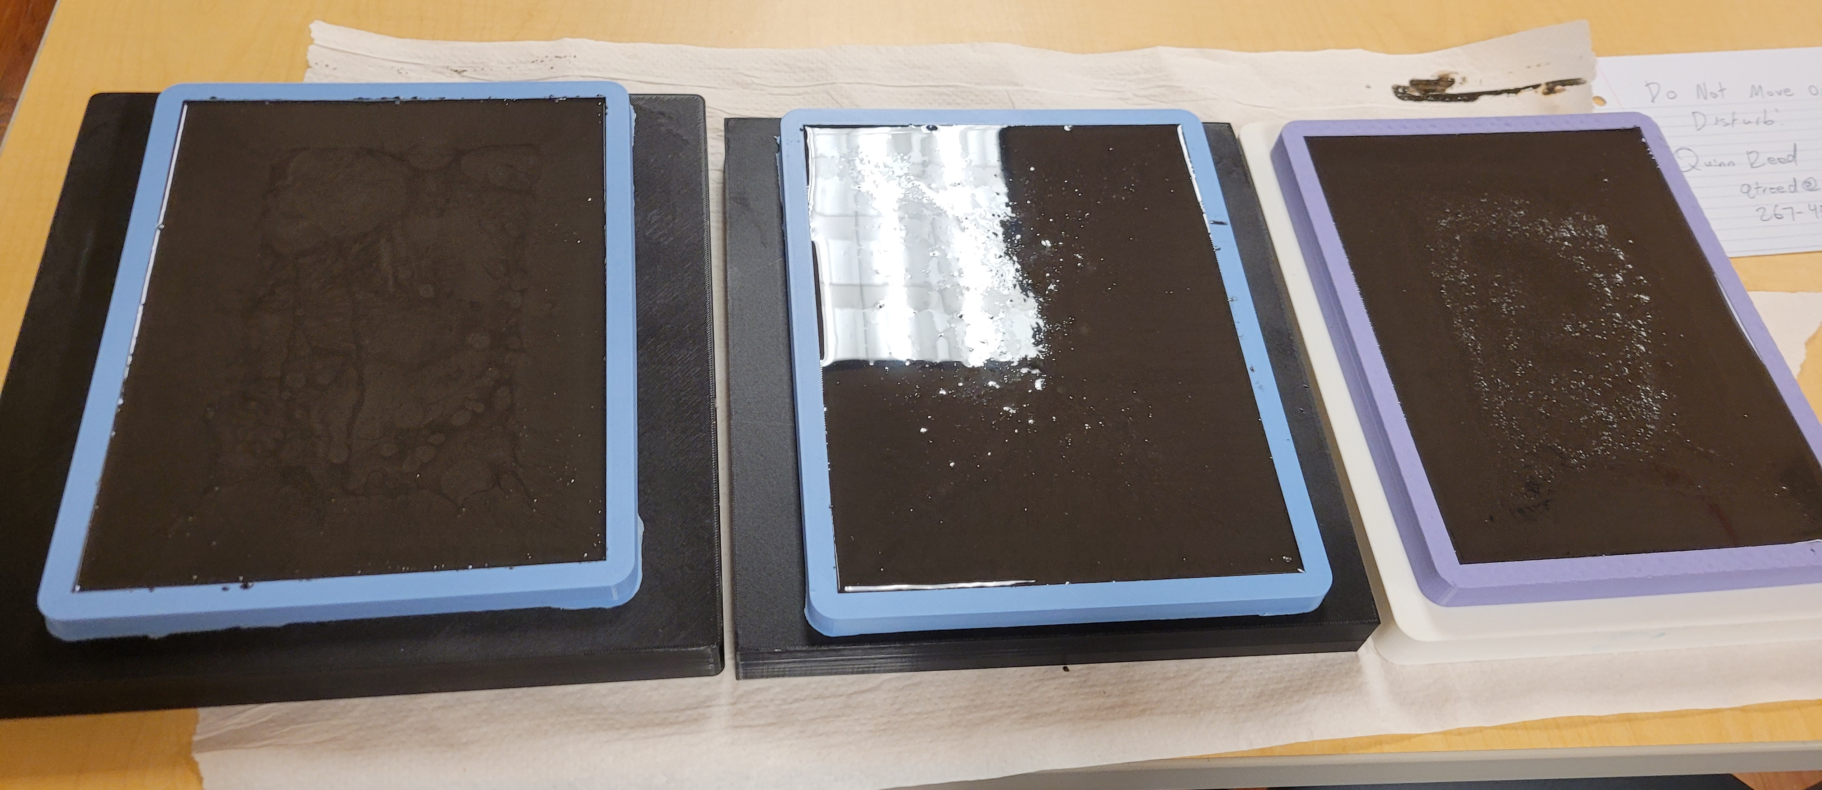
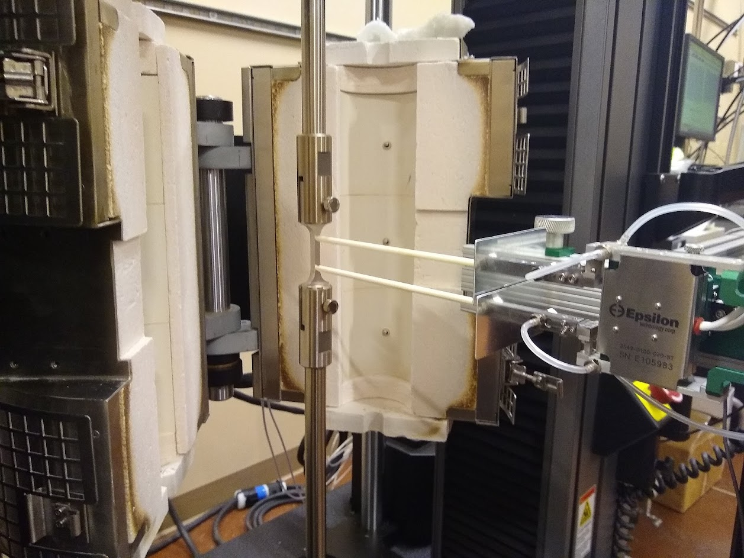
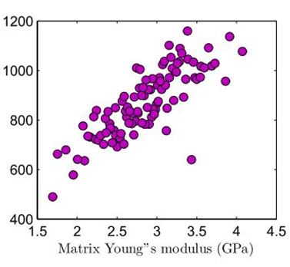
High Strain Rate and High Temperature Testing on Refined Graphite Epoxy Resin
and its effects on Internal Strain
Quinn Reed
Abstract and/or Background
Results and/or Conclusion
Background: Exfoliated graphite reinforced epoxy resin composites may harness beneficial mechanical properties under varying strain rate and high temperature testing. The incorporation of conductive exfoliated graphite in epoxy composites can help in measuring internal strain that is developed in the material. Various polymers and composites have been found to have strain rate-dependent behaviors at various initial conditions which could make their internal strain behavior more desirable for real-world applications. Most of these previous experiments have been done by testing using quasi-static, uniaxial tensile and/or compressive tests, meaning that the strain rates are kept constant and relatively low. While these tests are helpful, polymers have been observed to have very different mechanical properties under high strain rate and high temperature conditions. To test these properties, experiments will be conducted testing the internal strain of epoxy resin, graphene reinforced epoxy resin (0.1 weight% and 0.3 weight%), and graphene sensor-embedded epoxy resin samples using varying strain rate and high temperature testing. Each sample is placed in a furnace and brought up to a high desired temperature and then pulled in tension simultaneously at a predetermined strain rate in which the internal strain and yield strength data can be recorded. This data could lead to the implementation of these composites into real world applications that may require high temperature and high strain rate performance such as crash gear and bullet proof materials. After this, further research can be done by using phase-field modeling to investigate the micro-scale interactions that lead these samples to fracture such as crack initiation and propagation.
Each sample will have the dimensions laid out in Figure 1 with holes at either end for pin loaded testing. There will be four of each of the seven different sample variations which can be seen in the table in Figure 5. The CAD models required to fabricated each set of samples can be seen in figures 2-4. Outlines of the sample orientations show how the water jet cutter is able to distinguish and cut out the samples once the sheet is removed from its respective mold.
While this research is still in progress, steps are being made to test and gather results from the fabricated samples. The desired results will include modulus of elasticity, yield strength, ultimate strength, fracture stress, ductility, and more. These values will then be organized to form a stress/strain diagram to visualize the plastic and elastic behavior of each of the sample types. These results will then be compared to the quasi-static, room temperature values that are currently being collected by another researcher using the same samples. This comparison will conclude how graphite reinforced epoxy composites perform in different environments and which areas of application can they be used in. Additionally, these results will be compared to previous research studies that studied similar composites. This will allow for conclusions to be made regarding whether graphite reinforced epoxy composites advance the practicality and effectiveness of systems that utilize similar composites. If there is significant evidence showing that these graphite reinforced epoxy composites harness beneficial mechanical behavior, phase fielding may be used to enhance and further understand the practical extend of these composites. More information regarding phase field modeling is provided in the Future Work section below.
Fig. 1. Created by Quinn Reed - A Solidworks drawing illustrating the shape and dimensions of the samples that are being tested. All dimensions are in millimeters.
Future Work
Phase-field modeling is a relatively new method that illustrates the failure activity and mechanical properties of various materials. It is especially effective in modeling the complex nature of crack propagation of laminates [6]. A future area of study would be to study the benefits of phase field modeling as it relates to heterogeneous composites such as graphite reinforced epoxy composites. Li et al. conducted an experiment studying the micro-cracking properties of a heterogeneous composites by studying the phase-field model on the contact points of the distinct materials [7]. One reason for their inquiry was to understand how they could strengthen composites by slowing down the spread of cracks between the embedded materials themselves. Since boundaries between materials (interfaces) are nucleation sites for crack initiation, phase field modeling may be very effective in my research. Apart from each individual study, phase field models can be adjusted to find specific results and improve that accuracy of previous testing. All of these methods could be used to simulate the activity of the samples I create in this research to further understand the mechanical properties of each composite. Phase field modeling may also provide information on how to strength the composites that have been presented in this research.
Introduction and/or Research Question
Fig. 2. Created by Quinn Reed - The above inverted mold is used to create the pure epoxy, 0.1 weight%, and 0.3 weight% reinforced samples.
Fig. 3. Created by Quinn Reed - The above mold is used to create each of the stepped samples that inquire sensors oriented long ways through the samples.
Fig. 4. Created by Quinn Reed - The above mold is used to create samples with sensors oriented short ways across the samples.
This research seeks to find the mechanical properties of various exfoliated graphite reinforced epoxy resin composites on the basis of two factors: strain rate and high temperature. This research looks to provide more informational regarding the mechanical properties of graphite reinforced composites to generate solutions to problems in many different fields of physics and engineering. The goal of this research is to measure the extent of internal strain located inside each of the previously mentioned samples: epoxy resin, graphene reinforced epoxy resin (0.1 weight% and 0.3 weight%), and graphene sensor-embedded epoxy resin samples. For the latter samples, internal strain can be measured by the embedded sensors in the resin that could sense changes in the internal strain. These sensors will be made from 0.1 weight% and 0.3 weight% graphene/epoxy resin which will then be embedded into the samples both long and short ways individually. Measuring the resistance changes in the currents running through the embedded sensors can provide data about the internal strain of such a material.
Fig. 6. Photo by Quinn Reed - The image shown to the left shows the pouring and hardening process of the 0.1 weight% reinforced graphite/epoxy mixture. The two molds on the right make the 0.1 weight% sensors for the two stepped batches while the purple mold on the left makes the 0.1 weight% reinforced samples. At this point, the graphite, epoxy, and hardener were thoroughly combined, sonicated, and vacuumed to produce smooth, uniform results.
Fig. 5. Created by Quinn Reed - Each of the sample types listed per batch.
References and/or Acknowledgments
Methods
The final steps in the research process is to organize and make conclusions about the data that has been collected. While this research is still in progress, the collected data will provide helpful information regarding the properties and real-world applications of graphite reinforced epoxy composites. Some of the properties that are being tested for include modulus of elasticity, yield strength, ultimate strength, fracture stress, ductility, and more. Additionally, fracture shape, elasticity/plasticity, and necking should also be identified to draw conclusions about the practicality of these composites. Once this is done, the high temperature and high strain rate behavior can be compared to the quasi-static, room temperature behavior to observe any significant change between the results. These composites could advance technologies that require high strain rate behavior or high temperature tolerance such as crash gear and bullet proof materials.
[1] K.M. Hamdia, M.A. Msekh, M. Silani, N. Vu-Bac, X. Zhuang, T. Nguyen-Thoi, T. Rabczuk, Uncertainty quantification of the fracture properties of polymeric nanocomposites based on phase field modeling, Composite Structures 133 (2015) 1177-1190.
[2] K. Wang, L. Zhao, H. Hong, J. Zhang, A strain-rate-dependent damage model for evaluating the low velocity impact induced damage of composite laminates, Composite Structures 201 (2018) 995-1003.
[3] Ö.U. Colak, N. Bahlouli, D. Uzunsoy, C. Francart, High strain rate behavior of graphene-epoxy nanocomposites, Polymer Testing 81 (2020).
[4] M. Zhang, B. Jiang, C. Chen, D. Drummer, Z. Zhai, The Effect of Temperature and Strain Rate on the Interfacial Behavior of Glass Fiber Reinforced Polypropylene Composites: A Molecular Dynamics Study, Polymers 11(11) (2019).
[5] T.W. Sirk, K.S. Khare, M. Karim, J.L. Lenhart, J.W. Andzelm, G.B. McKenna, R. Khare, High strain rate mechanical properties of a cross-linked epoxy across the glass transition, Polymer 54(26) (2013) 7048-7057.
[6] J.J. Espadas-Escalante, N.P. van Dijk, P. Isaksson, A phase-field model for strength and fracture analyses of fiber-reinforced composites, Composites Science and Technology 174 (2019) 58-67.
[7] G. Li, B.B. Yin, L.W. Zhang, K.M. Liew, Modeling microfracture evolution in heterogeneous composites: A coupled cohesive phase-field model, Journal of the Mechanics and Physics of Solids 142 (2020).
[8] P. Zhang, W. Yao, X. Hu, X. Zhuang, Phase field modelling of progressive failure in composites combined with cohesive element with an explicit scheme, Composite Structures 262 (2021).
1 2 3 4 5 6 7 8 9 10 11 12 13 14
Sample Fabrication is the first step in the research process. Inverted molds must be modeled and 3d printed to make the pure epoxy samples, reinforced samples, sensor embedded samples (long and short ways), and the sensors themselves. A two-part rubber mixture is then poured into each of the 3d printed inverted molds once, with the sensor mold being poured twice. Then a two-part epoxy mixture can be vacuumed and then poured into the pure epoxy sample rubber mold. Then each of the reinforced graphite mixtures can be mixed (0.1 weight% and 0.3 weight%). The graphene flakes are mixed directly into the epoxy but before adding the hardener, each batch must be sonicated for 3 hours and 40 minutes each to break up the particles. Then the hardener is added, the batch is vacuumed, and the batch is poured into a reinforced mold and 2 sensor molds each. Once all the sheets are hardened, they are placed into a furnace at 100 Celsius for 3 hours to cure. Each sheet is then water jet cut into their respective shapes. The sensors that were cut will then be placed into the embedded rubber mold in which epoxy will be poured over top of the sensors. The same vacuuming and curing processes apply to the embedded sheets as well. Then these embedded sheets can be water jet into shape. Each sample can be pin loaded into an Instron that contains a built-in furnace surrounding the sample. The sample will then be heated long enough such that it reaches its desired temperature uniformly. Then the test can be carried out and data can be collected. Once all the samples are tested, the data will be organized, and conclusions can be made regarding the mechanical behavior of each of the sample types.
1 2 3 4 5 6 7 8 9 10 11 12 13 14
A
B
C
Fig. 8. Created by K.M. Hamdia, et al. [1] - The graph to the left illustrates the relationship between Fracture Toughness and the Young’s Modulus of a previously studied epoxy composite. This information can be used to compare how graphite reinforced epoxy composites perform compared to other related composites. Research done by other researchers on related materials can help identify whether the material currently being studied is a practical option for future technological advancement.
Fracture Toughness
Fig. 7. Photo by Daniel Kenney - The image above shows the set up that will be used to conduct the high temperature tests. It should be noted that the illustration above contains a smaller, metal sample to demonstrate the test. The samples will be attached via pins located on the top and bottom rods. The outer, white shell is the furnace that heats up the atmosphere around the sample. The two white rods measure the strain on the sample as the rods apply tensile forces on the sample at different points in time.

