Slide 1
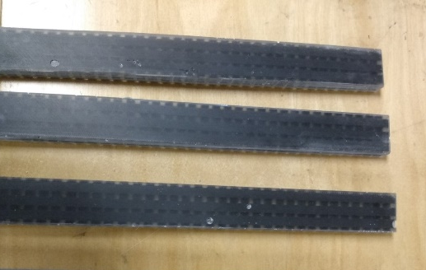
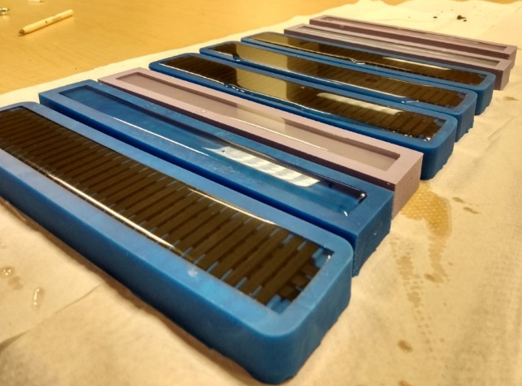
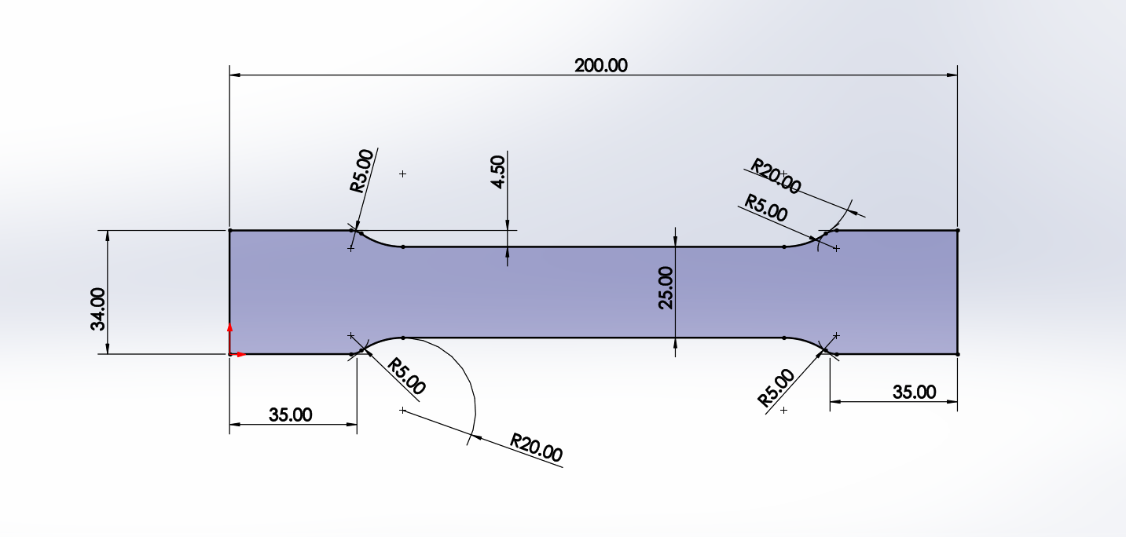
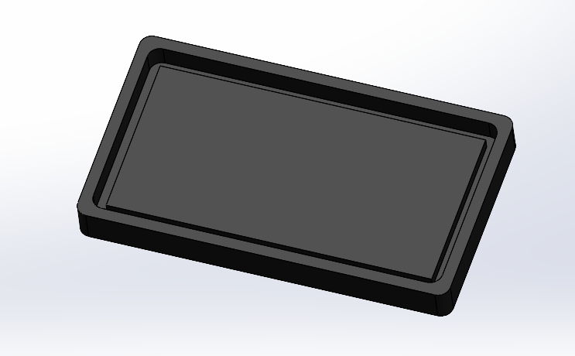
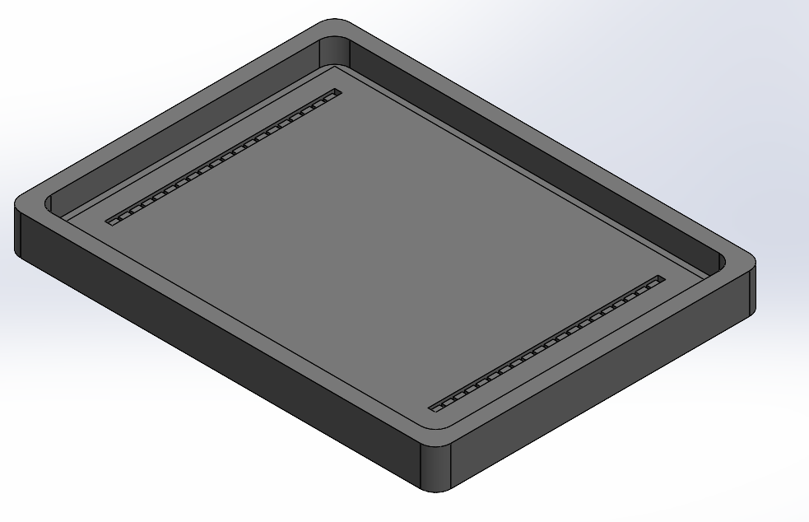
Room Temperature Mechanical Properties
of Exfoliated Reinforced Epoxy Composites
Arianna Verbosky and Dr. Ephraim Zegeye
Abstract
Results and Conclusion
Exfoliated graphite and other carbon nanomaterials possess distinctive electrical, material, and mechanical properties that have caused them to be of interest to researchers in recent years for their vast array of potential applications. These materials are some of the strongest discovered materials, with an elastic modulus higher than almost any other natural or synthetic material. They also have unique electrical properties that vary as both macro-scale and micro-scale stresses and strains are applied to them. Several research studies suggest that these properties may make exfoliated graphite and other carbon nanomaterials potentially viable options for the creation of more precise in-vivo strain sensors and reinforcing agents in composite materials. These strain sensors can be embedded directly into composite materials, thus potentially enabling the performance of the composite to be measured and its structural health to be monitored during service. Hence, embedded sensors could provide meaningful information about the health of the composite material in structural applications such as for aircraft and buildings made of composite materials. However, due to the heterogeneity of the material composition, the embedded sensors may act as defects in the composite and have the potential to either degrade or enhance its mechanical properties and overall strength. The objective of this project is to determine the effects of various configurations of embedding the exfoliated graphene in a composite on the composite’s mechanical properties at room temperature. A series of epoxy composite sample sets with two different volume percentages of exfoliated graphene embedded in different configurations are fabricated. Tensile tests are performed on the sample sets to fracture and the results are to be compared among the sets to determine the effect of the amount and configuration of the embedded exfoliated graphene on the composite material’s elastic modulus and ultimate tensile strength.
In a previous study using samples with the rectangular sample dimensions shown in Figure 1 and 2, tension tests were performed to investigate the mechanical and material properties of gridded samples as shown in Figure 2 with integrated Exfoliated Graphite sensors and samples comprised of plain epoxy in the same shape and dimensions as the sensor-integrated samples. After testing the samples using the INTRON testing apparatus and the testing parameters detailed above, the data was collected and analyzed for the force loading, displacement, tensile stress, and tensile strain of each sample and was inputted into an Excel spreadsheet. The stress vs strain curves were plotted for each sample and the elastic moduli were calculated using the 0.2% offset method. During testing, all but one, of the samples broke at both grip points rather than in the middle of the sample. This may be due to the rectangular shape of the samples with a uniform thickness along their lengths or due to the grips being tightened too much and thus applying too much compressive force at the grip points. It is possible that the samples should have been formed to be in the more traditional dog-bone shape for the uniaxial tension test to ensure that fracture would occur in the gage length rather than at the grips. The fracture that occurred at the grips could also be a result of material defects that were introduced unintentionally during the fabrication process for the samples. These defects may have been air pockets that formed inside and on the surface of the samples. In future testing, more efforts will be needed made to adapt the fabrication process in order to minimize the occurrence of such material defects and air bubbles. Thus, in this study, efforts were made to reduce material defects and discontinuities through cutting the samples out of larger single sheets to obtain more material homogeneity and vacuuming the mixture using a vacuum pump to try to pull bubbles out of the mixture. During the second round of sample fabrication, with these adjustments to the sample fabrication methods, it was found that these measures resulted in samples with less defects and discontinuities and more homogeneity throughout. It is predicted that the tension tests carried out with the second round of samples will result in more conclusive results.
In conclusion, the results from a previous study were inconclusive for a variety of reasons due to material defects in the samples, the possibility of contamination of the samples, the wide range of variability between some of the results, and the disparity between the ultimate tensile strength and elastic modulus of the epoxy matrix compared to other results from literature and previous studies. We cannot determine if the integration of the exfoliated graphite-epoxy composite sensors affected the maximum tensile stress the sample could withstand before fracture nor if the Elastic Modulus truly decreased with the integration of the sensors into the epoxy matrix. We would recommend that further research and testing be conducted in order to decrease the occurrence and formation of material defects during the fabrication of the samples, as well as to further characterize the mechanical properties of the exfoliated graphite-epoxy composite material. Furthermore, we would also recommend that a fractographic study be conducted using the samples from the test in order to try to determine what factors may have contributed to the fracturing of the materials at a lower stress level than expected. We hope to continue with this research and to refine the procedure in order to conclusively achieve our purpose to determine what the effects of integrating exfoliated graphite strain sensors into an epoxy matrix are on the hosting matrix’s mechanical properties.
Introduction
Figure 1: Curing the Samples in the Silicone Molds
Figure 2: First Set of Rectangular Samples from Previous Research in Spring 2021
Graphene and other carbon nanomaterials possess unique properties such as excellent mechanical strength and low density as well as high thermal and electrical conductivity [2, 4, 5]. Research is currently being conducted to investigate how the unique properties of carbon nanomaterials may be utilized to form composite materials that possess high mechanical strength, electrical and thermal conductivity and other properties that would be able to be utilized in space and aircraft applications [2]. The high surface area to volume aspect ratio of graphene and other carbon nanomaterials also makes them very efficient in transferring loads between the carbon nanomaterial reinforcing agent and the polymer matrix in a composite material [2, 3]. They have been found to have great potential to improve the mechanical, electrical, thermal, and gas impermeability properties of polymers and other composite materials when dispersed throughout the material [1]. Recently, several research studies have also been conducted to investigate the potential for the use of carbon nanotubes and graphene to be applied as strain sensors that could be used in the fields of human motion detection, structural health monitoring, smart textiles, and smart garments [8]. There have also been several efforts to develop the application of CNTs and graphene in the areas of energy storage, field effect transistors, electrodes, and sensors together with applications as supercapacitors, pressure sensors, structural health monitoring for composites, flexible temperature sensors, and as reinforcing fillers in polymers such as epoxy resin composites [5].
However, there remains little research about the effect of the embedded sensors on the mechanical properties of the hosting material. One concern is that the integrated sensors may act as defects in the composite material and could potentially degrade its mechanical properties. On the other hand, it is possible that the integration of the sensors may contribute to strengthening the composite material because of the high strength and stiffness of exfoliated graphite. The purpose of this study is to determine what the effects of embedding exfoliated-graphite (or graphene) composite strain sensors on the mechanical properties of the hosting material. The results from this study could be applied into the future research of the use of carbon nanomaterial-reinforced composite materials in structural health monitoring and other industrial applications.
Future Work
Continue to fabricate samples sets with varying weight %’s of Exfoliated Graphite according to the methods developed so far
Investigate various methods to streamline the sample fabrication process and minimize air bubbles and other material defects and discontinuities.
Perform Tension Tests to evaluate and generate stress-strain curves to compare the different sample configurations and the effect of the Exfoliated Graphite on the composite’s material and mechanical properties
Perform other mechanical tests such as Compression and Fatigue tests to characterize the material and mechanical properties of the samples more comprehensively
Perform tests in various temperature and humidity environmental conditions
Figure 3: Dimensions for Revised Samples for Sample Sets
Methods
In this study, we used bisphenol-A diglycidyl ether epoxy (DER 332) and an economical aliphatic polyamine hardener, triethylenetetramine hardener (DEH 24) as the hosting matrix for the composite. The host material was made by mixing 0.87 vol% of the epoxy and 0.13 vol% of the hardener. To make the embedded carbon nanomaterial strain sensors, we used exfoliated graphite and reinforced samples. The graphite was originally obtained in the form of small plate-like flecks that were acid-washed. The graphite was exfoliated by utilizing a microwave. In the process of exfoliating the graphite, the flecks expanded and become worm-like in appearance.
We made a series of 4 different sets of 4 samples each: 1 set of plain epoxy samples, 1 set of uniformly dispersed exfoliated-graphite-reinforced samples, 1 set of samples with the exfoliated graphite formed into rectangular strips oriented horizontally across the sample, and 1 set of samples with the exfoliated graphite formed into rectangular strips oriented vertically across the sample. For the samples containing the exfoliated graphene, 0.1% volume percent of Exfoliated Graphite was used throughout the sample set. The samples were cut out of uniform sheets of either plain epoxy, uniformly dispersed exfoliated graphite reinforced, or with the two different orientations with the strips of exfoliated graphite encased in the epoxy sheet using a water jet cutter. After the samples were prepared, uniaxial tension tests were carried out using a uniform strain rate at room temperature. The testing apparatus used was an INTRON universal tension and compression testing machine.
References
[1] H. Kim, A.A. Abdala, C.W. Macosko, Graphene/Polymer Nanocomposites, Macromolecules Perspective 43(1) (2010) 6515-6530.
[2] S. Rana, R. Alagirusamy, M. Joshi, A Review on Carbon Epoxy Nanocomposites, J. Reinf. Plast. Comp. 28(4) (2009) 461-487.
[3] L.S. Schadler, S.C. Giannaris, P.M. Ajayan, Load transfer in carbon nanotube epoxy composites, Appl. Phys. Lett. 73(26) (1998) 3842-3844.
[4] A. Montazeri, N. Montazeri, Viscoelastic and mechanical properties of multi walled carbon nanotube/epoxy composites with different nanotube content, Mater. Design 32(4) (2011) 2301-2307.
[5] J. Huang, S.-C. Her, X. Yang, M. Zhi, Synthesis and Characterization of Multi-Walled Carbon Nanotube/Graphene Nanoplatelet Hybrid Film for Flexible Strain Sensors, Nanomaterials (Basel) 8(10) (2018) 786.
[6] G.T. Pham, Y.B. Park, Z. Liang, C. Zhang, B. Wang, Processing and modeling of conductive thermoplastic/carbon nanotube films for strain sensing, Comp. Part B 39(1) (2008) 209-216.
[7] T. Yan, Z. Wang, Y.-Q. Wang, Z.-J. Pan, Carbon/graphene composite nanofiber yarns for highly sensitive strain sensors, Materials & Design 143 (2018) 214-223.
[8] A. Mehmood, N.M. Mubarak, M. Khalid, P. Jagadish, R. Walvekar, E.C. Abdullah, Graphene/PVA buckypaper for strain sensing application, Scientific Reports 10(1) (2020) 20106.
Figure 4: Mold for Sample Sheet to Cut out Revised Sample Set using the Water Jet Cutter
Figure 5: Mold for Sample Sheet to Cut out Revised Stepped Sample Set (With Integrated Sensors) using the Water Jet Cutter

