Slide 1
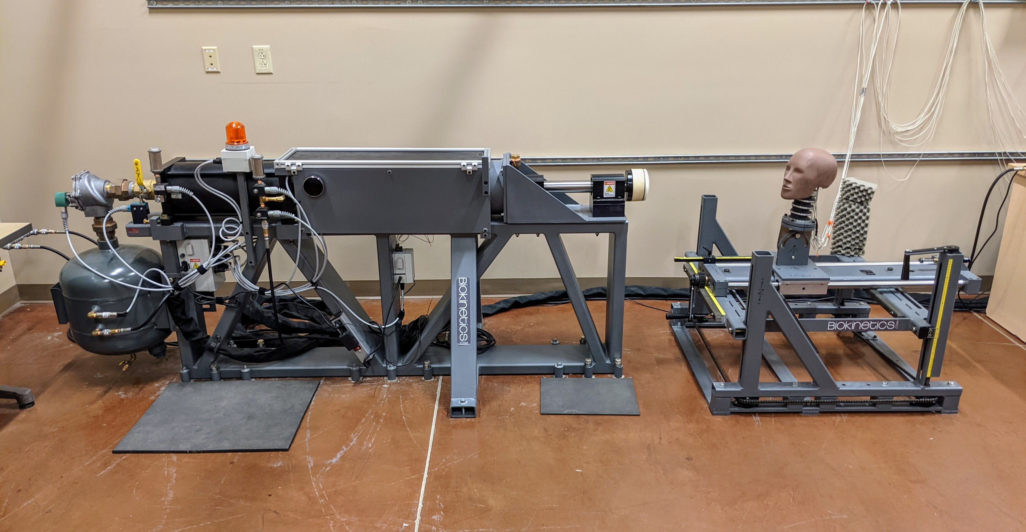
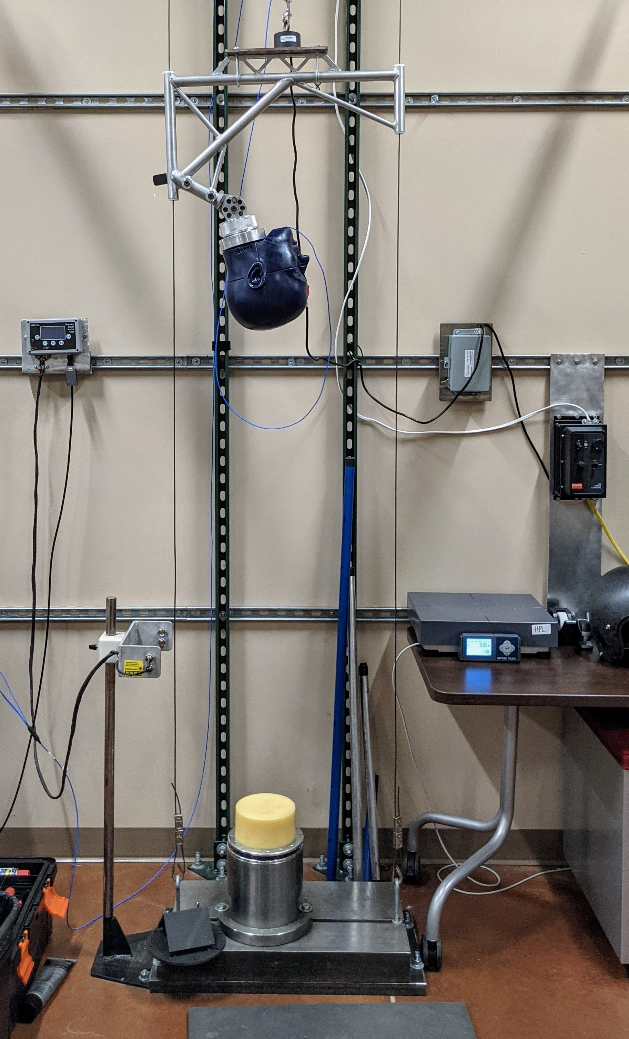
The Mechanical Properties and Impact Performance of Crushable Foams
Jeremiah Isaacs, Tate Fonville, and Dr. Mark
Horstemeyer
Abstract
Results and Conclusions
Abstract: In this research, we study the compressive mechanical properties of two types of low-density polymer foams and their applications in protective head gear. The two types of low-density foams include “crushable” Expanded Polystyrene (EPS) and “recoverable” Polyurethane (EPU). Both EPS and EPU are commonly used in sports, civil service, and military headgear which all receive a high level of impact on the brain. EPS foams are lightweight and highly energy absorbent, as such they are typically found in helmets that experience single high-level impacts. However, their usefulness for multiuse helmets is limited. Therefore, the purpose of this study is to identify a candidate recoverable EPU foam that offer enhanced impact performance over a baseline EPS foam for both both low-level (multiuse) and high-level (single use) applications. Two candidate foams were selected based off their compressive mechanical stress-strain behavior at quasistatic (0.1/s) and dynamic (280/s) strain rates. Four impacts were carried out with the equipment in the Helmet Performance Lab (HPL) at the Center for Engineering Research and Education (CERE) to perform side-by-side evaluation of the two liner options. The helmet mass, head acceleration (Peak-G), Severity Index (SI), and Head Injury Criterion (HIC) are metrics used to evaluate helmet performance experimentally. Preliminary test results indicate that a EPU foam liner offers some advantages over an EPS foam liner of comparable weight in the rear position, but not for the other tests. Future studies are planned to continue to evaluate more EPU options in hopes of finding a solution.
Results: Test results revealed the following:
EPU foam does not undergo as much strain as EPS foam when higher levels of stress are applied.
Force values are directionally dependent from linear impacts tests as this should be considered for helmets.
EPU foam on average can handle higher Peak-G values from greater heights.
Conclusions: While the EPU foam outperformed the EPS foam in the oblique rear position in the pneumatic linear impactor tests, we hoped to see improved performance for all tests and locations. Future tests are required to study other available EPU foams and select a suitable replacement.
Pneumatic Linear Impactor
Future Work
Determine the best layout of a foam liner to maximize protection for different helmets.
Determine if a layered foam solution with other types of foam provides improved protection.
Apply stronger EPU foam to helmet liners.
Use stress-strain data to create computational simulations of helmet liners for testing.
Comparative stress-strain data for EPS and EPU foam.
NOCSAE twin-wire drop tower
Research Question
Research Question: The research objective is to analyze the mechanical properties and impact performance of crushable EPS foam compared to recoverable EPU foam with side-by-side impact comparison.
References and Acknowledgments
1 2 3 4 5 6 7 8 9 10 11 12 13 14
1 2 3 4 5 6 7 8 9 10 11 12 13 14
Methods
Acknowledgments:
Dr. Mark Horstemeyer for the position to conduct research.
Tate Fonville for access to figures as well as continual support, guidance, and encouragement through this entire process.
References:
[1]Chen, W., Hao, H., Hughes, D., Shi, Y., Cui, J., & Li, Z.-X. (2015). Static and dynamic mechanical properties of expanded polystyrene. Materials & Design, 69, 170–180. https://doi.org/10.1016/j.matdes.2014.12.024
[2]Cronin, D. S., & Ouellet, S. (2016). Low density polyethylene, expanded polystyrene and expanded polypropylene: Strain rate and size effects on mechanical properties. Polymer Testing, 53, 40–50. https://doi.org/10.1016/j.polymertesting.2016.04.018
Methods: Two candidate foams were selected for the current study based off foam density, availability, and desirable compressive mechanical properties. The two foams, a crushable Expanded Polystyrene (EPS) and a recoverable Expanded Polyurethane (EPU) were used to construct a helmet liner. Guided free fall drop tests with the NOCSAE twin-wire drop tower (pictured to the right) at 3 and 4 ft. were conducted in the top (crown) impact position. A pneumatic linear impactor (pictured to the right) was also used to test both helmet configurations in the oblique rear and side upper locations at 6 m/s. The peak-g values were recorded for the drop tests and peak-g, HIC, and SI values were recorded for the pneumatic linear impactor tests.
A
B
C
Comparative average Peak-G values between EPS and EPU foams from linear impactor testing.
Comparative Peak-G values between EPS and EPU foams from upper and rear linear impactor testing.

