Slide 1
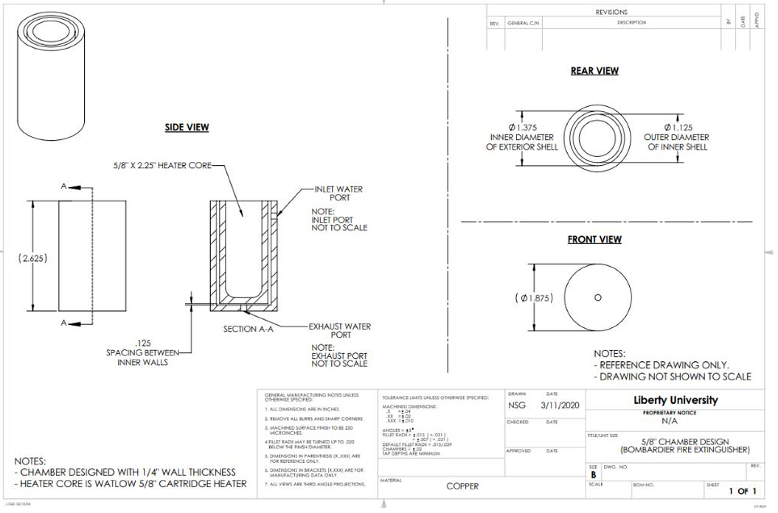
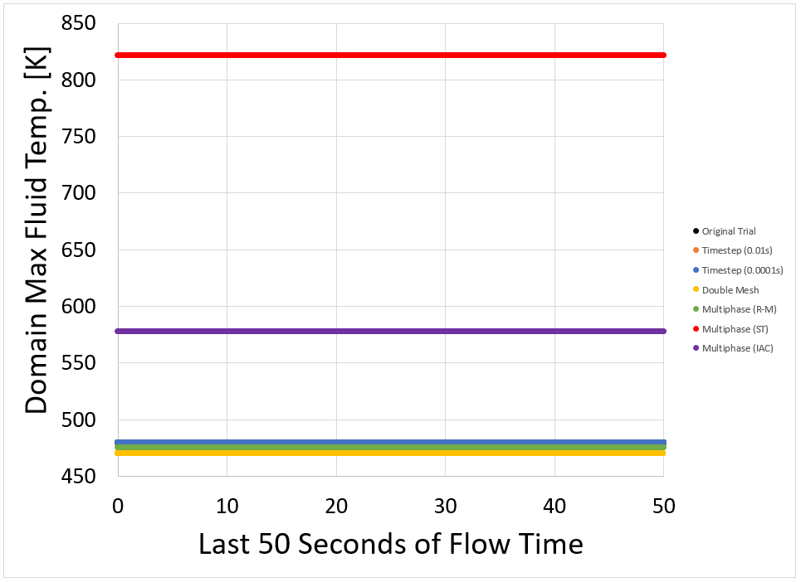
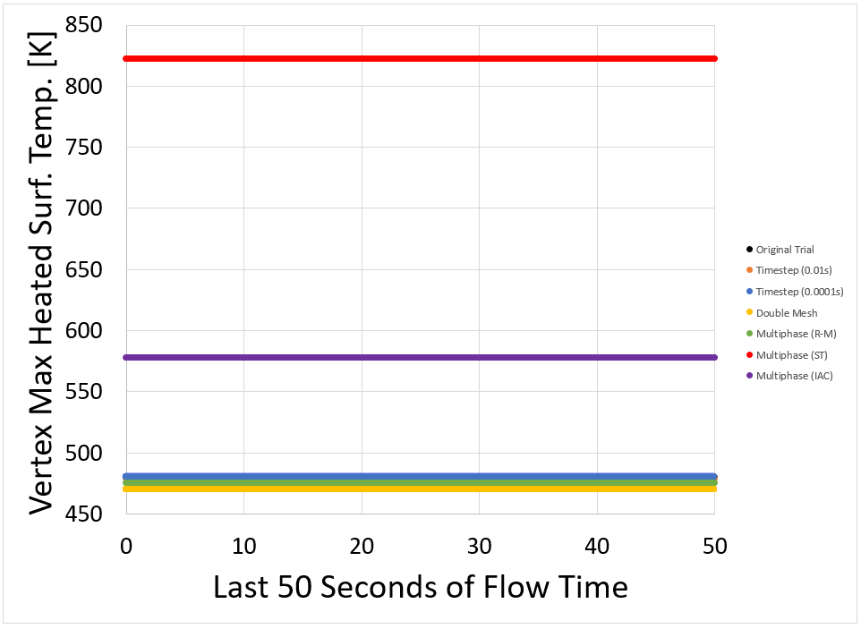
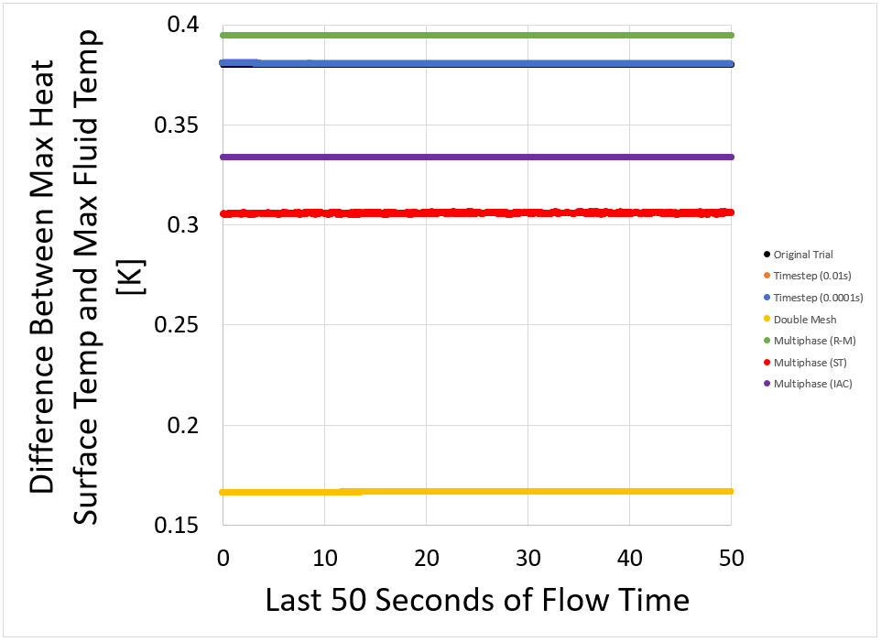
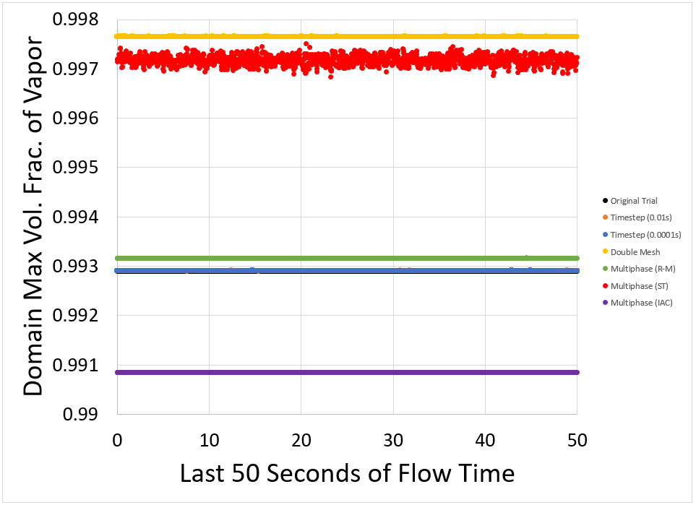
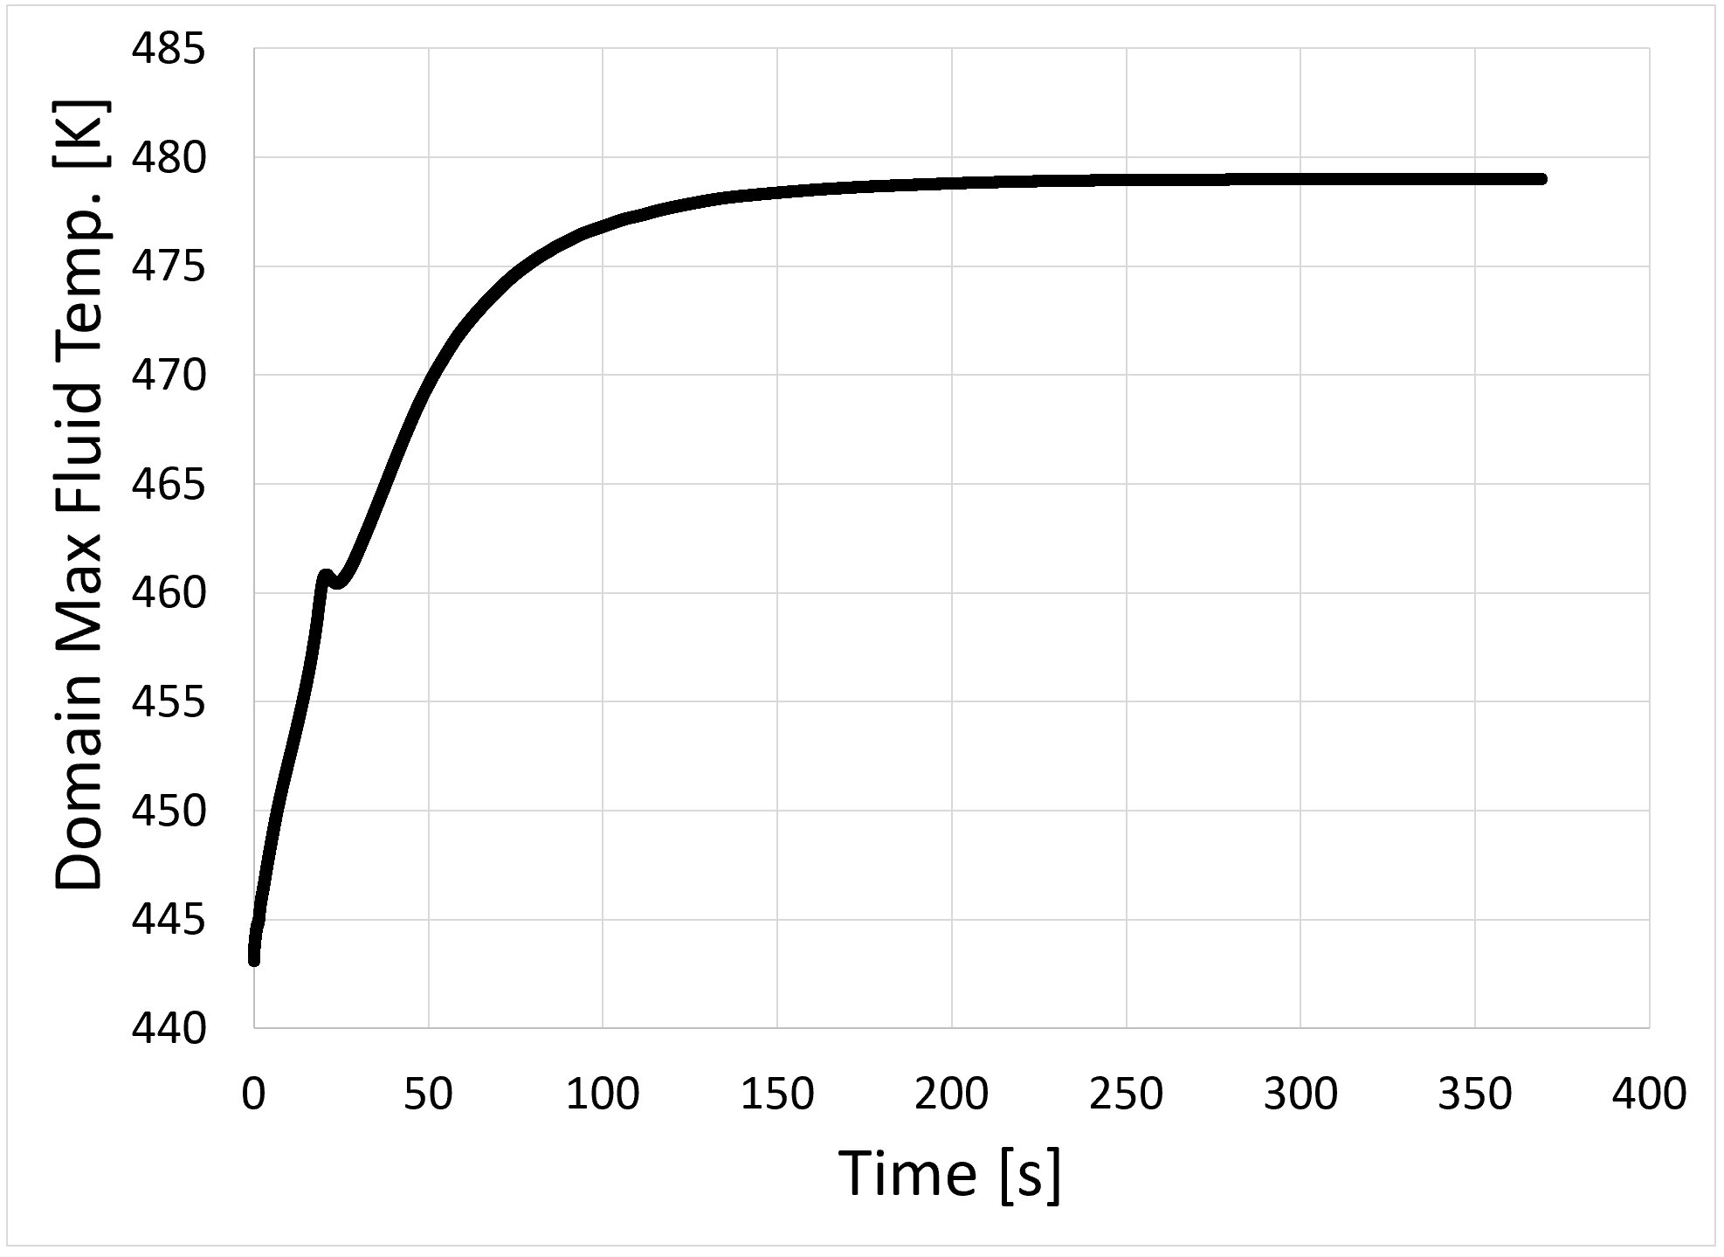
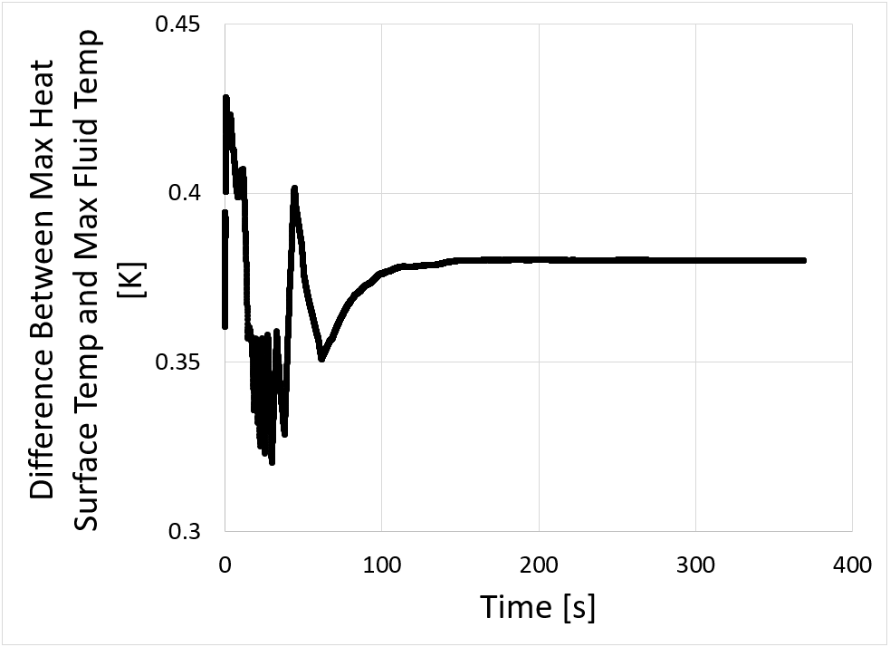
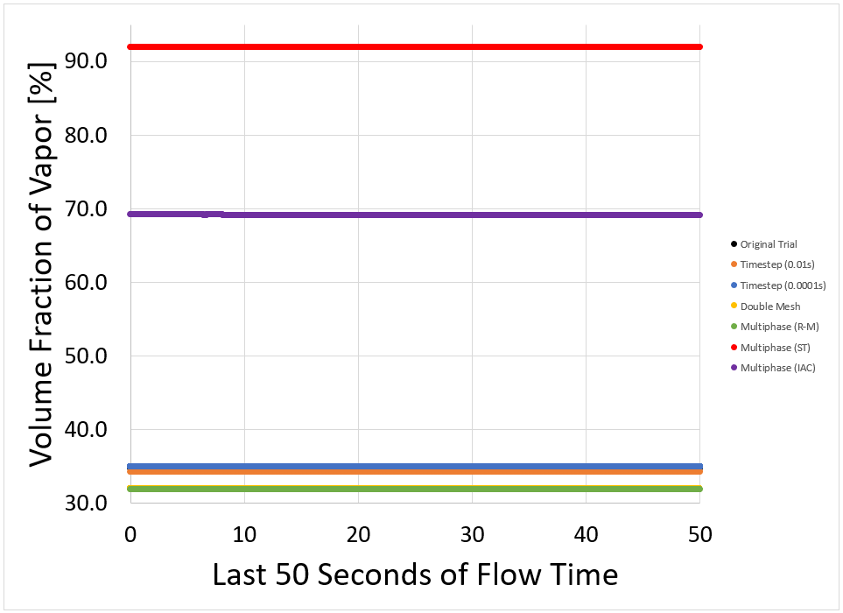
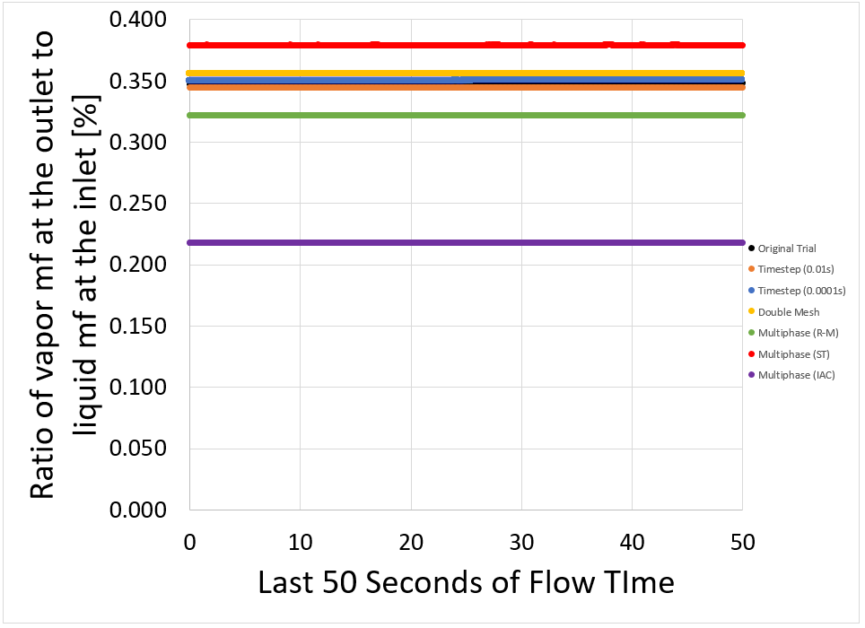
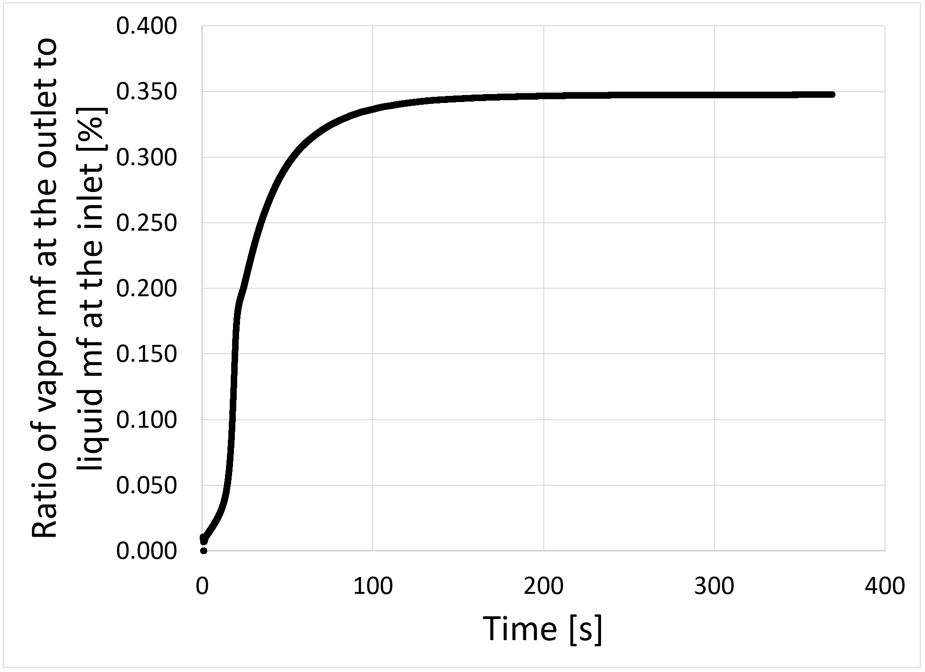
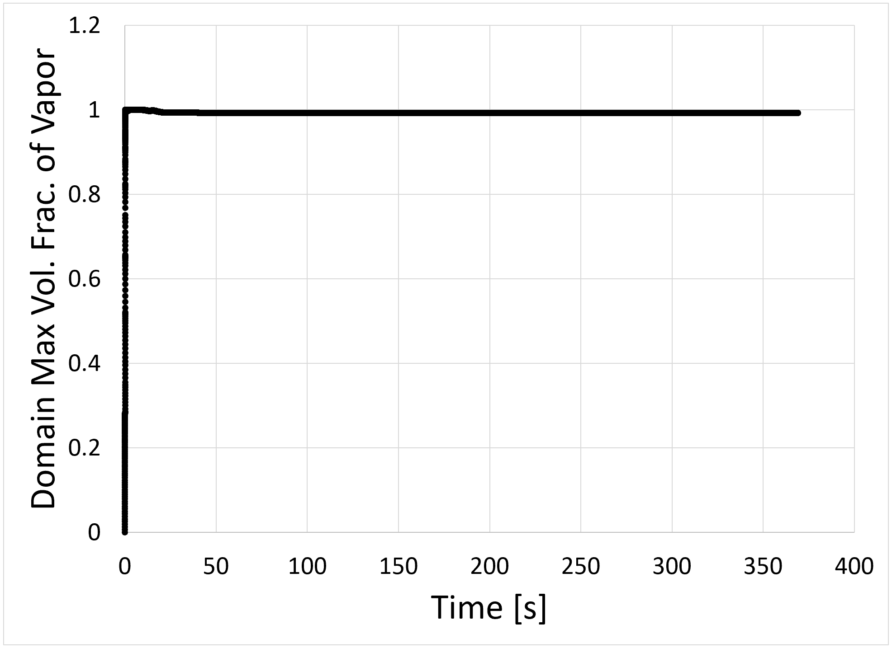
Modeling the Bombardier Beetle Fire Extinguisher: Verifying Computational Results
Elijah Yoder and Dr. Wayne Strasser
Abstract
Methods
While modern fire extinguishers are adequate in extinguishing fires, they tend to have a short spray distance, a wide target area, and use chemicals that can harm humans. By creating a fire extinguisher that mimics the defense mechanism of the Bombardier Beetle, many of these downfalls can be corrected. When threatened, The Bombardier Beetle can facilitate a chemical reaction in its abdomen that builds pressure, eventually releasing the reactants at high velocities, high frequencies, and for long distances. This mechanism can be replicated in a fire extinguisher by vaporizing water in a pressure chamber. This would allow for fire to be fought from a safer distance, with a safer working fluid, and more effectively. To examine this effect, multiphase flow was simulated through an experimental chamber geometry. The chamber has a cylindrical heater at the center with water flowing around it. It was found that around the outlet, the water mixture was sufficiently above vaporization temperature, the vapor had a volume fraction above 50%, and the outlet velocity was around 1.5 m/s. Various parameters of the model were modified to see their effect on the results. Timestep did not change the results significantly, while mesh count and vaporization model setting increased the temperature of the mixture, vapor volume fraction, and velocity at the outlet. This proves that this technique is viable as a mechanism in fire extinguishers. By proving the feasibility of this technique, lives and resources can be preserved or improved not only by its use in fire extinguishers, but also in sprinkler systems, fuel injectors, pharmaceutical sprays, and many more.
Model Number | Timestep Size (seconds) | Mesh Resolution (thousand cells) | Multiphase Settings Changes
1 | 0.01 | 119 | None
2 | 0.0001 | 119 | None
3 | 0.003 | 951 | None
4 | 0.003 | 119 | Ranz-Marshall Heat Transfer Coefficient
5 | 0.003 | 119 | Surface Tension Force Modeling
6 | 0.003 | 119 | Interfacial Area Concentration
Figure 1: Technical Drawing of the Chamber Geometry [1].
Conclusions
The model can be considered timestep independent
Increasing mesh resolution only significantly changed the volume fraction of vapor
All three multiphase model settings significantly changed all results
Introduction
3,655 deaths, 15,200 injuries, and $25.6 billion in loss from fires in 2018 [2].
Current fire extinguishers have a short and wide spray, run out of fluid quickly, and utilize chemicals that are harmful to humans.
The Bombardier Beetle can shoot a hot, direct, chemical, pulsating spray up to 200x its chamber length [3].
This same concept can be used in a fire extinguisher.
Water is vaporized in the chamber and expelled at high velocities and frequencies.
Figure 7: Results from the simulation sensitivity studies.
Figure 2: Results from Initial Simulation.
Future Work
Continue to test model sensitivity
Combine all significant parameters in one model
Optimize system by modifying boundary conditions
Incorporate nozzle ejection mechanics
Incorporate valves
Create a physical prototype
Droplet size measurement
Video analysis
1 2 3 4 5 6 7 8 9 10 11 12 13 14
Research Topic
A
B
Further develop the Bombardier Beetle Fire Extinguisher by determining model sensitivity to timestep, mesh size, and multiphase settings
Current Work
Figure 3: Temperature contour of liquid water in Kelvin.
Figure 4: Temperature contour water vapor in Kelvin.
References
Initial research completed on studying the bombardier beetle spray defense mechanism [4].
Created initial experimental rig [3].
Selected appropriate chamber geometry [1].
The outer shell is made of 440C Stainless Steel with a copper heater sheath [1].
Selected appropriate power supply based on power to weight ratio [1].
Ran initial Simulation to determine the temperatures of the fluid [1].
Ran initial multiphase CFD simulation.
Currently developing crude physical prototype.
C
[1] J. Stapleton, R. Krupanski, S. James, and N. Grove, “Bombardier Beetle Capstone Project Report,” Liberty University School of Engineering, Lynchburg, Virginia, USA, 2020.
[2] “U.S. Fire Statistics.” USFA. https://www.usfa.fema.gov/ data/statistics/ (assessed March 14, 2021).
[3] N. Beheshti and A. C. McIntosh, “A Novel Spray System Inspired by the Bombardier Beetle,” Design and Nature IV, vol. 114, pp. 13-21, 2008, doi: 10.2495/DN080021.
[4] T. Eisner, D. J. Aneshansley, M. Eisner, A. B. Attygalle, D. W. Alsop, and J. Meinwald, “Spray Mechanism of the Most Primitive Bombardier Beetle (Metrius Contractus),” Experimental Biology, vol. 203, pp. 1265-1275, Mar. 2000.
Figure 5: Contour plot of the volume fraction of vapor.
Figure 6: Velocity contour of liquid water in meters per seconds.

