Slide 1
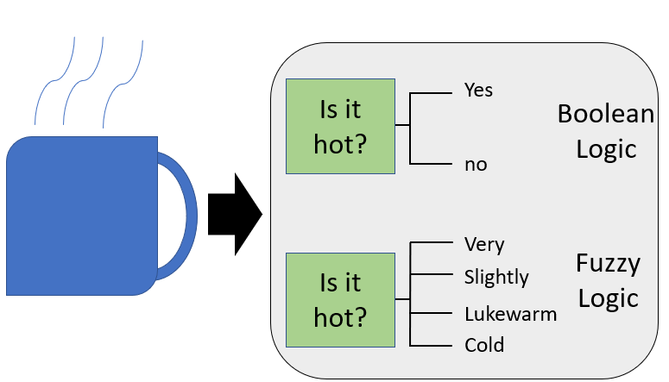
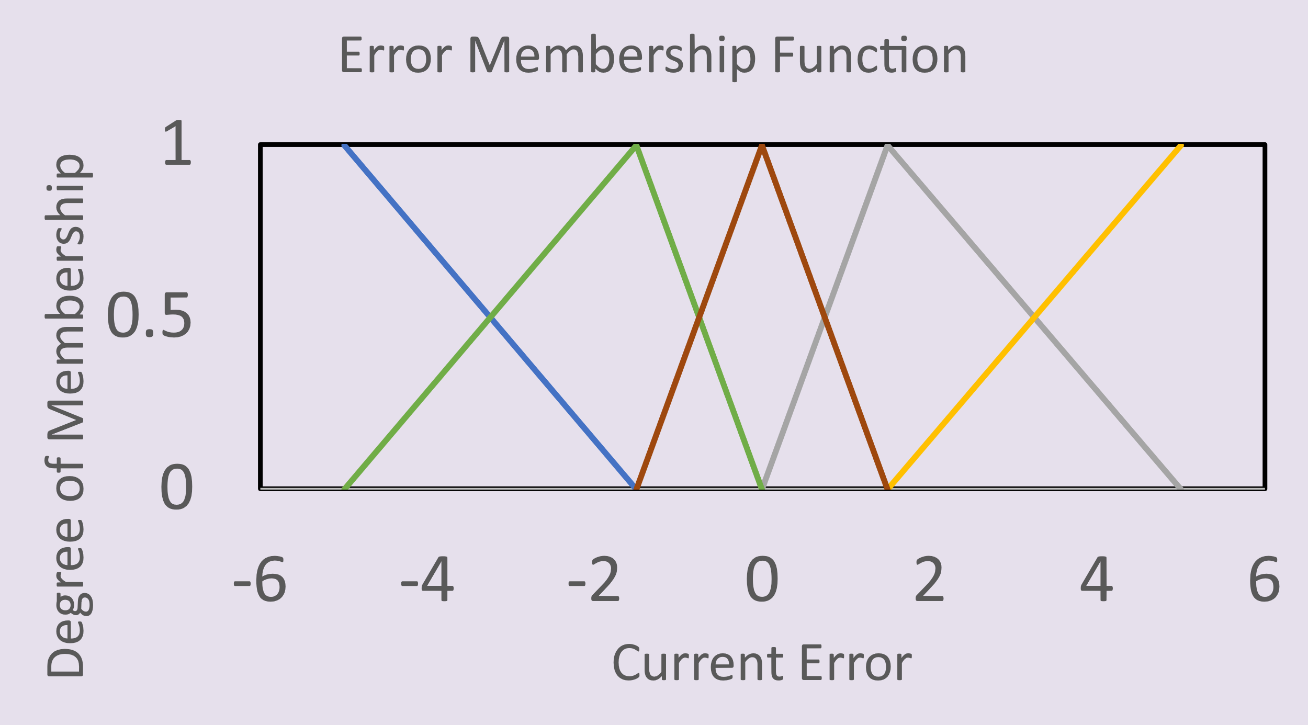
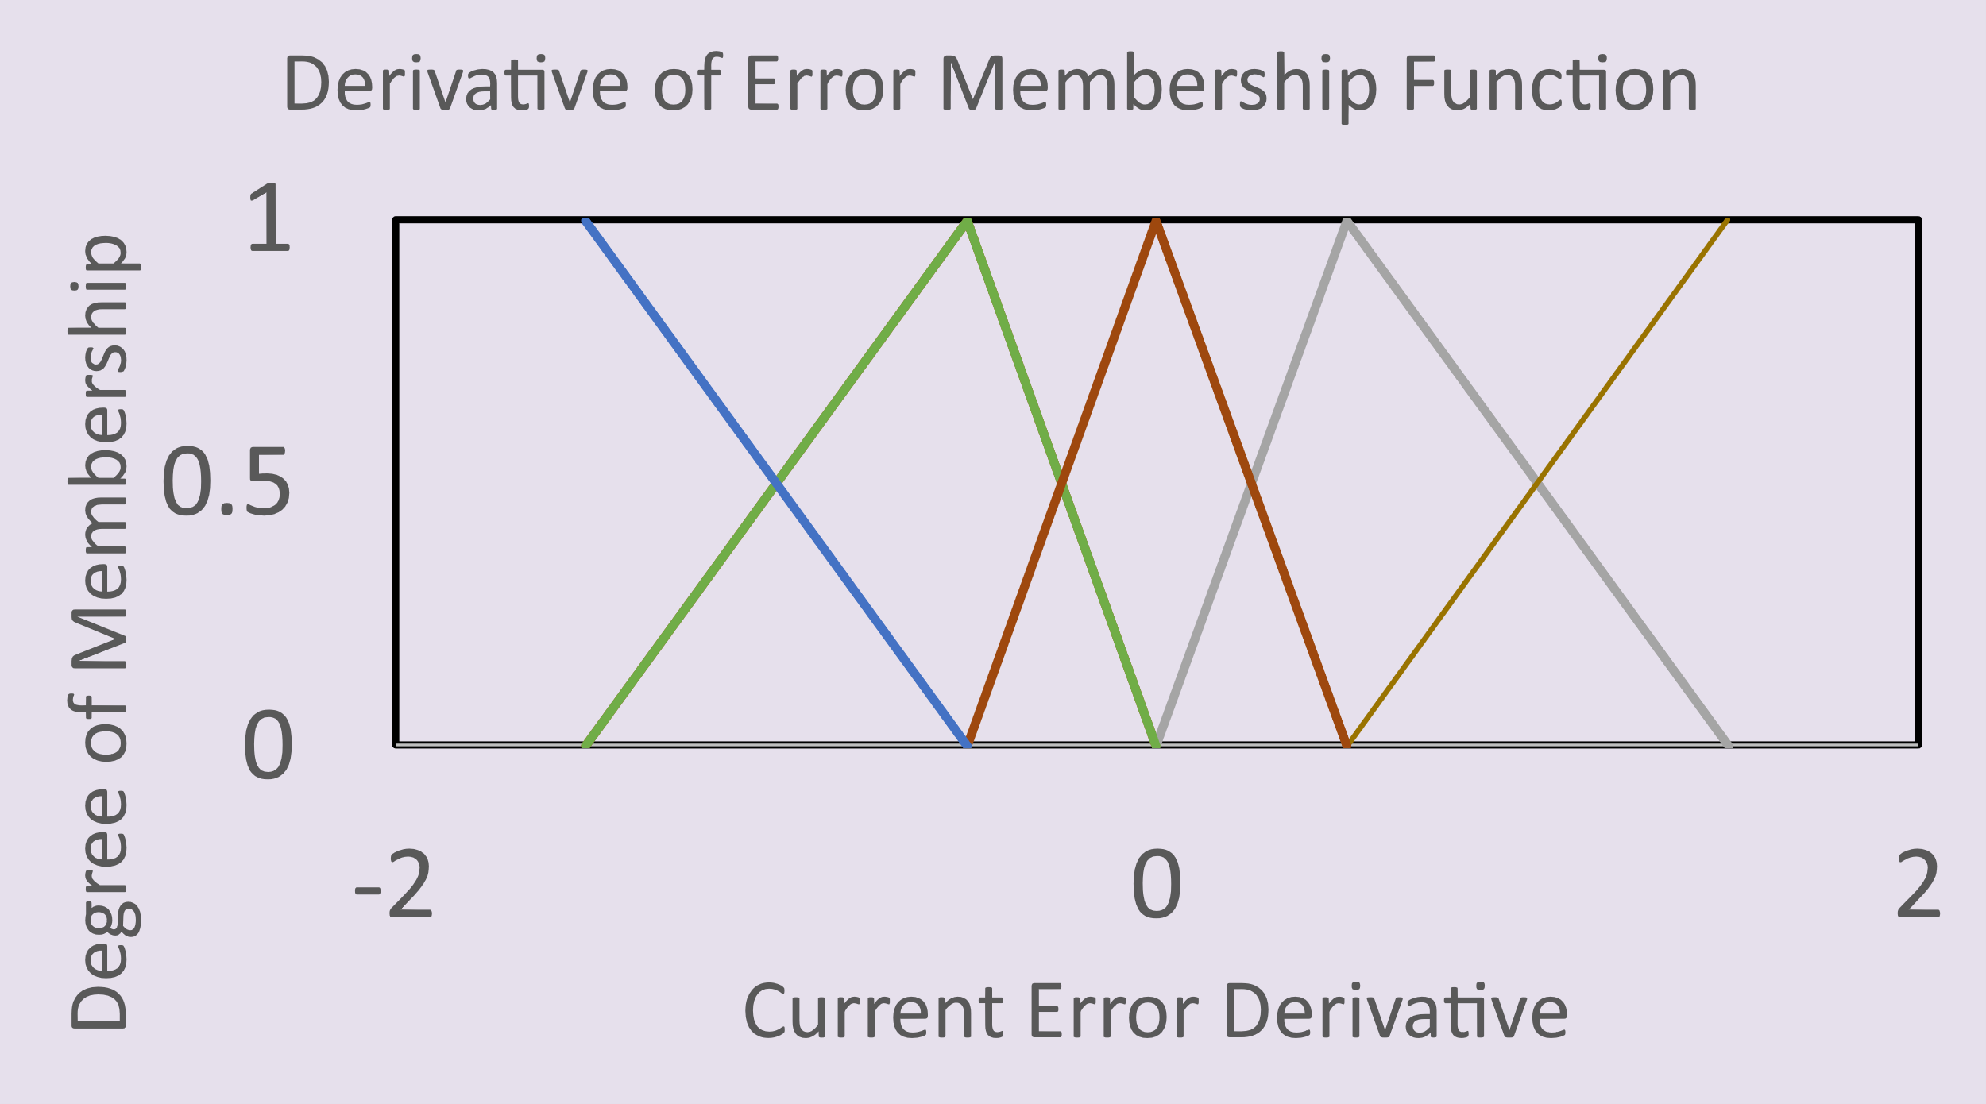
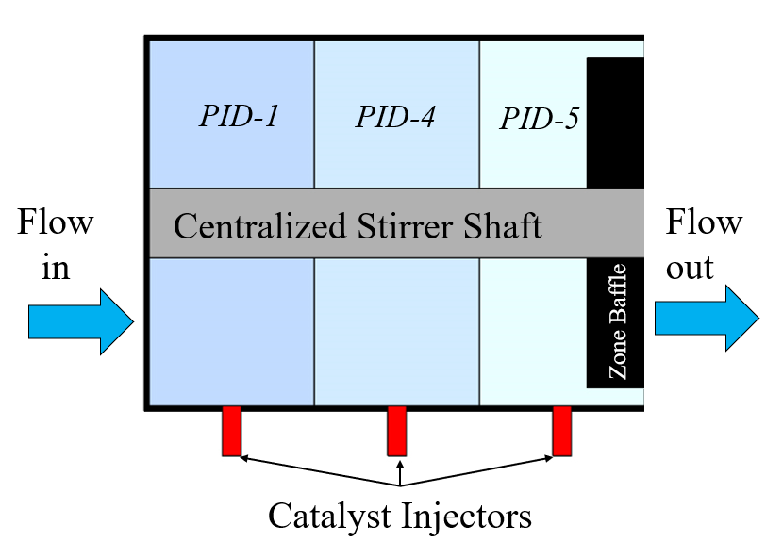
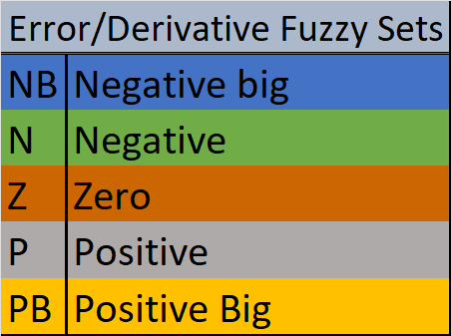
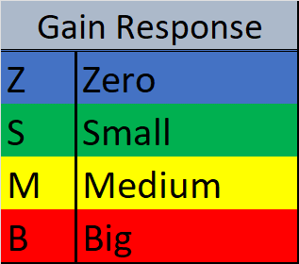
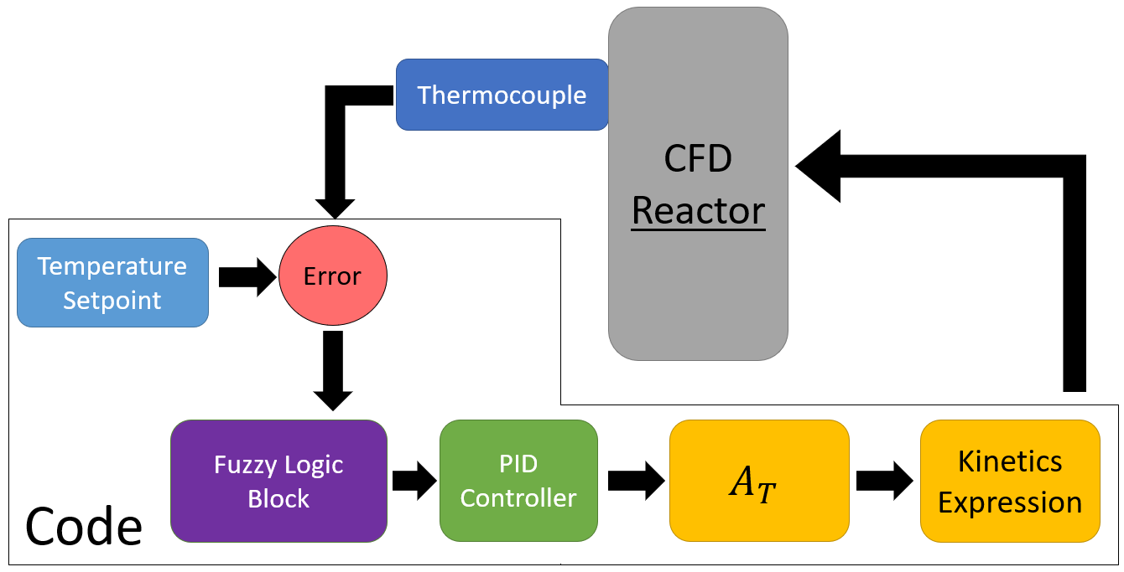
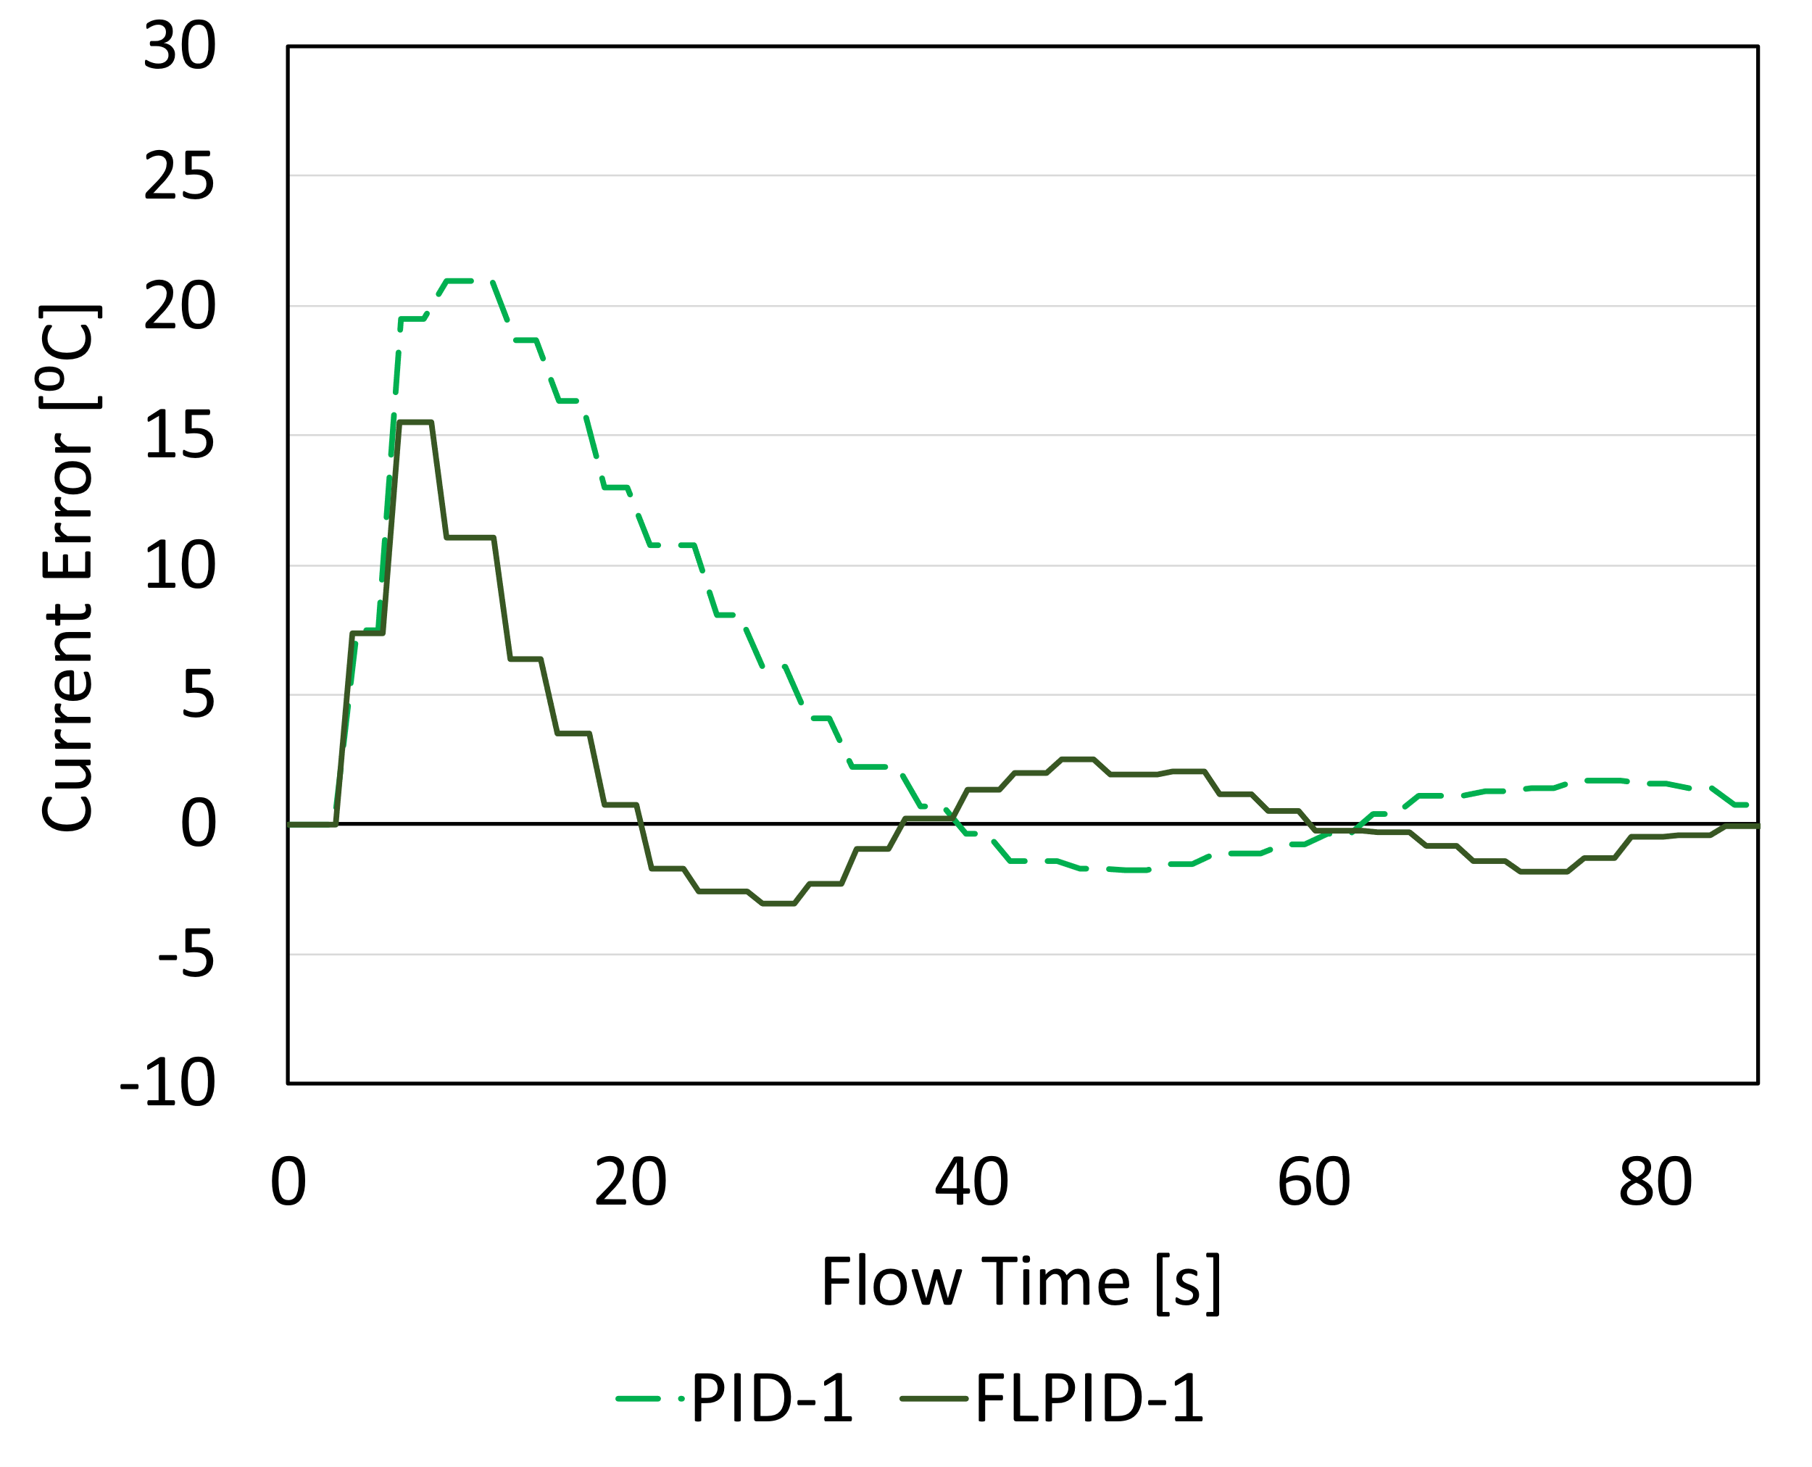
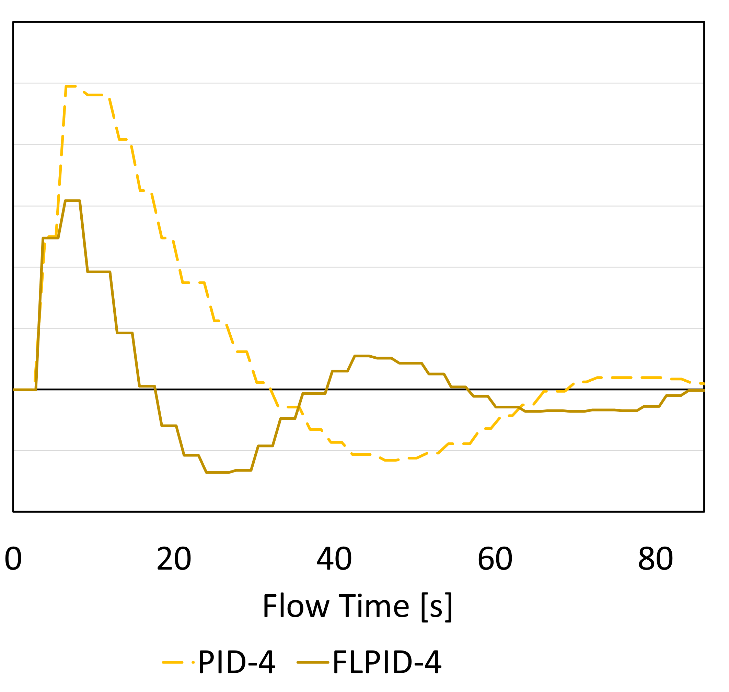
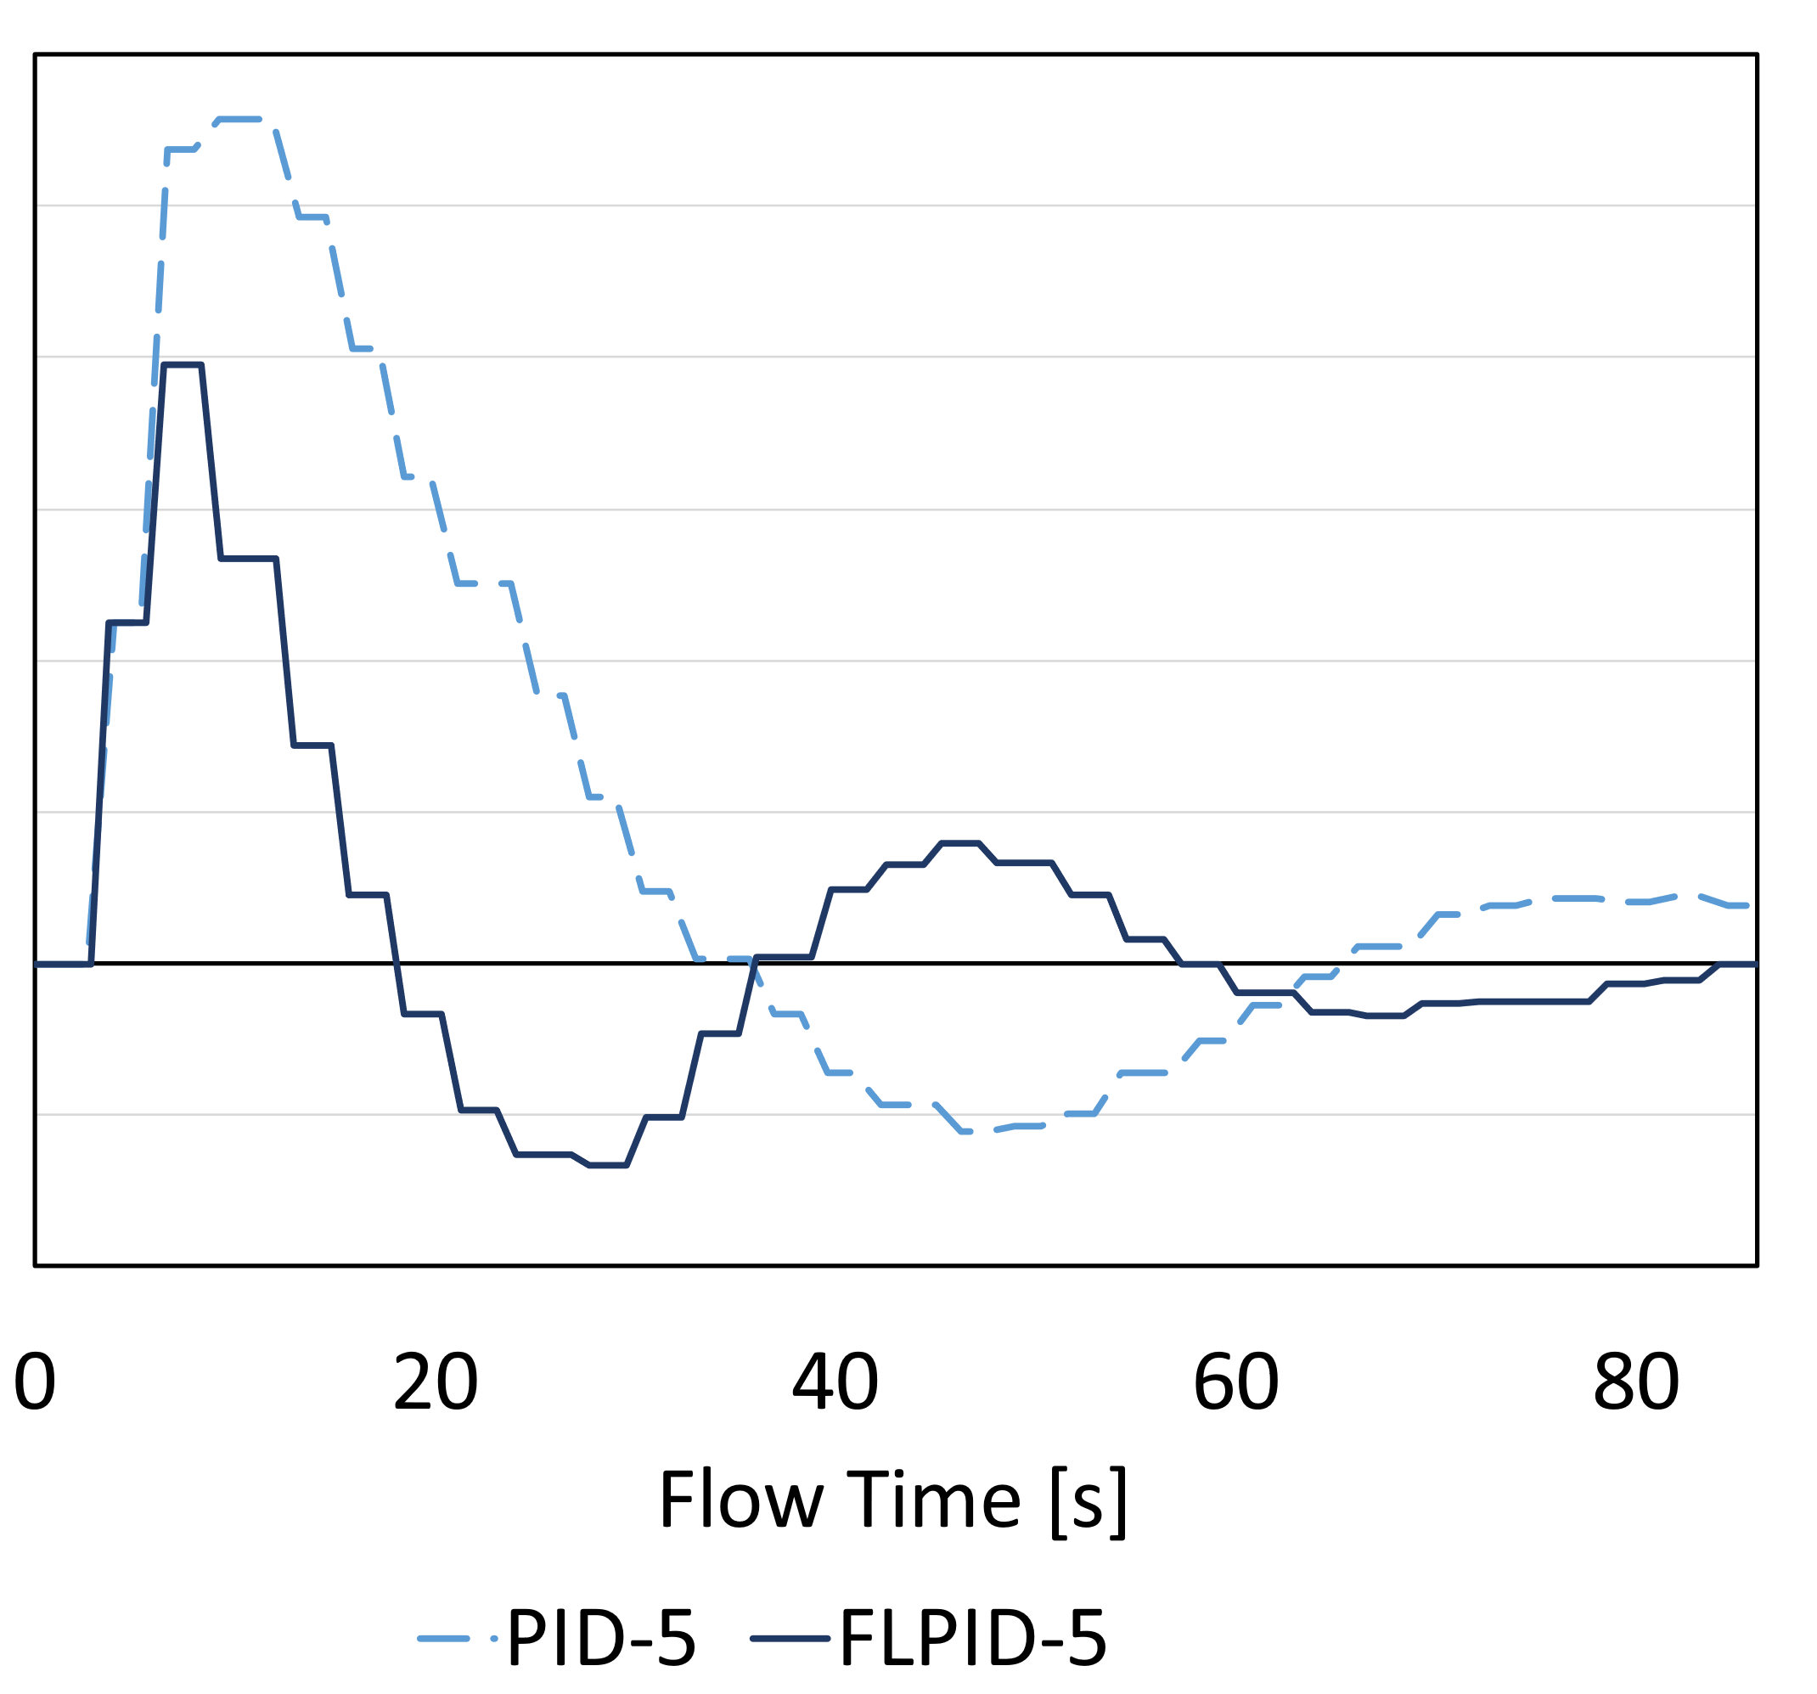
Leveraging Fuzzy Logic to Improve Solver Speed for Complex CFD
Eric Turman Advisor: Dr. Wayne Strasser Check out our research @ FLUIDgroup.org
Background
CFD requires careful treatment of model settings to get accurate results
Instantaneous contours of temperature and turbulent kinetic energy (k) report different results based on different meshes employed for a model of a chemical reactor
Mesh 2 costs 14x more than Mesh 1 to simulate
CFD requires methods to be validated to remove error due to numerical methods (turbulence model, mesh spacing, time step size, + many more)
Results and Conclusions
Engineering-based companies are developing computational simulations to replace conventional physical testing.
Companies like General Motors have publicly expressed a plan to reduce physical prototyping in favor of computational simulations.
Though cheaper than physical prototyping, simulations are still time and cost intensive.
Applying automated controllers to guide simulations can increase productivity and reduce cost.
Computational fluid dynamics (CFD) is an engineering simulation tool used in the field of fluids research. Accurate CFD is especially expensive to run. Complex models can require hundreds of computing cores to run.
Initial FL structure changed error based on current error alone and did not consider the derivative.
  This method proved no faster than PID control as controllers displayed significant oscillations about setpoint.
The FL structure was changed to consider error and its derivative which significantly improved controller performance.
FLPID-1, 4, & 5 limited the maximum error overshoot to be less than 25%, 40%, and 29% respectively compared to the PID controllers.
Both controller methods resulted in nearly identical A_{T} values. This ensures that QSS reaction rates are not impacted by the new the control strategy.
All 3 FLPID controllers reached QSS in only 80% of the time it took for the PID controllers to reach QSS.
80% faster convergence can save on the order of thousands of dollars per model for models requiring an excess of 100 computing cores.
One downfall of FL is the increase in parameters that need to be tuned to achieve faster convergence.
  PID has 3 constants per controller. FL has 5 factors for MFs, 6 total gain multipliers, and the overall rule structure. (more complexity added)
PID lacks the capability to achieve fast convergence for a nonlinear system even with proper tuning. Although more rigorous to develop, FL presents the best possibility of achieving fast convergence for CFD models.
Fuzzy Logic Benefits
Consider someone asks you if your cup of coffee is hot
Traditional logic allows only a yes or no response
FL allows you to be specific and describe exactly how hot your coffee is
This response can be equated to a value for computational needs (i.e. a controller checking error)
Mesh 1 Mesh 2 Mesh 1 Mesh 2
Fuzzy Logic + PID = Fast Controller
PID controllers rely on tuning constants (K_{P}, τ_{I}, τ_{D}) to alter controller response
FLPID allows for the current state of the error and its derivative to alter the controller constants to improve the controller’s response
Membership Functions translate current error and its derivative into fuzzy variables (big, medium, small)
A defined rule set evaluates the Membership Function values to determine an updated set of PID gains
Fuzzy Logic Process:
Introduction
1. Evaluate current error (E) and its derivative (DE) using Membership Functions (MF)
Transient CFD models need to calculate enough “simulation time” for the system to reach Quasi Steady State (QSS) in which variables are statistically stationary.
Coupling automated controllers with CFD can get a model to QSS faster [1].
Proportional Integral Derivative (PID) controllers are robust and proven but are slow to reach QSS for nonlinear systems.
Fuzzy Logic Proportional Integral Derivative (FLPID) controllers have proven to reach setpoint faster while maintaining low computational cost [2].
Previous studies involved simple single equation validation models [3]. This works seeks to evaluate the capabilities of an FLPID to ensure fast convergence for a complex CFD model.
CFD Reactor Model
3 Controllers, 1 fresh gas feed, 3 catalyst feeds
Flow has an Average Rotational Reynolds # of 25,000
Model uses SST, 3 million elements, and has a rotating stirrer shaft
2. Compare both fuzzy sets using rule sets to select a new Proportional gain (K_{P}) and Derivative gain (τ_{D})
ex) If E is N & DE is PB, Gain Output is S
Colors Correspond to Fuzzy Sets
Future Work
FL can be further improved by altering the sampling time of a PID controller. The affect of varying the sampling time coupled with changing the controller constants could further improve model speed.
Further validation should be conducted on more rigorous CFD models such as atomization studies. There is an opportunity to save a significant amount of time and money by reducing the required solver time.
Colors Correspond to Output Gains
Methods
3. K_{P} and τ_{D} are updated in the PID Controller to determine the latest controller response A_{T}
FLPID was compared to PID in dealing with a system upset for a nonlinear chemical reactor model in CFD.
Catalyst feeds were increased by 1.5x which dramatically raised the internal temperature of the model.
Controllers altered a kinetics tuning parameter (A_{T}) to bring the temperatures back into the operational range.
3 simultaneous independent controllers will change a kinetics tuning parameter A_{T} to alter the reaction rates in CFD.
Controller speed is determined by the overall time it takes to reach QSS. Overshoot and variation from the PID baseline model are also considered.
Thermocouples in CFD record temperatures in the model
Error = (Current Temperature – Temperature Setpoint)
A code coupled to CFD consists of all controllers and chemical reactions
Study Results
References & Acknowledgements
[1] E. Turman and W. Strasser, “CFD Modeling of LDPE Autoclave Reactor to Reduce Ethylene Decomposition: Part 1 Validating the Reactor Model,” Chemical Engineering Science.
[2] Y. García, “A Self-tuning PID Controller Design based on Fuzzy Logic for Nonlinear Chemical Processes,” in 2020 IEEE ANDESCON, Oct. 2020, pp. 1–6. doi: 10.1109/ANDESCON50619.2020.9272108.
[3] C.-T. Chao, N. Sutarna, J.-S. Chiou, and C.-J. Wang, “An Optimal Fuzzy PID Controller Design Based on Conventional PID Control and Nonlinear Factors,” Applied Sciences, vol. 9, no. 1224, p. 18, Mar. 2019, doi: 10.3390.

