Slide 1
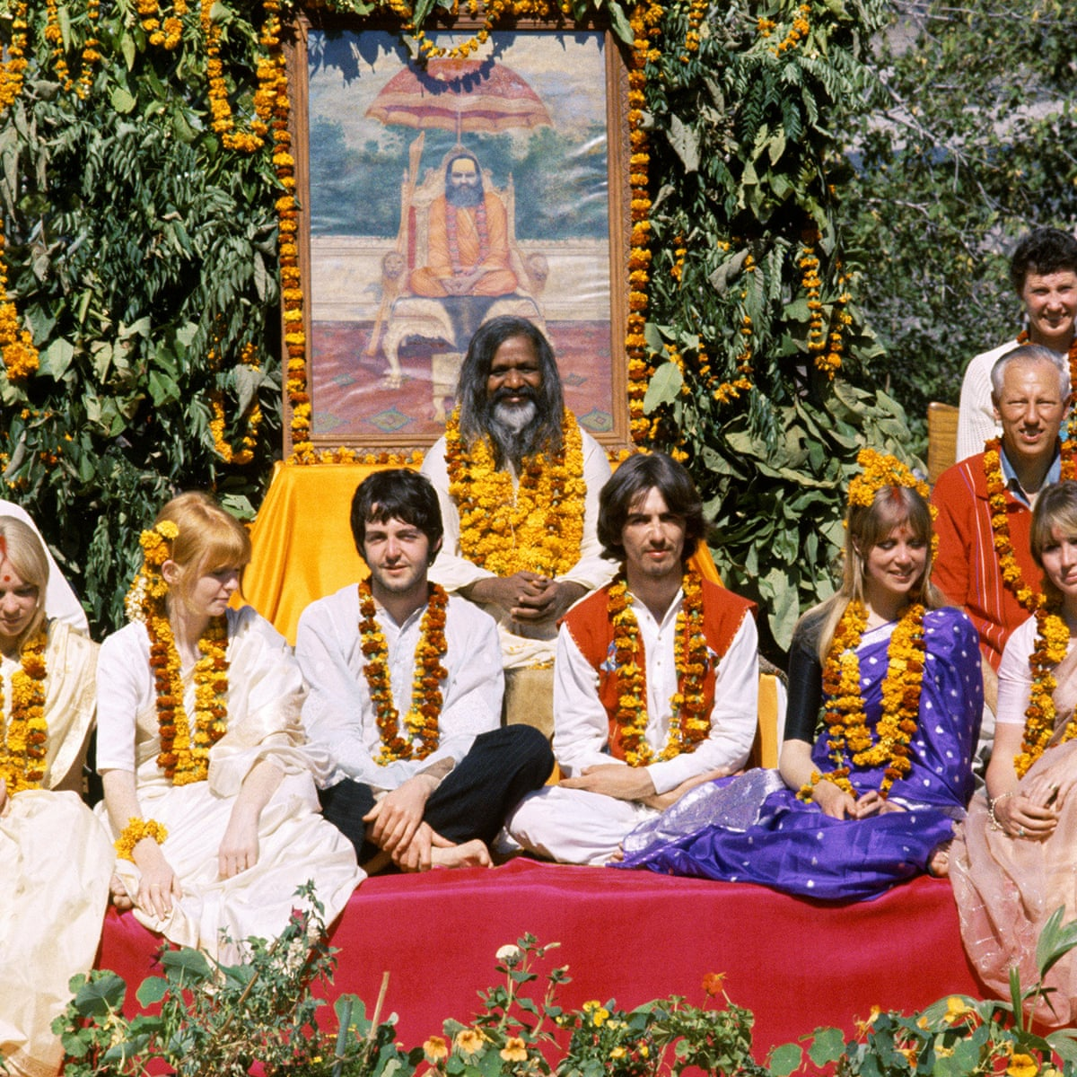
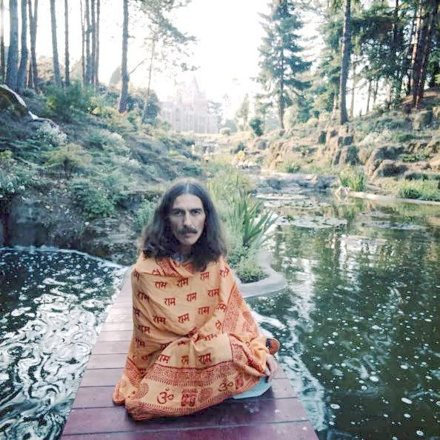
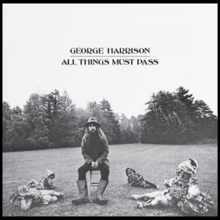
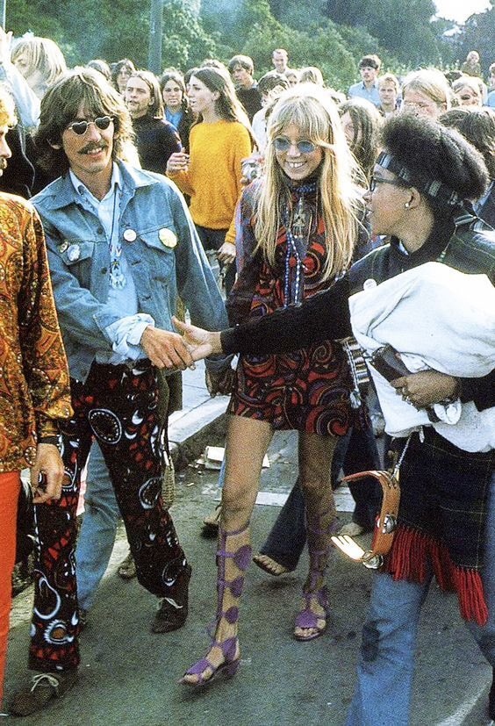
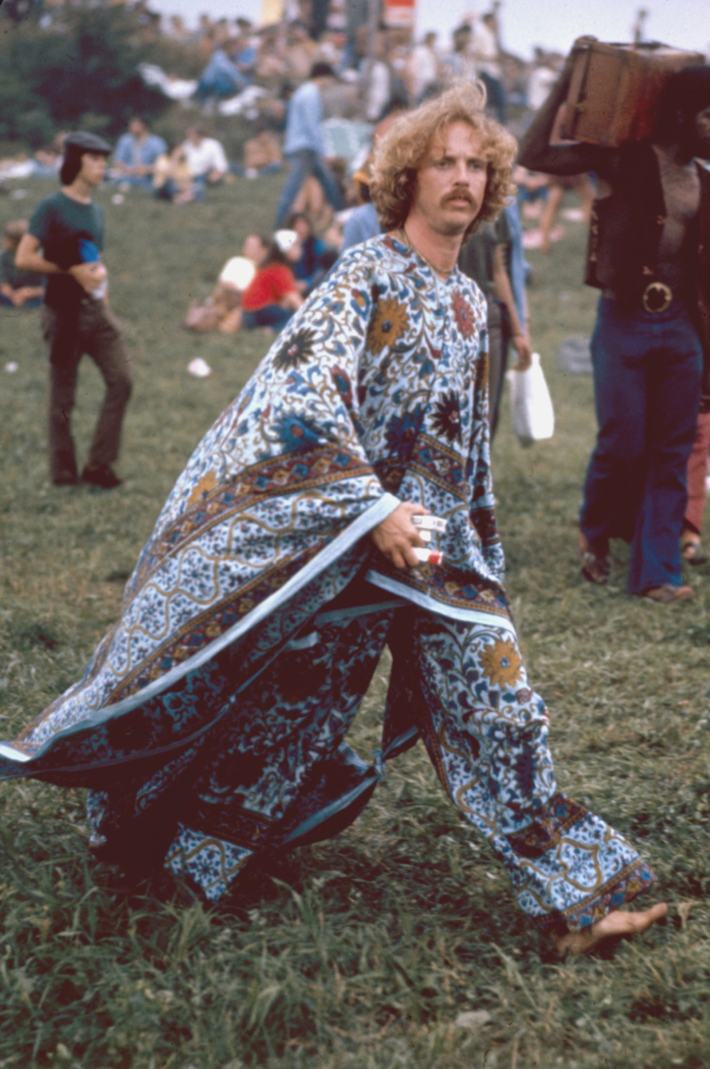
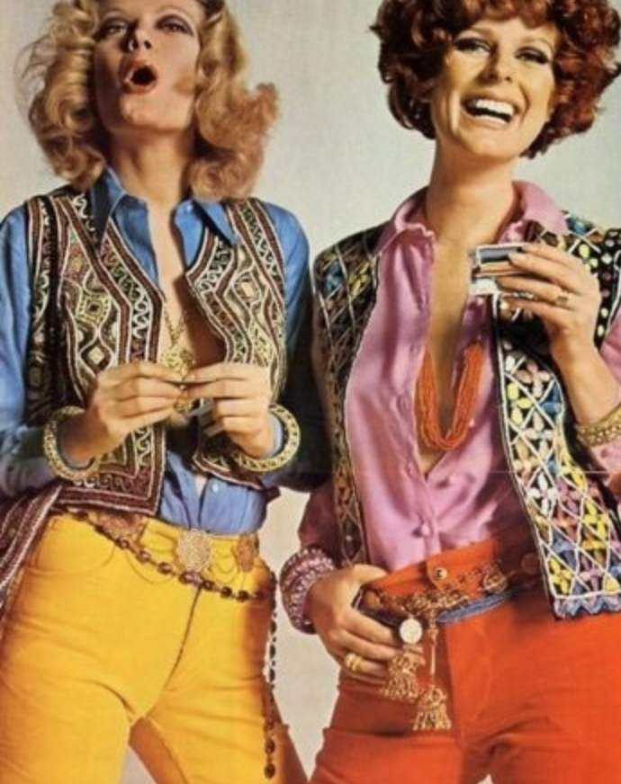
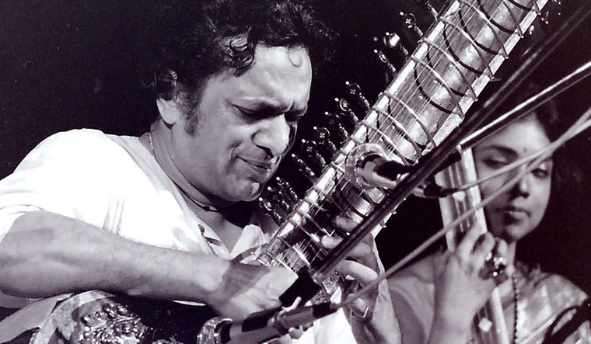
Eastern Influence in Western Waves: George Harrison, Indian Mysticism, and the
Arts in Pop Culture of the Mid-Century
Emma Christine Morgan
Background
Results and/or Conclusion
Background: George Harrison was one of the founding members of the world famous band, The Beatles. Known as the “quiet Beatle”, Harrison often turned to introspection as his means of creativity. Towards the end of the Beatles career as a band and after their breakup, Harrison would spend much of his life dedicated to Indian mysticism and Hinduism. This greatly affected his music and fashion taste as a solo artist. Harrison created a large impact on pop culture and many eastern influences such as music, belief systems, and fashion had a role in the arts during the decade of the 1970s.
Methods: Since no one had previously measured the degree to which George Harrison’s spirituality affected the hippie revolution and pop culture of Mid-Century America, we measured how the arts were affected through means of music styles, fashion trends, changes in popular religions in the US, and more.
Results: Results show that there was a significant cultural impact on belief systems, fashion influences, and music of young adults in the US, that incorporated many eastern elements. We found that the hippie revolution and the climactic event of the Woodstock event were direct results of this change in creative influences in pop culture in the mid century USA.
Conclusions: Results show that religious beliefs held by pop culture icons can have a large impact on secular pop culture, in the form of music, fashion, and more.
Results
Results show that Harrison’s solo work and lifestyle following the breakup of the Beatles was heavily affected by his spiritual journey with Indian mysticism and Hinduism. This infiltrated every aspect of his life, but the aesthetic impact of this journey would have the greatest impact on the West. The cultural impact from Harrison’s spiritual awakening was impactful in a way that was unprecedented. The hippie revolution of the late 1960s and early 1970s was heavily influenced by him through multiple different aesthetic ways. Fashion was one prominent way in which we can visually see Eastern influences at play in the West. Fashions from the East such as beaded necklaces, Indian textiles, kaftans, and more were commonly worn by those that identified as bohemian. The peak of this fashion change can be seen through the garments worn at the Woodstock music festival in August of 1969. These trends soon flowed into commercial fashion and advertising as well, marketing primarily teenagers and young adults that would identify with the hippie movement. This change in popular fashion would last until approximately the mid to late 1970s.
Music was the other form of art that was infiltrated by Eastern sounds during the late 1960s and early 1970s in the West. George Harrison’s most famous album, All Things Must Pass, incorporated the sitar in many of the songs, as well as including many Hindu mantras. In his song, My Sweet Lord, we can witness the combination of Western and Eastern religions by the combination of the tune being in the style of the song Oh Happy Day by the Ed Hawkins singers, the Krishna choir singing their Hare Krishna mantra repeatedly throughout the song, and the word “hallelujah” being repeated over 40 times. The other prominent sign of Eastern music in the US is the event of Ravi Shankar, Harrison’s sitar instructor, performing at Woodstock, showing the secular acceptance and preference of Eastern music in America.
Figure 1. The Beatles first trip to India (February, 1968)
The Beatles traveled to India to spend time at the Maharishi’s ashram, learning from Maharishi Mahesh Yogi, the leader of the Transcendental Meditation movement.
Figure 2. George Harrison 1975
Harrison shown photographed at his home in Friar Park, about 25 miles outside of London. Here, he spent much time on the grounds meditating and gardening.
Introduction
This research investigates the life and impact of George Harrison. The star who began his career in a sensational band that took the world by storm left a curious cultural impact that many did not expect. While he was an icon and inspired much of western culture, what many didn’t know is that his greatest influences came from the East. His interest in Indian mysticism led to a complete transformation of his wardrobe, philosophy, and even music and eventually found itself leaking into American culture. What began as an Eastern fusion into the musical styles of the Beatles became an all-encompassing lifestyle for Harrison, strongly affecting the fashion and musical choices of Harrison throughout his solo career. By examining the journey that Harrison went through during his extended time in India, and his subsequent cultural and spiritual changes heretofore, we are we able to witness how he brought a foreign cultural element to popular culture in the 1960s and 1970s, and how this influence affected culture as a whole for years to come. By surveying popular culture of the 1960s and 1970s through media and articles such as music, fashion trends, belief systems, and social and political revolutions of the time will we be able to see firsthand the cultural change towards accepting a more Eastern way of life. George Harrison and his decision to incorporate Indian influences in his life changed the tide for cultural and social revolutions for the decade to follow. This study allows for future investigation into popular icons in mainstream media having the ability (often unbeknownst to them), to strongly impact culture through many facets of culture by their personal and religious endeavors.
Figure 3. All Things Must Pass Album Cover
George Harrison’s first solo album following the breakup of the Beatles. This album exemplified the spiritual awakening Harrison was experiencing. Especially in the song “My Sweet Lord”, which combines multiple religious influences.
Future Work
Determine the correlation between religious influence in secular movements in hope of spreading Christianity.
Determine the power and influence of pop artists to single-handedly start movements within pop culture.
Find the correlation between religious movements and trends in the arts, such as fashion and music.
Figure 4. Pattie Boyd and George Harrison, 1967
Pattie Boyd and George Harrison in the midst of the Hippie Revolution, sporting many eastern inspired fashions at the time.
References
Figure 5. Woodstock, 1969
An attendee at Woodstock sports a kaftan and pants made of traditional Indian fabrics.
Feinstein, Barry. (Photographer.) (1970) All Things Must Pass Album Cover. Wikipedia.
Accessed March 16th, 2022. https://en.wikipedia.org/wiki/All_Things_Must_Pass
O’neill, Terry. (Photographer) (1975) Accessed March 16th, 2022. https://iconicimages.net/news/iconic-spotlight-george-harrison-terry-oneill/
Saltzman, Paul. (Photographer) (1968) The Beatles in India. Accessed March 22nd, 2022. https://en.wikipedia.org/wiki/The_Beatles_in_India
Scorcese, M. (Director.) (2011) George Harrison: Living in the Material World. [Film] Grove Street Pictures.
Tillery, G. (2011). Working Class Mystic: A Spiritual Biography of George Harrison. Quest Books.
Photographer Unknown. (1967) Pattie and George in Haight-Ashbury. https://swayingdaisiesblog.wordpress.com/2016/06/10/style-icons-pattie-boyd/
Photographer Unknown. (1967) Ravi Shankar performing. Accessed March 22nd, 2022. https://en.wikipedia.org/wiki/Ravi_Shankar
Photographer Unknown. (1969) Woodstock. Accessed March 22nd, 2022. https://rarehistoricalphotos.com/woodstock-fashion-photos-1969/
Photographer Unknown. 1970s Fashion Magazine. Accessed March 22nd, 2022. https://vintagedancer.com/1960s/hippies-in-the-60s-fashion-festivals-flower-power/
Methods
Observed primarily secular media and subject matter
Reviewed film, literature, art, music, and fashion of the 1960s and 1970s in mainstream USA.
Studied from a diverse list of authors, producers, artists, and photographers.
Figure 6. Magazine Fashion Plate
This magazine ad that was in circulation during the 1970s shows the prominent trend of those in pop culture in the West, specifically teens and young adults, wearing Indian textiles, Hindu beads, and traditional Indian garment designs.
Figure 7. Ravi Shankar at Woodstock, 1969
The instructor of Harrison’s sitar lessons, Ravi Shankar performed at the Woodstock festival in 1969.

