Slide 1
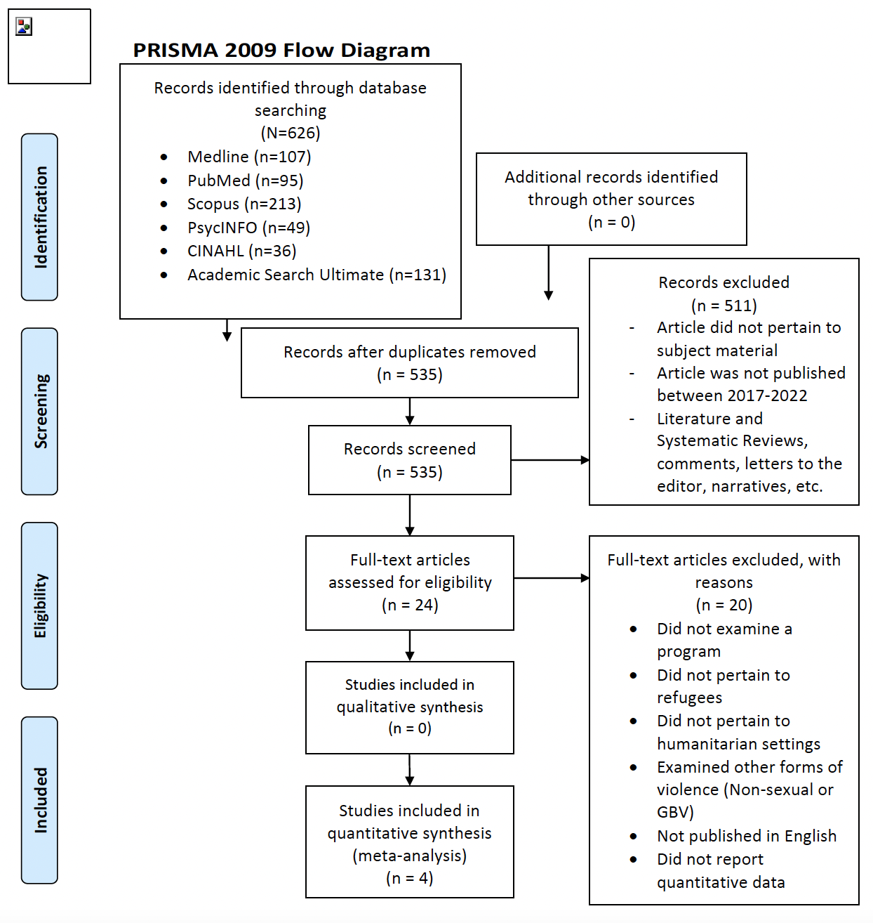
A Review of Programs Related to the Prevention of and Response to Sexual and Gender-based Violence Among Refugees in Humanitarian Settings
Lili Morgan
Advisor: Dr. Jeffrey Lennon
Background
Results
Conclusion
In 2020, 82.4 million were displaced from their homes due to oppression, violence, war, or the infringement of their human rights¹
Over 1% of the world’s population is currently displaced¹
Women and girls make up around 50% of displaced persons²
COVID-19 has intensified violence against women and girls on a global scale³
UNHCR definition of Gender-based violence:
CDC definition of sexual violence:
In environments of displacement, females are increasingly vulnerable to GBV⁴
The disproportionate rates of GBV in humanitarian settings call for an increase in protection services and further studies that target this multifaceted problem⁶
There is an overwhelming need for comprehensive research that examines the efficacy and strength of programs responding to GBV⁷
Tol, 2020⁹
Humanitarian emergencies present complex environments for interventions addressing sexual and gender-based violence. This review examined the methods, results, and implications of programs related to the prevention of and response to gender-based violence among refugees in humanitarian settings over the past 5 years. Several of the interventions included in this review did not achieve significant results. Notably, both prevention-oriented studies did not report a significant impact on the target population.
Overall, this review highlights a significant need for effective programs and interventions that target the prevention of and response to sexual and gender-based violence in humanitarian settings. To eradicate the prevalence of SV and GBV in refugee populations, future study designs must consider the implications and limitations of previous programs addressing this issue.
Tol, 2020¹³
Methods | RCT with 694 participants in Rhino Camp Settlement, Uganda Five workshops were facilitated alongside Self-help plus intervention to assess individual psychological distress Outcomes were measured at the individual level
Results | Intervention groups demonstrated “stronger improvements for Self-Help Plus on psychological distress 3 months post intervention”
Implications | Political instability in area impacted program Follow-up assessment was completed 3 months post-program, but a long-term follow-up could be more helpful to examine the benefits of program
¹³
UNHCR definition of gender-based violence (GBV) ⁴
“Harmful acts directed at an individual based on their gender. It is rooted in gender inequality, the abuse of power, and harmful norms”
Stark, 2018a¹⁰
Stark, 2018a¹⁴
Methods | Cluster RCT with 919 female participants aged 13-19 in Ethiopian refugee camps Females were divided into 31 clusters, 457 were included in intervention, 462 were included in control. Intervention group received life-skill training Primary measured outcome: “exposure to sexual violence in previous 12 months”
Results | Intervention was not significantly associated with reduction in exposure to sexual violence Intervention demonstrated attitude improvement associated with rites of passage and social support
Implications | Future evaluations should measure change at community level Future evaluations should target social norms and behaviors among men
CDC definition of sexual violence (SV) ⁵
“A sexual act that is committed or attempted by another person without freely given consent of the victim or against someone who is unable to consent or refuse”
Future Research
Development of interventions that target the social norms and behaviors of male participants in prevention of and response of GBV and SV
Further research on the factors that discourage refugees from reporting incidences of GBV or SV
Development of interventions addressing the multifaceted mental and physical health issues associated with SV exposure
Further research on the limitations of the COMPASS implementation and the identification of areas for potential modification¹¹
Development of alternatives to the COMPASS implementation for refugee contexts¹¹
Allinson, C., & Hayes, J. (1996). The Cognitive Style Index. Journal of Management
Studies, 33(1), 119–135.
Allport, G. W. (1937). Personality: A psychological interpretation. New York: Holt &
Co.
Battalio, J. (2009). Success in distance education: Do learning styles and multiple
formats matter? American Journal of Distance Education, 23(2), 71-87.
Beaumaster, S., & Long, J. A. (2002). Pedagogy, technology and learning styles—
their effect on the online learner. Proceedings from National Conference on Alternative
and External Degree Programs for Adults ’02, Pittsburg, PA, 80-97. Retrieved from
http://ahea.org/files/pro2002beaumaster.pdf
Stark, 2018b¹⁵
Methods | RCT with 919 participants from three refugee camps in Ethiopia Evaluated strength of COMPASS implementation in impacting safety and wellbeing of girls Girls attended 90-minute life-skill sessions, one time per week, for 10 months
Results | Intervention was not significantly associated with a reduction in economic vulnerability of girls Females who attended intervention were “no more or less likely than those in the control arm to (1) attend school; (2) work for pay; (3) work for pay while not being enrolled in school; or (4) engage in transactional sexual exploitation”
Implications | Utilizing socio-ecological model could help explain study’s impeded success The volatile context of Ethiopian refugee camps should hinder expectations of the success of a social empowerment program Programs targeting the empowerment of woman might demonstrate greater success if they target the engagement of men in the community
Stark, 2018b¹¹
Discussion
Response-oriented
PTSD existence in target population^{9,12}
Research Question
Social support is an effective component of programs addressing SV-related PTSD^{9,12}
What are the methods, results, and implications of programs related to the prevention of and response to sexual and gender-based violence among refugees in humanitarian settings?
References
1 2 3 4 5 6 7 8 9 10 11 12 13 14
1 2 3 4 5 6 7 8 9 10 11 12 13 14
9. Tol WA, Leku MR, Lakin DP, et al. Guided self-help to reduce psychological distress in South Sudanese female refugees in Uganda: a cluster randomised trial. The Lancet Global Health. 2020;8(2):e254-e263. doi:10.1016/s2214-109x(19)30504-2
10. Stark L, Asghar K, Seff I, et al. Preventing violence against refugee adolescent girls: findings from a cluster randomised controlled trial in Ethiopia. BMJ Global Health. 2018;3(5):e000825. doi:10.1136/bmjgh-2018-000825
11. Stark L, Seff I, Assezenew A, Eoomkham J, Falb K, Ssewamala FM. Effects of a Social Empowerment Intervention on Economic Vulnerability for Adolescent Refugee Girls in Ethiopia. Journal of Adolescent Health. 2018;62(1):S15-S20. doi:10.1016/j.jadohealth.2017.06.014
12. Annan J, Falb K, Kpebo D, Hossain M, Gupta J. Reducing PTSD symptoms through a gender norms and economic empowerment intervention to reduce intimate partner violence: a randomized controlled pilot study in Côte D’Ivoire. Global Mental Health. 2017;4. doi:10.1017/gmh.2017.19
13. Moher D, Liberati A, Tetzlaff J, Altman DG. Preferred Reporting Items for Systematic Reviews and Meta-Analyses: The PRISMA Statement. PLoS Medicine. 2009;6(7):e1000097. doi:10.1371/journal.pmed.1000097
References 1-8 detailed in research paper
A
B
Neither of the prevention-oriented studies produced significant results¹⁰⁻¹¹
Annan, 2017¹²
Prevention-oriented
Methods
Annan, 2017¹⁶
Methods | RCT with 1198 participants in Northwestern Côte d'Ivoire Treatment arm received both VSLA (group savings program) and an 8-session gender dialogue group (GDG) that addressed household gender inequalities Control groups received only VSLA
Results | Adding a discussion group focused on challenging inequitable gender norms to a savings group overall significantly reduced women’s posttraumatic stress symptoms compared with a savings group alone
Implications | Utilizing socio-ecological model could help explain study’s impeded success The volatile context of Ethiopian refugee camps should hinder expectations of the success of a social empowerment program Programs targeting the empowerment of woman might demonstrate greater success if they target the engagement of men in the community
A systematic search accessed articles from Medline, PubMed, Scopus, PsycINFO, CINAHL, and Academic Search Ultimate
The prevention-oriented studies demonstrated two similar implications¹⁰⁻¹¹
C
SEARCH TERM | VARIANTS
Programs should target male community members¹⁰⁻¹¹
Change should be examined at the community level¹⁰⁻¹¹
Refugee | Migrant, displaced-person, asylum seeker
Sexual violence | Rape, forced marriage, early marriage, survival sex, gender-based violence, sexual assault, molestation, sexual abuse⁸
Program | Evaluation, evidence, intervention, health service, integration, practice, models of care, evidence, response, prevention
Humanitarian Setting | Crisis, displacement, conflict
There is a significant need for effective programs and interventions that target the prevention of and response to sexual and gender-based violence in humanitarian settings

