Slide 1
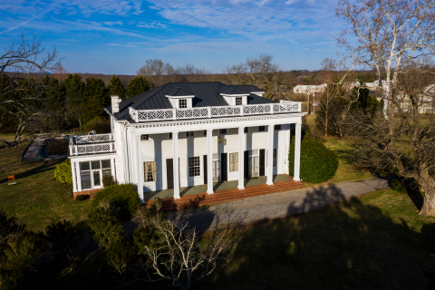
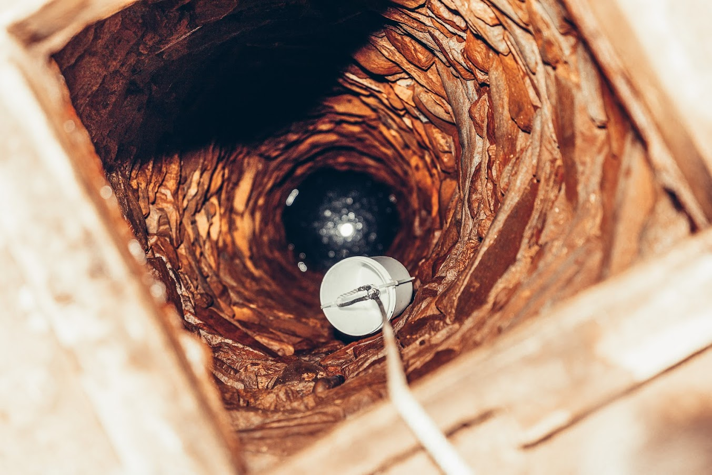
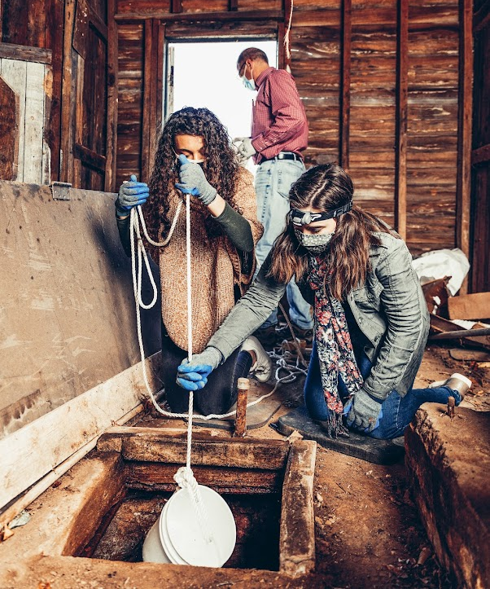
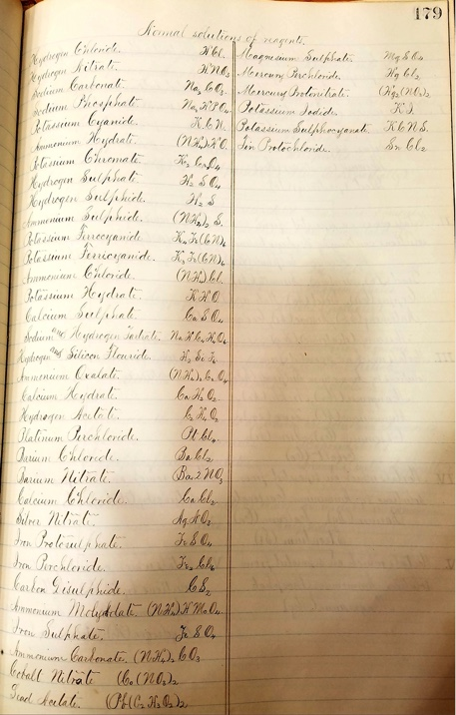
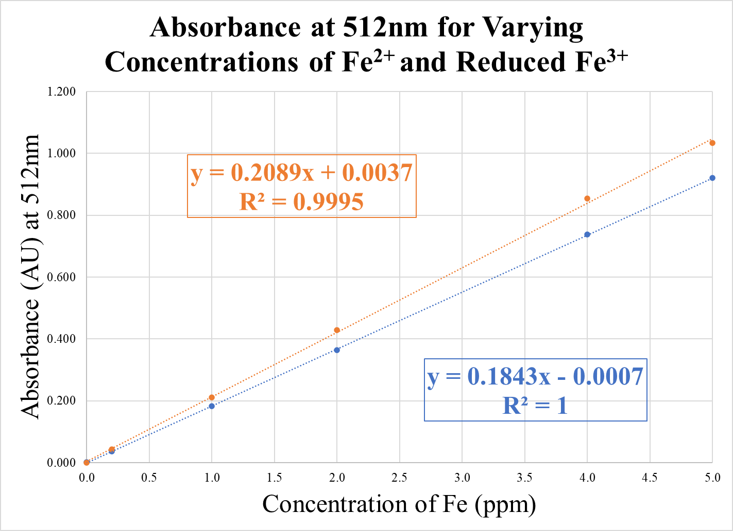
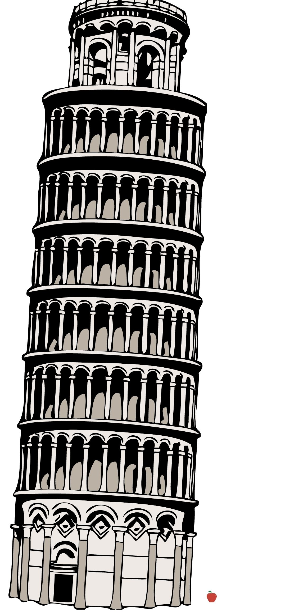
Historical Investigation of New London Alum Springs
through Elemental Analysis
Asia Eskaros, Chloe Vernon, Dr. T. Michael Bender
Background
Results
Background: In the 19th century, the Bedford Alum Springs Hotel attracted travelers by advertising the local mineral springs that were said to have healing benefits. During this time, visitors would come to the resort and leave with vials of powdered minerals that had been separated from water near the property. With ongoing archeological projects happening at the New London historical site, several hand-dug wells were found on the property. One well was found in a small outbuilding behind the Bedford Alum Springs Hotel while the other was found a short distance down the road inside Mead’s Tavern, the oldest standing building from the colonial era in central Virginia. Methods: This research project focused on determining whether these wells contained the famous mineral water promoted by the hotel. To answer this question, an elemental analysis was performed on the water samples taken from the wells at the hotel and Mead’s Tavern, as well as Buffalo Creek, which was located a mile downhill from the historical property. The elements of interest for this study were iron, aluminum, calcium, and magnesium. The water samples were analyzed against external standards by both UV-Vis spectroscopy and AAS spectrophotometry. Using these analytical methods, the concentrations of minerals and the relative water hardness were quantified and then compared to a circa 1850’s analysis of the mineral water. Results: Ultimately, the results indicated that all three water sources had standard to low levels of the elements of interest. Conclusions: These findings suggest that the wells behind the hotel and in Mead’s Tavern were intended for general household uses such as cooking, washing, and cleaning. The advertised mineral water from the springs referenced in historical papers was, therefore, likely not located immediately adjacent to the hotel property.
Percent Difference
 | Iron | Aluminum | Calcium | Magnesium
Hotel | 200 | 200 | 190 | 190
Meade’s | 200 | 200 | 180 | 200
Buffalo | 200 | 200 | n/a | n/a
Table 2. Summary table showing percent differences of 2021 results to Gilham’s c. 1850’s results
Results
All three sites, Bedford Alum Springs Hotel, Meade’s Tavern, and Buffalo Creek, showed low levels of each of the target minerals. Iron levels were shown to be highest in the water from Buffalo Creek, but Buffalo Creek showed the lowest amounts of aluminum. The amount of calcium and magnesium were not tested in Buffalo Creek because both minerals were in high concentration in this running water source. The water from the wells had iron and aluminum levels under one part per million. However, both magnesium and calcium were in higher concentrations in the well water. Nonetheless, these concentrations were far lower than what William Gilham had found and are typical for moderate hardness water in central Virginia.
Conclusions
Observable levels of dissolved minerals were found in the water samples from the wells and the creek. However, these levels were found to be the same as moderately hard potable water, which is common in Virginian water sources. This is far lower than what was found by Professor Gilham. Thus, it was concluded that the wells were not used as the source of mineral water. It is believed that the original mineral springs were adjacent to Buffalo Creek. This could possibly account for its higher levels of iron and other minerals. In conclusion, the wells were not the source of mineral water.
Figure 1. Image showing the Bedford Alum Springs Hotel
Figure 2. Image showing how water was sampled from 50 feet below the ground surface in the well at the Bedford Alum Springs Hotel.
Research Question
The popularity of the Bedford Alum Spring Hotel was primarily due to the “healing” mineral water advertised. The mineral content of the water was tested c. 1850’s by Professor William Gilham of the Virginia Military Institute, who reported high concentrations of iron, aluminum, calcium, and magnesium. This research project sought to compare current levels of those same minerals to that historical analysis to determine if the water in the wells at the Alum Springs, Meade’s Tavern, and Buffalo Creek were the source of this mineral water.
Figure 3. Image showing well water acquisition
Future Work
Additional studies were performed in tracking phosphorus levels in the soil across the Mead's Tavern excavated cellar to build a “heat map” of orthophosphates levels in the soil. These levels may help rationalize the use patterns and room partitions in that cellar.
Further work could be done to access the original mineral spring advertised by the Bedford Alum Springs Hotel to do a similar comparative elemental analysis. Land access rights have so far been denied, but perhaps this study will help gain those rights.
Methods
Figure 4. Standard curve plot of the absorbance of Fe²⁺ and reduced Fe³⁺ at 512nm with varying concentrations
Figure 5. Page from an 1871 VMI student’s notebook illustrating historical of chemical nomenclature pre-periodic table of the elements
Collection of Water Samples
Three different water sources were studied: Hand-dug wells at the Bedford Alum Springs Hotel and Meade’s Tavern along with surface water from Buffalo Creek. Once on site, the water was collected through tying a long rope to a 0.5L collection jug. The jug was carefully lowered tipped to allow for the jug to be filled. The sample was then carefully pulled up where it was sealed into a cleaned container and appropriately labeled.
Determination of Iron and Aluminum Concentration
A series of standards were prepared from 5 ppm to 0.5 ppm for iron (Fe), both Fe²⁺ and reduced Fe³⁺, and from 0.2 ppm to 0.02 ppm for aluminum (Al). The absorbance of the standards were analyzed using an UV-Vis Spectroscopy at the respective wavelengths using standard test methods from Eaton. For the analysis of iron, the wavelength used was 512 nm, while for aluminum, the analysis wavelength was 535 nm. The absorbance of each water sample was measured and, via the standard curves, the concentrations of the iron and aluminum in the three water samples were found.
Determination of Calcium and Magnesium Concentrations
A serial dilution of standards was developed from 5 ppm to 0.5 ppm for calcium and from 4.4 ppm to 0.18 ppm for magnesium. The absorbance levels of the standards were analyzed using an Atomic Absorption spectrophotometer at the respective atomic wavelengths. For the analysis of calcium, the wavelength used was 422.67 nm, while for magnesium, the analysis wavelength was 285.21 nm. The absorbance of each water sample was measured and, by comparison with the standard curves, the concentrations of the calcium (Ca) and magnesium (Mg) in the two well-water samples were established. Water hardness is the quantified by the measurement of calcium and magnesium concentrations. Buffalo creek was not analyzed by this method.
1 2 3 4 5 6 7 8 9 10 11 12 13 14
1 2 3 4 5 6 7 8 9 10 11 12 13 14
A
B
 | Iron (Fe) |  | Aluminum (Al) |  | Calcium (Ca) |  | Magnesium (Mg)
 | 2021 Testing | Gilham Testing | 2021 Testing | Gilham Testing | 2021 Testing | Gilham Testing | 2021 Testing | Gilham Testing
Hotel | 0.0456 | 295 | 0.149 | 73 | 4.39 | 128 | 3.17 | 90
Meade’s Tavern | 0.0827 | 295 | 0.142 | 73 | 5.58 | 128 | 1.08 | 90
Buffalo | 0.194 | 295 | 0.129 | 73 | n/a | 128 | n/a | 90
References and Acknowledgments
C
Eaton, Andrew D.; Clesceri, Lenore S.; Greenberg, Arnold E.; Franson, Mary Ann H.; Standard methods for the examination of water and wastewater; American Public Health Association; American Water Works Association.; Water Environment Federation.1998
Moorman, J. J. The Virginia Springs: Comprising an Account of all the Principal Mineral Springs of Virginia, with Remarks on the Nature and Medical Applicability of Each, 2nd edition, Richmond, VA, 1854
We would like to thank and acknowledge for their cooperation and assistance:
Professor Donna Donald, Director of Public History Initiatives at Liberty University, and Mr. Randy Lichtenberger, Director of Cultural Resources at Hurt & Proffitt, Inc. We also thank Mrs. Martha Bender for her help with the water sampling.
Figure 6. Visual comparison of Gilham’s c. 1852 concentrations of Al to 2021 Al results
Table 1. Comparison of 2021 experimental concentrations (ppm) of different elements to Gilham’s historical concentrations (ppm)

