Slide 1
“No One Will Talk”:
The Horrors of Sexual Trauma in the Holocaust
Evelyn Loftin

Slide 2
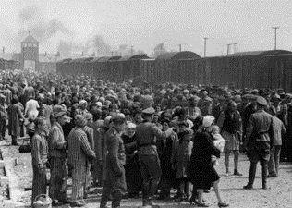
Background
Conservative estimate of over 13 million deaths
Sexual assault was experienced by many women causing lifelong trauma
Arguments against : Levenkron Nomi - It diminishes the magnitude of the intended outcome
Figure 1: Nazi guards round up arriving prisoners at the Auschwitz concentration camp's unloading ramp (Masses of people getting off the trains at Auschwitz, n.d., https://en.historylapse.org/the-holocaust)

Slide 3
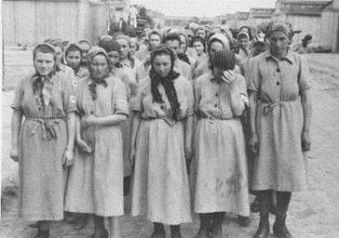
Women Were Specifically Targeted
They were the greatest threat to the “Aryan Race”
Had the ability to reproduce
The Nazis attacked their femineity as well as their bodies
Dehumanization was designed to attack religious persons and women greatly
Figure 2: Jewish women from Subcarpathian Rus who have been selected for forced labor at Auschwitz-Birkenau, march toward their barracks after disinfection and head shaving. (Photograph by Bernhardt Walter/Ernst Hofmann, Women standing in line for role call, n.d., https://collections.ushmm.org/search/catalog/pa8603)

Slide 4
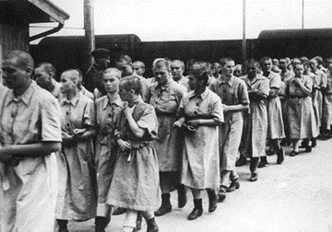
Shavings
Full body shavings
Typically done naked and in the presence of men
These were religious attacks
Numbers 6:5, Ezekiel 44:20, Proverbs 16:31
Their Judean idea of modesty
Paul, echoing Old Testament law, 1 Timothy 2:9
This did not come from a sexual desire
Mocking women in the shower
Figure 3: Female prisoners in Auschwitz, walking in lines with there heads shaven (Bald women walking in order, n.d., https://www.dailymail.co.uk/news/article-4976754/The-Auschwitz-BROTHEL-prisoners-rewarded.html)

Slide 5
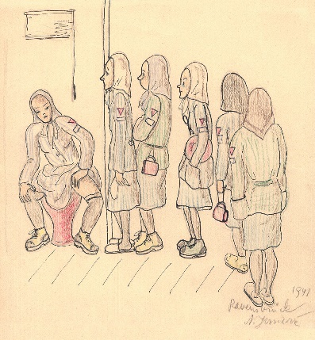
Menstruation & Pregnancy
Women would go through amenorrhea
The ceasing of a woman’s menstrual cycle
Would become a source of physical and emotional pain
If found, pregnant women were often killed immediately
Figure 4: A drawing of female prisoners waiting in line for the restroom while menstruating (drawing by Nina Jirsikova in 1941, n.d., https://www.historytoday.com/archive/feature/menstruation-and-holocaust)

Slide 6
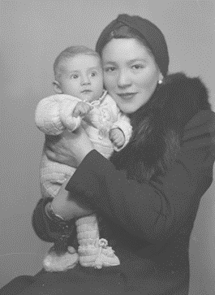
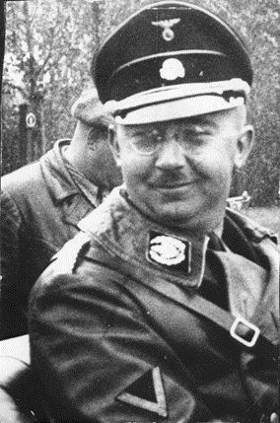
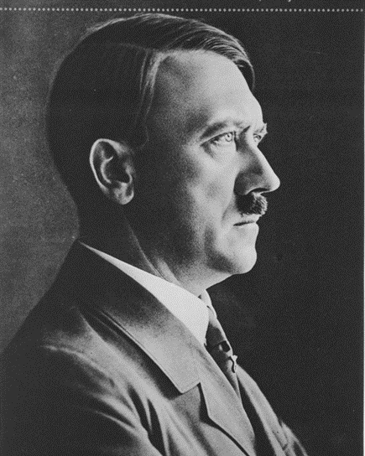
Abortion
Heinrich Himmler and Adolf Hitler would have contradicting views
Lebensborn, meaning “Fount of Life”
Auswahlfeiheit, meaning “Freedom of Choice”
Doctors inside of camps would attempt to help
Figure 5: Studio portrait of Icucha Kaufman and her baby. (A women and her baby, n.d., https://collections.ushmm.org/search/catalog/pa1172865)
Figure 6: Portrait of Reichsfuehrer-SS Heinrich Himmler. (Portrait of Himmler, n.d., https://collections.ushmm.org/search/catalog/pa1151323)
Figure 7: Portrait of Adolf Hitler. (Portrait of Adolf Hitler, n.d., https://collections.ushmm.org/search/catalog/pa1133280)

Slide 7
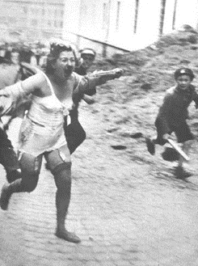
Beatings
A visual display of strength
Beatings happened for many reasons
Defending others
Bringing blankets to roll call in the winter
Before they would rape women
Unsensible beatings in the camp were “frequent”
Figure 8: Jewish woman being chased by men and youths armed with clubs, Medova Street in Lviv, (Women being beaten, n.d., https://thesocialvoiceproject.org/2019/01/06/public-history-matters-history-is-upon-us/)

Slide 8
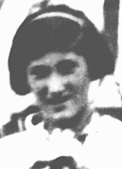
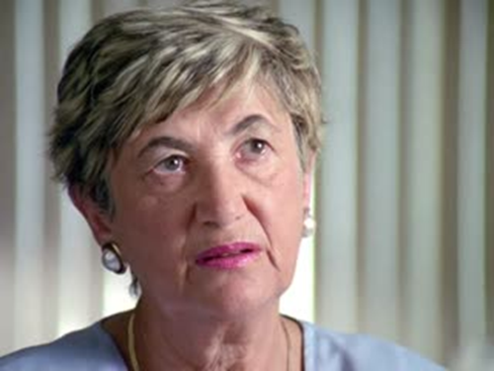
Rape
Women being raped would happen all through out Nazi occupied Europe
Cecilie Klein-Pollack
She wrote “Ballerina” about a nameless dancer in the camps
Rape culture was built into the foundation of the camps
Firgure 9: Portrait of young Cecilie Klein-Pollack, in black and white (Portrait of a young girl, n.d., https://encyclopedia.ushmm.org/content/en/id-card/cecilie-klein-pollack)
Figure 10: Portrait of Cecilie Klein-Pollack wearing a purple shirt with short blonde hair. (Photograph of Cecilie Klein-Pollack, n.d., https://testencyclopedia.ushmm.org/content/en/oral-history/cecilie-klein-pollack-describes-survival-with-her-sister-in-auschwitz#:~:text=Oral%20History%20Cecilie%20Klein-Pollack%20describes%20survival%20with%20her,In%201939%2C%20Hungary%20occupied%20Cecilie%27s%20area%20of%20Czechoslovakia.?msclkid=50e185b8a59611eca9a57f69509042a9

Slide 9
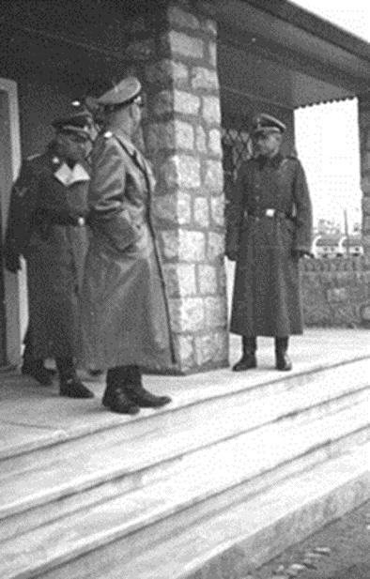
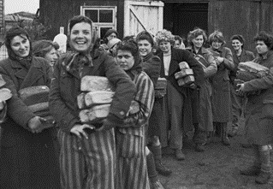
Brothels & Sex Trafficking
SS officers presented this as a volunteer position
Promised better accommodations and food
“It wasn’t sex, it was bread”
Used for a reward for fellow male prisoners as well as an attempt to “cure” gay men
Figure 12: Prisoners of the Bergen-Belsen concentration camp cheerfully collect bread rations upon their liberation by British forces in April 1945. (Women receiving bread rations after liberation, n.d., https://www.royalnavy.mod.uk/news-and-latest-activity/news/2018/january/29/180129-holocaust-memorial-day)
Figure 11: Himmler standing on the steps of the Mauthausen concentration camp brothel in October 1941 (Himmler at the barracks, n.d., https://www.dailymail.co.uk/news/article-4976754/The-Auschwitz-BROTHEL-prisoners-rewarded.html)

Slide 10
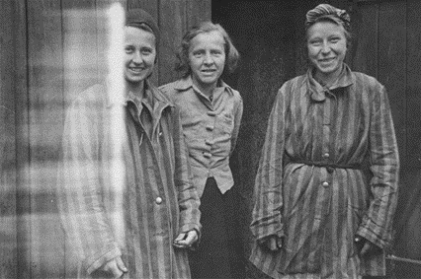
Victims After Liberation
The worry of their families knowing and going through Shanda
Extreme shame or pity
An attempt to keep Kiddushin
Holiness of marriage
Lost of status as a state recognized victim status
Could have been seen as a collaborator
The “Hierarchy of Suffering”
“Is molestation important?”
Figure 13: Liberated female prisoners in the womens' camp at Woebbelin. (Women smiling now that they have been liberated, n.d., https://collections.ushmm.org/search/catalog/pa1039411)

Slide 11
Conclusion
Sexual assault effected many women in many ways
Women would not speak out for many reasons
In 2007, the 1st conference was held to talk about the “sexual violation” women endured
In 2017, the #MeToo movement allowed for the conversation around sexual assault to be normalized
Even though sexual assault was not the intend outcome, it is still important

Slide 12
Sources
Primary
Bernstein, Tuvel. The Seamstress: A Memoir of Survival. New York, NY: Berkley Books, 1999.
Bradley, Sandra. Other. Oral History Interview with Cecilie Klein-Pollack. United States Holocaust Museum, February 26, 1992. https://collections.ushmm.org/search/catalog/irn505571.
Dumitru, Diana. Other. Oral History Interview with Ivan Guleaev. The United States Holocaust Memorial Museum, June 23, 2011. https://collections.ushmm.org/search/catalog/irn50621.
Eibuszyc, Suzanna. Memory Is Our Home: Loss and Remembering: Three Generations in Poland and Russia 1917-1960s Stuttgart: Ibidem-Verlag, 2015.
Frank, Otto H., ed. Anne Frank: The Diary of a Young Girl. New York, NY: Doubleay, 2001.
Goldman, Stanley A. Left to the Mercy of a Rude Stream: The Bargain That Broke Adolf Hitler and Saved My Mother. Lincoln: Potomac Books, 2018. Accessed December 2, 2021
Grădinămare, Illie. Other. Oral History Interview with Ilie Grădinămare. The United States Holocaust Memorial Museum, October 27, 2009. https://collections.ushmm.org/search/catalog/irn45653.
Greene, Joshua, and Shiva Kumar, eds. Witness: Voices from the Holocaust. New York, NY: Simon & Schuster, 2001.
Ingekamp-Swart, Margretha. “Oral History Interview with Margretha Ingekamp-Swart.” Other. United States Holocaust Memorial Museum, June 12, 2005. https://collections.ushmm.org/search/catalog/irn518706.
Klüger Ruth. Still Alive: A Holocaust Girlhood Remembered. New York, NY: Feminist Press at the City University of New York, 2012.
Migra, Andrzej. Other. Oral History Interview with Andrzej Migra. The United States Holocaust Memorial Museum, June 25, 2005. https://collections.ushmm.org/search/catalog/irn518686.
Sharp, Charles P. “Charles Phillip Sharp Collection, 1945-1993.” The United States Holocaust Memorial Museum. https://collections.ushmm.org/findingaids/2004.664.3_02_trs_en.pdf.
Secondary:
“About Sexual Violence and Exploitation.” Sexual Assault, Harassment, and Exploitation. Elon University. N.d. https://www.researchgate.net/publication/289150557_WOMEN_and_the_Holocaust_Analyzing_gender_difference.
Alliance for Human Research Protection. Last modified October 23, 2015. https://ahrp.org/august-1942-august-1943-heinous-medical-experiments-at- ravensbruck/.
Baer, Elizabeth Roberts, and Myrna Goldenberg, eds. Experience and Expression: Women, the Nazis, and the Holocaust. Detroit, MI: Wayne State University Press, 2003.
Browning, Christopher R. Remembering Survival: Inside a Nazi Slave-Labor Camp. New York, NY: W.W. Norton, 2011.
Clay, Catrine, and Michael Leapman. Master Race: The Lebensborn Experiment in Nazi Germany. London: Coronet, 1996.
Clementi, Federica K. Holocaust Mothers & Daughters Family, History, and Trauma Waltham, Massachusetts: Brandeis University Press, 2013.
Confino, Alon. A World without Jews: The Nazi Imagination from Persecution to Genocide. New Haven, CT: Yale University Press, 2015.
Deem, James M. The Prisoners of Breendonk: Personal Histories from a World War II Concentration Camp. Boston, MA: Mariner Books, 2020.
Fox, Tamar. “Rape and the Holocaust.” My Jewish Learning. Last modified June 6, 2011. https://www.myjewishlearning.com/2011/06/06/rape-and-the- holocaust/.
Goldenberg, Myrna., and Amy H. Shapiro. Different Horrors, Same Hell Gender and the Holocaust 1st ed. Seattle: University of Washington Press, 2013.
Gordon, Sarah Ann. Hitler, Germans and the "Jewish Question". Princeton, NJ: Princeton University Press, 1984.
Groth, Nicholas. Men Who Rape. Plenum, 1979.
Hedgepeth, Sonja M., and Rochelle G. Saidel. Sexual Violence Against Jewish Women During the Holocaust. Waltham, MA: Brandeis University Press, 2010.
Lawton, Clive A. The Story of the Holocaust. New York, NY: Franklin Watts, 1999.
Lowery, Zoe, and James R. Norton. The Nazi Regime and the Holocaust. New York, NY: The Rosen Publishing Group, Inc., 2017.
“Me Too: Sexual Harassment Awareness & Prevention.” MaryvilleOnline. Maryville University, September 16, 2020. Last modified September 16, 2020. https://online.maryville.edu/blog/understanding-the-me-too-movement-a-sexual-harassment-awareness guide/#:~:text=The%20Me%20Too%20movement%20is%20an%20effort%20to,experiences%20with%20sexual%20harassment%20in%20 the%20film%20industry.
“Part 4B: Women's Camps and Brothels.” The Concentration Camps. Kupferberg Holocaust Center, n.d. https://khc.qcc.cuny.edu/camps/part-4b-womens- camps/.
Pető, Andrea, et al., editors. Women and the Holocaust: New Perspectives and Challenges. Central European University Press, 2015,
Petrak, Jenny, and Barbara Hedge. The Trauma of Sexual Assault Treatment, Prevention, and Practice Chichester. West Sussex, England: Wiley, 2002.
Poliakov Léon, and Albert Joseph George. Harvest of Hate: The Nazi Program for the Destruction of the Jews of Europe. Syracuse: Syracuse University Press, 1954.

Slide 13
Sources
Ravitz, Jessica. “Silence Lifted: The Untold Stories of Rape during the Holocaust.” CNN. Cable News Network, June 24, 2011. Last modified June 24, 2011. http://www.cnn.com/2011/WORLD/europe/06/24/holocaust.rape/index.html.
Rittner, Carol, and John K. Roth, eds. Rape: Weapon of War and Genocide. St. Paul, MN: Paragon House Publishers, 2012.
Robinson, Rivka R. “The Ballerina of Auschwitz.” Aish.com. Aish, September 21, 2020. Last modified September 21, 2020. https://aish.com/the-ballerina-of-auschwitz/.
Shermer, Michael, and Alex Grobman. Denying History: Who Says the Holocaust Never Happened and Why Do They Say It? Berkeley, CA: University of California Press, 2009.
Sommer, Robert. “Forced Prostitution in National Socialist Concentration Camps—The Example of Auschwitz.” Forced Prostitution in Times of War and Peace (2007).
The Dachau Concentration Camp, 1933 to 1945: Text and Photo Documents from the Exhibition, with CD. Dachau: Comité International de Dachau, 2005.
“The Nazis and Abortion.” Cpforlife. https://www.cpforlife.org/the-nazis-and-abortion.
Thornhill, Randy., and Craig. Palmer. A Natural History of Rape Biological Bases of Sexual Coercion Cambridge, Mass: MIT Press, 2000.
United States Holocaust Memorial Museum. “Ravensbruck.” United States Holocaust Memorial Museum. United States Holocaust Memorial Museum, n.d. https://encyclopedia.ushmm.org/content/en/article/ravensbrueck.
W., Goda Norman J. The Holocaust: Europe, the World, and the Jews, 1918-1945. New York, NY: Routledge, 2013.
Waxman, Zoe. “Rape and Sexual Abuse in Hiding.” In Sexual Violence Against Jewish Women During the Holocaust, edited by Sonja M. Hedgepeth and Rochelle G. Saidel, 124- 133. Lebanon, NH: University Press of New England, 2010.
Williams, Jessie. “Sexual Violence Against Women during the Holocaust: Inside and Outside of Extermination Camps.” History in he Making 14 (2021).

