Slide 1
The Death and Rebirth(?) of the Biblical Languages
Seth K. Pryor

Slide 2
Problem 1: Retention Rates? What Retention?
David Miller, author of Biblical Language Pedagogy in Crisis, surveyed 32 professors and professionals in the field of New Testament Greek from 25 schools in 3 countries and found that 90% of students do not go on to use their biblical Greek.
My data: I interviewed 11 liberty alumni, all of whom had taken at least 3 classes of Greek, with most averaging 5, and one having taken a combined 9 classes. None of them had kept up with their biblical languages if they were still in a educational program.
I also interviewed 2 other students, one from T.E.D.S. and the other from Southeastern Seminary, with the same results.
Notes:
Quite a few had won Greek & Hebrew awards, and most were a G.S.A.

Slide 3
Problem 2: Following the Wrong Παιδαγωγός
“We’re not trying to speak the language our goal is simply to read a text”
This common refrain is completely understandable. I also have the same goal of reading the the Bible well, but this reveals a lack of awareness of the field of Second Language Acquisition which studies how we learn languages.
If not SLA then what is being used?

Slide 4
Problem 2: Following the Wrong Παιδαγωγός
Grammar Translation Methodology
Outdated since World War 2 when the US Military stopped using it.
SLA has shown that reading is a higher order skill which is dependent on listening and speaking abilities in the language (Cf. Brian Shultz on psycho-linguistics).
In order to read well, SLA has shown that you need to understand at least 95% of the vocabulary in a given text (Cf. Krashen).
Studies have also shown that traditional vocabulary cards while useful, are not the most effective method of learning vocabulary. (Cf. Paul Nation).
Notes:
Nation has discovered that to have a 50 % chance of recall of a vocabulary word you need to have seen that word at least 8 times
In some cases it takes between 5 to 16 exposures to a word to remember or recall it
Furthermore students are incentivsed to not continue in the biblical langauges because the classes are exam driven and not success driven. For instance, if a student gets a C or even a B they know they may not do well in the second class since everything builds on what they’ve failed to master, and it will only get harder. For me and many others, the serious driving motivation, (beyond just our love of Gods word) is that they are necessary to a Phd. I wouldn’t have taken if it wasn’t.

Slide 5
Problem 2: Following the Wrong Παιδαγωγός
Extensive Reading Foundation: We need to be reading around 5K words per week to develop fluency in a language
Foreign Service Institute Data:
The rate both modern Hebrew and Greek as a 3 out of 4 difficulty rating, requiring approximately 44 weeks (1100 class hours), which studying everyday would take 3 years (or maybe 6 university classes).
Common European Framework of Reference for Languages (a vocabulary Fluency assessment scale):
A1 = 500, A2 = 1,000, B1 = 2,000, B2 = 4,000, C1 = 8,000, C2 = 16,000
Notes:
Someone might reply, well if there are only 4000 words that occur less than 10 times in the New Testament, do they really need to learn them? Survey knowing down to 10x occurrence at 1000 words is good enough. That’s fine if you only wanted to know the NT, but not if you want to read the Septuagint (which has 15,000 unique words), or the apostolic fathers, or Plato or Aristotle. Which I do, and I know that you need to really be reading lots of literature to understand the language well, at least according to SLA which has no dog in the fight in interpreting the New Testament.
The FSI lists languages according to difficulty for native english speakers and the time it takes to become “proficient” in them.
There are 6 levels of fluency, B2 is being considered generally “fluent” in everyday conversations, C2 is native level.
Paul nation has reported that it takes about 2K word families to be conversationally fluent and about 8-9K word families to read a newspaper.
If this sounds crazy, Both the book of Luke and Acts each have over a 1000 words which only occur 1-9 times, Luke itself has only a little over 2000 unique words, mark has 551 words which occur 1-9x out of about 1400
Pleasure reading and reading rate gains
David Beglar Temple University, Japan Campus Japan
Alan Hunt Kansai University Japan
The findings indicated that the participants who made the greatest fluency gains read an average of 208,607 standard words and primarily read simplified texts up to the 1,600-headword level. This study also provides an empirically supported criterion for the minimum amount learners should read annually (i.e., 200,000 standard words), p
There is only 138,000 words in the entire GNT
VOCAB DECAY RATE:

Slide 6
Problem 2: How Do Traditional Biblical Language Classes Compare With SLA Data?
Seminaries generally only require memorizing 320 of the most common words, which covers 80% of words in the NT.
Students who use the Basics of Biblical Greek Workbook will only “read” (i.e. translate) about 6,000 words over 2 classes (their first year). This is the most widely used textbook but others are very comparable.
Our undergraduate program memorizes down to 15x occurrence or 720 words over 5 classes (2.5 years). If they can get to 10x occurrences then they know about 1000 words.
Students often do not get into actual literature (i.e. a book of the Greek NT) before their fourth class.
Notes:
Almost all students would not be able to listen to the Greek NT being read out loud, and some classes barley read their target language out loud in class.
Students often do not get into actually literature (i.e. a book of the Greek NT) before their fourth class, often bypassing the easiest literature of the NT in favor of more difficult books (Which goes against the principle of Comprehensible Input).
Seminaries generally only require memorizing 320 of the most common words (which covers 80% of words in the NT- but only the dictionary form).
Most of the words you might memorize or paradimgs you memorise, after your tested, generally you are not tested again and so the brain is likely to put it into the short term memory.
It is now all to obvious why so many attempts at teaching lay persons in the church greek or Hebrew fail
Biblical studies students can only practice their biblical langauges by decoding everything one word at a time, They cant read anything fluently. But it worse than than, the only way they can practice their language is by physically sitting down and translating. They cant listen to it in the car, they cant have conversations. They are severely limited in the ways they can practice their languages. Who has the attention span in the 21st century to practice math in their free time?
Holding up the guy who took 2 years to translate through acts,
By comparison, I read and listen to a chapter of John 2x while I run on the treadmill.

Slide 7
Problem 2: How Do Traditional Biblical Language Classes Compare With SLA Data?
Photo (screenshot) by Seth Pryor
Photo by Seth Pryor
Notes:
Photos by Seth Pryor
Second photo referes to M.L. Kohen’s video of 1st John at https://youtu.be/KhWmiX-l9FI
Almost all students would not be able to listen to the Greek NT being read out loud, and some classes barley read their target language out loud in class.
Students often do not get into actually literature (i.e. a book of the Greek NT) before their fourth class, often bypassing the easiest literature of the NT in favor of more difficult books (Which goes against the principle of Comprehensible Input).
Seminaries generally only require memorizing 320 of the most common words (which covers 80% of words in the NT- but only the dictionary form).
It is now all to obvious why so many attempts at teaching lay persons in the church greek or Hebrew fail
Biblical studies students can only practice their biblical langauges by decoding everything one word at a time, They cant read anything fluently. But it worse than than, the only way they can practice their language is by physically sitting down and translating. They cant listen to it in the car, they cant have conversations. They are severely limited in the ways they can practice their languages. Who has the attention span in the 21st century to practice math in their free time?
Holding up the guy who took 2 years to translate through acts,
By comparison, I read and listen to a chapter of John 2x while I run on the treadmill.
https://youtu.be/KhWmiX-l9FI

Slide 8
Problem 2: Byproducts
Elitist
It seems that the only way to ensure continued use of the biblical languages is not only to get a Ph.D. in either the Old Testament or New, but also to teach the languages themselves.
Exclusionary
The methodology and structure of the class essentially makes it very difficult for students with learning disabilities to learn these languages.
Notes:
The people who teach these langauges, got a Ph.D. In them, and do research with them day in and day out can not be the standard by which we judge whether a methodology works, the classic expression “if it ain’t broke don’t fix it” doesn’t work here because this path is only for the very lucky few.
As it is now, it is those students who are naturally gifted who do well in these classes. Specifically those who do well in math and logic are also those who will do very well (and most of us know how well we did in math, logic, and philosophy). In fact, this method, actually uses a different part of the brain than the side used for learning a language. So we are even working against our own anatomy and the way God wired us to learn languages.
For example, I spent my summer learning the first half of the semesters material and I still didn’t come out on top as the highest student (and I was only taking two classes). I have two masters, one in philosophy and an entire Mdiv, and that class still gave me panic attacks (and I wasn’t alone either). One students who had the lowest score described it as hell- and the person with the highest had serious anxiety from the class. I don’t like admitting these things, but this is the truth. These are the things students will tell each other but will not leave on the end of year survey.

Slide 9
Problem 3: The Future of Enrollment Rates Are Apocalyptic
The Modern Language Association documented a 42% drop in Ancient Greek enrollment from 2006 to 2016.
At Northpark Seminary, Dr. Max lee reported only having 4 students in Greek 101, while I believe my Greek 101 class here had only 7.
Most are already familiar with the biblical languages cuts to the M.Div. at seminaries.
Notes:
Of course there are numerous factors for this, but this doesn’t change the enrollments and its outcomes

Slide 10
Problem 3: Could We Be Next?
In 2018 the University of Montana: Missoula, which has the only classics department in the state (along with Greek and Latin), announced it would dissolve the department.
In 2021 Howard University, the only HBU with a classics department announced it would dissolve their department
In 2021 Princeton made headlines by removing Latin and Greek as requirements for their classics degree.
Notes:
These are only a sample of some of the largest schools shuttering access to these languages.
In all of these cases, enrollment was the biggest factor.
This will have serious consequences for the future.

Slide 11
What Would the Rebirth of the Biblical Languages Look Like?
Maybe.. Podcasts in the biblical languages, Music in the biblical languages, Spoken Conferences in Greek? Books in Latin? News in Hebrew? Playing video games in them?
Notes:
https://calvinchimes.org/2015/10/16/spoken-latin-conference-proves-latin-is-not-dead/
https://www.wsj.com/articles/the-people-who-are-bringing-latin-to-life-1466786605
all of those things are available..

Slide 12
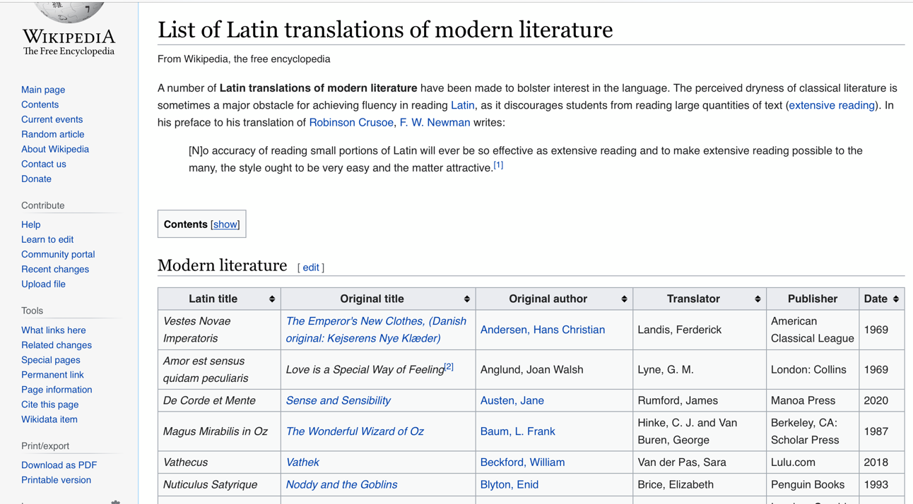
At Least Over 80 Works of Literature Have Been Translated Into Latin..
Photo by Alexander Lenard
Photo (screenshot) by Seth Pryor
Notes:
https://www.amazon.com/Winnie-Latin-Translation-Milnes-Winnie/dp/4871873943/ref=asc_df_4871873943/?tag=hyprod-20&linkCode=df0&hvadid=312041961788&hvpos=&hvnetw=g&hvrand=13628230279485330761&hvpone=&hvptwo=&hvqmt=&hvdev=c&hvdvcmdl=&hvlocint=&hvlocphy=9008885&hvtargid=pla-571522310095&psc=1
https://en.wikipedia.org/wiki/List_of_Latin_translations_of_modern_literature
And this in no way accounts for all of the novels and

Slide 13
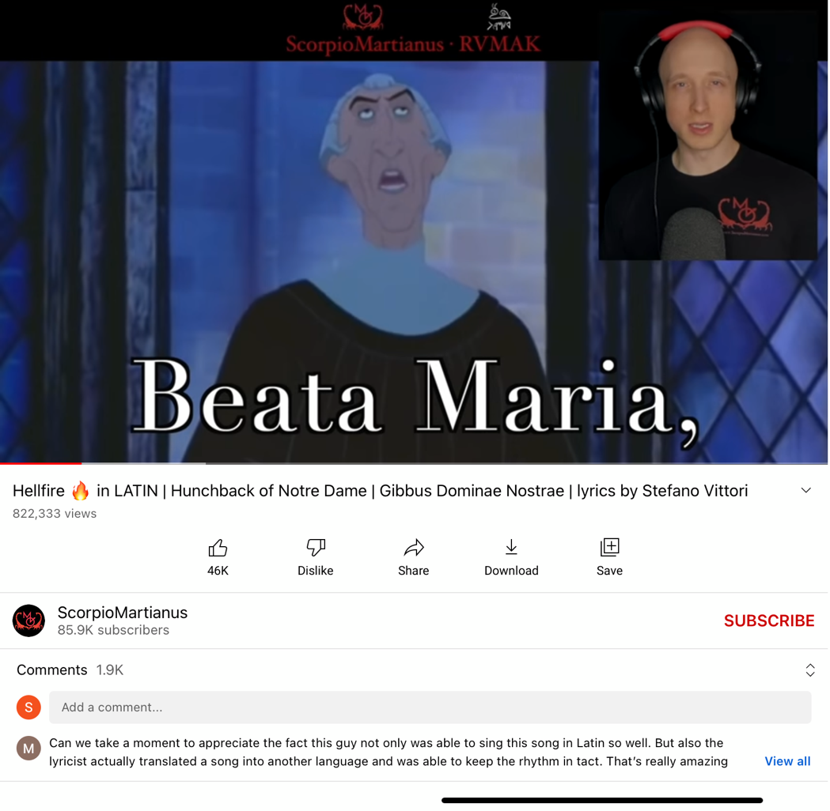
Music in Latin: Luke Ranieri’s Rendition of Disney’s Hellfire has received more than 820K views
Photo (screenshot) by Seth Pryor
Notes:
The image is of Luke Ranieri’s youtube video which can be accessed here: https://youtu.be/H0c1QNWH1H8
His “we don’t talk about Bruno” cover has 22k views

Slide 14
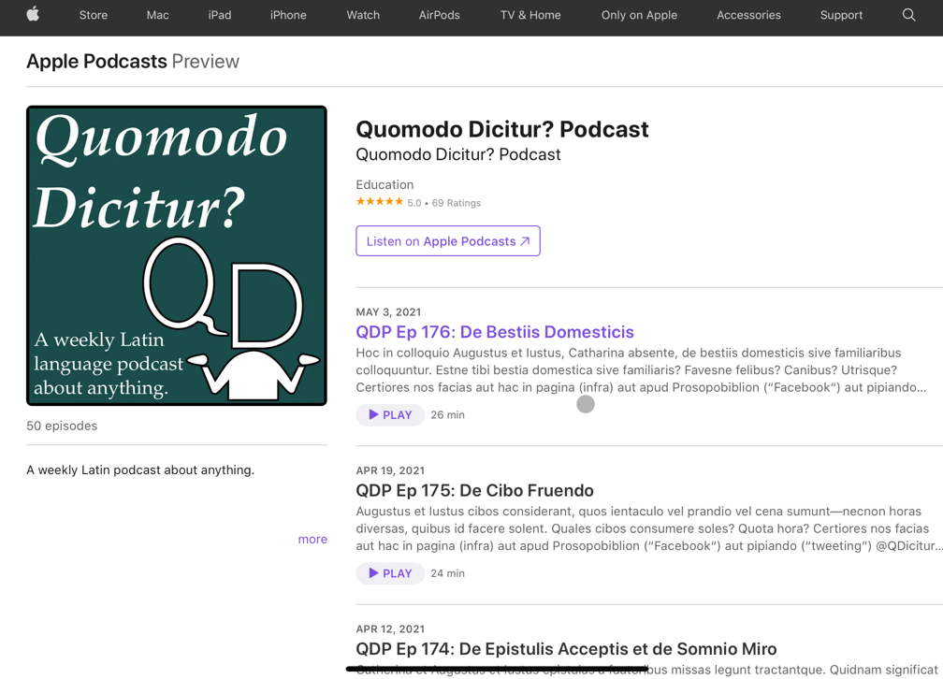
Podcasts in Latin…
Philologia Perennis
Sermones Raedarii
Quomodo Dicitur
Latinitium
In Foro Romano
Nuntii Latini Vasintonienses
Photo by Seth Pryor

Slide 15
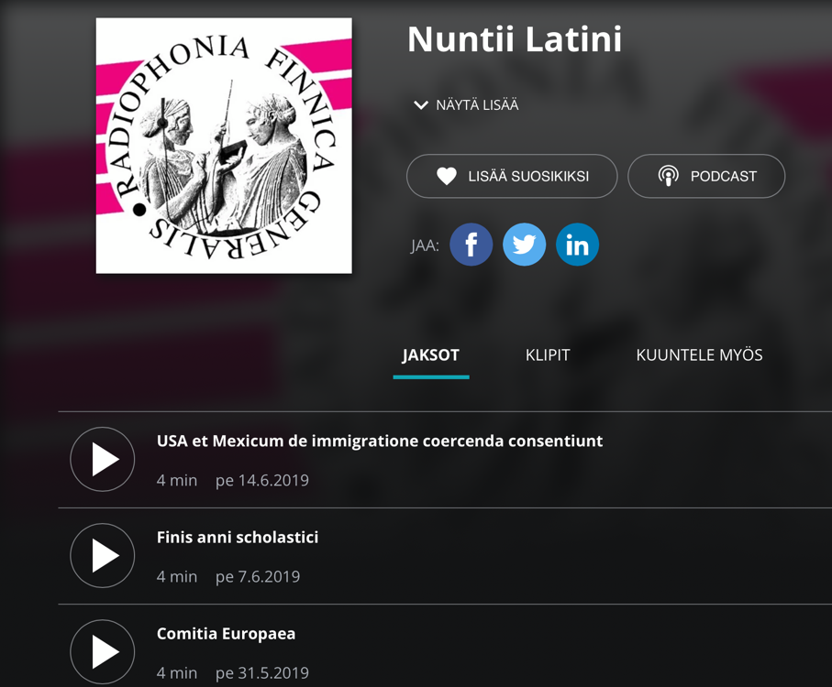
The News in Latin:
Nuntii Latini, hosted by a Finnish broadcasting network, has been reporting on global news events in Latin since 1989.
Photo By Seth Pryor

Slide 16
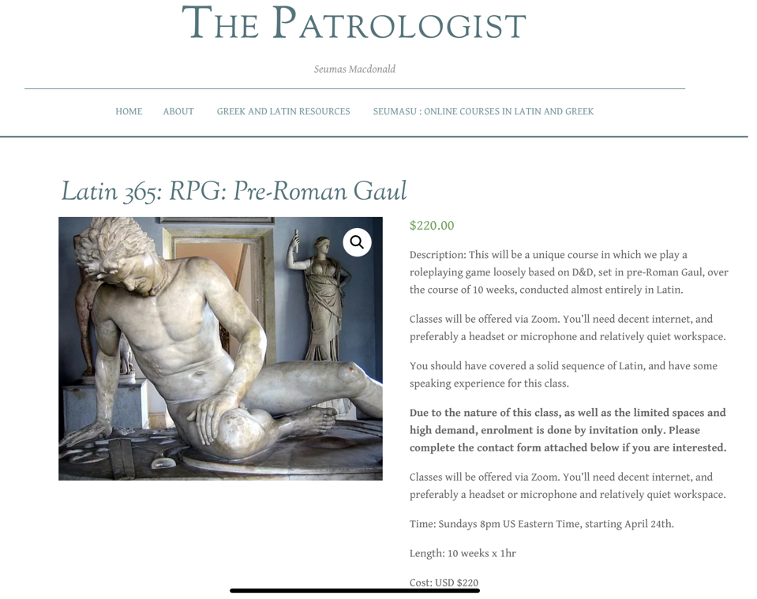
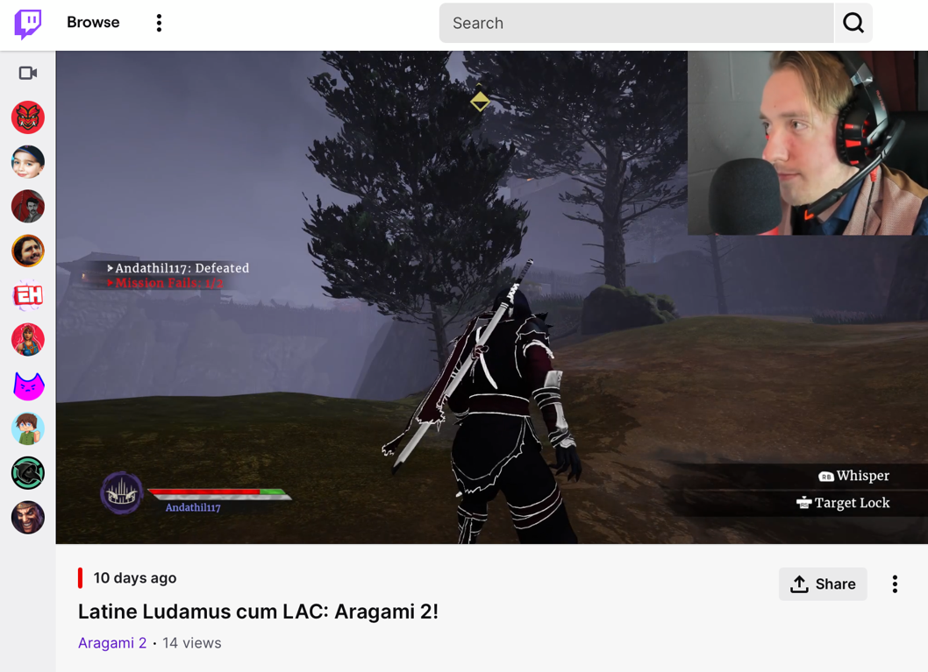
Video Games in Latin..
Photo by Seth Pryor
Photo by Seth Pryor
Notes:
The source of the first photo can be found at: https://thepatrologist.com/shop/
The source of the second photo can be found at: https://www.youtube.com/watch?v=ZgHYzGCrr6s

Slide 17
Conferences in Latin:
In 2007, the Academy Vivarium Novum in Naples had over 300 Latin speakers present at its conference
In 2013, Calvin U’s Living Latin conference had 90 participants
In 2014, The Conventiculum Lexintonense had 85 participants
In 2016, Fordham’s Living Latin in NYC Conference brought in more than 150 participants.
In 2019, The Paideia Institute had around 250 participants in their Living Latin event.
Photo by Duolingo
Notes:
https://foundinantiquity.com/2022/01/05/the-internet-brings-spoken-latin-back-into-classrooms/
Photo can be found at https://medium.com/in-medias-res/bite-sized-latin-for-your-morning-commute-246cfa57916f
Sidenote: There are 1.4 M active learners in the Latin duolingo course, compare that to 1.22M learning Modern Greek or 940K for Modern Hebrew
* Conventiculum Bostoniense
* Conventiculum Buffaloniense
* Conventiculum Dickinsoniense
* Conventicula Aestiva
* Conventiculum Vasintoniense
* Rusticatio
* Vox Latina
* Accademia Vivarium Novum
* Septimannae Latinae Europaeae
https://www.promotelatin.org/speaking-latin

Slide 18
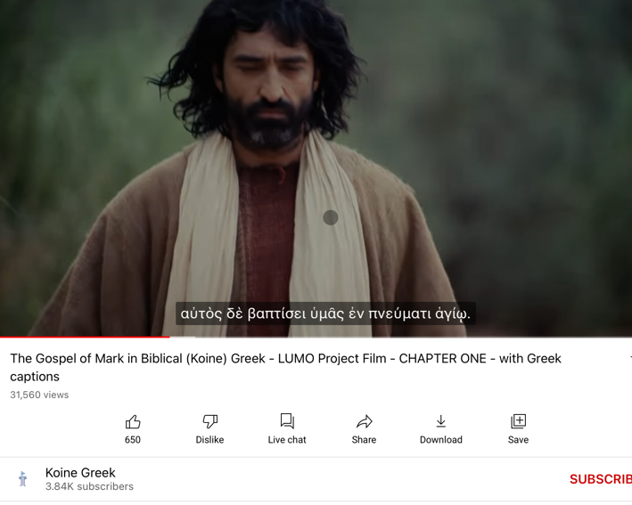
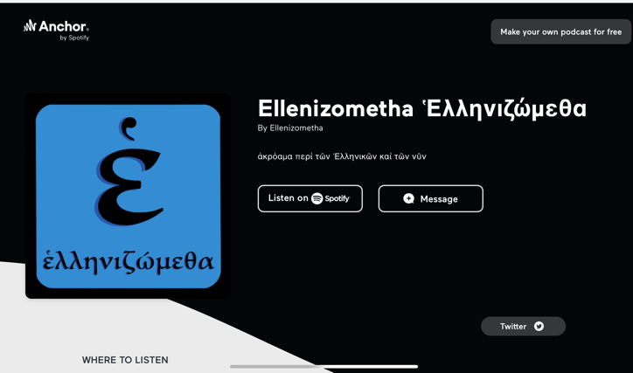
All Of This Exists In Ancient Greek As Well (Just To A Lesser Extent)
Photo by Seth Pryor
Photo by Seth Pryor
Photo by Andrew Wilson
Notes:
The source of the first photo can be found at: https://youtube.com/playlist?list=PLea-iHHZAgbWWvaBg7pMjx4lA7wV2HvIW
The source of the Second photo can be found at: https://www.amazon.com/Harry-Potter-Philosophers-Stone-Ancient/dp/158234826X

Slide 19
Proposals?
Normalize the biblical languages as languages
Show how they compare to other languages that regular people learn everyday.
Provide a roadmap to “fluency,” based on vocabulary and time spent in the language (Cf. the Foreign Service Institute and the CEFR scale).
Balance translation exercises with reading comprehensible material at the reader’s level. Aaim to get 5000K words a week, not year. (Cf. Dr. Percer)
Incorporate listening exercises from the beginning (at the minimum, add speaking if realistic)
Lastly, make it fun. (Cf. Liberty’s Arabic classes)
Notes:
Students perspective
Anecdotal stories
(Joe’s wife- Makalya)
Other students
Personal Experience
Panic Attacks, anxiety, increased blood pressure) and I was not alone
This is ”extensive reading”
https://danielstreett.com/2012/12/13/setting-the-bar-at-fluency-pt-2-sbl-2012-report/

Slide 20
Practical Application
Most “readers editions” of the Greek NT contain only words occurring 25x or less, which presumably will not be of much help for 2 years.
These difficulties are at once overcome from the first semester by using an Interlinear.
This is best implemented by reading each section at least around 10x
This allows reading large swaths of original material to easily reach 5K words a week, in context (which is much more meaningful), in the natural syntax (which enables the student to learn Greek as Greek), and allowing each vocabulary word to be seen 10x, boosting vocabulary retention.
This also allows an easy path to restart biblical languages for those who stopped and forgot most of what they learned.
Notes:
This proposal is based on my own research of using interlinears specifically for the purpose of vocabulary learning only. Many may not agree with this proposal. However it does conform to basic principles of SLA.

Slide 21
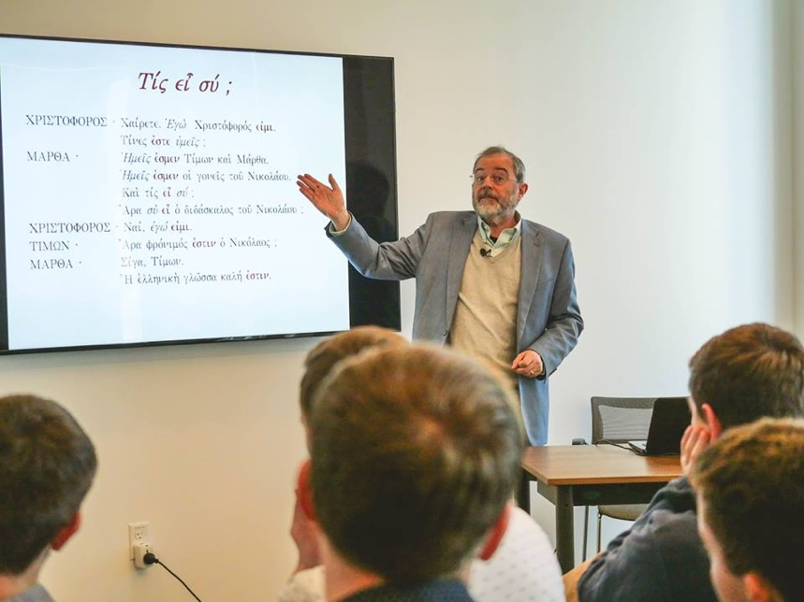
Inspiration
The Polis Institute, in Jerusalem, teaches all their ancient languages communicatively.
Briercrest Seminary, in Canada, recently transitioned to a natural method where students take 5 classes worth of Ancient Greek in their first semester with staggering results.
Even professors at Oxford are being won over, and their Oxford Ancient Language Society is making great strides in active language pedagogy
Photo by the Polis Institute
Notes:
The source of the first photo can be found at: https://www.polisjerusalem.org/about/https
https://medium.com/in-medias-res/greek-and-latin-are-finding-a-voice-at-oxford-8c96adfaed87
Having talked with students at the Polis institute I know they will memorize far more paradigms than the average greek students

Slide 22
Bibliography
“2016 Enrollments Final Report - Modern Language Association.” Accessed March 23, 2022. https://www.mla.org/content/download/110154/2406932/2016-Enrollments-Final-Report.pdf.
“The CEFR Levels.” Common European Framework of Reference for Languages (CEFR). Accessed March 23, 2022. https://www.coe.int/en/web/common-european-framework-reference-languages/level-descriptions.
“Foreign Language Training - United States Department of State.” U.S. Department of State. U.S. Department of State, March 4, 2022. https://www.state.gov/foreign-language-training/.
Miller, David R., and David Alan Black. Greek Pedagogy in Crisis: A Pedagogical Analysis and Assessment of New Testament Greek in Twenty-First-Century Theological Education. Eugene, OR: Wipf & Stock, 2019.
Mounce, William D. Basics of Biblical Greek: Workbook. Grand Rapids, MI: Zondervan Pub. House, 2019.
Nation, Paul, and P Waring. “Second Language Reading and Incidental Vocabulary Learning.” Angels on the English Speaking World 4 (2004): 97–110. https://doi.org/10.26686/wgtn.12560288.
Notes:
https://www.polisjerusalem.org/about/https
https://medium.com/in-medias-res/greek-and-latin-are-finding-a-voice-at-oxford-8c96adfaed87
Having talked with students at the Polis institute I know they will memorize far more paradigms than the average greek students

