Slide 1
Dynamic and Diverse
The Church’s Perspective of Violence and the Constantinian Shift

Slide 2
Research Question:
What is the correct understanding of the evolution of the early church’s understanding of violence and the role of Constantine in the supposed shift?

Slide 3
The Standard Interpretation
Christian Nonviolence
Just War Theory
Identification of the Cross and the Sword
Tertullian
Origen
Ambrose
Augustine
Urban II and Crusades
Christian persecutions

Slide 4
Differing Interpretations
Just War Theorists
Pacifists
Early Church pacifism was a sectarian reality rather than a moral choice
Pacifism was descriptive, not prescriptive
Motive for abstaining from military service was idolatry, not necessarily violence
Early church’s position on violence was underdeveloped, like many other doctrines
Early church pacifism was a moral rejection of both personal and state violence
Early church pacifism was normative
Motive for abstention from military service was an aversion to violence
Early church’s position on violence was the correct view

Slide 5
Methods
Examine pre-Constantinian church writers and other church sources (such as orders)
Examine contextual evidence regarding the early church’s relationship with violence
Compare and contrast scholarly interpretations of the church’s understanding of violence and the Constantinian shift

Slide 6
Standard evidence
No evidence of Christians serving in the military before 170 AD
In the rare occasion military service is addressed, it is opposed (Tertullian, Origen)
Pagan accusations of Christian’s failure to fulfill citizenship duties as soldiers
Church orders (Hippolytus)
“Ecostystem of peace” (Clement, Didascalia Apostolorum, Justin, and Cyprian)
Figure 1: Image of Tertullian. (From New York Public Library, Tertullian—Wonders of the Ancient World., n.d., https://digitalcollections.nypl.org/) CCO 1.0 Dedication

Slide 7
A Complex Environment
Legio XII Fulminate: “The Thundering Legion” in AD 173
The church is not as uniform in condemning violence as some scholars claim. Christian writers acknowledge presence of Christians in the military, and pacifists such as Tertullian and Origen not representative of the wider church
Soldier-martyrs Laurentius and Egnatius
Emperor Galerius’s expulsion of Christians from the legions 303-304 AD
Gravestones of Christian soldiers
Reinterpretation of the Constantinian Shift
Figure 2: Image of the “Thundering Legion” on the Column of Marcus Aurelius” (Photograph by Cristiano64, Miracolo della Pioggia, July 14, 200,9 https://en.wikipedia.org/wiki/Legio_XII_Fulminata#/media/File:Miracolo_della_Pioggia.JPG

Slide 8
A Nuanced Interpretation: Diversity
Although the vast majority of the early church abstained from military service, the picture is not as clear or as uniform as has been suggested.
The early church experienced great diversity. Although most of the literature lends itself to a pacifist interpretation of the early church, obviously there were Christians who served in the legions in the first three centuries.
Different understandings should be understood as occurring in different geographic and temporal contexts
There was some sort of shift that occurred, because the environment was quite different after Constantine

Slide 9
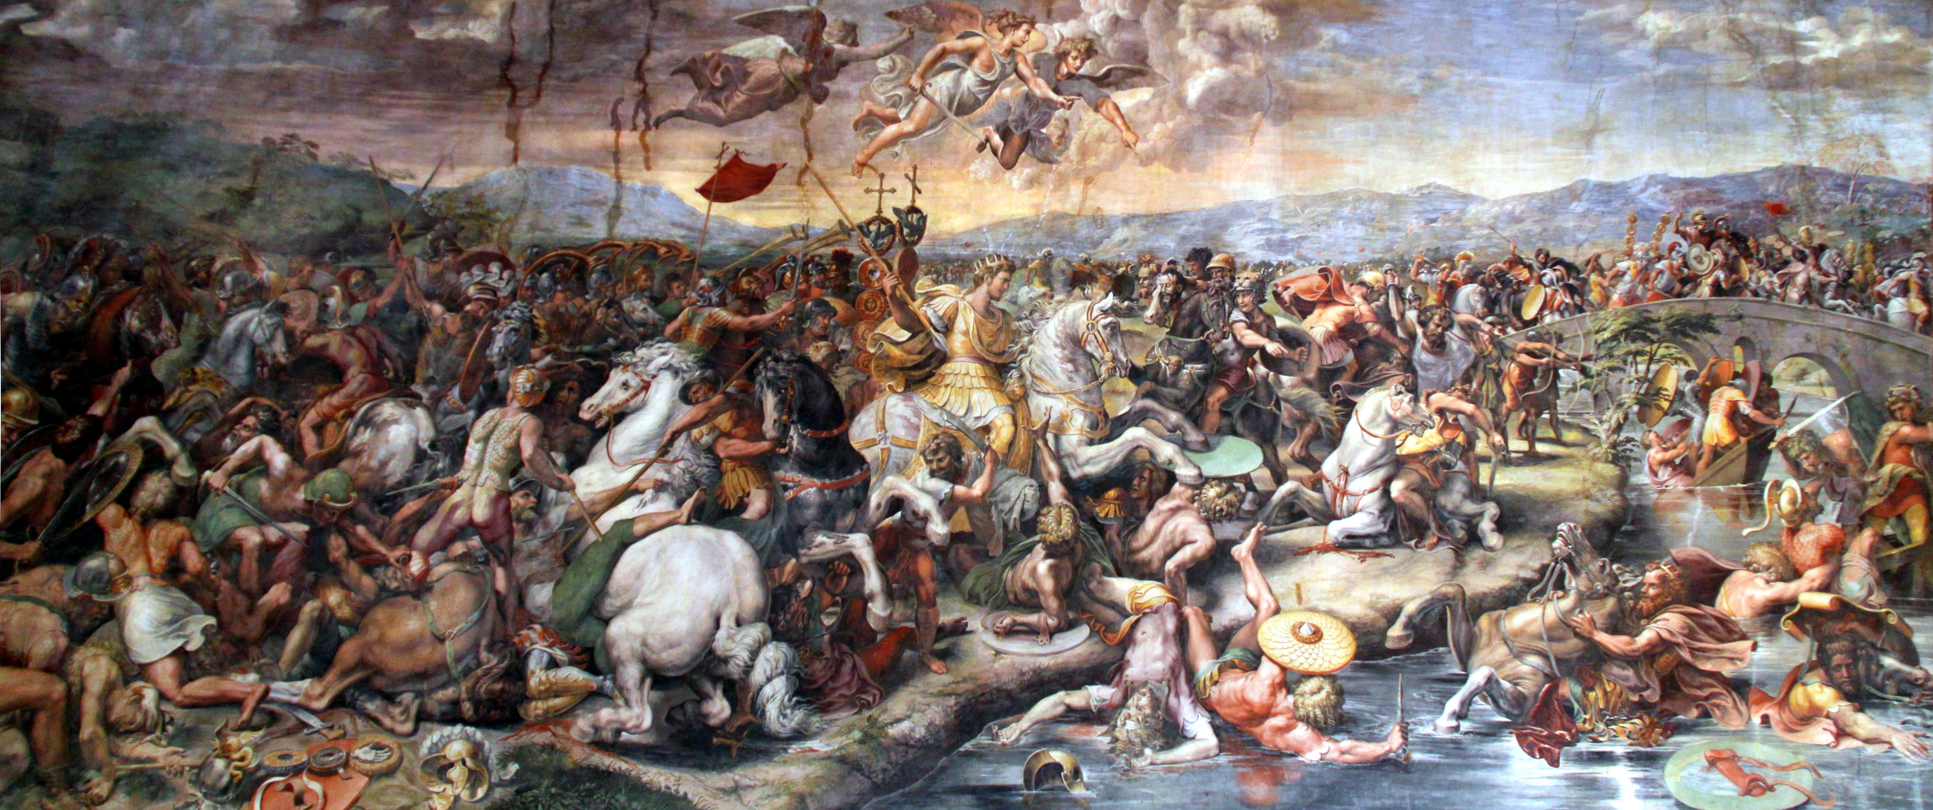
Constantine and the Constantinian Shift
Figure 3: The Battle of Milvian Bridge, where Constantine encountered Christianity (Giulo Romano, The Battle of Milvian Bridge,1520-1524, https://commons.wikimedia.org/wiki/File:Battle_of_the_Milvian_Bridge_by_Giulio_Romano,_1520-24.jpg).

Slide 10
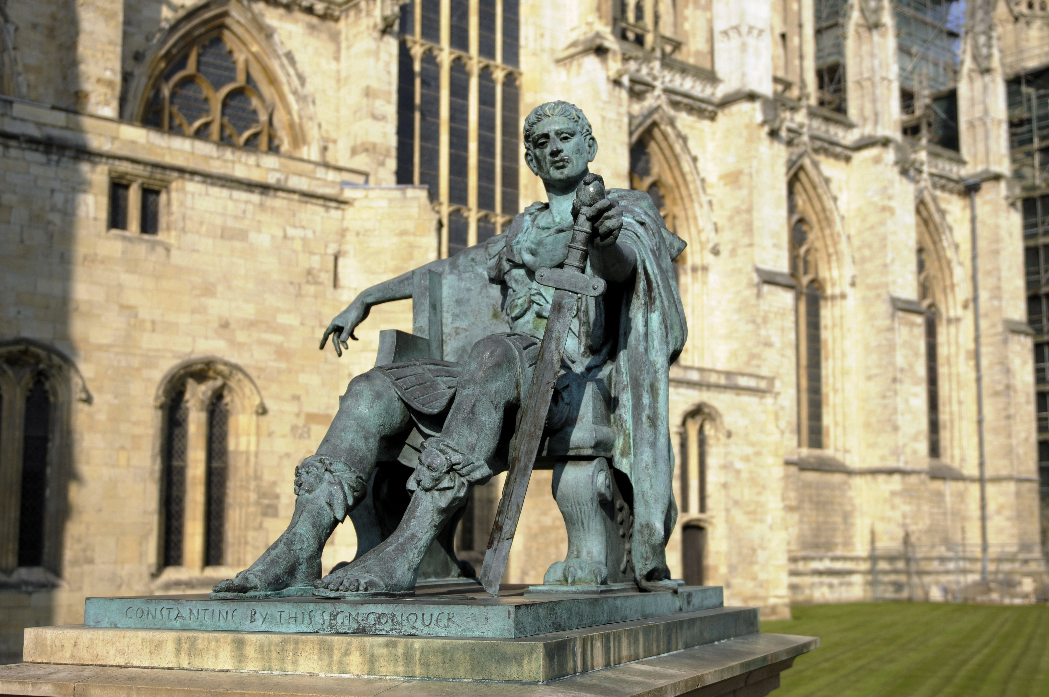
The Role of Constantine
Milvian Bridge (312)and Edict of Milan (313)
Constantine legitimized Christianity, built massive churches, encouraged cults of martyrdom, removed obligatory pagan worship in the legions, and began the identification of the Church with the empire.
Debate over whether he was a Christian
The Constantinian Shift was a wave that had been gathering power for over two centuries, cresting only with Constantine
Figure 4: Statue of Constantine the Great, with quote “By this sign, conquer.” (Son of Groucho, Constantine 1, September 26, 2008, https://www.flickr.com/photos/sonofgroucho/2899327903).

Slide 11
Augustine and Just War Theory
City of God and Just War Theory
Combined threads of Just War tradition (Socrates and Cicero), Neo-platonic thought, and Biblical evidence
Emphasis on proper authority: Kingdom of Heaven and Kingdom of God
Made possible in a societal context in which the state was not viewed as an evil oppressor to the greater Church, a context that was introduced by Constantine and solidified by later emperors.
Augustine not as optimistic as other writers like Eusibius or Paul of Orosius, who explicitly identified the Church with the Empire
Figure 5: Saint Augustine, a landmark figure in Christian thought and theology (Antoine Dieu, Saint Augustin of Hippo. Line Engraving by M. Dossier after A. Dieu, 1734-1750, https://wellcomecollection.org/works/m99qsyfb)

Slide 12
Conclusion
The Church’s understanding and relationship with violence has not been a static, historical reality.
However, although a shift occurred towards greater Christian participation in the military, the landscape of the early Church was much more diverse than often suggested.
This shift, although in some sense a natural progression, was exacerbated by the influence of Constantine and the eventual partnership of the Church and the state in post-Constantinian Europe. It was a smaller part of the Church’s growing influence in all areas of society.

Slide 13
Primary
Athenagoras. “A Plea for the Christians.” Translated by B.P. Pratten. From Ante-Nicene Fathers, Vol. 2. https://www.newadvent.org/fathers/0205.htm
Clement of Alexandria. Paedagogus. Translated by William Wilson. From Ante-Nicene Fathers, Vol. 2. https://www.newadvent.org/fathers/0209.htm.
Cyprian. “An Address to Demetrianus.” Translated by Robert Ernest Wallis. From Ante-Nicene Fathers, Vol. 5. https://www.newadvent.org/fathers/050705.htm
Dionysius of Alexandra. “Epistles and Fragments of Epistles, of Dionysius.” Translated by S.D.F. Salmond. From Ante-Nicene Fathers, Vol. 6. https://www.newadvent.org/fathers/0632.htm/
Justin Martyr. “The First Apology.” Translated by Marcus Dods and George Reith. From Ante-Nicene Fathers, Vol. 1. https://www.newadvent.org/fathers/0126.htm
Origen. Contra Celsus. Translated by Frederick Crombie. (1885) from Ante-Nicene Fathers. Volume 4. https://www.newadvent.org/fathers/0416.htm
Paul F. Bradshaw, ed., The Canons of Hippolytus, trans. Carol Bebawi (Nottingham: Grove, 1987)
Tertullian. “Apologeticum.” Translated by S. Thelwall. (1869). Christian Classics Electronic Library. https://www.tertullian.org/anf/anf03/anf03-05.htm
--. “The Chaplet, or De Corona.” Translated by S. Thelwall. (1869). Christian Classics Electronic Library. https://www.tertullian.org/anf/anf03/anf03-10.htm
--. “De Cultu Feminarum.” Translated by S. Thelwall. (1869). Christian Classics Electronic Library. https://www.tertullian.org/works/de_cultu_feminarum.htm
Tertullian. “On Idolatry.” Translated by S. Thelwall (1869). Christian Classics Electronic Library, https://www.tertullian.org/anf/anf03/anf03-07.htm#P815_331177.

Slide 14
Secondary
Arnold, Luke. “From Pacifism to Just War Theory: The Development of Christian Attitudes to War and Military Service from the Late First Century to the Early Fifth Century.” Masters thesis., George Fox University, 2011.
Bainton, Richard. “The Early Church and War.” Harvard Theological Review 39, no 3 (July 1946): 189-212.
Bralewski, Slawomir “Was Constantine the Great Aware of the Constantinian Shift?” Studia Ceranea 9 (2019): 157-169.
Charles, J. Daryl. “Pacifists, Patriots, or Both? Second Thoughts on Pre-Constantinian Early-Christian Attitudes Toward Soldiering and War.” Logos: A Journal of Catholic Thought and Culture 13, no. 2 (Spring 2010): 17-55.
Heid, Stefan. “The Romanness of Roman Christianity.” In A Companion to Roman Religion. Edited by Jörg Rüpke, 406-426. Malden, MA: Blackwell Publishing, 2007.
Kreider, Alan. “Converted but not Baptized: Peter Leithart’s Constantine Project.” Mennonite Quarterly Review 85, no. 4 (2011): 1-173.
Ployd, Adam. “Augustine, Martyrdom, and the Exemplary Rhetoric of History.” Journal of Early Christian Studies 28, no. 3 (Fall 2020): 423-441.
Reimer, James. “‘Constantine: From Religious Pluralism to Christian Hegemony.” In The Future of Religion: Toward a Reconciled Society, edited by Michael R. Ott, 71-90. Leiden: Koninklijke Brill NV, 2007.
Windass, Stanley. “Saint Augustine and the Just War.” Blackfriars 43, no. 509 (Nov. 1962): 460-468.
Yoder, John Howard. “War as a Moral Problem in the Early Church.” In The Pacifist Impulse in Historical Perspectives, edited by Harvey L. Dyck, 90-110. Toronto: University of Toronto Press, 1996.

