Slide 1
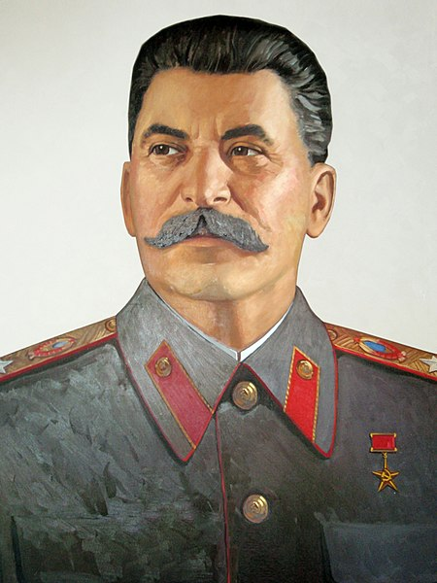
Stalin’s Last Grand Scheme: The Korean War and Joseph Stalin’s Strategy to Neutralize Germany
By Ron Shaw
Research Week 2022
Figure 1 “Portrait of Joseph Stalin at the Stalin Museum in Batumi." by Ephraim Stilliberg licensed under CC BY-SA 3.0
Notes:
Intro
Red Liberty background was perfect for a discussion of Cold War Communism!

Slide 2
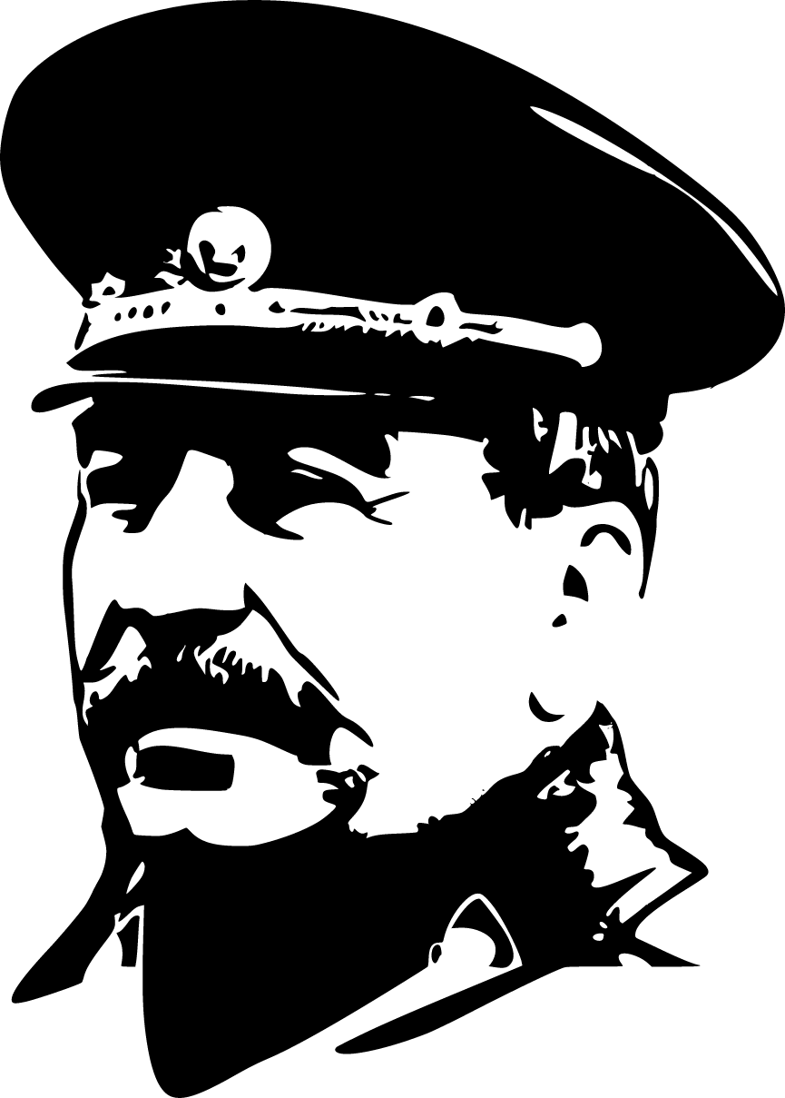
Introduction
The culmination of the Korean War: The 1952 Stalin Note
Germany, Germany, Germany.
Stalin’s last grand scheme
“Hitlers come and go. The German people and the German state remain." ¹ - Joseph Stalin
“All of Germany must be ours. That is, Soviet Communism." ²
- Joseph Stalin
Figure 2 “Joseph Stalin Image” by Public Domain Vectors licensed under CC0 1.0 Universal
Notes:
-The premise of this research is that the culmination of the Korean War was not at Inchon, the Chinese entry into the war, or the Armistice. It came in March 5, 1952 with the First Stalin Note, a proposal for a united Germany from the same mind that instigated and sustained the Korean War.
-It was part of the last grand scheme of Stalin’s long political life, growing out of the failure of his Soviet response to the Marshall Plan and the Berlin blockade.
-Germany was the focal point of Stalin’s famed paranoia (just look at the quotes in the late 1940s, his called the Berlin Blockade his “defensive action”). Germany ends up playing a large but unacknowledged role in the Korean War.
Where did Stalin’s idea start? The victory of communism in China in 1949 gave him a new, unexpected opportunity…what John Lewis Gaddis called a “second front in Asia” in the Cold War.
Most Cold War historians (Gaddis included) view the Korean War as a sideshow. At best, a distraction from Europe not linked to any larger plan.
However, drawing on the primary sources (declassified telegrams and papers) at The Wilson Center Digital Archive of the Korean War, I take a unique look at how Stalin planned to utilize a “second front in Asia,” using it for leverage against the West in Europe in an attempt to soothe his German paranoia.

Slide 3
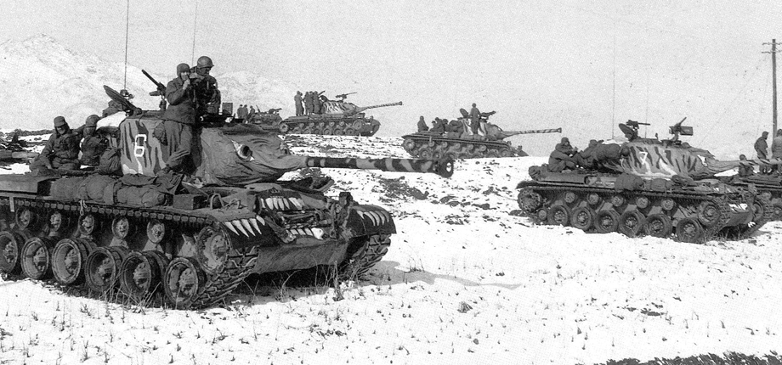
Prelude and War in Korea
Stalin gives green light
Soviet Security Council boycott
The UN at war
Chinese coercion
Figure 3 “M46 tanks of the US Army 6th Tank Batallion in Yangpyeong County, South Korea painted with tiger stripes and faces in order to frighten supposedly superstitious Chinese troops" by S. J. Zaloga, US Army, available as public domain as a work prepared by the United States Government as part of official duties under Title 17, Chapter 1, Section 105 of the US Code.
May 1949 – Stalin lifts Berlin Blockade, an attempt to force reunited Germany on his terms
Oct 1949 – Mao and communists take power in China
Dec 1949 – Stalin reverses previous decisions and grants Kim his blessing to attack South Korea
Jan 1950– Soviets boycott UN Security Council
Jun 1950 – North Korea attacks South Korea
July 1950– UN passes Resolution 82 as Soviets continue boycott
1949
1950
Notes:
Stalin was surprised by the communist victory in China. He had previously denied Kim Il Sung’s requests to invade South Korea after World War II, but with the CCP victory, embraced this new Cold War front in Asia. He reversed his decision with Kim while at the same time directing Ho Chi Minh to go on the offensive against the French in Vietnam in late 1949. But this wasn’t just opportunism, it was part of large scheme taking shape.
At almost the same time, the Soviets began a boycott of the UN over representation of Communist China on the Security Council.
When Kim launches his attack, Soviet Foreign Minister Andrei Gromyko claimed that he directed UN Ambassador Jacob Malik to return to the UN immediately and veto the planned resolution against North Korea. However, Stalin personally (and emotionally according to Gromyko) intervened to stop Malik’s return. In a rare direct communication with a Soviet ambassador, Stalin personally ordered Malik to stay away from the UN.
Many consider this an oversight or blunder. Sir Max Hastings called it a “unique accident.” Others historians called it “ham fisted”, “stupid”, or “stubborn”. But it was anything but an oversight and clearly done with purpose.
Without a Soviet boycott, the UN passed Resolution 82 and US/UN enters war.
As the 8th US Army mobilized in Japan, telegrams show Stalin beginning to actively press a somewhat reluctant Mao to be prepared to assist NK if needed.

Slide 4
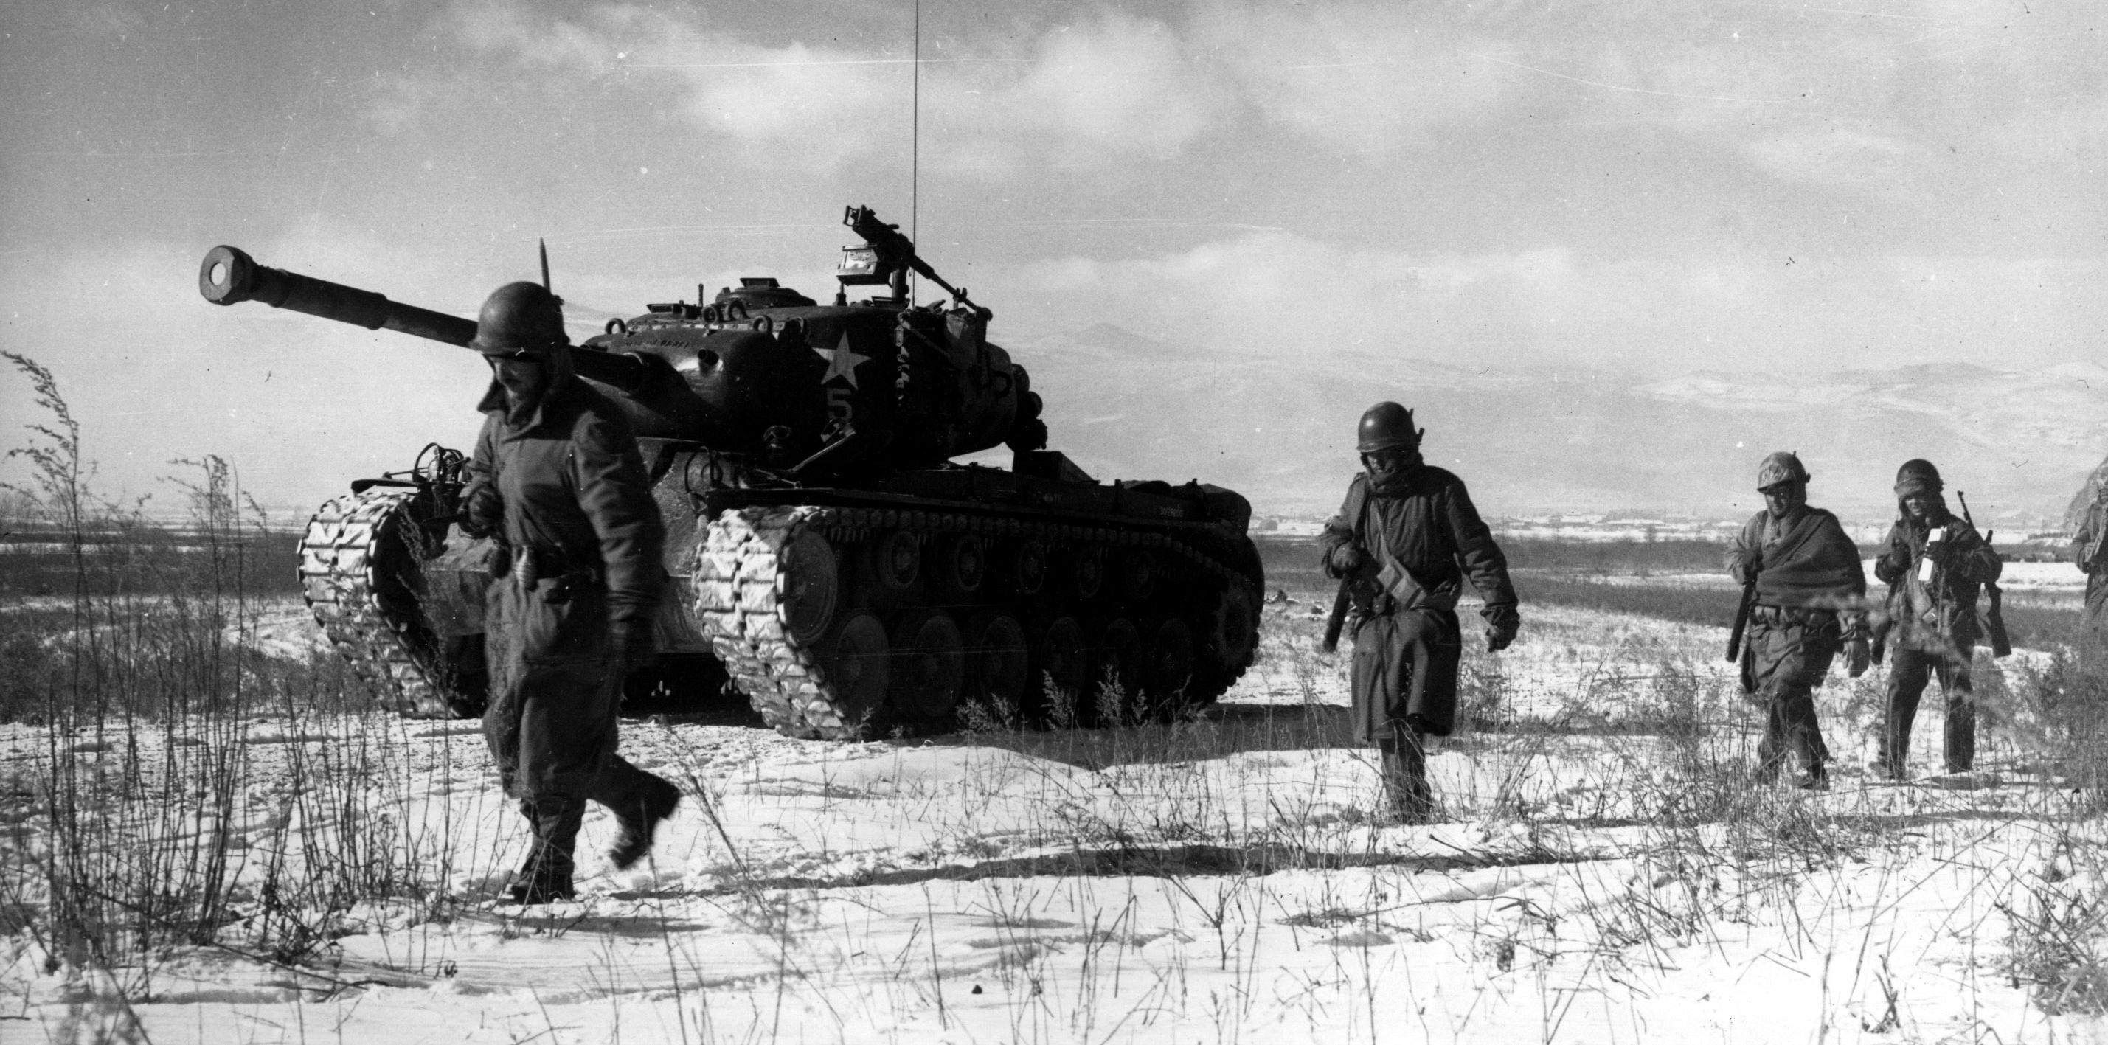
Korean War Continues
Telegram for Mr. Gottwald³
Stalin: We’ve “lost nothing, except for casualties…”⁴
US limits on resources⁵
Figure 4 “US Marines at Chosin" by Corporal Peter McDonald/U.S. Marine Corps, US Dept of Defense, available as public domain as a work prepared by the United States Government as part of official duties under Title 17, Chapter 1, Section 105 of the US Code.
August
1950 –
Soviets end UN boycott
Sept 1950– Stalin sends telegram to Gottwald explaining plan
Oct 1950– UN forces cross the 38th Parallel into North Korea
Oct 1950– Stalin threatens a communist withdrawal from Korea. Mao commits China to the war
Nov 1950 to Apr 1951– UN forces battle China in intense ground combat
May 1951– Peace talks
begin between the UN and China/NK.
1950
1951
Notes:
At the same time, Czechoslovak President Klement Gottwald apparently questioned Stalin on the UN boycott timing. His challenge to Stalin is unrecorded, but Stalin’s reply in a telegram (declassified in 2005), explained his plan to lure the West to “overextend itself in (Korea) and be incapable of a third world war … which would provide the time necessary to strengthen socialism in Europe.” The Soviets actually rescinded the UN boycott just a few weeks later in August 1950. There is only one explanation as to why Ambassador Malik was ordered away from the UN. Stalin was anxious for the US to be involved in bloody slugfest in Korea.
Now that the West was focused on Korea, Stalin continued his work to prolong the war through active Chinese participation. As US/UN forces advanced into North Korea, he threatened in an Oct 13, 1950, telegram to withdraw everything from North Korea. “So be it. America will be our neighbor.” Mao however could not stomach this and decided he needed to intervene in force to protect his Manchurian border.
With the Chinese entry, the war becomes a bloody infantry stalemate. Stalin continued to send various telegrams to Mao and Chinese premier Zhou Enlai urging them not to compromise on any peace deals. In commenting on whether to continue the struggle, Stalin was adamant in fighting on. “This war is getting on America’s nerves,” and we’ve “lost nothing, except for casualties” revealing an icy analysis of his plan’s progress
However, US forces are feeling the strain of fighting a manpower based war on the Korean Peninsula. General MacArthur petitioned the Joint Staff to pull troops from Germany to continue the fight or use Chinese Nationalist troops. In his memoirs, MacArthur stated that the JS was wary of Soviet action in Germany and directed him (and later General Matthew Ridgway) to continue the fight with only the 8th Army.

Slide 5
The Stalin Note
March 1952⁶
Height of strained US resources⁷
German neutrality?
Paranoia goes both ways
Figure 5 “Portrait of Joseph Stalin at the Stalin Museum in Batumi." by Ephraim Stilliberg licensed under CC BY-SA 3.0
March 1952 – Stalin transmits “Stalin Note” proposal for Germany
March-April 1952 – “Stalin Note” uniformly rejected by Western Powers
April 1952 to March 1953- Peace talks stall. Stalin presses Mao to accept nothing short of communist demands.
1951
1952
1953
Notes:
The stage was set for the March 1952 Stalin Note, in which Stalin suggested a neutral, non-aligned Germany and removal of all foreign forces. Stalin was prepared to sacrifice the Soviet presence in East Germany for a “neutral unified Germany.”
Many historians see the First Stalin Note as a propaganda maneuver designed to reverse negative images of the Soviet Union after the Berlin Blockade and Korean War or a desperate attempt to avoid West Germany from joining NATO.
However, there is clear reason to believe that Stalin thought it would succeed according to his plans. The American public was tiring of the Korean War and the US military was finding it increasingly difficult to balance the threat in Europe with the fighting on the Korean peninsula. Stalin believed a stabilized, neutral Germany was an attractive offer to the Americans, who could reduce their commitment to Europe and focus on ending the Korean War in their favor.
But German neutrality was a façade. Proximity to the Soviet Union would result in Germany being less than neutral. Even today, Germany is prone to Russian influence (energy markets, military action).
US and Great Britain immediately rejected the note without any counteroffer. The US State Department, wary from the communist surprise attack in Korea, considered the Stalin Note some kind of trick.
The great irony was that the Western powers rejected the Stalin Note out of paranoia, the trait typically ascribed to Joseph Stalin.

Slide 6
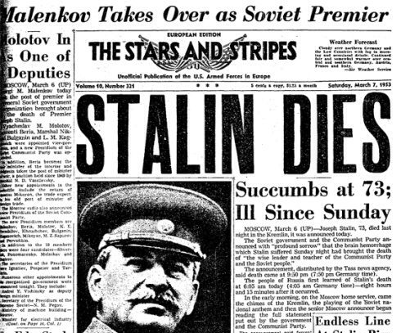
The Death of Stalin
March 1953
Communists quickly agree to terms⁸
West Germany joins NATO two years later
Figure 6 “Stalin Dies” by Stars and Stripes Newspaper, Sunday March 7, 1953, page 1, Defense Media Activity, licensed under CC0 1.0 Universal, available as public domain as a work prepared by the United States Government as part of official duties under Title 17, Chapter 1, Section 105 of the US Code.
March 1953 – Stalin dies of a massive cerebral hemorrhage
April 1953 – Communists drop demands
July 1953 – Armistice ends fighting in Korea
May 1955– West Germany joins NATO
April 1953 –1955 Soviet power struggle
1953
1954
1955
Notes:
The unproductive attempts to realize Soviet gains from the Korean War finally came to end on March 5,1953 when Stalin died suddenly from a cerebral hemorrhage. His death marked a radical change of the Soviet perspective on the Korean War. By moving quickly to bring an end to the war, his successors demonstrated that Stalin alone had made the personal decision to prolong the conflict.
Evidence from a declassified Soviet document on the Korean War showed that Chinese leadership saw Stalin's death as their opportunity to end the war: While in Moscow for Stalin's funeral, Premier Zhou Enlai proposed speedy negotiations for an armistice to the Korean War.
The Soviets readily agreed. But Stalin was so firmly entrenched in the Soviet mind that there was an instinctual difficulty in altering a Stalin policy. The response to Zhou was a convoluted classified statement: “the Soviet Government has reached the conclusion that it would be incorrect to continue the line on this question which has been followed until now, without making those alterations in that line which correspond to the present political situation and which ensue from the deepest interests of our peoples, the peoples of the USSR, China and Korea.” In other words, we agree let’s end this, but Stalin was never wrong in pursuing it.

Slide 7
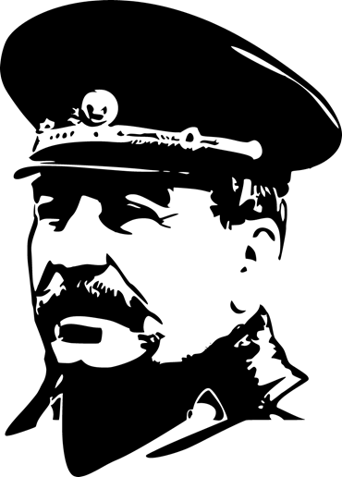
Summary
Centrality of the Stalin Note is chilling in its inhumanity
Hunter or the hunted?⁹
Parallels with Putin¹⁰
Figure 7 “Joseph Stalin Image” by Public Domain Vectors licensed under CC0 1.0 Universal
Notes:
-Stalin would sacrifice millions of lives for an opportunity to achieve a foreign policy goal. Brutal and chilling in its inhumanity. I believe this is one of the reasons this idea is rejected. As Christians, it is difficult to understand how anyone could be this cold and calculating…but new information continues to emerge, it seems more and more likely.
-David Halberstam wrote that Stalin had little use for friendships. “In the world as Stalin knew it, you were either the hunter or the hunted.” He made sure that he was the hunter and was brutally realistic in his foreign policy.
Similar to the convoluted Soviet statement at the end of the Korean War, there remains a Russian instinct to not contradict the state. Vladimir Putin is exhibiting the same kind of cult of fear and control in his invasion of Ukraine. Stalin and his repression remain in the bloodstream of Putin’s Russia. Putin readily agrees, “Excessively demonizing Stalin,” said Putin in a 2017 interview, “is a means to attack …Russia.”
Putin must be understood in the context of Stalin in deciding when and where to apply deterrence and, if necessary, military force. A thorough understanding of an adversary such as this is an unsavory but an absolutely necessary part of a Christian worldview. Understanding Putin and modern Russia start by studying and analyzing Stalin’s brutal history of realism and power politics.

Slide 8
Notes
¹ Quote from a stele monument in Berlin. See Rudolph photo from German Federal Archives, December 1949, at https://www.bild.bundesarchiv.de/dba/de/search/?query=Bild+183-S91833
² Vladimir O. Pechatnov and C. Earl Edmondson, “The Russian Perspective,” in Ralph B. Levering, Vladimir O. Pechatnov, Verena Botzenhart-Viehe, and C. Earl Edmondson, Debating the Origins of the Cold War: American and Russian Perspectives 85-151 (New York: Rowman and Littlefield, 2002), 109.
³ Donggil Kim and William Strueck, “Did Stalin Lure the United States into the Korean War?” in North Korean International Documentation Project E-Dossier #1, edited by Christian F. Osterman and Charles Kraus, Washington DC: Woodrow Wilson Center, June 2008, 5.
⁴ Robert Gellately, Stalin’s Curse: Battling for Communism in War and Cold War (New York: Alfred A. Knopf, 2013), 340.

Slide 9
⁵ Douglas MacArthur, Reminiscences (Annapolis, MD: Bluejacket Books, 1964), 337 and 400.
⁶ Peter Ruggenthaler, “The 1952 Stalin Note on German Unification: The Ongoing Debate,” Journal of Cold War Studies 13, no. 4 (2011): 172.
⁷ Stanley Sandler, The Korean War, No Victors, No Vanquished (Lexington, KY: The University Press of Kentucky, 1999), 144.
⁸ Kathryn Weathersby, "Stalin, Mao, and the End of the Korean War” in Odd Arne Westad, ed. Brothers in Arms: The Rise and Fall of the Sino-Soviet Alliance, 1945-1963 (Washington, D.C.: Woodrow Wilson Center Press, 1998), 108.
⁹ David Halberstam, The Coldest Winter (New York, NY: Hyperion Books, 2007), 346.

Slide 10
¹⁰Simon Sebag Montefiore, “Why Putin in Beholden to Stalin’s Legacy,” The New Statesman, March 9, 2022. https://www.newstatesman.com/long-reads/2022/03/a-tale-of-two-dictators-why-putin-is-beholden-to-stalins-legacy

