Slide 1
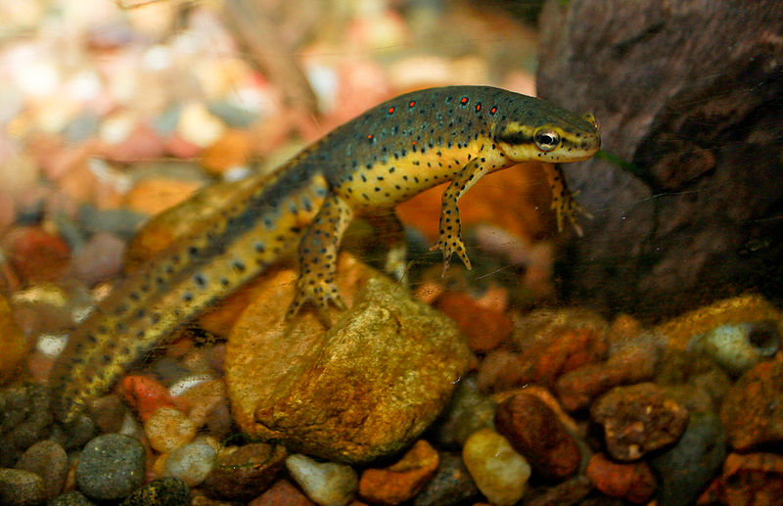
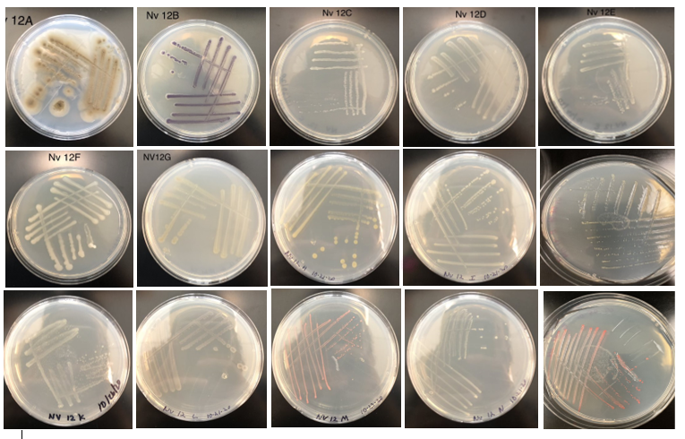
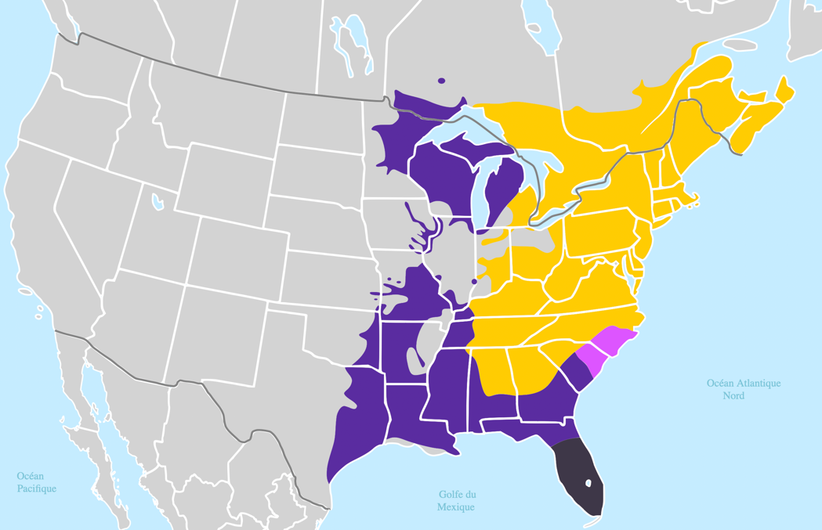
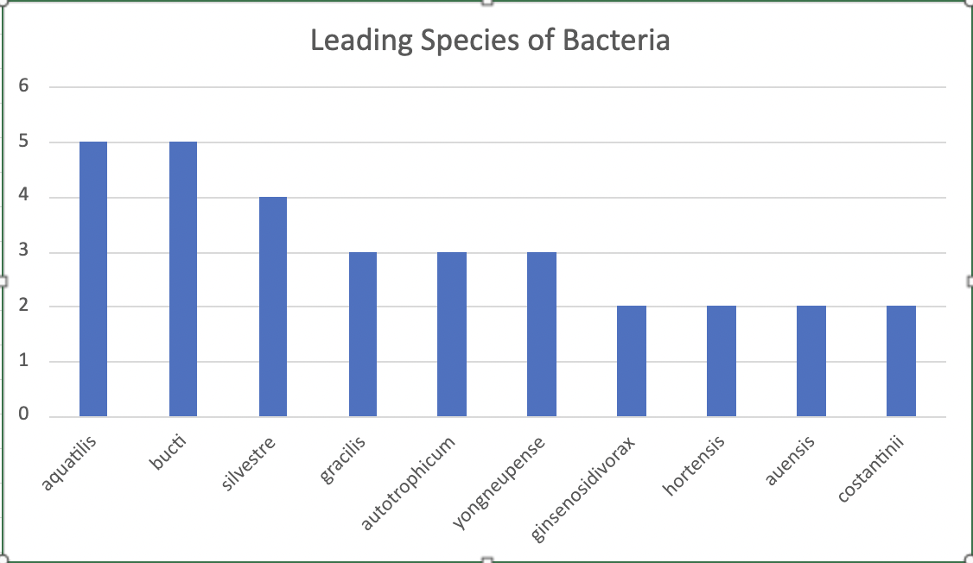
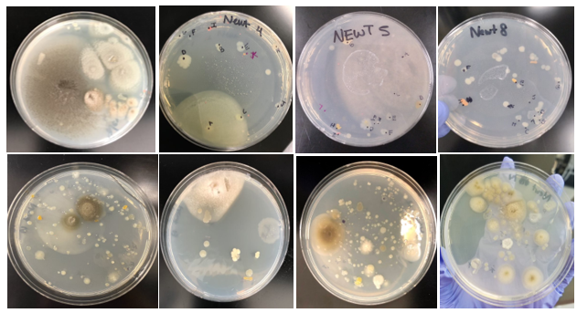
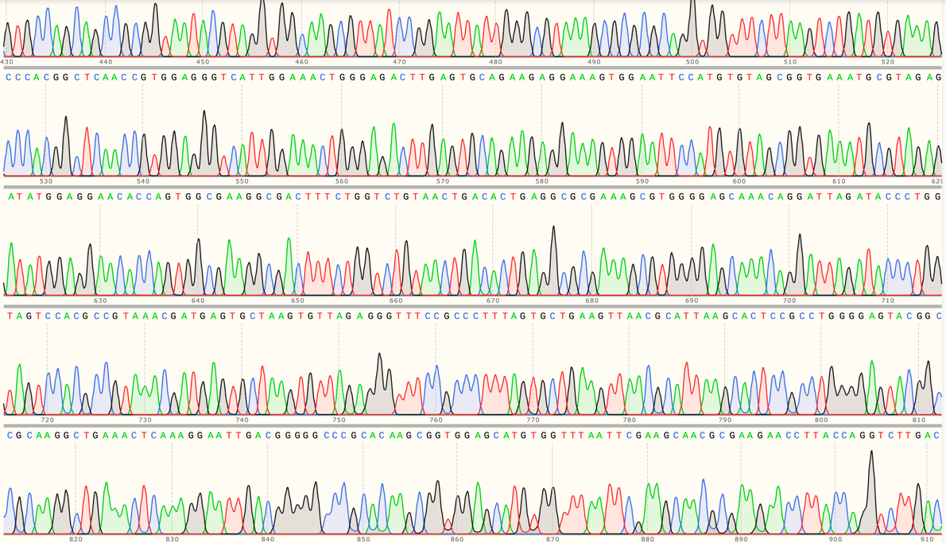
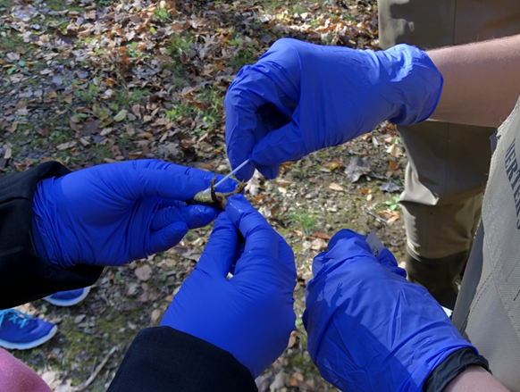
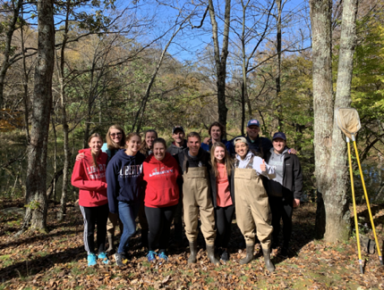
The Cutaneous Microbiome of the Red-Spotted Newt (Notophthalmus viridescens) and Its Role
as Defense Against Fungal Pathogens
Joseph Bierbaum, Dylan Peterson, Danielle Sweeney, & Matthew Becker
Background
Results
The lethal disease chytridiomycosis is an ongoing threat to the survival of amphibian species worldwide, and its continued spread through amphibian populations threatens the existence of especially susceptible species. Chytridiomycosis is caused by two fungal pathogens, Batrachochytrium dendrobatidis (Bd) and B salamandrivorans (Bsal).
The eastern red spotted newt (Notophthalmus viridescens) is common throughout the eastern United States in freshwater habitats. N. viridescens has been identified as a species that is susceptible to chytridiomycosis through the infection of Bd or Bsal.
Prior research has proven that chytridiomycosis may be inhibited through the secretions made by specific cutaneous bacteria in select species of amphibians. There are a few studies regarding the microbiome of N. viridescens, but research to characterize it would provide further insights into possible natural defenses specifically against Bd.
A total of 188 different bacterial morphotypes were obtained and there was found to be an average of 12.5 different bacterial morphotypes per newt swabbed.
Each individual bacterial morphotype was isolate on R2A plates and underwent DNA extraction from pure colonies. This DNA extraction was used to identify species of bacteria by identifying the 16S rRNA gene of each bacteria isolate.
The bacteria Aquitalae aquatilis and Solimicrobium silvestre were discovered four times on the newts, with both showing inhibition properties greater than 80% for Bd.
47 out of the 188 bacterial morphotypes showed greater than 80% inhibition levels when tested against Bd.
Results for all of the bacteria identifications are still being determined, with the last three newt microbiomes still needing to be sequenced.
Figure 1. Photo of Notophthalmus viridescens
Brian Gatwicke https://commons.wikimedia.org/wiki/File:Redspotted_newt.jpg
3. Isolation streaks from one mass culture plate. The DNA of each isolated colony will be extracted for DNA sequencing.
Research Question
The purpose of this research is to characterize the microbiome of N. viridescens to determine the presence of helpful cutaneous bacteria as a potential natural defense against Bd. What cutaneous microbiota does N. viridescens sustain as a potential natural defense against Bd?
1. Distribution map of N. viridescens in the yellow and the location of where the swabbing took place [blue arrow] (Powell et al., 2016).
Future Work
Based on our research, it can be assumed that the Red-Spotted Newt is one of many amphibian species affected by chytridiomycosis. By continuing this research, we will continue to help other species by discovering an efficient solution to mass inoculation.
Methods
4. Frequency distribution of bacteria that were found on the N. viridescens population.
1. Eastern newts (N=15) were caught via seine and using gloves from Watson Pond in the Peaks of Otter region of the Blue Ridge Mountains of Virginia and then placed in sterile water to remove transient microbes.
2. The skin of each newt was then swabbed, and then cells were transferred to R2A plates and incubated at room temperature for several days with diverse colony types appearing.
3. Bacterial colonies were examined for different morphologies and were then selected and streaked for isolation on R2A plates in order to collect pure cultures.
4. Colonies were then placed in glycerol solutions for future use in CFS protocol and DNA extraction.
5. PCR amplification was completed to multiply specifically the 16S gene in order to sequence through Sanger sequencing.
6. Metabolites from the cell free supernatant (CFS) protocol were collected after growing bacterial cells in tryptone broth for 72 hours and a thorough filtration process.
7. The metabolites were added to a 96-well plate and grown in the presence of Bd in order to calculate the inhibition score over a 10-day period. The assay results will then be compared with the identity of bacteria being assessed.
References and Acknowledgments
¹ Harris, R., Brucker, R., Walke, J. et al. Skin microbes on frogs prevent morbidity and mortality caused by a lethal skin fungus. ISME J 3, 818–824 (2009). https://doi.org/10.1038/ismej.2009.27.
² Sreedharan, G., & Vasudevan, K. (2021). Chytridiomycosis in Asian Amphibians, a Global Resource for Batrachochytrium dendrobatidis (Bd) Research. Journal of the Indian Institute of Science, 101(2), 227–241. https://doi.org/10.1007/s41745-021-00227-3.
³ Blackburn, L., Nanjappa, P., & Lannoo, M. J. (2001). An atlas of the distribution of US amphibians. Copyright, Ball State University, Muncie, Indiana, USA, 230.
⁴ Powell, R., Conant, R., Collins, J. (2016). Peterson Field Guide to Reptiles and Amphibians of Eastern and Central North America, 4th edition. Mifflin Harcourt.
We would like to thank the Liberty University Department of Biology and Chemistry , the Center for Research and Scholarship, and the Virginia Herpetological Society for funding and support. We would also like to thank the other members of Dr. Becker’s Research Team.
2. The skin of each newt was swabbed with a standardized technique to collect cutaneous microbial cells. The morphology and color of each colony was examined and recorded. Pure cultures of each morphotype was produced from the mass culture via streaking.
5. Example of chromatogram results from Sanger Sequencing to determine the 16S rRNA gene.
Figure 2. Photo of swabbing the newts to obtain the skin bacteria.

