Slide 1

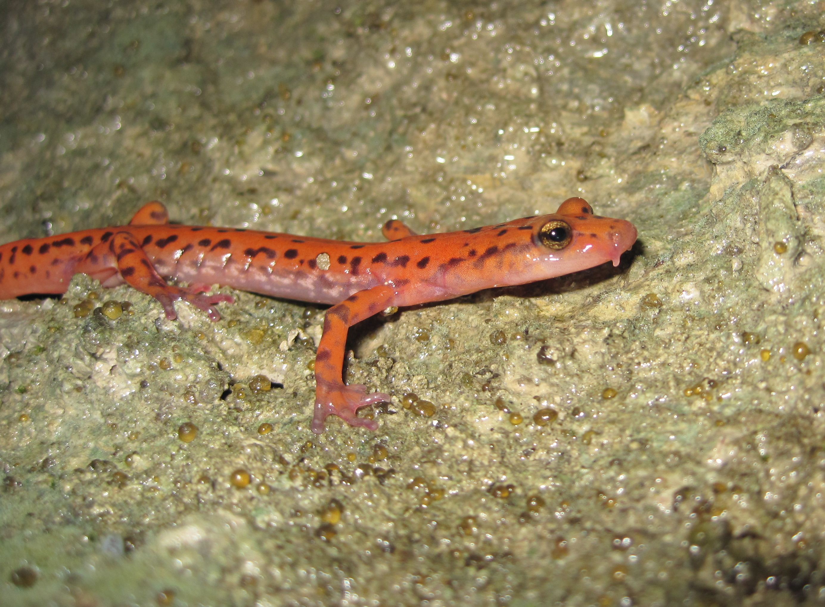
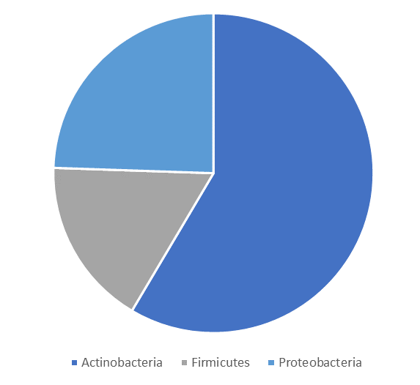
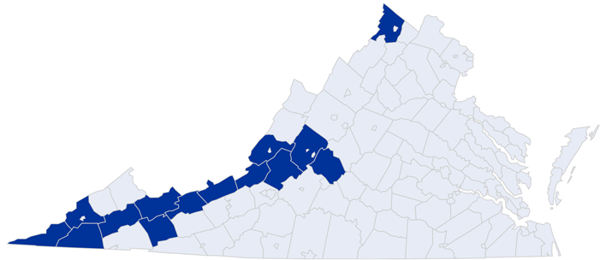
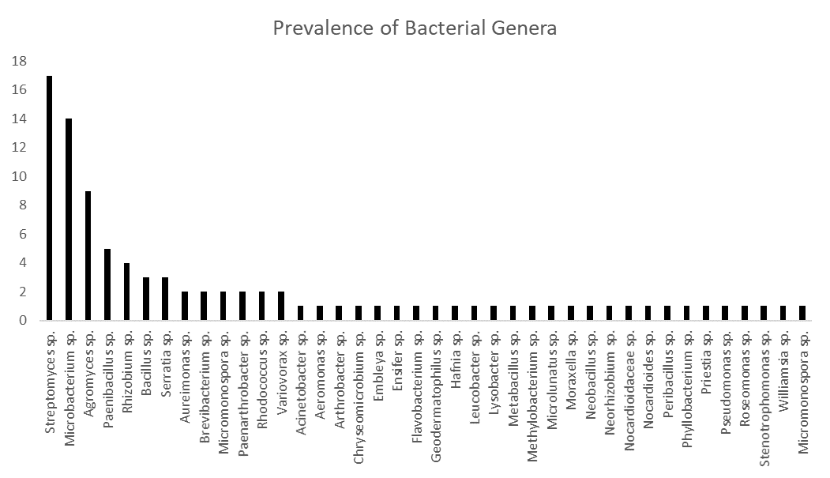
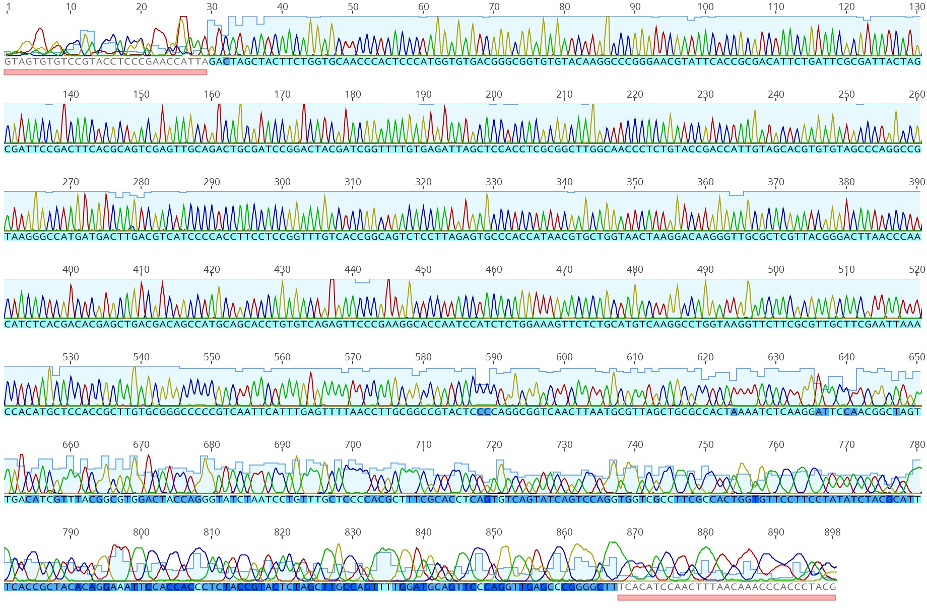
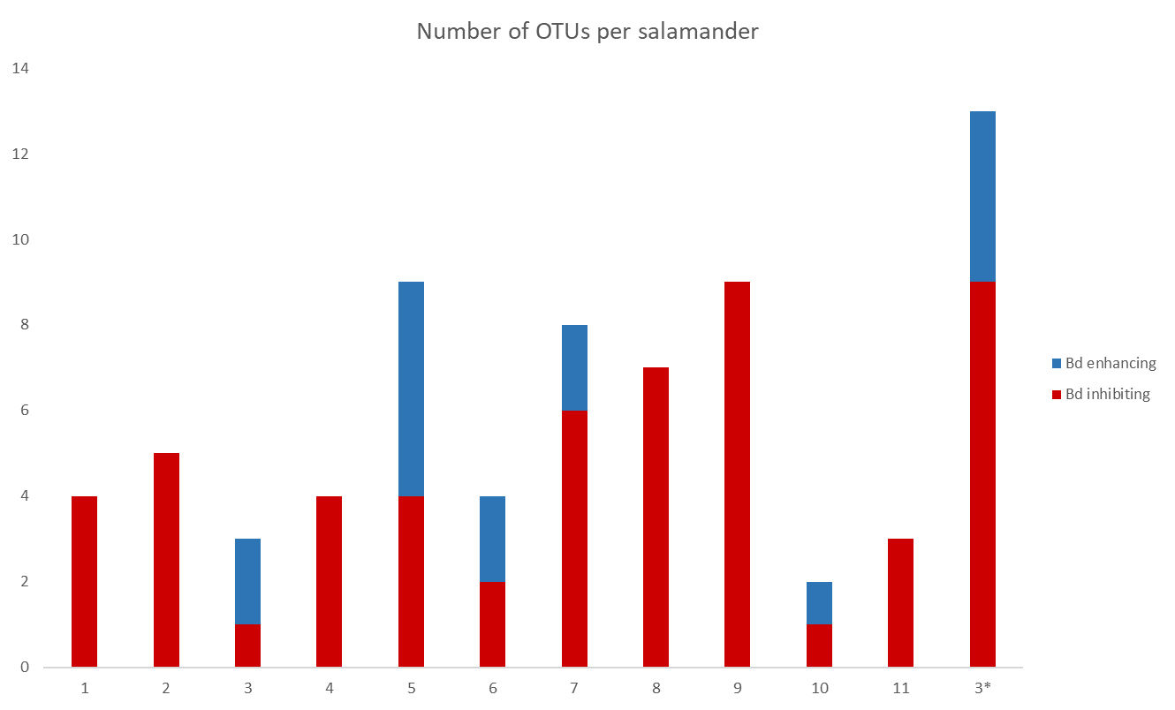
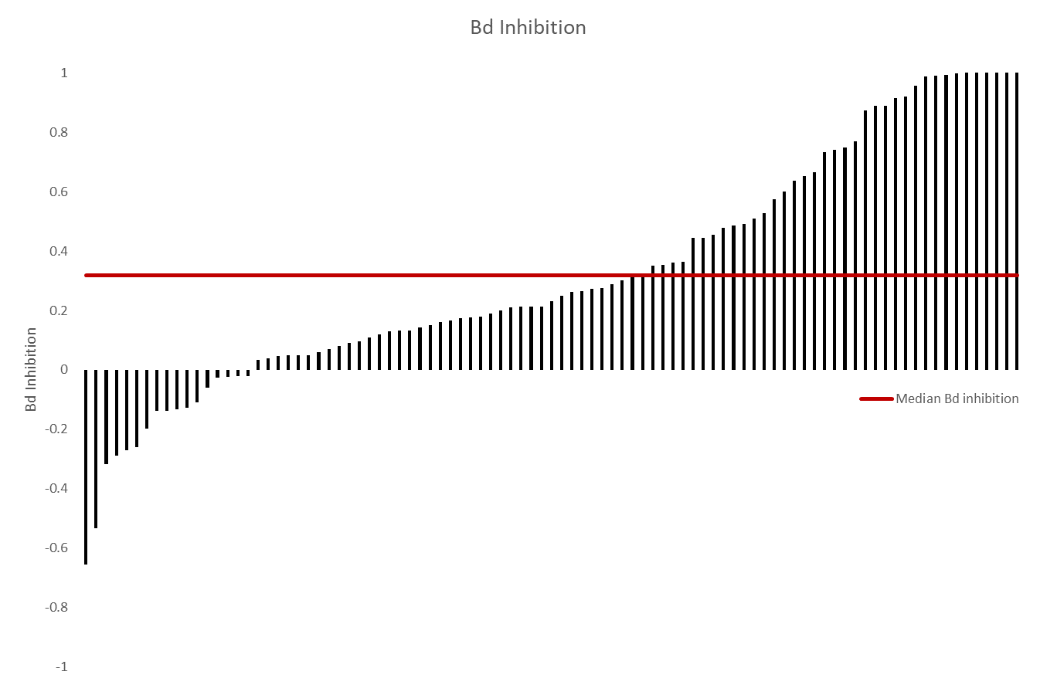
Characterizing the cutaneous microbiome of Eurycea lucifuga as a potential defense against infectious diseases
Madeline Key, McKenzie Perkins, and Dr. Matthew H. Becker
Introduction
Results
Many amphibian species, especially those who inhabit aquatic environments, are at risk for developing chytridiomycosis, a lethal disease caused by the fungal pathogens Batrachochytrium dendrobatidis (Bd) and Batrachochytrium salamandriovorans (Bsal). Among the affected amphibian species is the cave salamander, Eurycea lucifuga, which is found along the Ohio River Valley and Southeast United States.
Previous research has indicated that among the variety of bacterial species present within the salamander microbiome, there may be many species which possess antifungal properties, possibly aiding in providing some level of immunity against Bd and Bsal. Characterization of the salamander microbiome as well as assessing the antifungal activity, if any, of the present bacterial species may provide insight into possible treatment options for many amphibian species against Bd and Bsal at large.
A collection of resident microbiota samples from the skin of Cave salamander individuals (N=13) provided uniquely observable microbial cultures that included fungi and bacteria.
A chromatogram (Figure 6) for each isolate was obtained as a result of the DNA sequencing of each microbial isolate.
40 unique bacterial genera were identified within three different phyla (Figure 3), with the most prevalent being Streptomyces, Microbacterium, and Agromyces (Figure 4).
A challenge assay was conducted (Figure 8) with the isolated bacteria to determine their in vitro effect against Bd. 82% were inhibitory against Bd, with the median inhibition being 0.32.
Each E. lucifuga individual contained from 1-9 Bd-inhibiting bacteria and one-third of the individuals contained Bd-enhancing bacteria (Figure 7).
6 bacterial genera provided Bd-inhibition of over 0.95.
Figure 1. Eurycea lucifuga (Credit: Dr. Becker)
Figure 2. Distribution of E. lucifuga and sampling location (red arrow)
(Credit: Dr. Becker)
Figure 3. Distribution of bacterial isolate phyla
Research Question
The purpose of this study is to: (1) characterize the microbiome of salamander species Eurycea lucifuga, and (2) assess the antifungal properties, if any, of the bacterial species present on salamander skin which would protect the salamander against infection by Bd or Bsal. What bacterial species within the native resident microbiota of Eurycea lucifuga would aid in its defense against Bd and/or Bsal?
Figure 4. Prevalence of bacterial genera found on the sampled E. lucifuga population
Future Work
Future work in this area of research would entail identifying which bacterial species within the resident microbiome of Eurycea lucifuga would be most useful in terms of developing a treatment against Bd and/or Bsal to prevent chytridiomycosis in amphibian species.
Methods
Figure 6. Example of chromatogram results from Sanger sequencing
Figure 5. Mean inhibition of the top Bd-inhibitory bacterial genera with their prevalence on E. lucifuga individuals
Cell-free supernatant (CFS) was used to isolate bacterial metabolites from bacterial cultures.
The isolated bacterial colonies were grown on R2A plates.
A small sample from each of these colonies was placed in culture tubes filled with tryptone broth, which were later incubated in a shaker incubator at 23°C for 72 hours at 140 rpm.
Syringes capped with filtration tips were used to filter the contents of each sample, and to produce CFS which would then be later used in a Bd challenge assay.
Heat-killed Bd was prepared and frozen CFS samples were thawed.
A 96-well plate was prepared with each sample and control run in triplicate. Plates were read, and antifungal activity was assessed.
References and Acknowledgments
1 2 3 4 5 6 7 8 9 10 11 12 13 14
1 2 3 4 5 6 7 8 9 10 11 12 13 14
We would like to thank the Liberty University Department of Biology and Chemistry for the use of their equipment and facilities as well as the Virginia Herpetological Society for their funding and support. We would also like to thank the other members of Dr. Becker’s lab team and acquaintances who helped with the sampling and lab methods.
Becker, M. H. et al.(2009). The bacterially produced metabolite violacein is associated with survival of amphibians infected with a lethal fungus. Applied And Environmental Microbiology, 75(21), 6635-6638.
Becker, M. H., & Harris, R. N. (2010). Cutaneous bacteria of the redback salamander prevent morbidity associated with a lethal disease. PLoS One, 5(6), e10957.
Bletz, M. C. et al. (2013). Mitigating amphibian chytridiomycosis with bioaugmentation: characteristics of effective probiotics and strategies for their selection and use. Ecology Letters, 16(6), 807-820.
Myers, J. M. et al. (2012). Synergistic inhibition of the lethal fungal pathogen Batrachochytrium dendrobatidis: the combined effect of symbiotic bacterial metabolites and antimicrobial peptides of the frog Rana muscosa. J Chem Ecol, 38(8), 958-965.
Stuart, S. N. et al. (2004). Status and trends of amphibian declines and extinctions worldwide. Science, 306(5702), 1783-1786.
Woodhams, D.C. et al. (2015). Anti-fungal isolates database of amphibian skin-associated bacteria and function against emerging fungal pathogens. Ecology 96:595
Figure 7. Number of Bd-inhibiting (red) and Bd-enhancing (blue) OTUs present on each Cave salamander individual
Figure 8. Bd-inhibition of each OTU with the median inhibition labeled in red

