Slide 1
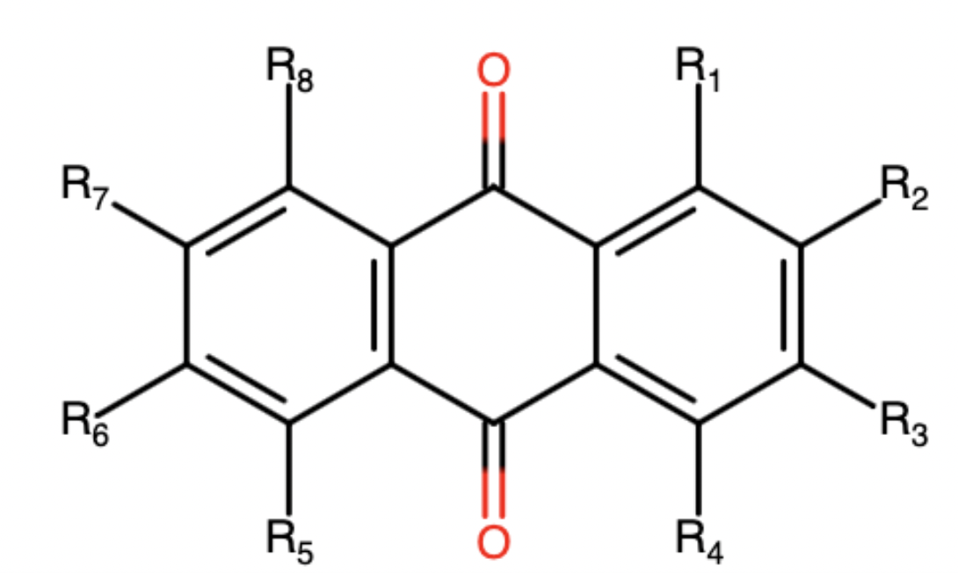
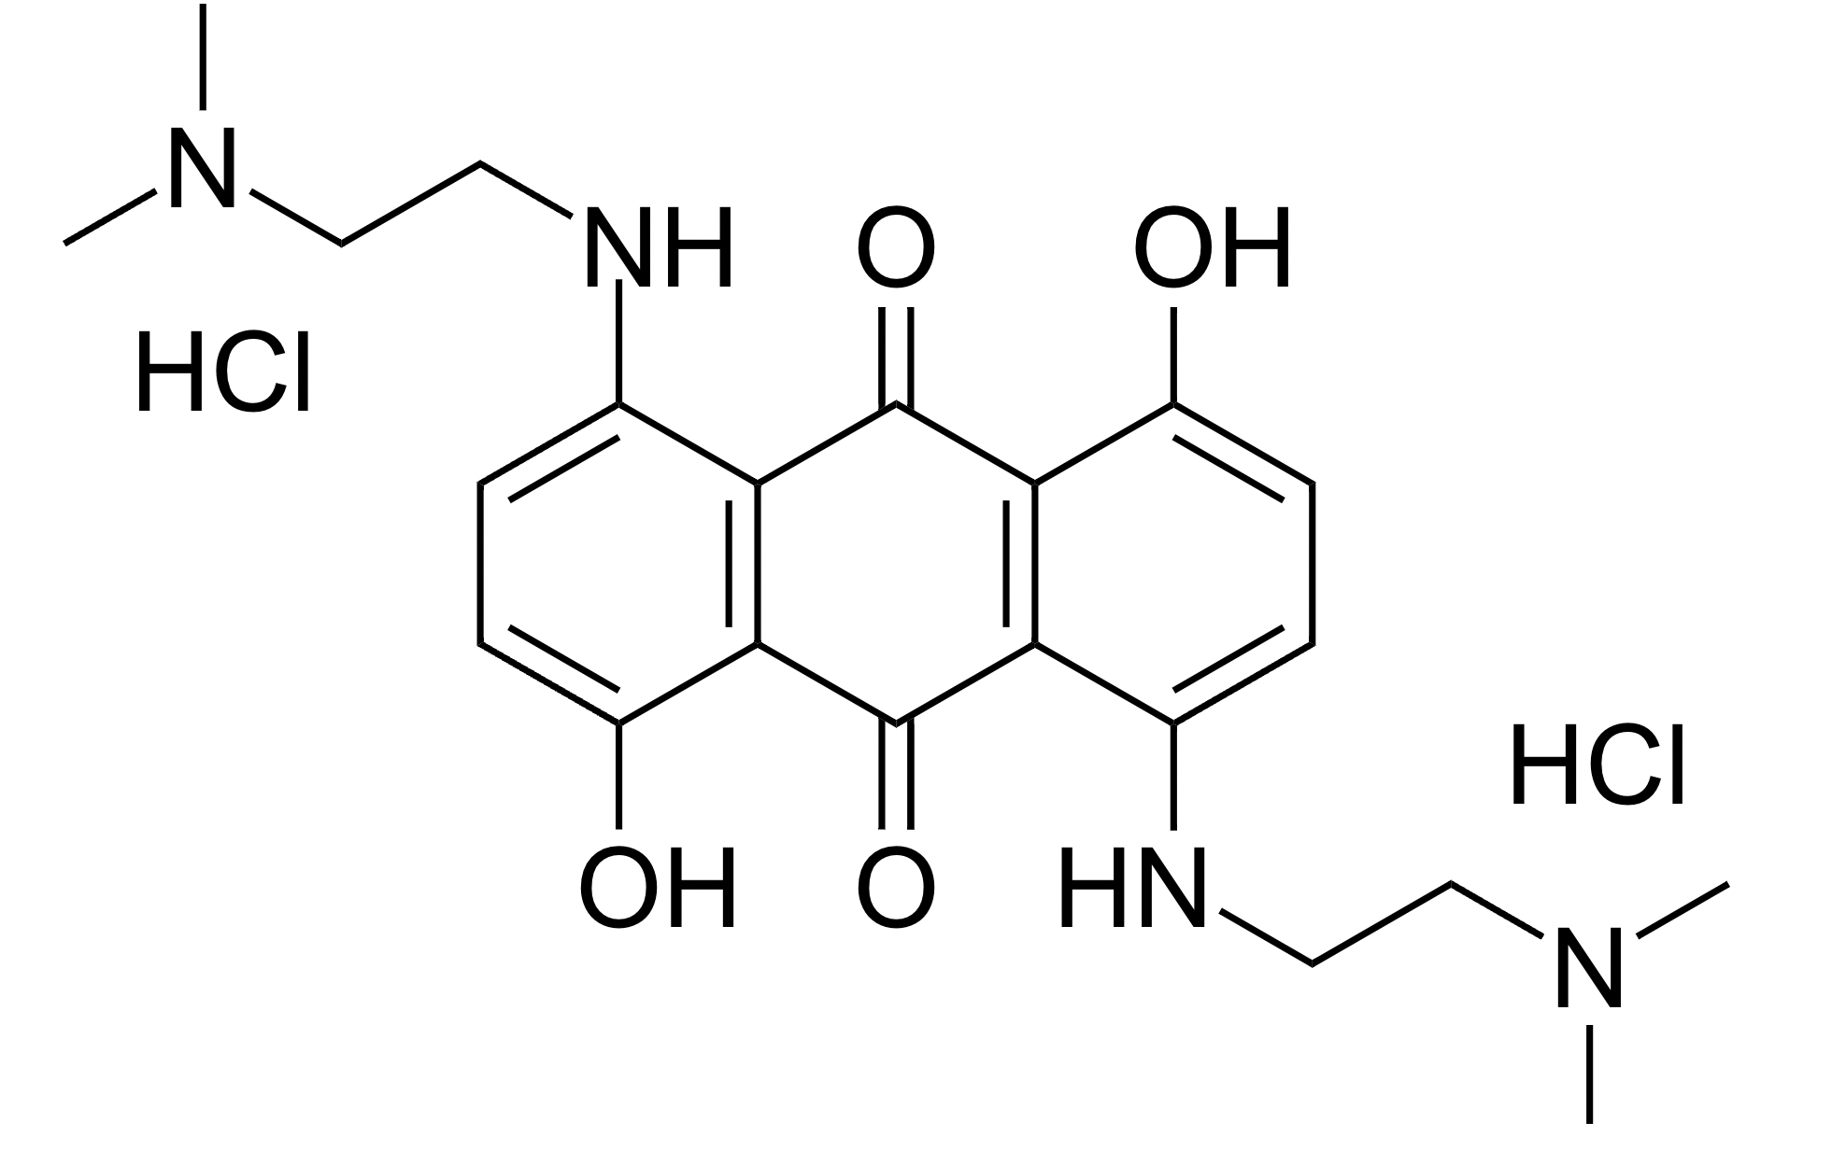
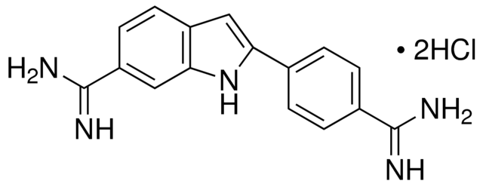
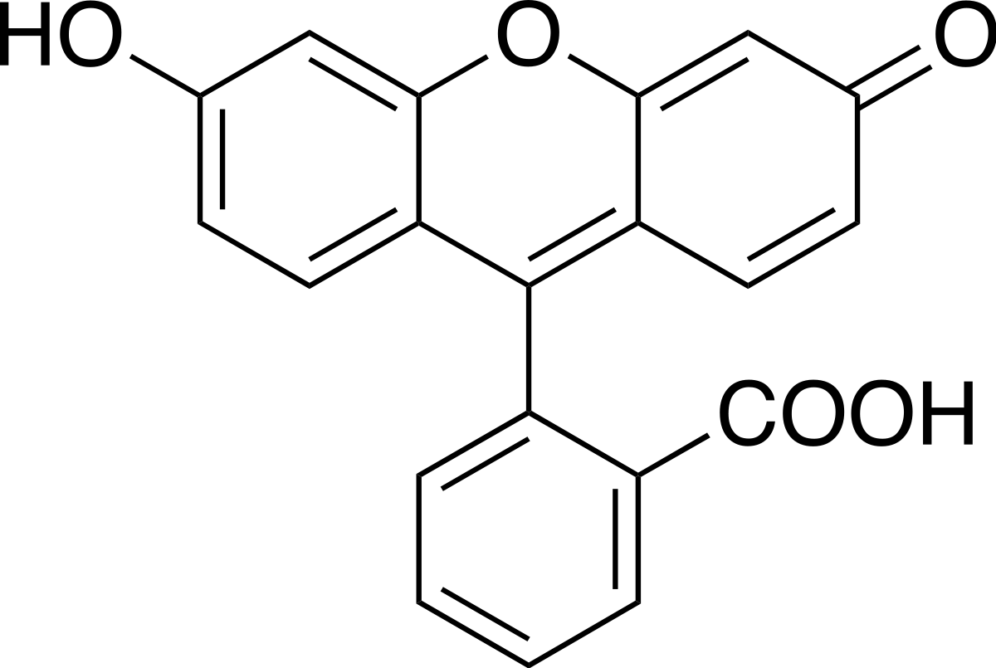
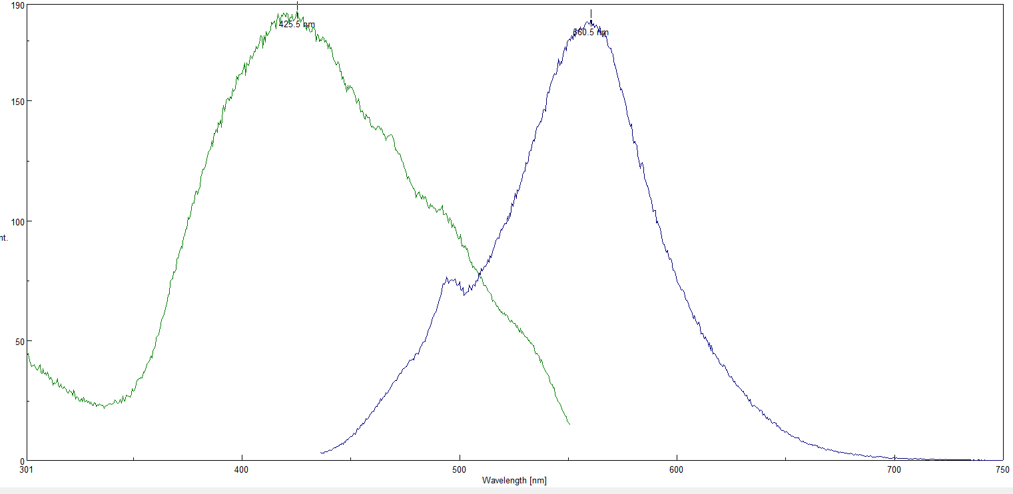
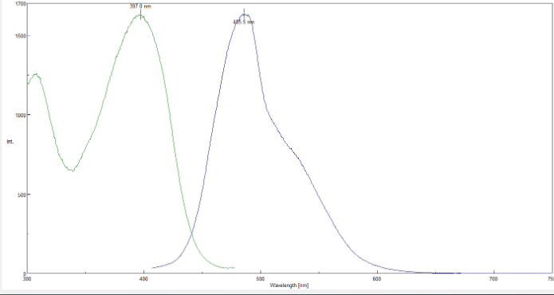
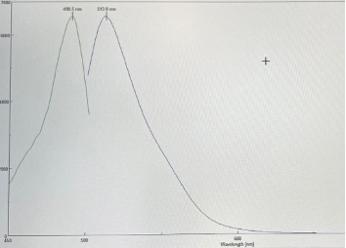
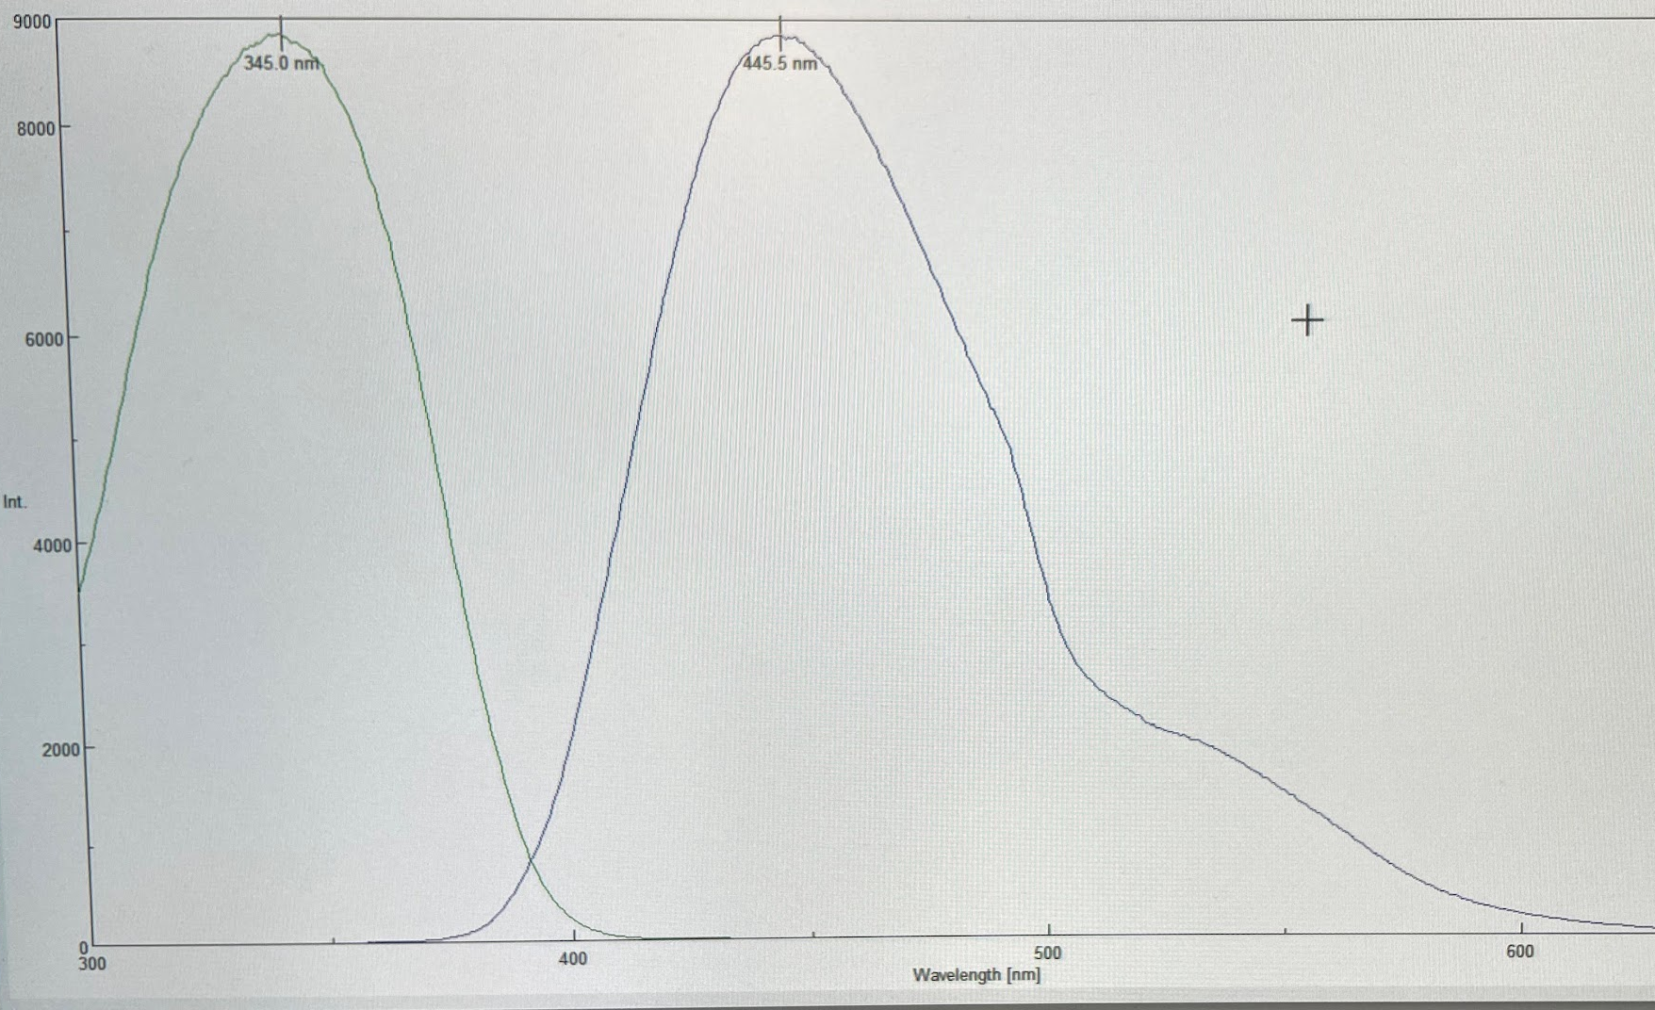
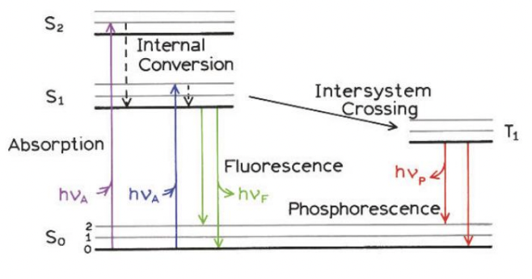
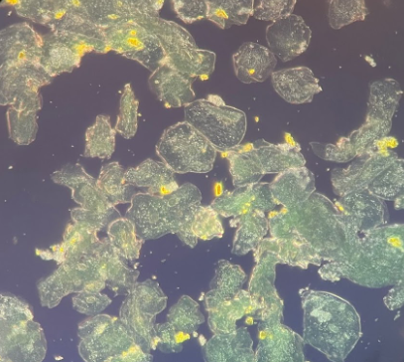
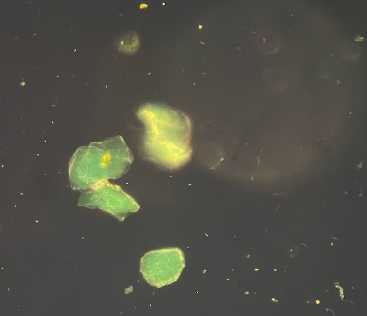
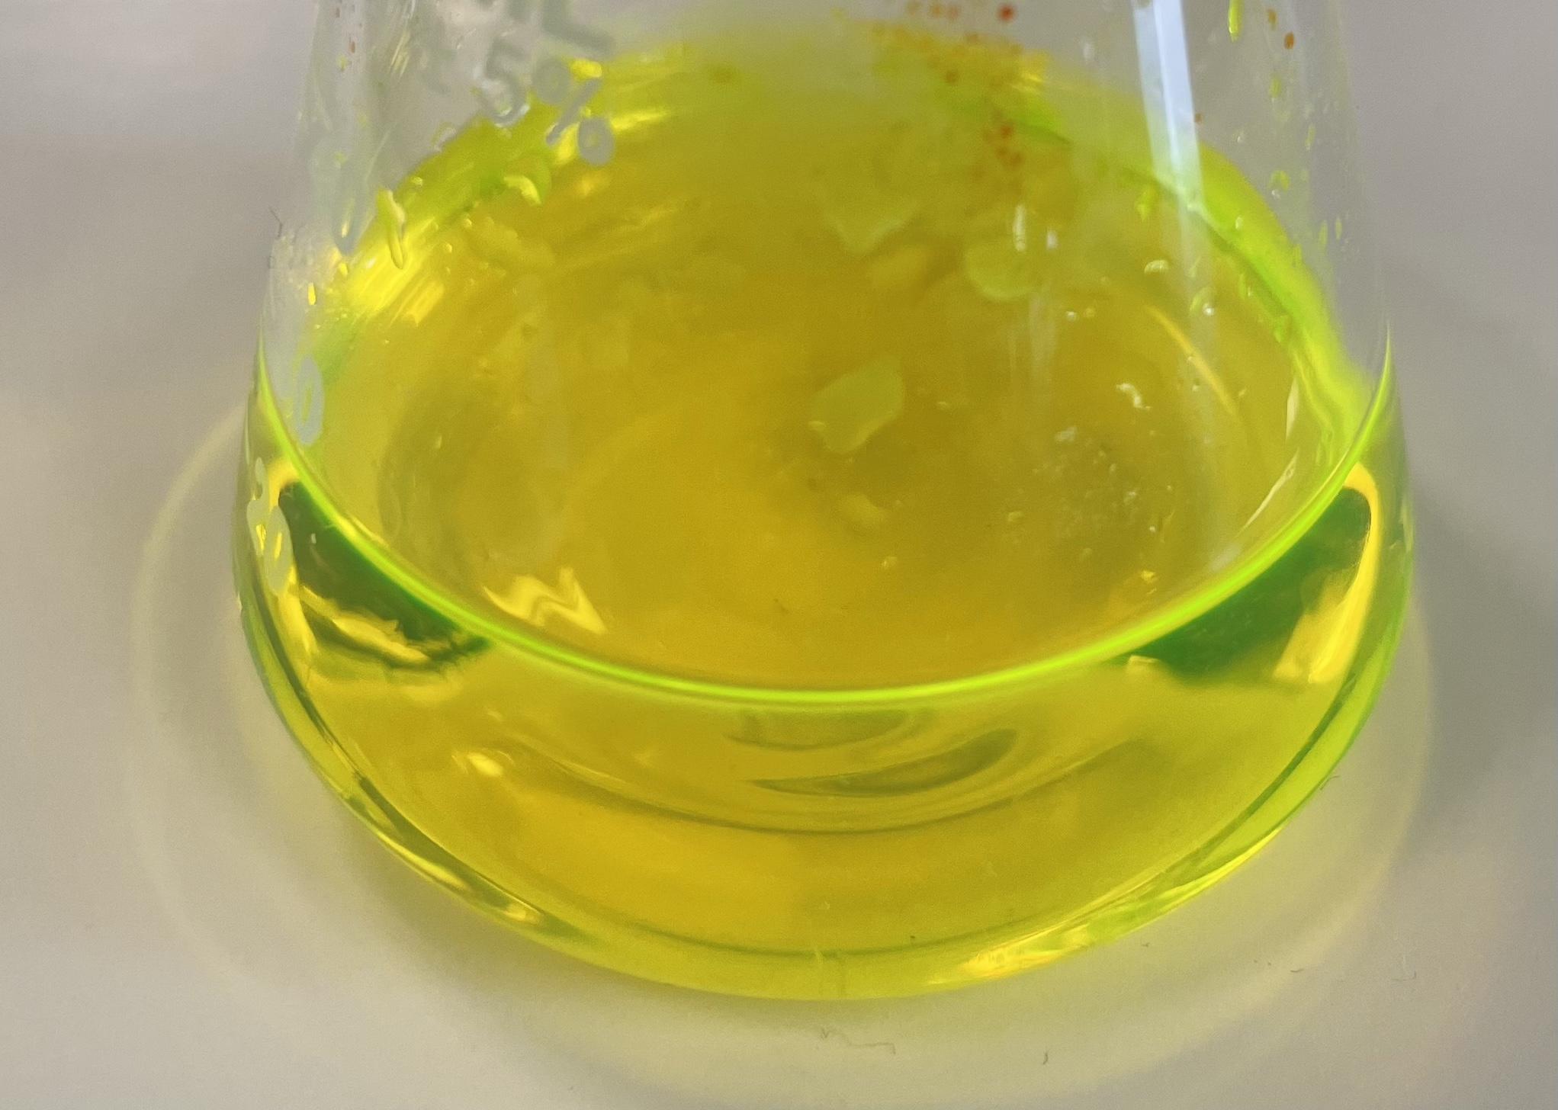
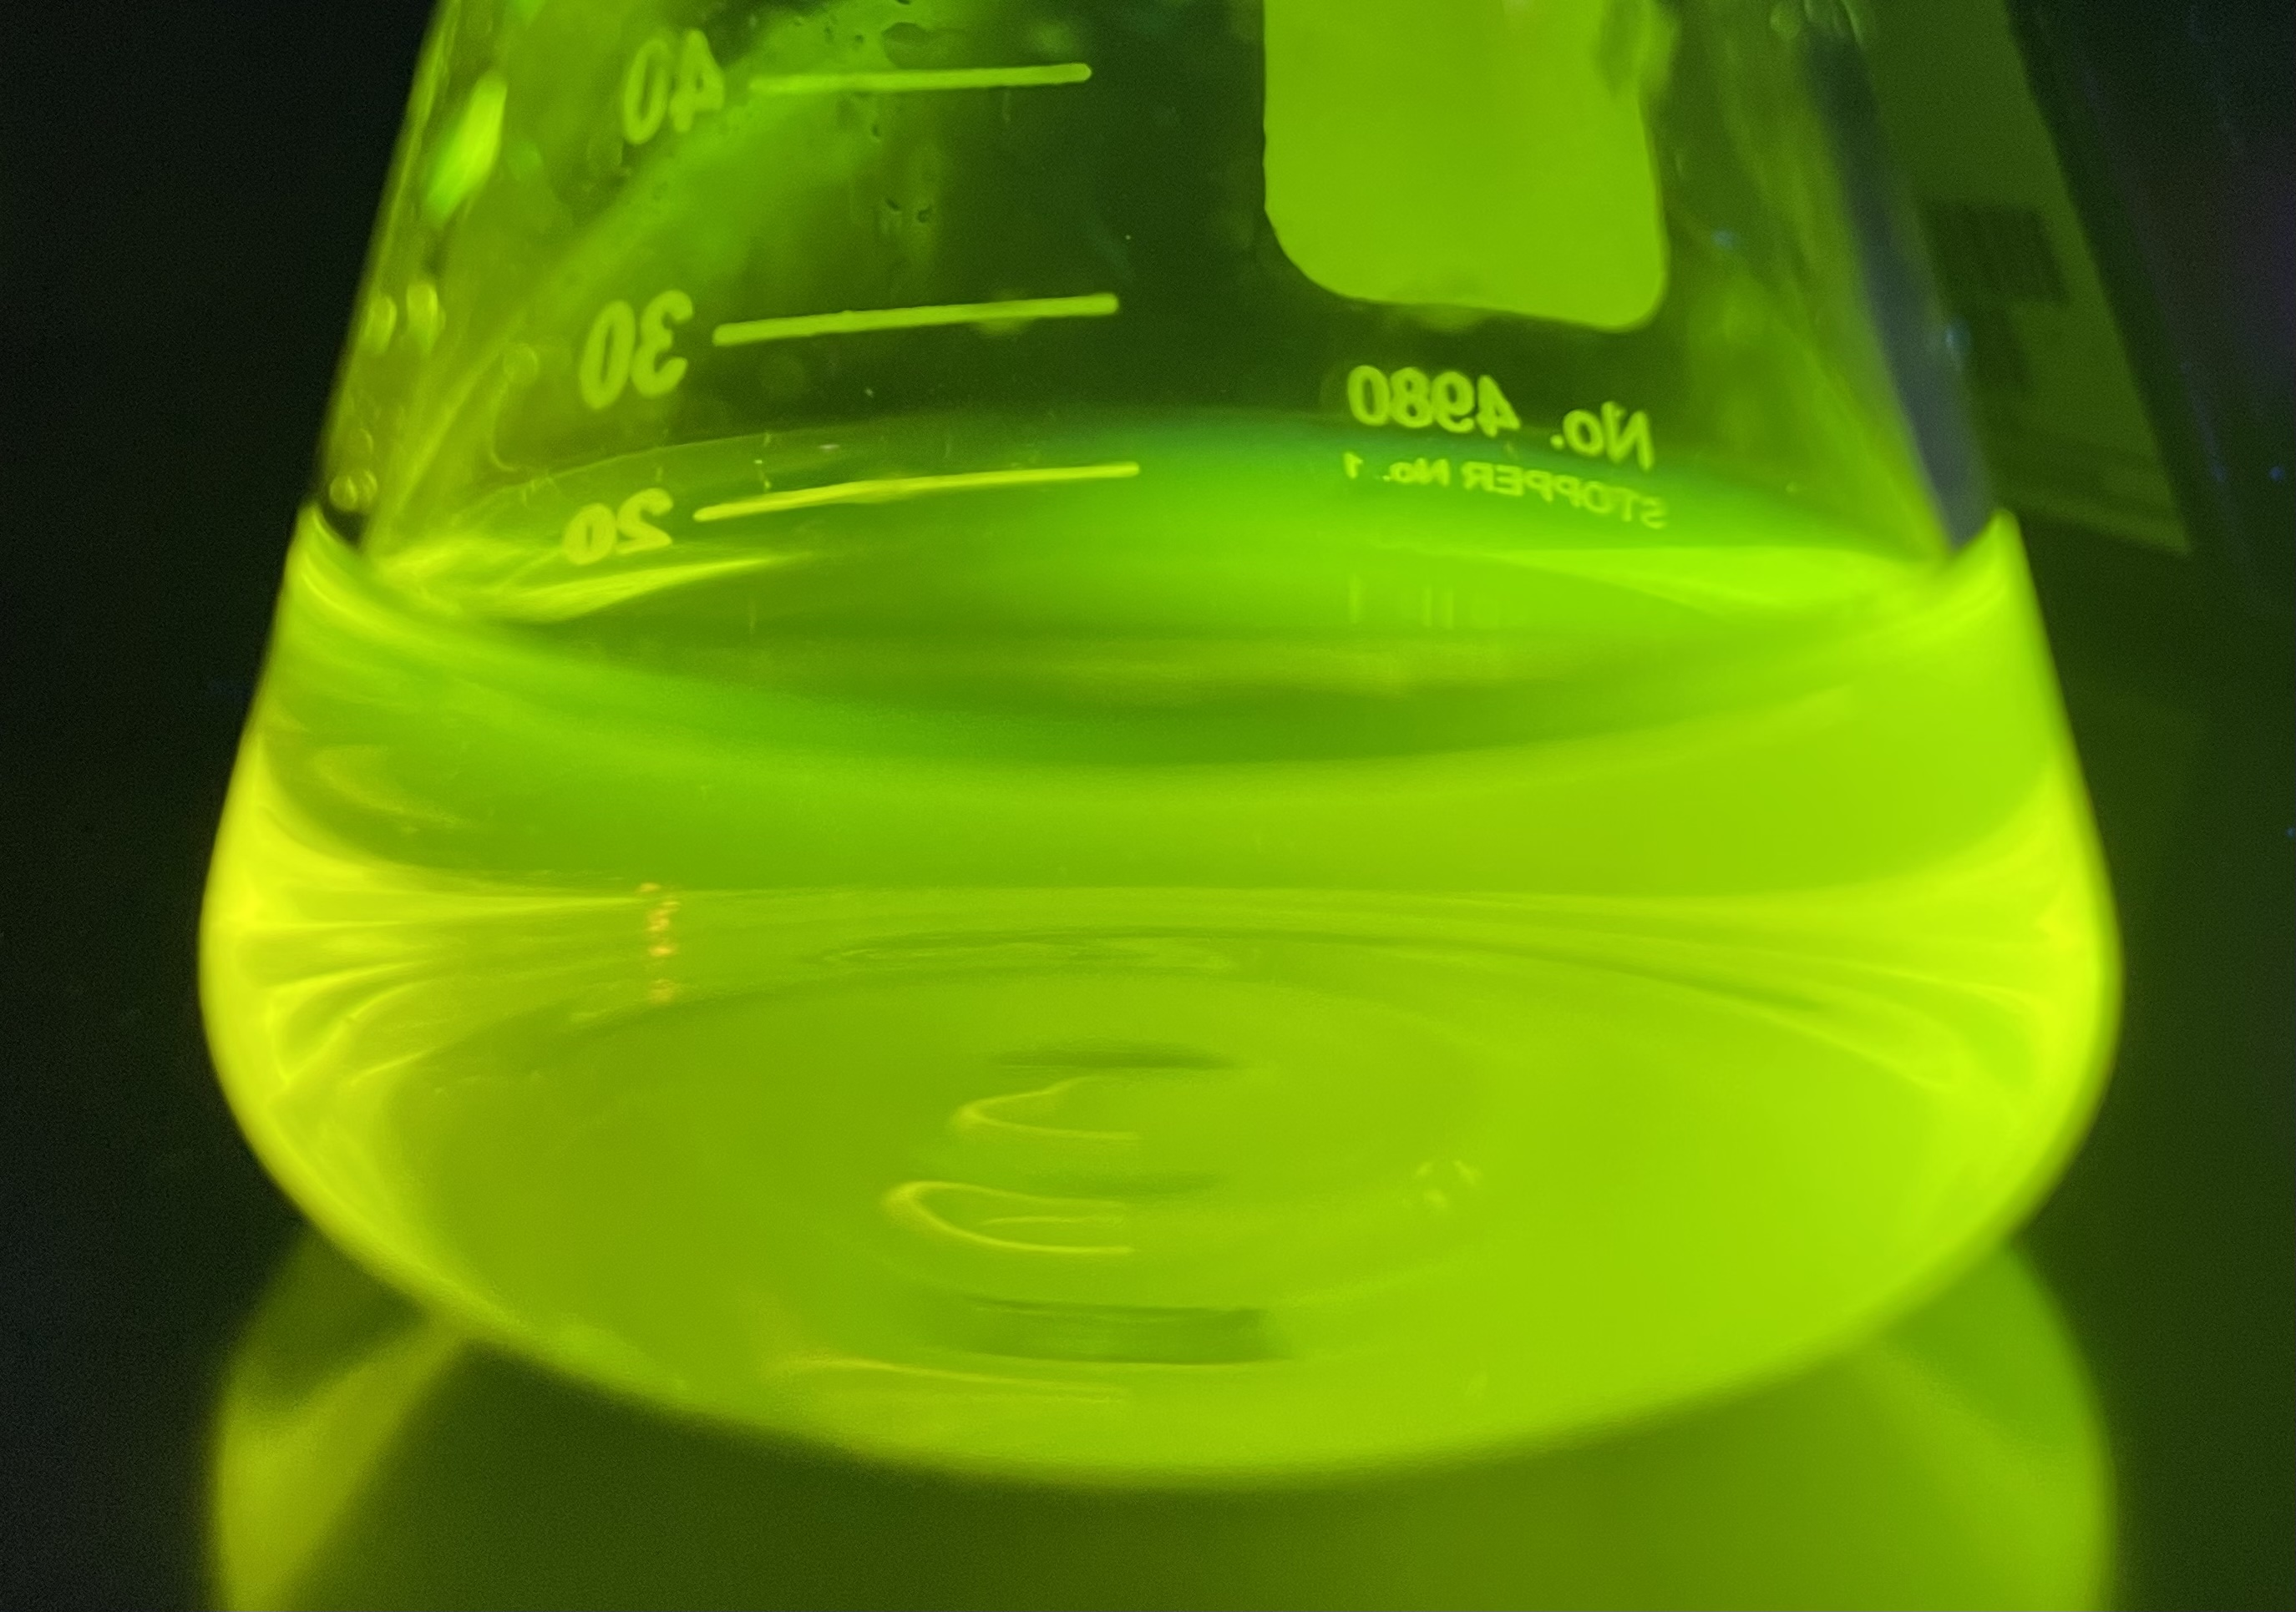
The Synthesis and Analysis of Fluorescent
Cell Stains For Biomedical Applications
Angielisa Sirard, Ashley Stubbs, Richard Tuttle, and Dr. Michael Korn
Background and Abstract
Results and Conclusion
Background: The principle of fluorescence has become a widely accepted and important biological technique as it allows for the visualization of cells, their extracellular environment, and intracellular organelles. Fluorescence then offers various biological and biomedical applications, including live-cell imaging, bioconjugation strategies, and bioassays [1]. A large number of fluorescent dyes (fluorophores) are presently known for biomedical applications, several of which are shown (Figure 1) [1]. Anthraquinone-based fluorophores (Figure 1(a)) represent several promising fluorescent dyes and exhibit favorable properties, such as a large Stokes shift. The Stokes shift is the difference between the absorption (excitation) and release (emission) of light (Figure 5) [2]. A larger Stokes shift is desired, as small Stokes shifts increase the likeliness of self-quenching for the fluorophore. Very few anthraquinone dyes are on the market, implying many opportunities for further inquiry and development. One currently available dye is DRAQ5 (Figure 1(b)), which has the anthraquinone core and exhibits a far-red stain and is mainly used for nuclei counterstaining [3]. The downside to DRAQ5 and other commonly used cell stains, like DAPI, is the complex synthesis that results in a higher price, so part of this research is striving to look for a cheaper and more readily available alternative. Furthermore, many commonly used fluorescent dyes are only used on fixed cells, not live cells, which could be very beneficial for medical research, especially in DNA dying.
Abstract: This research analyzes and builds upon previous students' work to synthesize more effective fluorescent dyes (fluorophores) with an application as cell stains. The anthraquinone core has demonstrated desirable fluorescent and photophysical properties; variable substituents have then been added to synthesize various fluorescent dyes (Figure 1).
1. Several new anthraquinone-based fluorophores were synthesized and characterized by various analytical tools. These dyes seem to be efficient in their dying abilities and appear to be promising in their abilities.
2. These new fluorophores exhibit fluorescent properties with excitation and emission maxima between 380-750 nm, and the Stokes shifts are large enough to diminish the magnitude of self-quenching.
3. ADS3 shows the ability to permeate cell membranes and stain organelles inside the cell.
Figure 8 shows that the ADS3 compound can stain buccal cells without needing a lengthy washing stage that requires a centrifuge and using low temperatures. ADS3 can stain live cells just through incubation at room temperature in the dark.
4. FT-IR spectra, melting point analyses, and TLC plates prove the presence of new compounds with properties different from the starting materials and consistent with theoretical values.
These experimental techniques identify new characteristics between the starting material and synthesized compounds. New characteristics then indicated successful synthesis reactions.
5. RRT1-4 presented difficulty in being isolated and purified.
A suitable solvent, or mixture of solvents, was difficult to locate/isolate and purify these compounds. Without isolation and purification, these compounds’ properties were not able to be completely identified.
6. RRT5 demonstrated promising results in terms of purity and physical properties.
The RRT5 product was successfully found to be a compound different than the starting material. Experimental techniques demonstrated the relative purity of the compound. This compound proved promising as it was water-soluble.
(a) (b) (c) (d)
Figure 1. The structure of the anthraquinone core with respective R-group positions (a) [4]. The structure for DRAQ5 (b) [5], DAPI (c) [6], and fluorescein (d) [7].
Figure 2. ADS3 fluorometer spectrum. The excitation and emission maxima are 425.5/560.5 nm [4].
Figure 3. AFS1AA in Tris buffer fluorometer spectrum. The excitation and emission maxima are 397.0/485.5 nm [4].
(a) (b)
Figure 4. Sodium fluorescein spectrum with an excitation and emission maxima are at 490.0/514.0 nm (a). DAPI spectrum with an excitation and emission maxima at 345.0/445.5 nm (b) [4].
Future Work
Utilize the confocal microscope at LUCOM to image cells stained with the synthesized dyes to identify what structures/organelles are being stained.
Further purification of the compounds.
Analyze the dyes using flow cytometry.
Further testing using DNA Gel Electrophoresis to see if the dyes bind to or intercalate with DNA.
High-performance liquid chromatography (HPLC) and liquid chromatography-mass spectroscopy (LC-MS) to determine the purity and identity of the compounds.
Introduction
This research investigates the photophysical properties of modified anthraquinones. Very few anthraquinone dyes are on the market, implying many opportunities for further inquiry and development. Presently, various new anthraquinone-derived fluorophores have been synthesized in the experimental process. The fluorescent properties of these fluorophores have been analyzed, and some of their biomedical applications will be presented.
1 2 3 4 5 6 7 8 9 10 11 12 13 14
Figure 5. Jablonski diagram shows the process of light absorption and emission [2].
1 2 3 4 5 6 7 8 9 10 11 12 13 14
Figure 6. Live buccal cells stained with ADS3 using Zeiss Axioskop 2
Plus fluorescence microscope [4].
References and Acknowledgments
A
B
(1) Mahato, R. Chapter 2- Multifunctional Micro- and Nanoparticles. Emerging Nanotechnologies for Diagnostics, Drug Delivery, and Medical Devices: Micro and Nano Technologies 2017, 21-43.
(2) Lakowicz J.R. (eds) Principles of Fluorescence Spectroscopy, Springer, 2006, pp. 27-61.
(3) https://www.thermofisher.com/order/catalog/product/62251 (accessed 3/12/22).
(4) Generated by Dr. Michael Korn, Angielisa Sirard, Richard Tuttle.
(5) https://images.aatbio.com/products/figures-and-data/readiuse-draq5-staining-solution-5-mm-in-water/chemical-structure-of-readiuse-draq5-staining-solution-5-mm-in-water.svg (accessed 3/12/22)
(6) https://images.aatbio.com/products/figures-and-data/dapi-4-6-diamidino-2-phenylindole-dihydrochloride-cas-28718-90-3/chemical-structure-of-dapi-4-6-diamidino-2-phenylindole-dihydrochloride-cas-28718-90-3.svg (accessed 3/12/22)
(7) https://en.wikipedia.org/wiki/Fluorescein#/media/File:Fluorescein_2.svg (accessed 3/12/22)
We thank Dr. Winter, Dr. Rockabrand, and Dr. Passburg for their advice and any materials they provided us. We thank the Center for Research and Scholarship (CRS) at Liberty University for their financial support of this project.
Methods
C
Figure 7. AFS1 compound fluorescing under UV light [4].
Several new anthraquinone-based compounds were synthesized with several different functional groups were placed on the R groups (Figure 1), varying for each compound.
Those compounds have been analyzed by thin layer chromatography, melting point analysis, and infrared
spectroscopy.
Fluorimetry (Figures 2 and 3) was used to determine the Stokes shifts.
Fluorescence microscopy (Figure 6) was used to determine the dye's
ability to stain cells.
Figure 8. Fluorescein in D.I. water under visible light (left) and short wavelength (365 nm) UV light (right) [4].
Figure 9. The graph shows the correlating wavelengths (nm) and Stokes shifts of various anthraquinone compounds [4].

