Slide 1
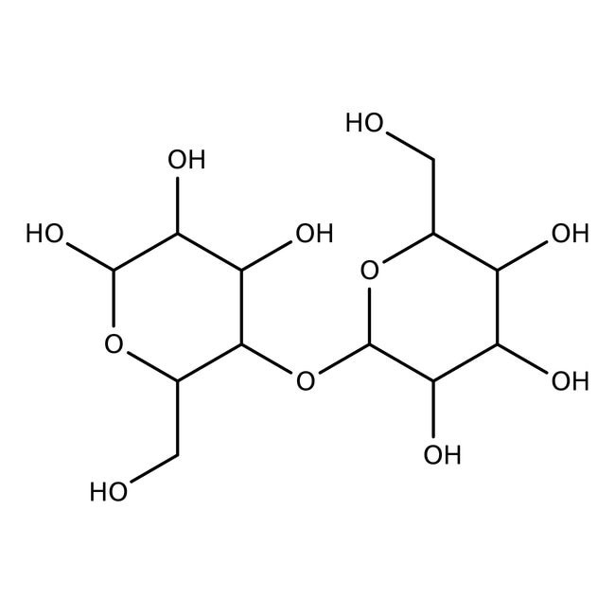
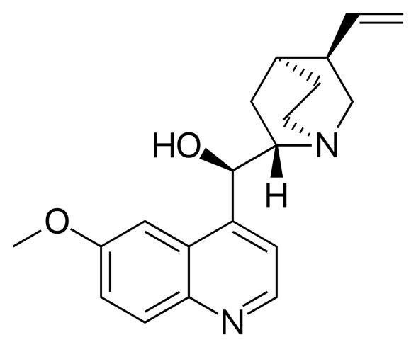
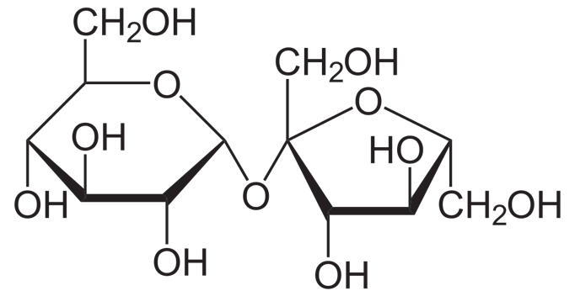
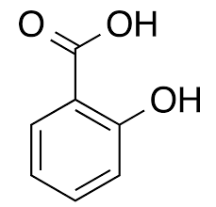
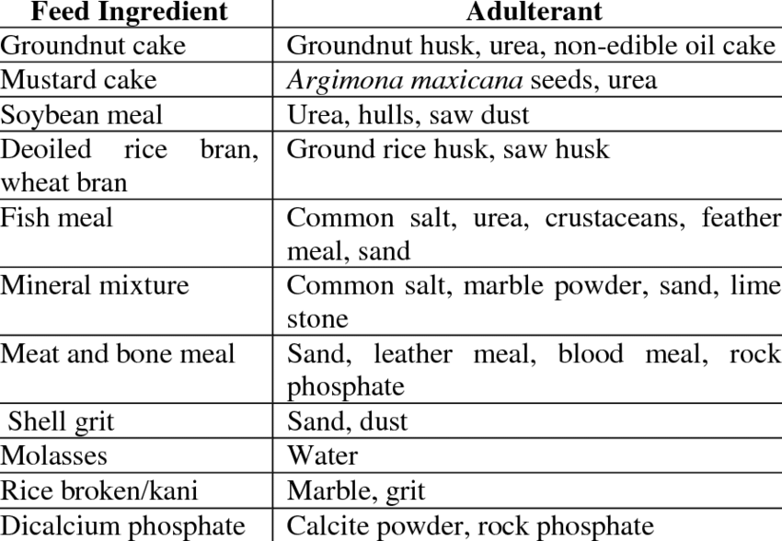
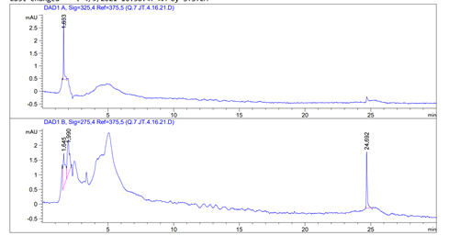
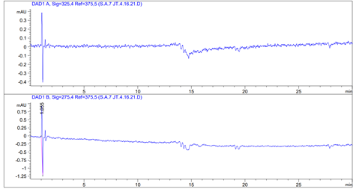
HPLC Analysis of Common Adulterants
Jedidiah Black, Lynza Osorio, Madison Landreth, and Dr. Chad Snyder
Abstract and Background
Results and Conclusion
Background: Illicit drugs, which at times can be sold in pure form, are often instead combined, or “cut,” with an additional substance besides the drug itself. These additional substances are divided into two categories: Adulterants and diluents. This research focused primarily on adulterants. While diluents have no psychological effect on the user, adulterants are defined in the following way: “They are used to enhance or mimic the effects of illicit drugs [and] to ease or make the administration of the illicit drug more efficient” (Broséus et al, 2016). Furthermore, adulterants are “pharmacologically active substances, usually more expensive and less available than diluents” (Broséus et al, 2016). For example, an adulterant for cocaine could be caffeine. Identification of adulterants and diluents in illicit drug samples can become a key element in helping to identify the distributor and distribution patterns. Methods: High Performance Liquid Chromatography (HPLC) was the instrument used to analyze quinine and salicylic acid, the adulterants used in this research. The specific methodology can be found below. Results and/or Conclusion: While detecting quinine and salicylic acid separately was a success, we were unable to detect both adulterants simultaneously. Additionally, after several weeks of attempting adulterant detection, the minimum amount of time we were able to detect results was approximately thirty minutes.
Results:
The HPLC machine was able to detect both Quinine and Salicylic acid separately (see Figure 6); however, we were unable to repeat these results. Furthermore, these results were obtained within 30 minutes, not within the 10-minute goal of our experiment. We attempted the experiment multiple times, but unfortunately, we were unable to detect Quinine and Salicylic acid in under 10 minutes using High Performance Liquid Chromatography.
Conclusion:
We believe we were unable to achieve our goal due to several reasons. We do not think it is impossible to detect Quinine and Salicylic acid using HPLC, however we believe this process would require long hours of laboratory work that we were unable to dedicate. There were a few factors we could have played around with, such as using different solvents or changing the settings on the HPLC machine until we found one that worked. This, however, was not possible to do the amount of time and resources we had to conduct our research each week.
Figure 1. Chemical Structure of cornstarch, a common diluent.
Figure 2. Chemical Structure of sucrose, a common diluent.
Figure 3. Chemical Structure of quinine, one of the two analyzed adulterants.
Future Work
Introduction and Research Question
Determine if both quinine and salicylic acid can be detected simultaneously using HPLC.
Determine if both adulterants can be detected by HPLC in under 10 minutes.
Determine if other common adulterants would result in more efficient detection time.
Determine if other analytical detection methods can be used that would result in a more efficient outcome.
Determine if varying concentrations of the two adulterants would affect detection results.
Oftentimes, illegal drugs are cut with additional substances. The purpose of these additional substances is to allow the drug producer to mass produce a higher supply without using more product. By using these cutting agents, the drug producer saves money by using less product for each substance that is sold. These cutting agents fall into two categories: Diluents and Adulterants. Diluents have no physiological effect on the user. Diluents can be simple compounds like sucrose (C12H22O11) or corn starch (C6H10O5) that solely stretch the supply of product. In contrast, adulterants are used to mimic or enhance a drug’s physiological effects. For example, caffeine is oftentimes added to cocaine because of its stimulatory properties. This not only stretches the supply, but also mimics the effects of the illicit drug itself. This research seeks to use High-Performance Liquid Chromatography (HPLC) to efficiently detect and quantify mixtures of these cutting agents. Two organic compounds that will be used are salicylic acid and quinine. Salicylic acid is a bitter tasting, but odorless solid, and quinine is commonly used as a muscle relaxant. Both of these compounds are adulterants that appear as white crystalline solids and can easily be made into a powder. There are three goals for this project: (1) Research HPLC methods that can detect known concentrations of cutting agents, (2) identify these cutting agents as compared to the standards made in the laboratory, and (3) determine a method of analysis that can be run successfully in under ten minutes. If cutting agent(s) are able to be quantified, this process can be effective in the determination of the origin of the distributor of the drugs themselves, and therefore, can prove valuable to the forensic community.
Figure 4. Chemical Structure of salicylic acid, one of the two analyzed adulterants.
Figure 5. Common adulterants potentially found in varying foods.
References
Aljohar, H. I., Abuhaimed, S. N., Maher, H. M., Nafisah, B. A., & Alkhalaf, A. M. (2019). Gas chromatography tandem mass spectrometry for the screening of adulterants in seized captagon™ tablets. Null, 42(11-12), 358-366. https://10.1080/10826076.2019.1610433
Barreto, D. N., Ribeiro, Michelle M. A. C., Sudo, J. T. C., Richter, E. M., Muñoz, R. A. A., & Silva, S. G. (2020). High-throughput screening of cocaine, adulterants, and diluents in seized samples using capillary electrophoresis with capacitively coupled contactless conductivity detection. Talanta, 217, 120987. https://doi.org/10.1016/j.talanta.2020.120987
Broséus, J., Gentile, N., Bonadio Pont, F., Garcia Gongora, J. M., Gasté, L., & Esseiva, P. (2015). Qualitative, quantitative and temporal study of cutting agents for cocaine and heroin over 9 years. Forensic Science International (Online), 257, 307-313. http://dx.doi.org/10.1016/j.forsciint.2015.09.014
Broséus, J., Gentile, N., & Esseiva, P. (2016). The cutting of cocaine and heroin: A critical review. Forensic Science International, 262, 73-83. https://https://doi.org/10.1016/j.forsciint.2016.02.033
Dawidowicz, A. L., Bernacik, K., Typek, R., & Stankevič, M. (2018). Possibility of quinine transformation in food products: LC–MS and NMR techniques in analysis of quinine derivatives. European Food Research and Technology = Zeitschrift Für Lebensmittel-Untersuchung Und -Forschung.A, 244(1), 105-116. http://dx.doi.org/10.1007/s00217-017-2940-0
Kaliszewski, Michael (14 October 2019). Statistics of Drug Use in High School. American Addiction Centers. Retrieved from https://americanaddictioncenters.org/blog/statistics-of-drug-use-in-high-school
Kochana, J., Zakrzewska, A., Parczewski, A., & Wilamowski, J. (2005). TLC screening method for identification of active components of “Ecstasy” tablets. influence of diluents and adulterants. Null, 28(18), 2875-2886. https://10.1080/10826070500269984
National Center for Biotechnology Information (2021). PubChem Compound Summary for CID 338, Salicylic acid. Retrieved September 12, 2021 from https://pubchem.ncbi.nlm.nih.gov/compound/Salicylic-acid.
Substance Abuse and Mental Health Services Administration. (2018). Key Substance Use and Mental Health Indicators in the United States: Results from the 2017 National Survey on Drug Use and Health. Retrieved fromhttps://americanaddictioncenters.org/rehab-guide/addiction-statistics
Vinkovic, K., Galic, N., & Schmid, M. G. (2018). Micro-HPLC–UV analysis of cocaine and its adulterants in illicit cocaine samples seized by austrian police from 2012 to 2017. Null, 41(1), 6-13. https://10.1080/10826076.2017.1409237
1 2 3 4 5 6 7 8 9 10 11 12 13 14
Methods
1 2 3 4 5 6 7 8 9 10 11 12 13 14
Standard Preparation
Analytical standards were prepared using a 1 L stock solution of each salicylic acid and quinine (concentration of 100 ppm in DI water). These stock solutions were diluted to make our working standards which had the following concentrations of individual salicylic acid and individual quinine: 0.1 ppm, 0.3 ppm, 0.5 ppm, and 0.7 ppm. An additional standard was made that was a combination of 0.3 ppm quinine and 0.3 ppm salicylic acid. Each standard was 100 mL and stored in a Pyrex, A grade, 100 ± .08 mL volumetric flask. Standards were stoppered, covered with parafilm, and refrigerated for storage.
Chromatographic Conditions
The analytical column was a Bondapak, C₁₈, 1 mm, 3.9 x 150 mm². The mobile phase consisted of acetic acid, methanol, CAD prepared Na₂HPO₄ – Na₂B₄O₄, and deionized water. The method was varied in order.
Experimentation
Experimentation was carried out using an Agilent 1260 Infinity Quaternary pump, type ID G1311B, serial number DEADO 16907 (Agilent, Santa Clara, California). Injection was carried out through the built-in injection valve and sample detection was achieved by an Agilent Diode Array Detector, Type ID G1315C, serial number DEAA 203238. Solvents were degassed through the built-in integrated vacuum degassing unit. The method used was 70% DiH₂O (.1% TFA), 20% Methanol (100% BASILE), 9% acetonitrile (.1% TFA), and 1.0% glacial acetic acid (100% RICA), with a run time of 10 minutes per sample. Standard HPLC vials were used, and 200 mL samples of the standards were pipetted into the vials using a Poseidon, Genesee Scientific, 20-200 mL transfer pipette. Nine samples in total were run, which were one of each of the following: 0.1 ppm salicylic acid, 0.3 ppm salicylic acid, 0.5 ppm salicylic acid, 0.7 ppm salicylic acid, 0.1 ppm quinine, 0.3 ppm quinine, 0.5 ppm quinine, 0.7 ppm quinine, and a .03 ppm salicylic acid/quinine mix.
A
B
C
.
Figure 6. HPLC analysis detection for quinine (above) and salicylic acid (below).

