Slide 1

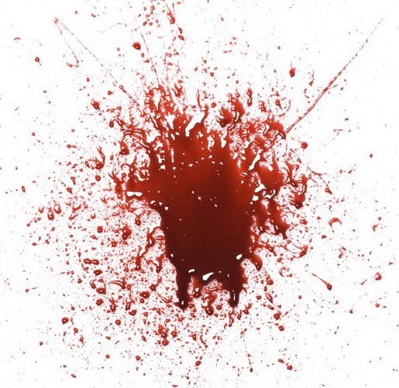
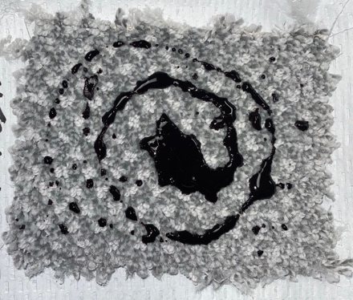
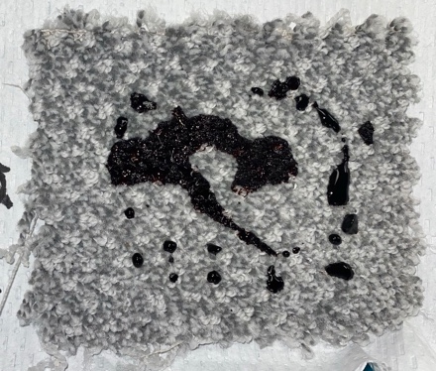
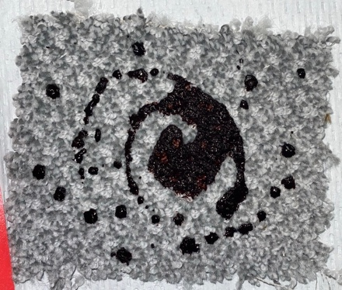
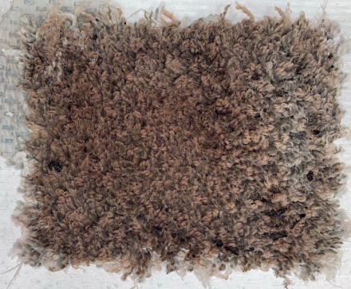
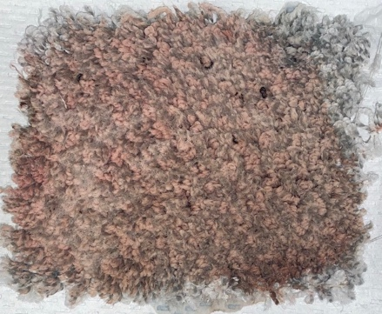
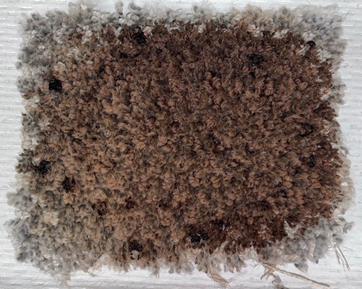
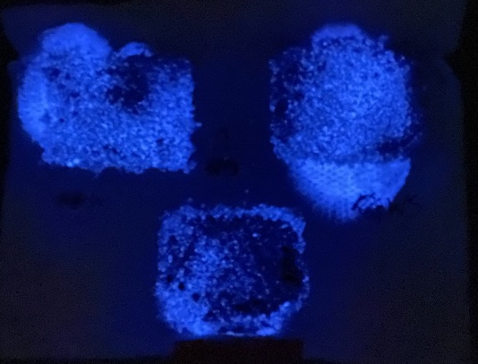
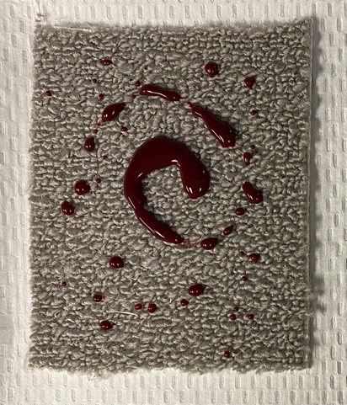
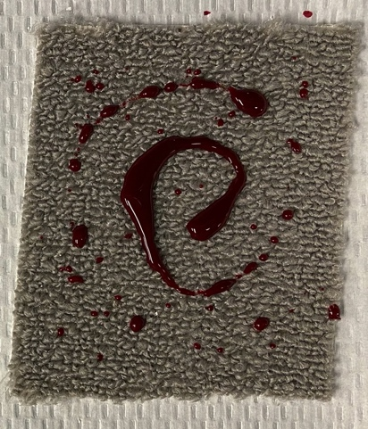
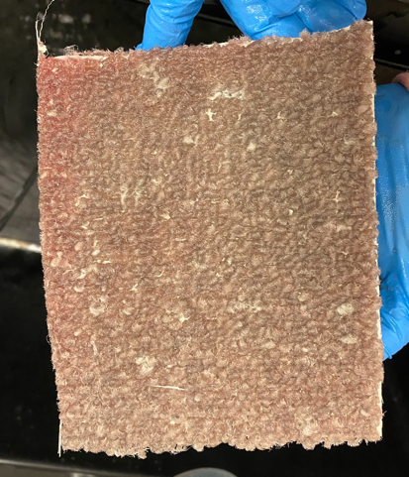
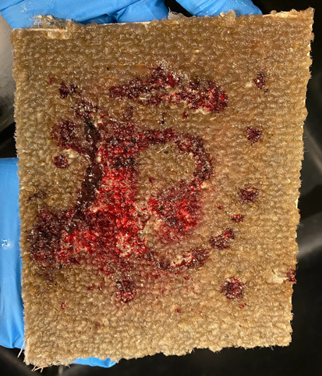
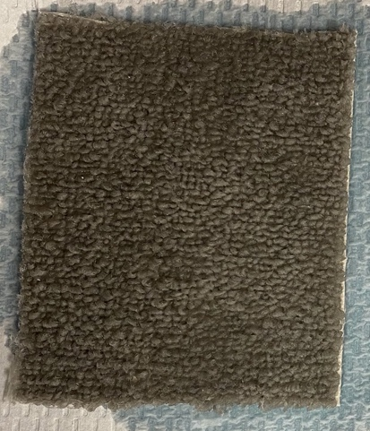
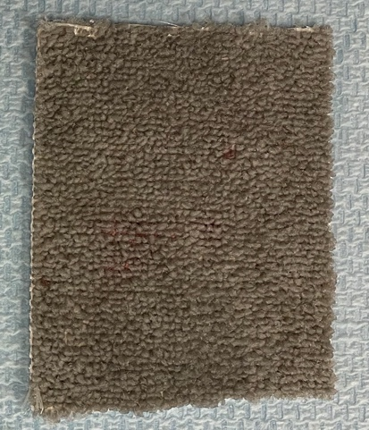
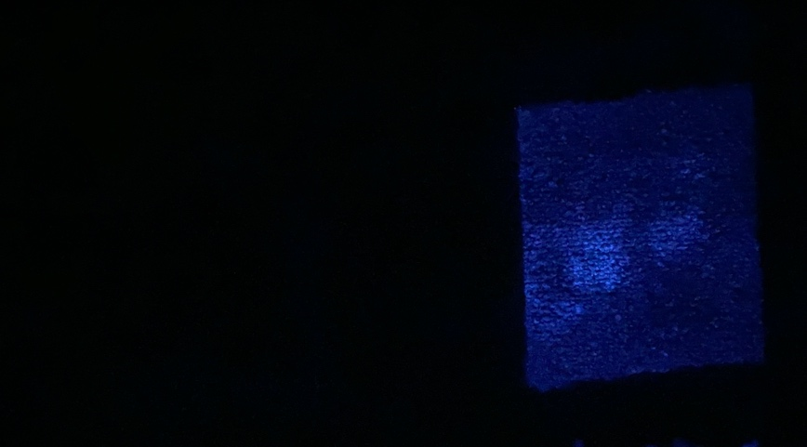
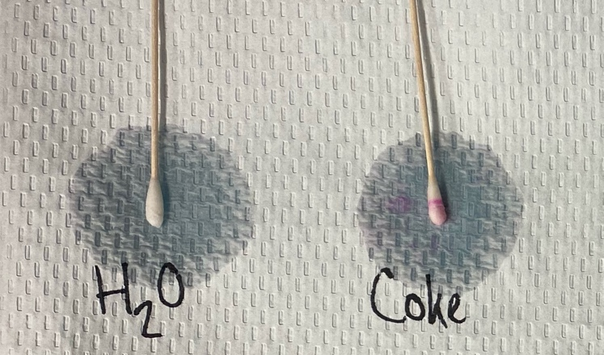
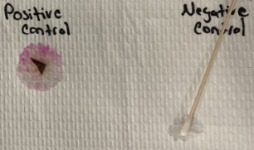
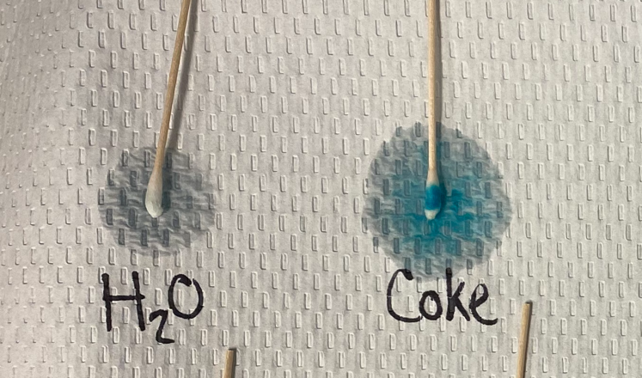
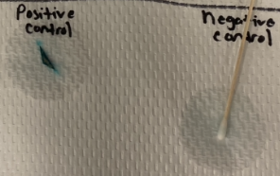
The Effect of Coca-Cola™ on the Detection of Fresh and Latent Blood Stains
Brittany N. Johnson, Kaitlyn T. Steigerwald, Rachel L. Eberle, Bethany R. Smith, and J. Thomas McClintock
Abstract
Results and Conclusion
At a crime scene where blood is the major bodily fluid, it is not uncommon for the perpetrator to attempt to clean up the stains using an assortment of household cleaning agents. During the trial of two University of Virginia students, Jens Soering and Elizabeth Haysom, who were accused of killing Ms. Haysom’s parents in the town of Boonesboro, Virginia, Ms. Haysom² testified to instructing Mr. Soering to clean up the blood-soaked carpet of their rent-a-car using Coca-Cola™. Although no blood or remnants were observed (via Luminol) in the rental car months after the crime occurred, questions as to the efficacy of this method arose during the making of a Netflix documentary centered around the mysterious murders of Derek and Nancy Haysom. Thus, this research focused on the effect of Coca-Cola™ on the potential removal of fresh and latent blood stains from carpet by varying the times of exposure to Coca Cola™. Carpet samples were subjected to soaking in Coca-Cola™ followed by scrubbing the carpet sample then rinsing the carpet until the water running off appeared to be clear. Removal and/or degradation of the blood stains were determined by various presumptive testing by exposure to Luminol (a product designed to fluorescence in the presence of blood) and chemical testing (i.e., phenolphthalein and leucomalachite green).
a)
Results​
After carpet samples were treated (Figure 1a), an obvious stain remained dispersed throughout the carpet (Figure 1b). All samples appeared to have the same amount of high fluorescence when analyzed with Luminol (Figure 1c, Table 1). Due to the inability to decrease the fluorescence in the carpet samples during Rounds 1 and 2, treatment methods were altered for Rounds 3-6.​
When analyzed with Luminol, carpet samples from Rounds 3 and 4 appeared to have moderate to high fluorescence suggesting the blood stain was not significantly affected (Figure 4). Round 3 samples had moderate to high fluorescence in the same pattern as the blood stain. The Round 3 - 30 Minute Coke sample had the lowest fluorescence of all the samples tested in Round 3. Phenolphthalein tests, a presumptive test for blood (Table 2a), of Round 3 samples produced a faint positive response except for the 30 Minute Scrub (negative), and the 2 Day Rinse (positive). LCG, another presumptive test for blood (Table 2b), of Round 3 samples were positive, with an intense positive 2 Hour Rinse and 1 Day Rinse, and faint positives for all the Scrub samples.​
Round 4 samples appeared to have fluorescence (Figure 4) at the blood stain in addition to lesser fluorescence around the blood stain area. Samples from 30 Minute and 2 Hour appeared to fluoresce the same and progressively increased in fluorescence the longer blood remained before treatment. Phenolphthalein (Table 2a) was positive for all samples (faint positive for all scrub samples and 2 Hour Rinse sample). LCG (Table 2b) indicated positive results: 2 Hour Rinse and Scrub, and 2 Day Scrub (faint positive); 2 Day Rinse, 30 Minute and 1 Day Scrub (positive); 30 Minute and 1 Day Rinse (intense positive).​
Blood was applied to the Round 5 and 6 carpet samples (Figure 3a), soaked in Coke (Figure 3b), treating the sample (Figure 3c), allowed to dry, and analyzing the carpet sample with Luminol (Figure 3d). Round 5 Water samples did not fluoresce when analyzed with Luminol (Figure 4). Round 5 Coke samples fluoresced when analyzed with Luminol (2 Hour sample had the lowest fluorescence). Phenolphthalein (Table 2a) was negative for all samples except 30 Minute Scrub (faint positive). LCG (Table 2b) tests were negative for all Coke, 2 Hour and 2 Day Water samples. A faint positive resulted from 1 Day Water sample and a positive result for 30 Minute Water. Round 6 samples, analyzed with Luminol (Figure 4), resulted in no fluorescence for the 30 Minute Water sample. A few spots were visualized on the 2 Hour and 1 Day Water samples. The entire carpet fluoresced for all Round 6 Coke samples. Phenolphthalein (Table 2a) and LCG (Table 2b) indicated positive results for all samples except the 30 Minute Water (Figure 5a, b), which appeared negative. Round 6 samples were subjected to retreatment to determine if multiple treatments would assist in the removal of the blood stains. No fluorescence appeared on the Water samples and a decrease of fluorescence was shown on the Coke samples. All samples, except the 2 Hour and 1 Day Coke, were negative when subjected to phenolphthalein (Table 2a) and LCG (Figure 2b) tests. ​
A positive control was conducted by pouring blood on a carpet sample, dried, and analyzed with Luminol (highly fluorescent). A negative control was established with 2 samples: Coke being poured on a carpet sample (not rinsed) and a one soaked in 300ml of Coke (2 hours), rinsed for 20 seconds and dried before being analyzed with Luminol (no fluorescence). ​
Conclusion​
Multiple Coke treatments could potentially eliminate blood stains from carpet​
Soaking carpet samples in Coke was determined to be the most effective method of reducing the presence of blood stains on carpet samples. ​
Scrubbing carpet samples was shown to be more effective compared to rinsing the samples in removing the blood from carpet​
Coke cannot be used alone to remove blood from carpet samples.
b)
c)
Figure 1. Results from Round 1- 2 Hour Samples. Blood was applied to the carpet (a) and allowed to dry for 2 hours until subjected to treatment (b) which consisted of either water (left), soap and water (center) or Coke (right). The carpet samples were scrubbed and allowed to dry. The samples were analyzed with Luminol (c) to detect the presence/absence of blood. All the carpet samples containing fresh or latent blood were highly fluorescent when viewed with Luminol. Carpet samples containing blood and cleaned with soap and water (top right) were the most fluorescent with the carpet samples containing blood and rinsed with Coke were the least fluorescent (bottom).​
Introduction
Table 1. Results of the Carpet Samples from Rounds 1 and 2. Carpet samples containing fresh and latent blood stains were subjected to a scrub with water, water and soap, or Coke. After the carpet samples were dried, samples were analyzed with Luminol to detect the presence/absence of blood. All the carpet samples showed high fluorescence as indicated by a score of 5/5.
The purpose of this research was to determine if the corrosive properties of Coca-Cola™ could be used as an effective way of removing blood from carpet, in the same way Elizabeth Haysom allegedly instructed Jens Soering to use Coca-Cola™ to remove the blood from the floor of the rental car.^{1,2} This was tested by pouring a predetermined amount of blood onto various samples of carpet. The length of time for which the blood sat on the carpet varied, as did the method of cleaning and the solution used to clean the carpet for the first two rounds, comparing the results obtained from cleaning the carpet with Coca-Cola™ to those obtained when cleaning with only water or soap and water. The preceding rounds focused primarily on comparing the results of trials conducted with only water or Coca-Cola™ and the scrubbing method of cleaning. All carpet samples were subjected to a series of presumptive tests, including Luminol, leucomalachite green (LCG), and phenolphthalein.
a) b)
c) d)
Methods
h
Carpet samples were cut into sizes of 11cm x 14cm. Dog blood was obtained from a local veterinarian’s office. 3-5ml of blood was measured into conical tubes and refrigerated until testing. Blood was warmed to 37ºC for 15 minutes and vortexed prior to pouring onto the carpet samples. The blood was poured on the carpet samples in a circular fashion and remained untouched for a set amount of time (30 minutes, 2 hours, 1 day, 2 days, or 1 week) prior to treatment. Treatment consisted of a rinse, scrub, or soak. A rinse was performed under a steady stream of water until the “runoff” appeared clear. After treatment, carpet samples were dried at room temperature before being subjected to a series of presumptive tests.
Rounds 1 and 2: Three carpet samples containing fresh or latent blood were used for each time increment (i.e., 2 hours, 1 day, 2 days, and 1 week) and rinsed in water, water and soap, or Coke. 50ml of Coke or water was poured onto the corresponding carpet sample, scrubbed, and dried. On samples labeled water and soap, 25ml of water was combined with soap then poured onto the sample and scrubbed. The remaining 25ml of water was poured onto the sample and the carpet was scrubbed again and dried. Round 2 samples were subjected to a rinse after scrubbing then dried.
Rounds 3 and 4: Two carpet samples containing fresh or latent blood were used for each time increment (i.e., 30 minutes, 2 hours, 1 day, and 2 days), soaked in 150ml of Coke (Round 3 samples for one hour and Round 4 samples for 2 hours), scrubbed and/or rinsed, and dried.
Rounds 5 and 6: Two carpet samples for each time increment (30 minutes, 2 hours, 1 day, and 2 days) were soaked in 300ml of Coke or water (3 hours [Round 5] or 2 hours [Round 6]). The carpet samples were scrubbed, rinsed, then dried. Round 6 samples were subjected to another round of treatment upon completion of the initial presumptive tests. The same treatment protocol was followed again for further analysis.
Presumptive Tests: Presumptive Tests were used to detect the potential presence of blood on the carpet samples. 4ml of Luminol (Evident) was made for each Round of samples.³ Phenolphthalein test kit³ (Evident): positive samples will turn pink in color whereas a negative sample remains colorless. LCG³ (Alfa Aesar): positive samples will turn a bright green/blue color whereas a negative sample will remain colorless.
Figure 3. Results from Round 6 - 30 Minute Samples. Photographs were taken of carpet samples containing fresh and latent blood after treatment (scrubbing and rinsing) and analyzed with Luminol. Blood was applied to the carpet samples (a), allowed to dry for 30 minutes, and soaked in 300 ml of water (left – b) or Coke (right – b). After 2 hours, the carpet samples were removed from the liquid, then subjected to treatment (c) - scrub followed by a rinse under a steady stream of water. The carpet samples were then analyzed with Luminol (d) after the samples were dried.​
Figure 4. Luminol Results from Rounds 3-6. Samples were analyzed with Luminol after treatment to detect if blood remained on the carpet samples. The blue line shows the results from samples soaked with water or samples which were subjected to rinse only (Rounds 3-4); the red line shows the results from samples treated with Coke or a scrub and rinse (Rounds 3-4). The level of fluorescence ranged from 0 - 5: with 0 - no fluorescence, 1 – a very low fluorescence or only a small spot fluoresced, 2 - a few spots on the carpet fluoresced, 3 - entire carpet sample had a light fluorescence, 4 – a bright fluorescence covered the entire carpet, and 5 – a very high fluorescence covered the entire carpet.
a)
b)
Future Work
a) b)
Analyze the effect of Coke, using identical treatments, on automobile carpet similar to the rental car (1985 Chevrolet Chevette) used by Jens Soering and Elizabeth Haysom used during the weekend of the murders of Derek and Nancy Haysom. The carpet will be used to determine if the results differ from that observed using thin, household carpet.​
Perform DNA extractions, followed by visualization via gel electrophoresis, on carpet samples from all Rounds of samples to detect possible degradation of blood. ​
Testing other variables such as water temperature, combining multiple cleaning products/methods, or cleaning the carpet samples numerous times to determine if any treatments could effectively remove blood from carpet samples. ​
Figure 5. Presumptive Test Results from Round 6 – 30 Minute Samples. Phenolphthalein (a) and leucomalachite green (b), were used to detect the presence/absence of blood from the carpet samples. A positive control and a negative control were performed alongside each round of testing to ensure the reagents worked properly. A pink color and a bright blue color will result if the sample is positive in a phenolphthalein and LCG test, respectively. No color change is indicative of a negative result.
Table 2. Results from Presumptive Blood Tests. Phenolphthalein (a) and leucomalachite green (LCG) (b) were used to detect the presence of blood after the carpet samples were subjected to treatment (soak, scrub, rinse). Results were indicated as followed: negative results ”-”, faint positive “+”, positive “++”, and intense positive “+++”.
References
Commonwealth of Virginia v. Jens Soering. (1990). Courtroom Testimony.
Commonwealth of Virginia v. Elizabeth Haysom. (1987). Courtroom Testimony.
McClintock, J. Thomas. (2014). Exercise 3: Detection of Blood. In Forensic Analysis of Biological Evidence: A Laboratory Guide for Serological and DNA Typing (pp. 28-30), CRC Press.

