Slide 1

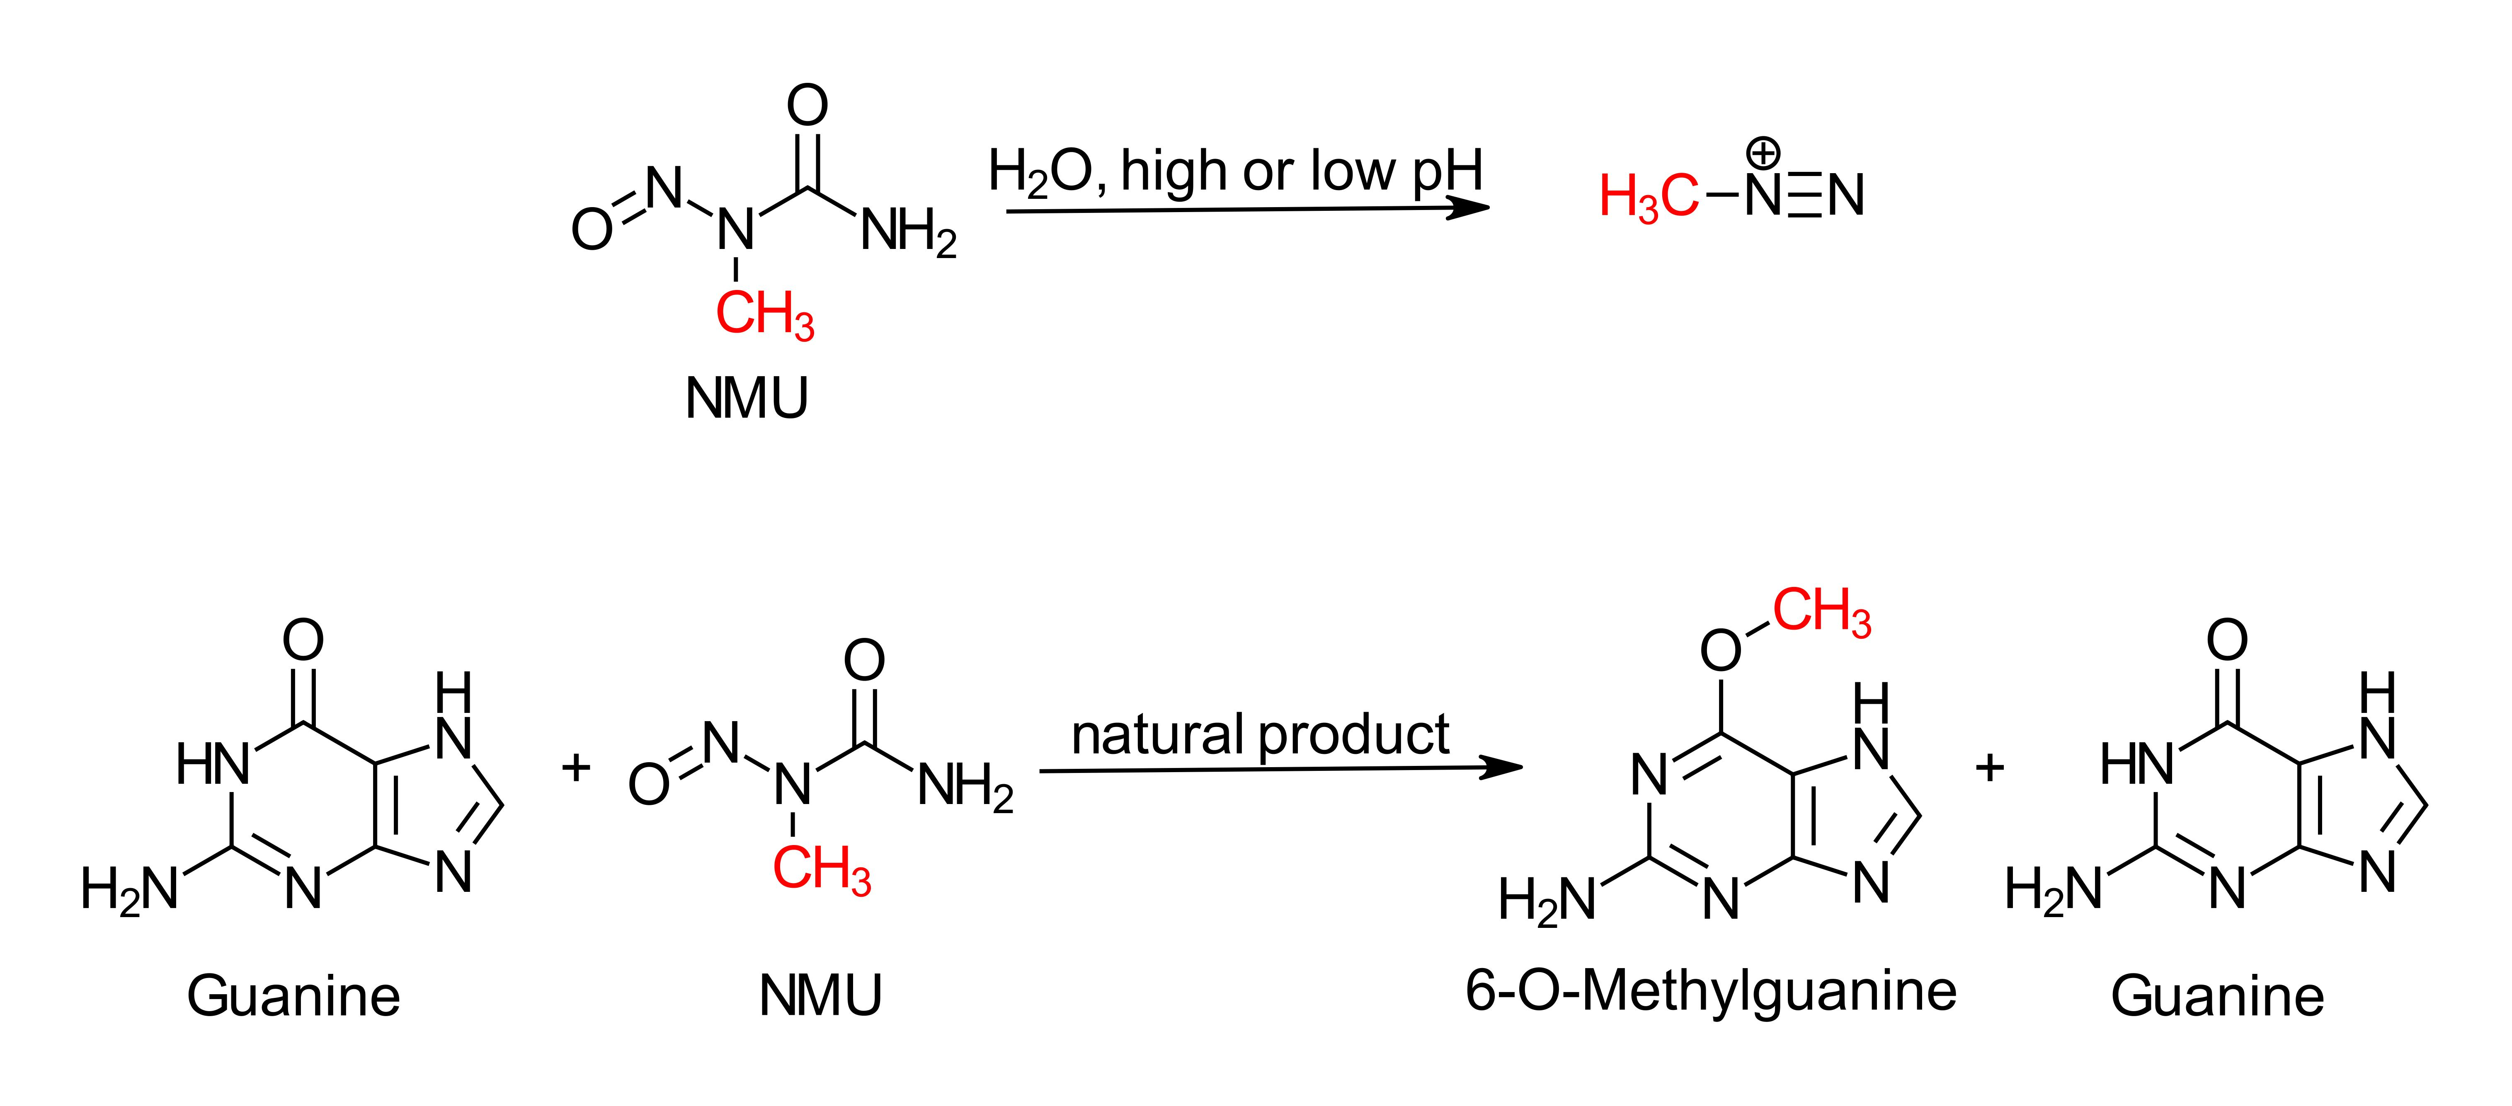
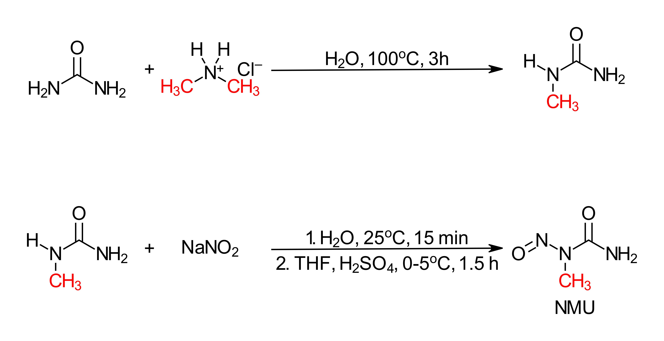
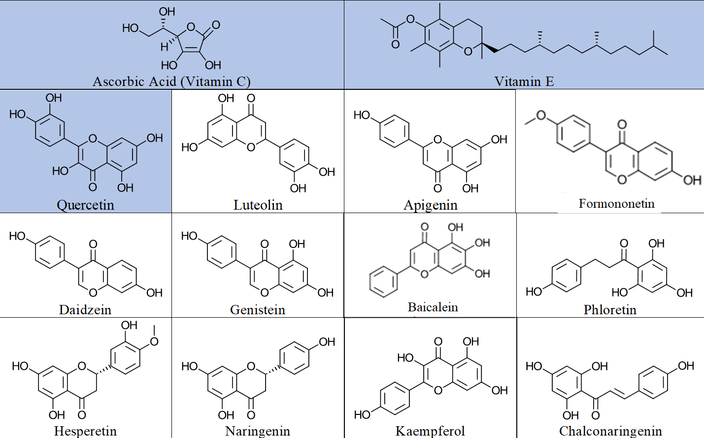
Effect of Dietary Supplements of N-Methyl-N-Nitrosourea Mediated Guanine Methylation
Alec Basile, Madeline McCoy, Hannah Klose, Mary Kate Hall, and Dr. Stephen T. Hobson*
Abstract
Results
Stomach cancer is estimated to affect 27,510 patients per year with over 40% of these cases resulting in fatality. Based on these statistics, a therapeutic lead is needed to prevent the formation of stomach cancer rather than waiting until it develops and treating it. N-methyl-N-nitrosourea (NMU) is formed in situ in the gut from the intake of foods containing nitrate preservatives. At low pH, NMU decomposes to a methyl diazonium salt (Scheme 2) that specifically alkylates guanine at the O-6 position (Scheme 3). This alkylation of guanine on existing DNA leads to DNA mispairing mutations that are linked to stomach cancer. NMU was successfully synthesized by reacting N-methyl urea with various nitrating agents. Reaction conditions were developed to determine the effect of dietary supplements, vitamins, and flavonoids on the alkylation of guanine. Modification of methylation conditions with NMU and results with other flavones and flavonoids will be reported. Relative amounts of inhibition will be reported based on concentrations. These data will provide a lead compound that in the future will form the basis for the design and synthesis of novel compounds.
N-methyl-N-nitrosourea (NMU) synthesized
Effective HPLC methods developed for analysis
Guanine methylation by NMU completed and confirmed by HPLC
Upon exposure of guanine to NMU (Scheme 2)
  Ascorbic acid (Vitamin C) methylation ↓
  Vitamin E methylation ↓
  Quercetin no effect
Scheme 2. Decomposition of NMU to the active alkylating agent, methyl diazonium salt.
Future Work
Develop a standard curve for HPLC
Confirm HPLC method on HPLC-MS
Screen all flavonoids for effect of guanine methylation
Produce relative concentration of inhibition for each antioxidant using fraction of alkylation equation
Determine the most effective concentration of antioxidant for inhibition of guanine alkylation
Scheme 1. Laboratory synthesis of N-methyl-N-nitrosourea starting from urea and dimethyl amine hydrochloride
Scheme 3. Methylation of guanine by NMU in presence of natural products to produce 6-O-Methylguanine and unalkylated guanine
Acknowledgments and
References
Research Question
Acknowledgements:
Faculty Advisor: Stephen T. Hobson, Ph.D. Associate Professor of Chemistry, Liberty University
The authors gratefully acknowledge the support of the Biology and Chemistry Department at Liberty University for the initial support of this work through the funding of CHEM 495 and the continuing support of Liberty University via PRI Grant #1911. We thank Dr. Greg Raner for HPLC training as well as Dr. Gary Isaacs for additional advice.
References
Inhibition of N-nitroso formation: (a). Pourazrang, H., Moazzami, A. A., & Bazzaz, B. F. Inhibition of mutagenic N-nitroso compound formation in sausage samples by using L-ascorbic acid and α-tocopherol. Meat science, 2002, 62, 479-483.
Nitroso induced carcinogenesis: Swann, P. F., & Magee, P. N. Nitrosamine-induced carcinogenesis. The alkylation of nucleic acids of the rat by N-methyl-N-nitrosourea, dimethylnitrosamine, dimethyl sulphate and methyl methanesulphonate. Biochemical Journal, 1968, 110, 39-47.
Blocking the formation of N-Nitroso: Mirvish, S. S., Wallcave, L., Eagen, M., & Shubik, P. Ascorbate-nitrite reaction: possible means of blocking the formation of carcinogenic N-nitroso compounds. Science, 1972, 177, 65-68
Vitamin E as an inhibitor: Lathia, D., & Blum, A. Role of vitamin E as nitrite scavenger and N-nitrosamine inhibitor: a review. International journal for vitamin and nutrition research. Internationale Zeitschrift fur Vitamin-und Ernahrungsforschung. Journal international de vitaminologie et de nutrition, 1989, 59, 430-438
As the inhibition of NMU formation in vivo has been demonstrated with Vitamin C and E in previous research, we are using this to search for lead compounds from flavonoids to find to prevent alkylation of guanine.
Methods
Alkylation of Guanine: An equal molar ratio of guanine and NMU were weighed and added to 1ml of a 0.1M NaCl solution in a micro reaction kit. The reaction was conducted under reflux conditions with stirring for 24 hours.
Preparation of Guanine for HPLC: 600µl of the reaction solution was added to 1.5ml microcentrifuge tubes with 300µl of ethanol and 10µl of NaOAc (3M) solution. The solution was centrifuged at max speed for 10 minutes and the supernatant was then discarded. The guanine was dissolved into 100% methanol and transferred to HPLC vials.
HPLC Conditions: NaOAc buffer (0.1M) was ran as mobile phase A and 100% methanol as mobile phase B. Each sample was run for 30 minutes with varying concentrations of mobile phase. The first 5 minutes was an 80/20% ratio of A/B, followed by 5 minutes of 77%/23%, 8 minutes of 75%/25%, 5 minutes of 0%/100%, and 7 minutes to 85%/15%. The DAD signals of alkylated guanine was overlaid with the the signals of a guanine standard as well as an alkylated guanine standard.
Inhibition of alkylation using Vitamin C: Guanine, NMU, and vitamin C were all weighed at a 1:1:1 molar ratio and reacted in the same reaction conditions stated above for 24 hours. The reaction sample was centrifuged and dissolved in 100% methanol for HPLC trials. Inhibition of alkylation was shown through the overlay of a guanine standard signal and an alkylated guanine standard signal shown in Figure 3.
Figure 1. HPLC signal of purified guanine
Figure 2. HPLC signals of alkylated guanine standard (brown) overlaid with vitamin E standard (blue)
A
B
C
Figure 3. HPLC peaks of alkylated guanine standard (brown), guanine standard (blue), and guanine with Vitamin C (green).
Selected commercially available antioxidants and structures (already tested in blue)

