Slide 1
The cutaneous microbiomes of Appalachian salamanders and their role as an innate defense against the pathogen Batrachochytrium dendrobatidis
Presented by Miranda Sheridan

Slide 2
Overview
WHAT IS CHYTRIDIOMYCOSIS? ​
The disease that is wiping out amphibians worldwide, and how conservationists are fighting it.
UNDERSTANDING THE MICROBIOME​
How the invisible organisms on the skin can radicalize treatment.
WHAT ARE WE DOING ABOUT IT? ​
Study methods, results, and implications.

Slide 3
Chytridiomycosis
Batrachochytrium dendrobatidis and Batrachochytrium salamandrivorans ​
Aquatic, motile, unicellular fungi​
Infect the skin of individuals from three orders- Anura, Caudata, and Gymnophiona​
Disrupts natural cutaneous respiration and osmosis
Cause of widespread amphibian mortality

Slide 4
Chytridiomycosis
501 species of amphibians have been affected Bd​
90 species have gone extinct in their natural environments ​
Up to 100% mortality in some tropical species​
This decrease in biodiversity can decimate fragile ecosystems ​
​Crrently, there is no effective treatment ​
Less is known about Bsal, but preliminary studies have shown that, if it were to spread to North America, it would cause mass extinctions​

Slide 5
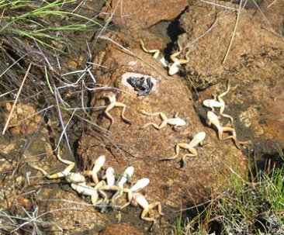
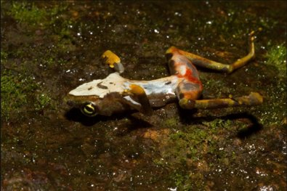
STUART ET AL. 2004, WAKE AND VREDENBURG 2008, PHOTO: VANCE VREDENBURG​
PHOTO BY BRIAN GRATWICKE​ ​

Slide 6
The Amphibian Microbiome
Microbiome-the collection of resident microbes that live on or in an organism​
It has been demonstrated that some of the resident microbes living on amphibian skin have anti-fungal properties ​
​When added to amphibian skin, concurrently with the introduction of Bd, these bacteria have been shown to increase survival rates ​and decrease infection levels

Slide 7
Bd - Resistant Bacteria
Some populations of amphibians have natural immunity to Bd​
Bullfrogs, which were the initial vector of Bd​
Many amphibian populations in North America ​
A study by Becker, et. al. determined the composition of the bullfrog microbiome ​
Many anti-Bd isolates were identified​

Slide 9
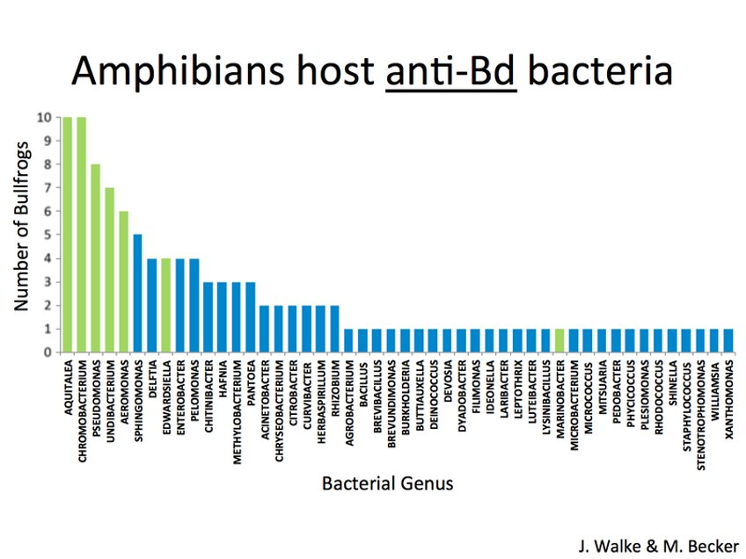

Slide 10
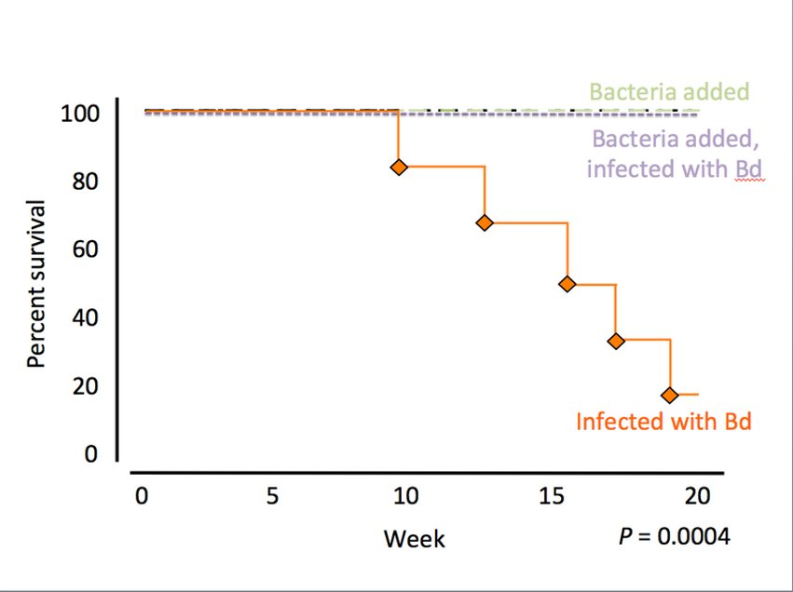

Slide 11
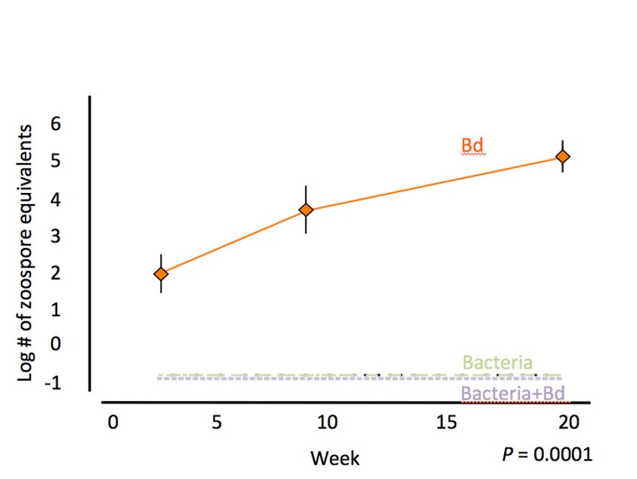

Slide 12
The Study
OBJECTIVES
Amphibian populations in Virginia have not seen the same declines that other regions have ​
​The microbiome could be a key part of their defense system against Bd​
​Our goal is to survey the defense mechanisms of these populations against Bd​
​The defenses against Bd could be used to create probiotics for other populations and could help defend against Batrachochytrium salamandrivorans if it invades

Slide 13
The Study
SAMPLING​ ​Salamanders were caught with clean nitrile gloves, rinsed, swabbed, measured, and tail-clipped on site. ​
Culture
Microbiome swabs were plated onto RIIA media and grown for two weeks. All morphologically unique colonies were isolated.​
MOLECULAR ANALYSIS​ ​ DNA from each isolate was extracted, amplified using PCR, and identified through Sanger sequencing of the 16S ribosomal RNA gene.
Competition assay
Metabolites produced by each isolate in a two- day culture were tested against Bd for anti-fungal properties.

Slide 14
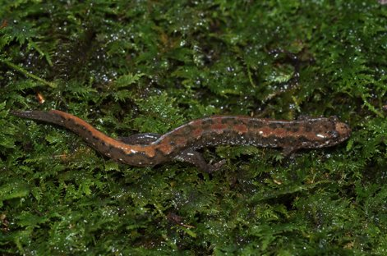
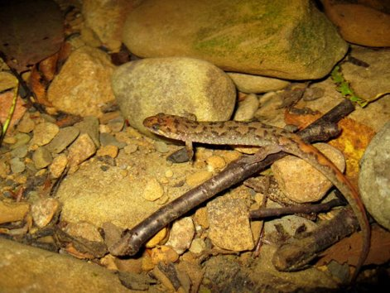
Desmognathus fuscus​
Desmognathus monticola​

Slide 15
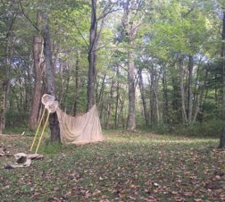
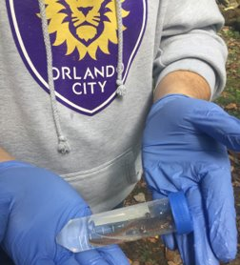
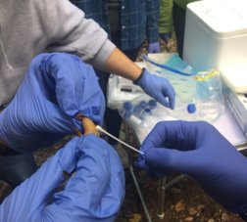

Slide 16
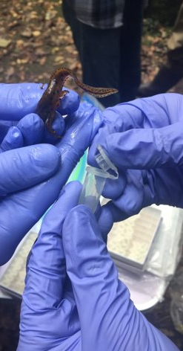
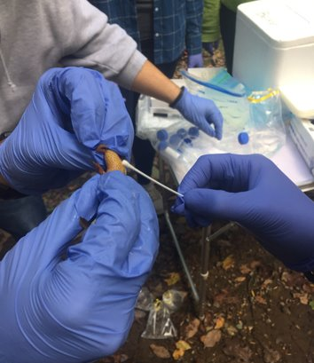

Slide 17
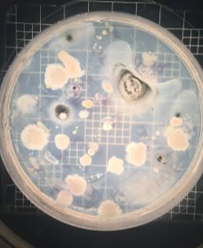
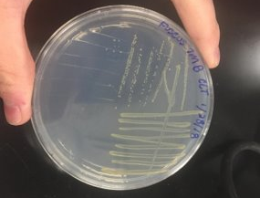
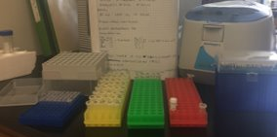

Slide 18
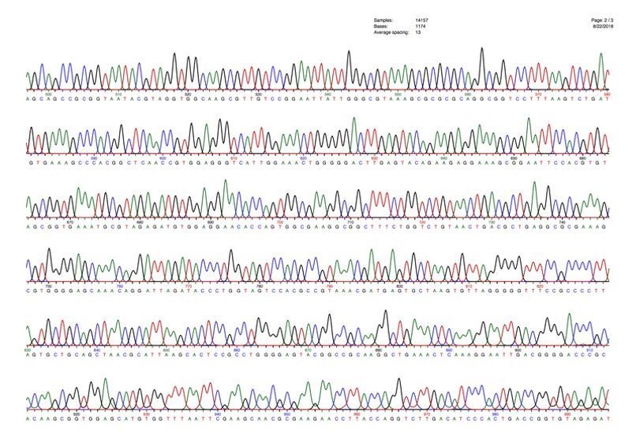

Slide 19
The Results
472 individual bacterial isolates cultured from 29 salamanders ​
185 from 11 Desmognathus monticola (17 per individual)​
287 from 18 Desmognathus fuscus (15 per individual)​
44 genera identified from the 123 isolates sequenced so far​
1 anti-Bd isolate characterized, out of 26 tested so far.

Slide 20
Acknowledgements
Funding: ​ Liberty University Center for Research and Scholarship ​ Virginia Herpetological Society ​ ​ ​ Thanks to: ​ Dr. Matthew Becker and all lab members​ Dr. Doug Woodhams and lab ​

