Slide 1
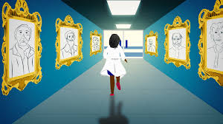
THE LACK OF MENTORSHIP AMONG BLACK WOMEN FACULTY AT PREDOMINATELY WHITE INSTITUTIONS
Presented By
Caitlyn M. Ybarra, MA, LPC, NCC
Prepared For
Liberty University’s
2021 Graduate Research Week 3MT Contest
“This image originated from the Website About Life https://www.tentangkehidup.com/ and was retrieved from https://www.statnews.com/2020/01/16/black-doctors-leaving-faculty-positions-academic-medical-centers/”.

