Slide 1
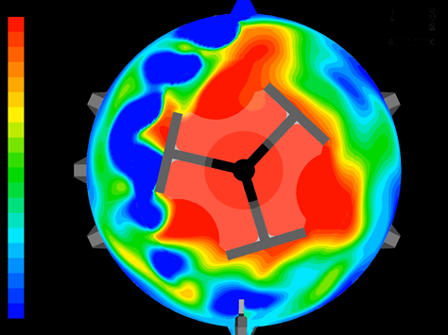
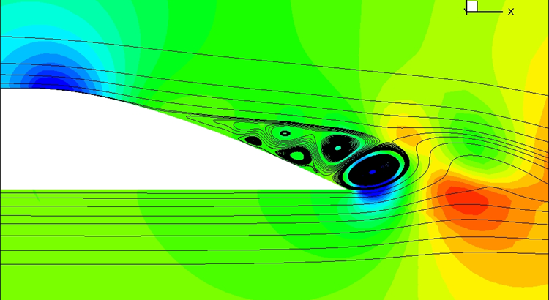
Developing “Smart” Simulations for Computational Fluid Dynamics (CFD) Studies | Eric Turman Advisor: Dr. Wayne Strasser
CFD is a tool used to simulate the movement of mass and energy through or around any system
Relies on “heavy” computational algorithms and hardware
PID Controller Block Diagram
$$K_{c}$$
+
Setpoint
$$Σ$$
Error
$$τ_{I}$$
$$Σ$$
Process
Output
-
$$τ_{D}$$
Fluids Simulations
Automatic Control
CFD Challenges
Controlled CFD
Proportional Integral Derivative (PID) controllers used for automation
Adjusts inputs based on departure from goal
Requires no user input
254
225
Goal: Combine CFD with PID controllers
Can guide the simulation using expected answer
Reduced cost for same accuracy for future simulations
Hydrofoil Results from CFD
Accuracy = $$$

