Slide 1
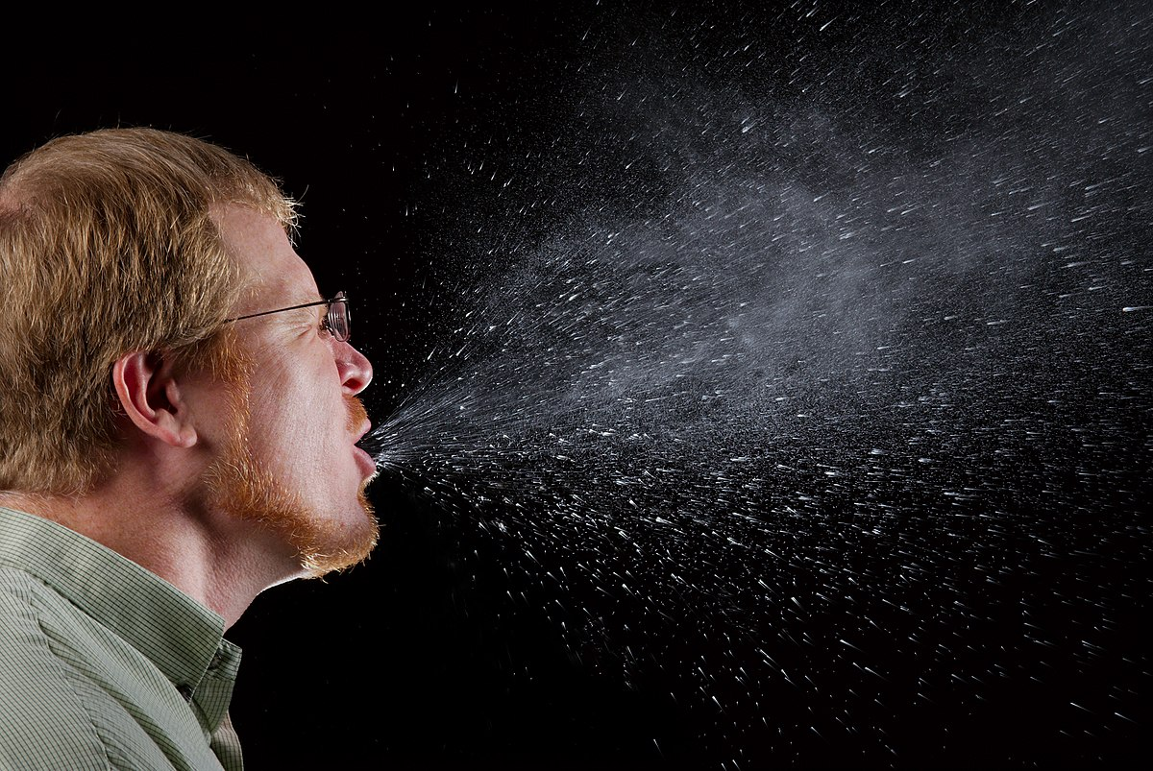
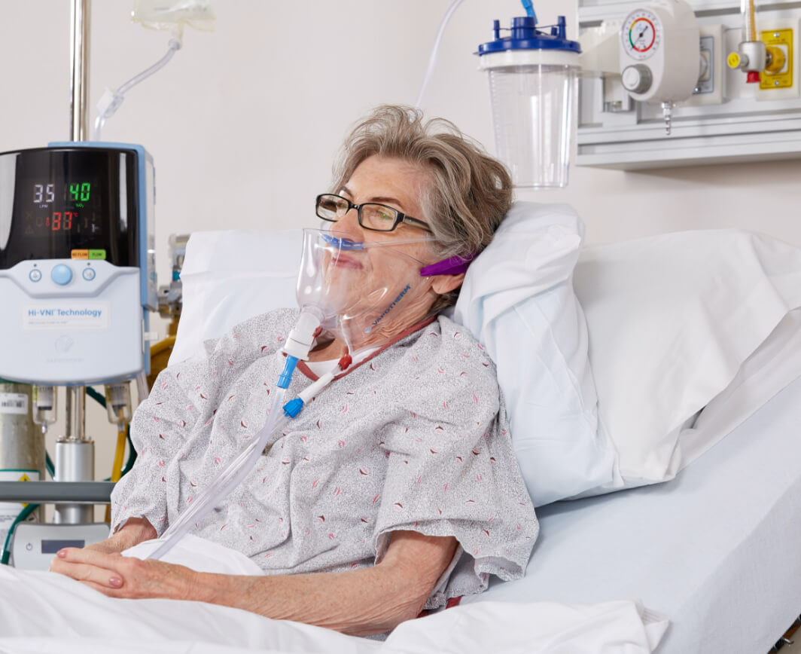
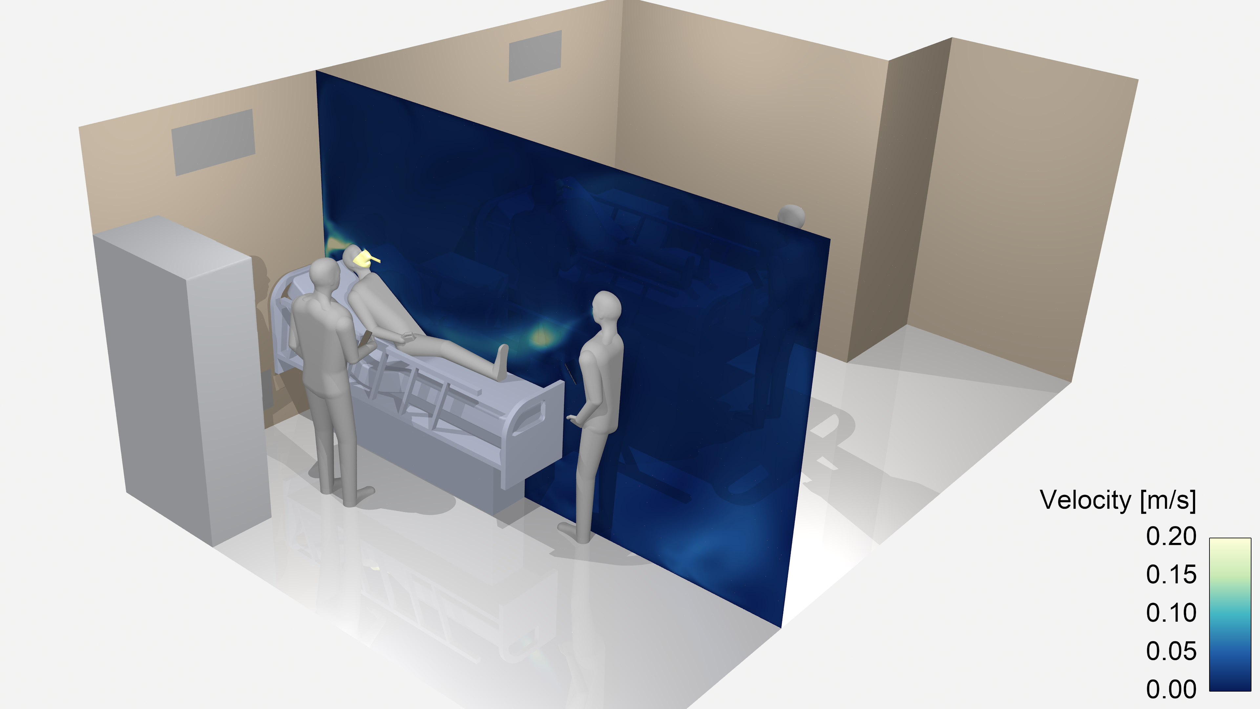
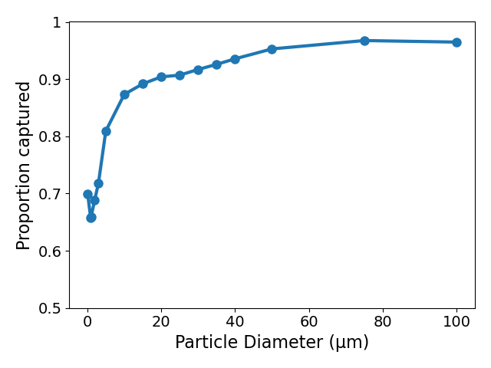
Modeling a Novel Method to Diminish COVID-19 Transmission in a Hospital Room
“Felix-1” mask designed to reduce airborne spread of COVID
Computer simulation
Felix-1 effectively captures virus-laden particles
More particles captured = better

