Slide 1
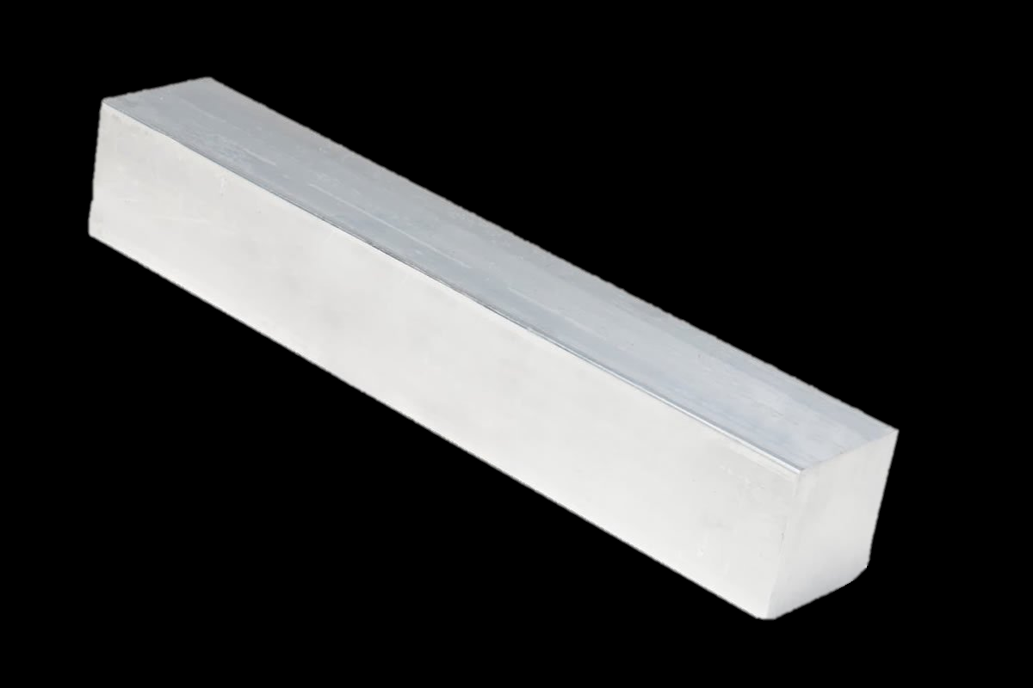
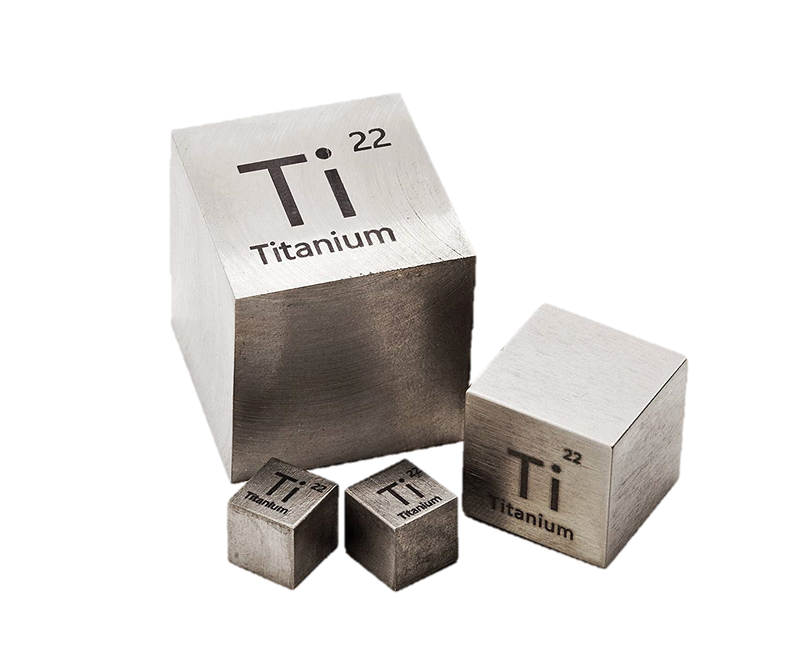
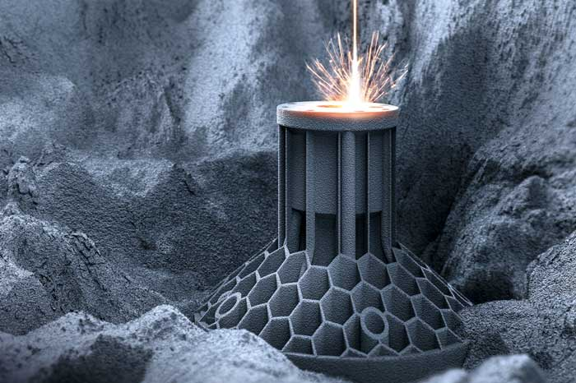
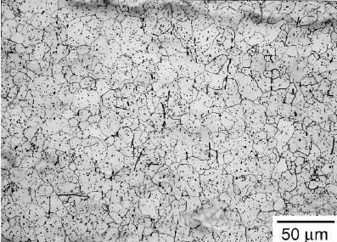
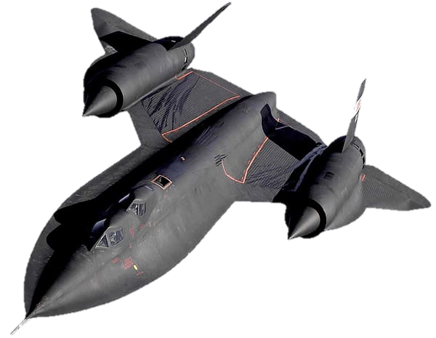
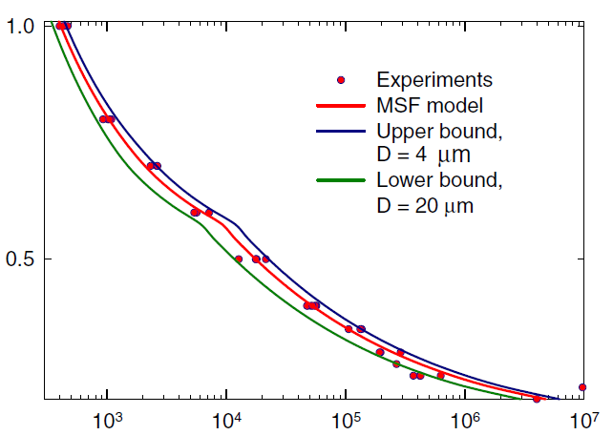
Jared Darius
Advisor: Dr. Lugo
Integrating Temperature Dependence to Microstructure-Sensitive Fatigue Modeling of Titanium Alloys
1. Process
Extrusion
$$T_{melt}$$
$≈1660°C$
$β$-phase
2. Structure
Grains
Pores
Particles
Oxides
Phases
3D Printing
$$T_{phase change}$$
$≈1010°C$
Body-Centered-Cubic
(BCC)
$$T_{Recrystallize}$$
3. Property
$≈550°C$
$α$-phase
$$T_{Creep}$$
[Xue, 2007]
Fatigue Model
4. Performance
Typical working range
Strain Amplitude $\frac{Δε}{2}$
$$T_{Room}$$
Hexagonal-Close-Packed (HCP)
Cycles to Failure, $N_{f}$
Ti-6Al-4V Temp. Spectrum
Notes:
Images From:
Titanium Cubes:
https://www.google.com/search?q=Titanium&tbm=isch&ved=2ahUKEwj79qu8zZLoAhUINd8KHdGXCqYQ2-cCegQIABAA&oq=Titanium&gs_l=img.3..35i39l2j0i67l5j0j0i67l2.84439.85211..85350...0.0..0.134.556.7j1......0....1..gws-wiz-img.ETwwUfI02ZE&ei=D_JoXruzFojq_AbRr6qwCg&bih=578&biw=1280&rlz=1C1CHBF_enUS870US870#imgrc=jYwcXPDKqi3KNM
Titanium Microstructure Image:
https://www.researchgate.net/figure/Initial-microstructure-of-CP-titanium-transverse-direction_fig2_267406005
SR71-Blackbird – 85% titanium!!
https://www.google.com/search?q=sr71-blackbird+white+background&tbm=isch&ved=2ahUKEwjPhbrL0JLoAhURFVkKHZy-ADgQ2-cCegQIABAA&oq=sr71-blackbird+white+background&gs_l=img.3...14594.16357..16452...0.0..0.184.1100.16j1......0....1..gws-wiz-img.......0i30j0i10i30.X7MQH9A37kA&ei=VPVoXs-LFpGq5AKc_YLAAw&bih=578&biw=1280&rlz=1C1CHBF_enUS870US870#imgrc=FAj8EGz4_B95_M
3D printing
https://www.google.com/search?q=Metal+3D+printing&rlz=1C1CHBF_enUS870US870&sxsrf=ALeKk02IXzp7eW1-CaO1H-BsYrKJtqIiKg:1583939669345&source=lnms&tbm=isch&sa=X&ved=2ahUKEwiZ3NiK25LoAhU8mHIEHe_3DUkQ_AUoBHoECBAQBg&biw=1280&bih=578#imgrc=-ifdMsg10bU_lM&imgdii=w4DYEBBei8qBBM
Casting:
https://www.google.com/search?q=metal+casting&rlz=1C1CHBF_enUS870US870&sxsrf=ALeKk01kqe_IBPgGKMqm1EEQ9IkBfe3opQ:1583940315208&source=lnms&tbm=isch&sa=X&ved=2ahUKEwiug9W-3ZLoAhUTlnIEHUQqBGgQ_AUoAnoECBIQBA&biw=1280&bih=578#imgrc=ojSuL4yCEJeRDM
Square Extrusion:
https://www.google.com/search?q=square+bar+extrusion+metal&tbm=isch&ved=2ahUKEwjYrp753pLoAhWQWN8KHdpWBnUQ2-cCegQIABAA&oq=square+bar+extrusion+metal&gs_l=img.3...14961.18830..18965...0.0..0.103.1561.25j1......0....1..gws-wiz-img.......35i39j0i67j0j0i5i30j0i8i30j0i8i10i30j0i24.LihmgjMn1A8&ei=YgRpXtj1HJCx_QbarZmoBw&bih=578&biw=1280&rlz=1C1CHBF_enUS870US870#imgrc=6F8ullfEc4XjiM
Fatigue Model:
Xu, 7075 Alloys
Crystal Structure Phases:
https://www.google.com/search?q=hexagonal+close+packed+crystal+structure&rlz=1C1CHBF_enUS870US870&sxsrf=ALeKk02bdqdSLYczvLMHvtTg0xhjLassdw:1615574003867&tbm=isch&source=iu&ictx=1&fir=Umy_t25slD4WiM%252CO6m2JMlqaRYs8M%252C_&vet=1&usg=AI4_-kQ-OG9GHhIAog_FSlXehAnFtLSHgQ&sa=X&ved=2ahUKEwiy9-6UsqvvAhUtqlkKHXp8DroQ_h16BAgSEAE#imgrc=Umy_t25slD4WiM

