Slide 1
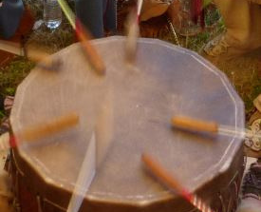
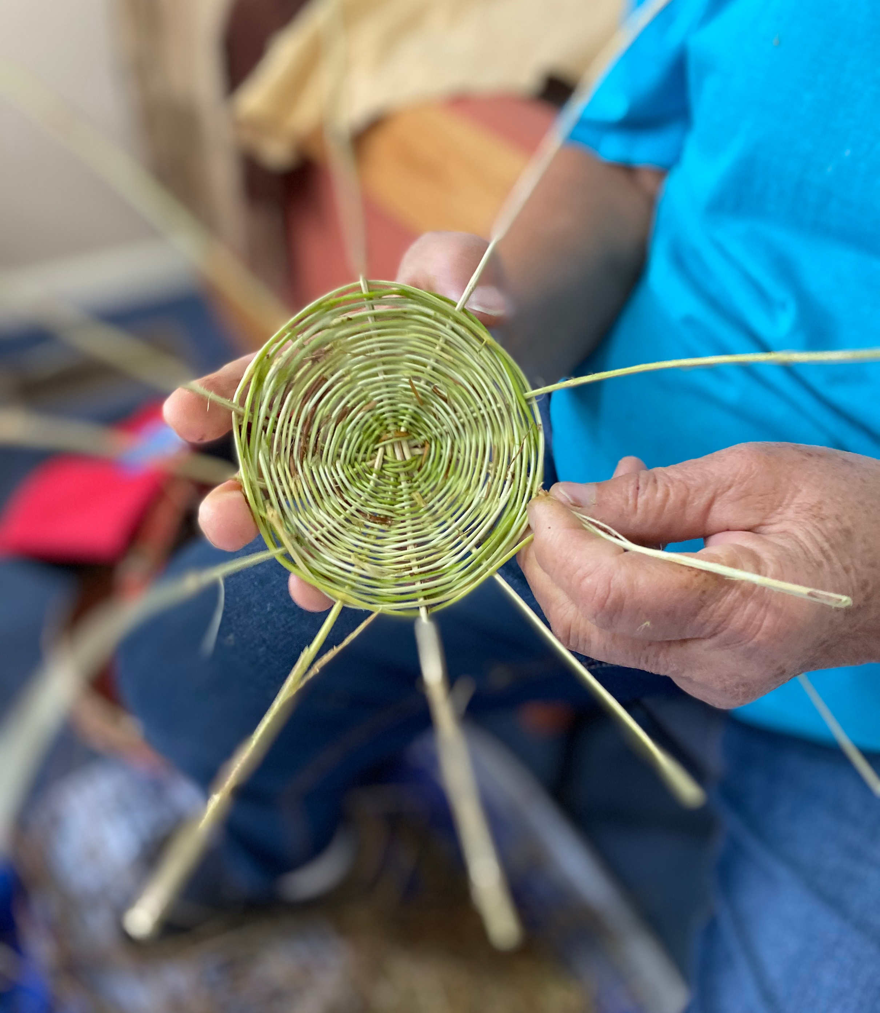
A basket is a song you can see.
—Danny Lopez, Tohono O’Odham (1936–2008)
Notes:
picture of Monacan basket weaving and drum used by permission of Bertie Branham and the Monacan Nation. copyright 2020, Bertie Branham and the Monacan Indian Nation
Graphic created by Gretchen E. Cline, copyright March 2021

