Slide 1
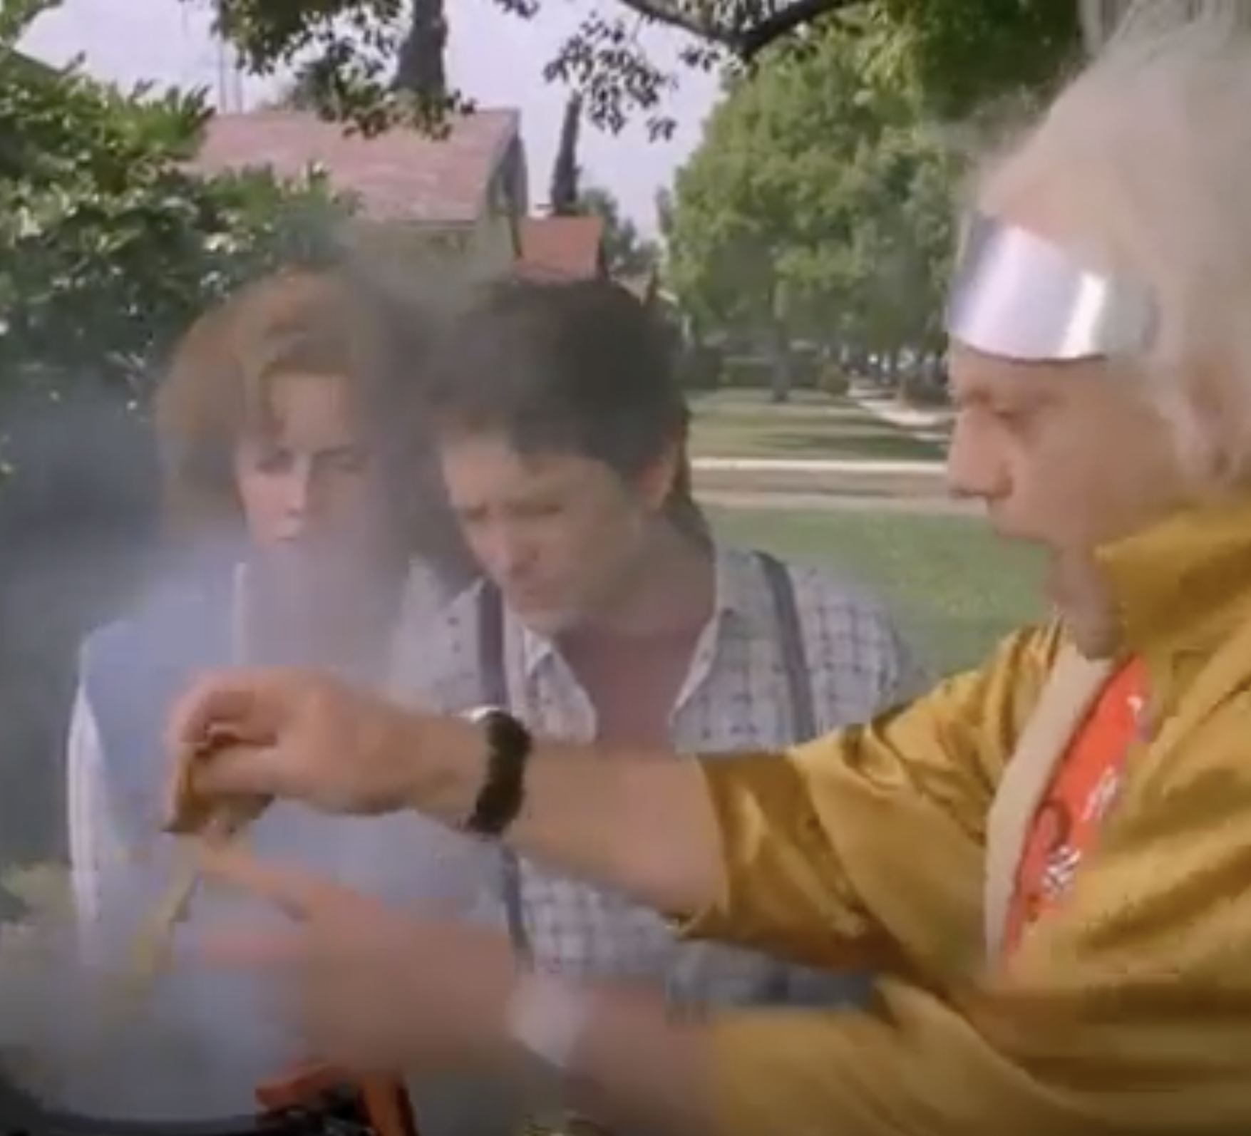
Implementing Gasification of Biological Material in Developing Countries
Back to the Future Part II

Slide 2
References
Zemeckis, R. (Director), & Spielberg, S. (Producer). (1989). Back to the future part ii [Video file]. United States: Universal.

