Slide 1
One God?
A documentary treatment exploring the Protestant and Catholic divide
By Jacqueline Hale

Slide 2
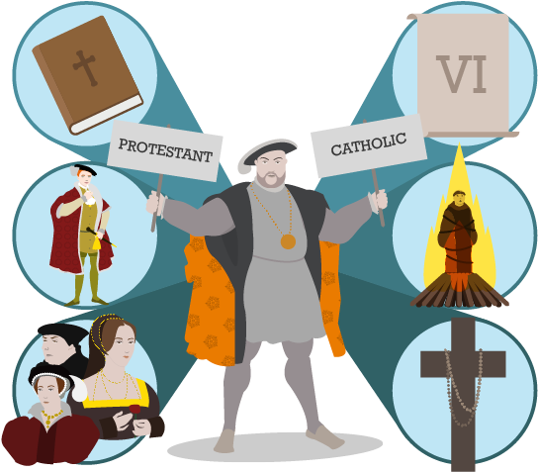
Research Question: What characterizes the divide between Catholics and Protestants today and what should the church do about it?
Illustrated Talk At St Margaret Clitherow's - Catholic Protestant Clipart
Notes:
Hi, My name is Jacqueline Hale. My research is centered around the question, what characterizes the divide between Catholics and Protestants today and what should the church do about it?
This question is near to my heart because I am a Catholic Christian, but only because of Protestantism.
When I came to Liberty, I was hardly a Christian, let alone a Catholic. Though I was baptized Catholic, I do not consider myself being raised Catholic. My family didn’t go to church, rarely talked about the faith, and so I had no real understanding of what it meant to be a Christian… until I came to Liberty. I fell in love with Jesus here. I developed a real relationship with Him here. I now love worship nights and Bible studies and talking about what Jesus is doing in my life. But I also fell in love with the Catholic faith here.
When I started claiming myself as Catholic, however….

Slide 3
Do you worship Mary?
What Protestants say about Catholics:
Are you sure you have a relationship with Jesus?
Why did Catholics add books?
My friend is a “Christian,” well, he went to Catholic Church so… you know…
Your theology is totally wrong.
You are not a real Christian.
Notes:
I realized that Protestants didn’t have an accurate grasp on what Catholicism means.
Seen through questions like
And because of a lack of understanding, this leads to backhanded remarks and sharp opinions like
You are not a real Christian.

Slide 4
Why don’t you take communion at every service?
What Catholics say about Protestants:
Who is your authority?
You are missing the richness, the reverence
This is all based on emotions.
You are not a part of the body of Christ.
Notes:
Of course, me now being in a Catholic circle coming from Evangelicalism, I realized that Catholics don’t understand Protestants either.

Slide 5
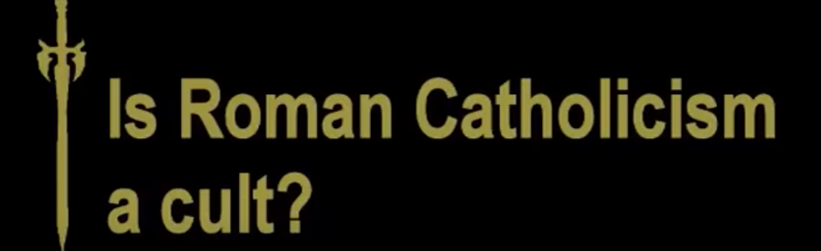
Protestant Attacks on Catholics
YouTube: Pastor John MacArthur
YouTube: Soul Refuge
Grace to You Series
Notes:
Wondering if my experience reflected that of others, I began doing research and found a gold mine on the internet with both Catholics and Protestants posting videos, documents and series detailing, with conviction, the heresies of other so called “Christians.”
Explaining the Heresy of Catholicism
A series that includes episodes called “Exposing the Idolatry of Mary Worship” and “Explaining the Heresy of the Catholic Mass”
Is Roman Catholicism a cult
Where Pastor John MacArthur affirms that yes, it is.
Seven False Teachings of the Roman Catholic Cult
A former Roman Catholic made a video to warn others about the Roman Catholic cult

Slide 6
Catholic Attacks on Protestants
YouTube: Father Mike Schmitz
YouTube: Father Ian Vanheusen
YouTube: LizziesAnswers
Notes:
Why Be Catholic and Not Just Christian
Father Mike Schmitz talks about the authority of the Catholic Church
Yes, Protestantism is a Heresy
Where Father Ian Vanheusen discusses the specific heresies of Protestantism.
10 Heresies I Believed as a Protestant
Where a former Protestant depicts the lies she believed as a Protestant.
As you can see, there is a bit of tension between the two.

Slide 7
Middle Ground
Protestants: Catholics can be saved if they have a relationship with Jesus and have professed him as Lord
Catholics: Protestants are our “separated brethren,” so they are still Christ-followers but not fully because they are removed from the Sacraments
Notes:
In my own life and online I also discovered a middle ground,
but this middle ground simply defines the other side based off its own perspective and worldview without genuinely interacting with the terminology and key aspects of the other. Protestants define Catholics based off the terminology of being “saved” and Catholics define Protestants based on the definition of the church.

Slide 8
What characterizes the divide?
A power over TRUTH that they both claim to hold.
Little understanding and a lack of conversation and respect
Notes:
They do have one thing in common. They all claim the truth.
This set my path to understand the first part of my research question: what characterizes the protestant and catholic divide today? It is this power over truth that both hold. A divide that means little understanding and a lack of conversation and respect creating this sharp contrast that rarely is addressed because of the camps they embody. Not even the middle ground supports productive conversation but puts each in a box that fits neatly into its own worldview.
So my research proposal tries to answer the second part of the question: What can the church do about it?

Slide 9
Research Proposal:
A documentary film
made for Protestants and Catholics
that puts opposing voices in juxtaposition in order to spur conversation towards deeper understanding and richer faith
Notes:
I am proposing a documentary film that will allow a clash to happen.
The point of my research is not to discover what this truth is. Plenty of people have a claim on that. The point of my research is not to discuss the theological differences between Protestants and Catholics. Plenty of people have done that. The point of my research is not to convince someone to one side or the other. Plenty of people do that.
The point of my research is to open up a conversation between two sides that rarely have productive conversation.
The following slides will explain what this will look like on the screen. The documentary will be divided into the past, present and future, laying out what the divide used to look like, what it is today, and will attempt to answer the question of what to do with it.

Slide 10
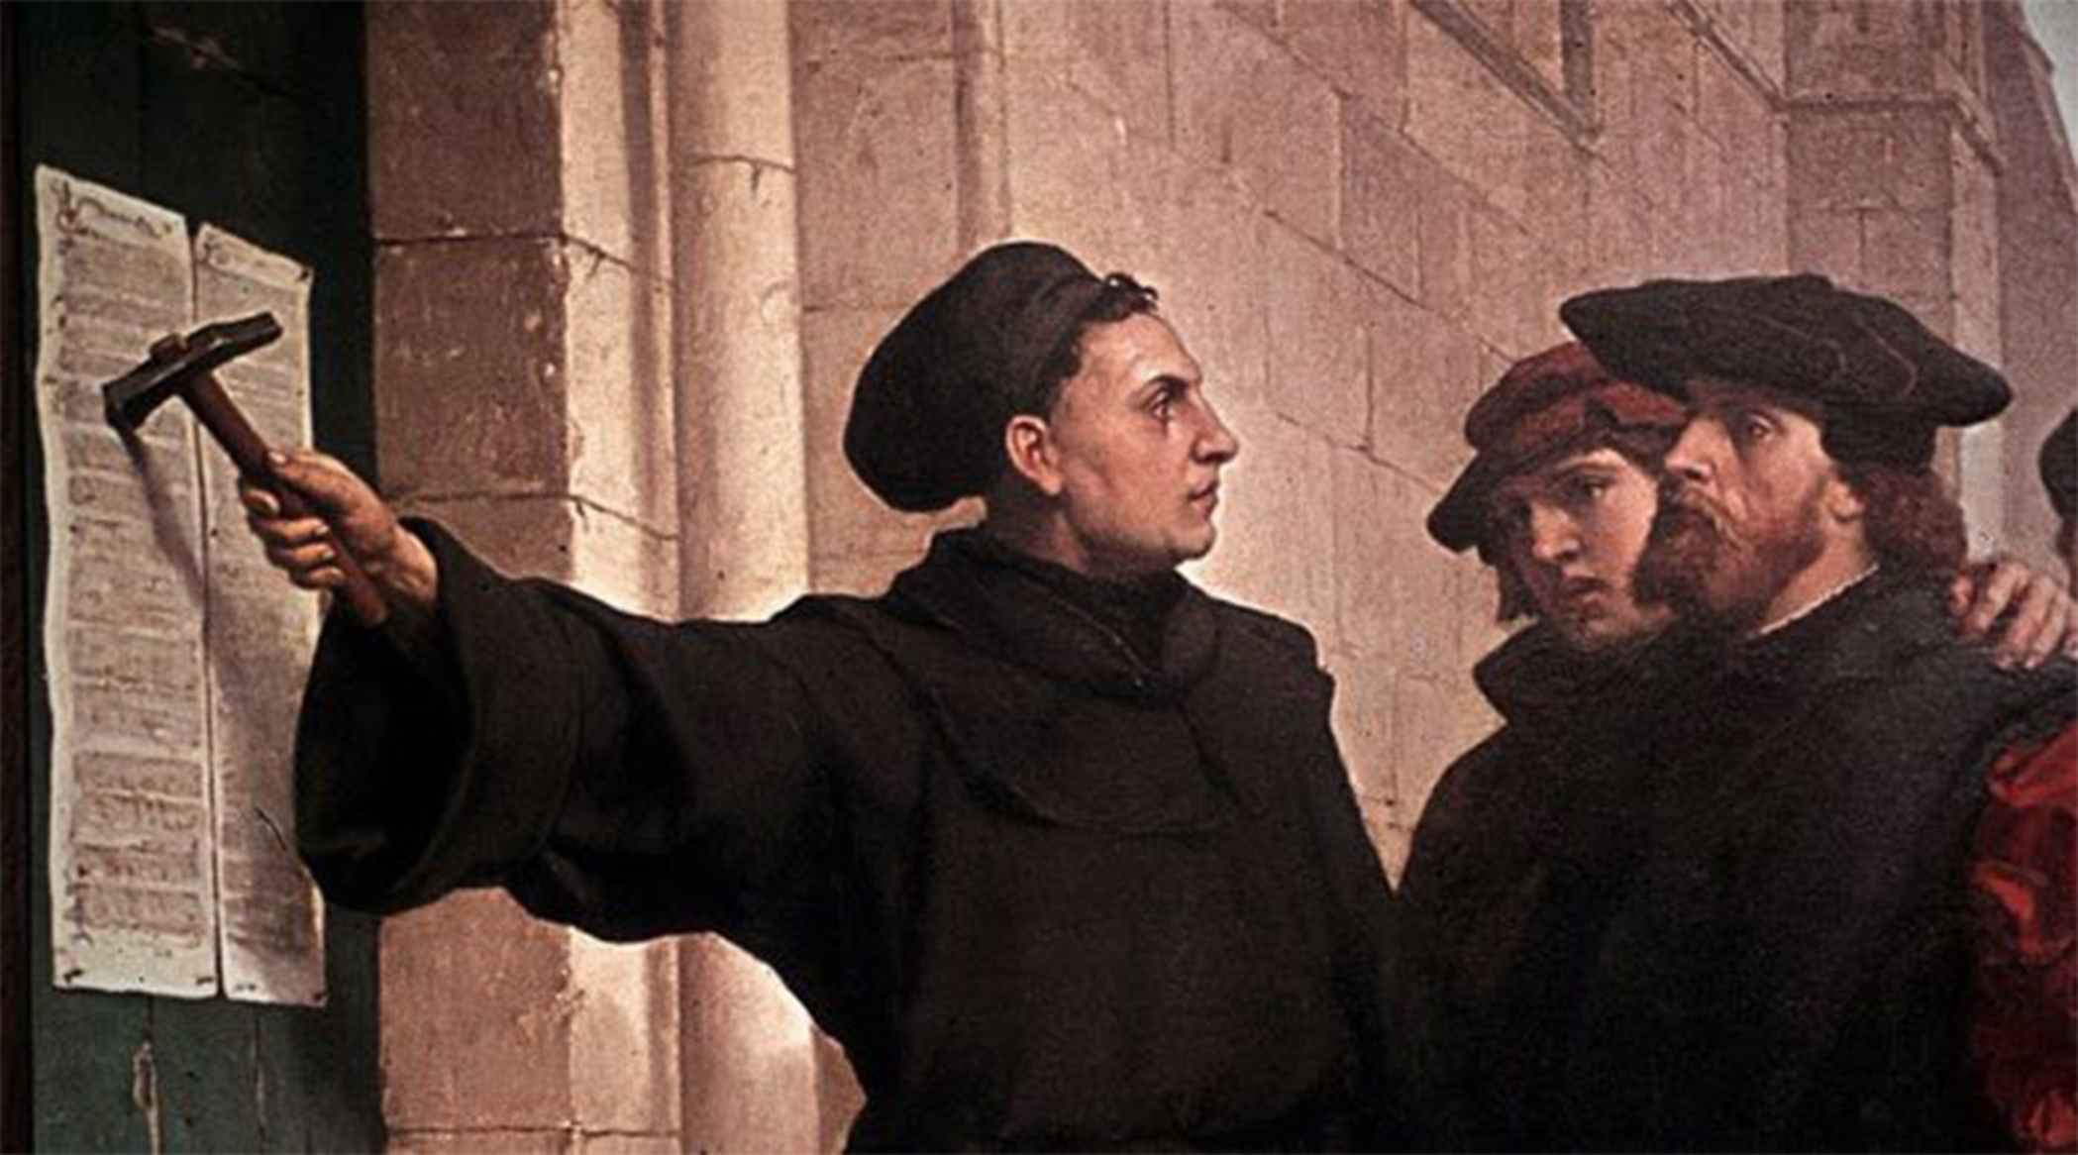
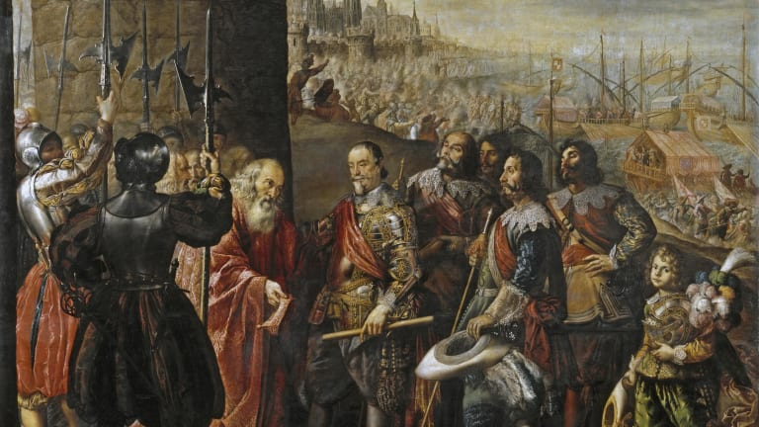
Reformation and Violence
Martin Luther, Christianity.com
Thirty Years’ War, History.com
Notes:
The documentary will begin addressing the question of what characterizes the divide through a look at history and through outspoken Protestant and Catholic leaders.
It will start with the reformation to see the background on the divide
Reform was happening even earlier than this- inquisitions to get rid of reform movements
30 Years War shows the violence we no longer see today

Slide 11
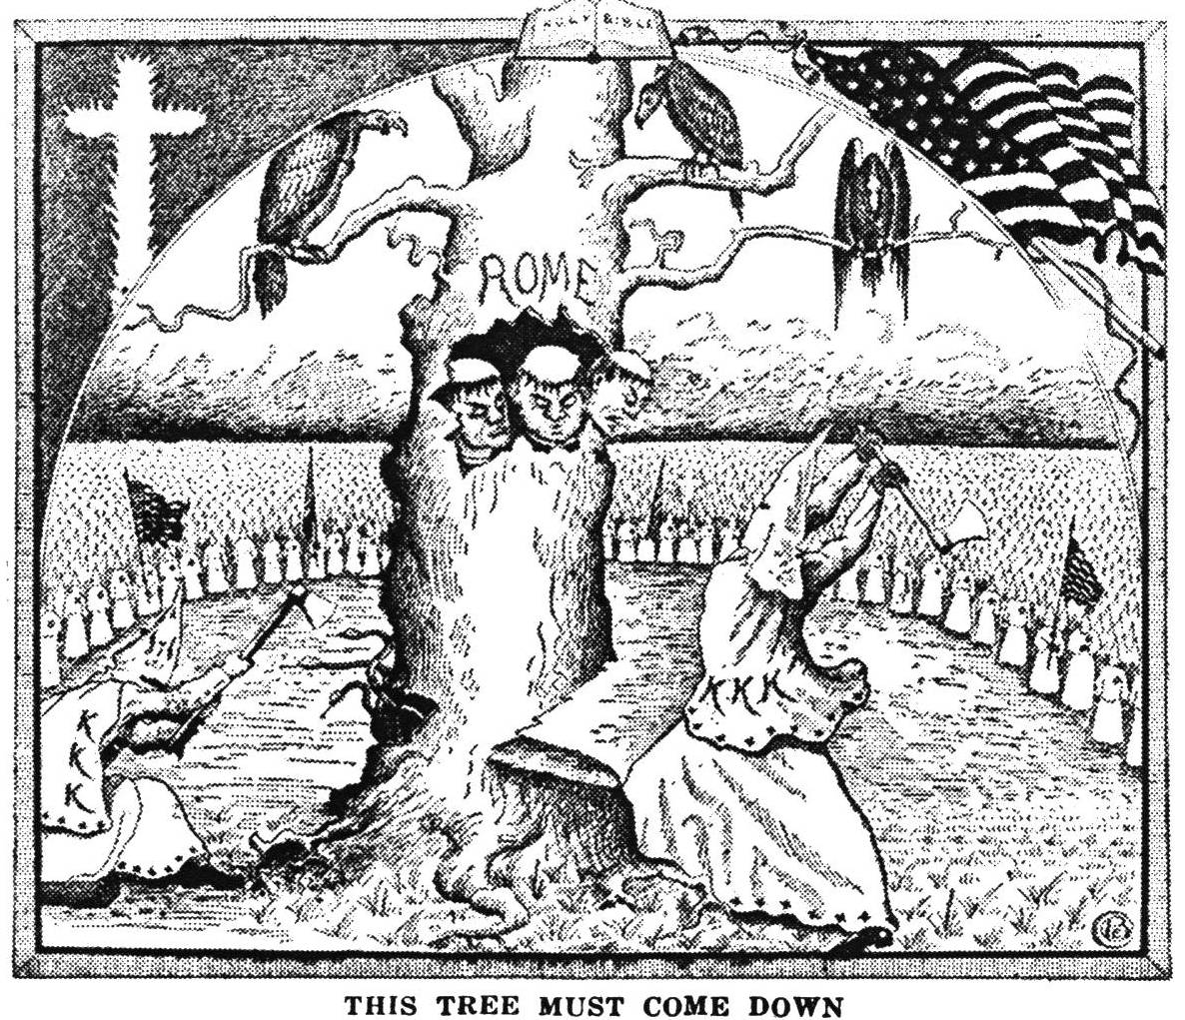
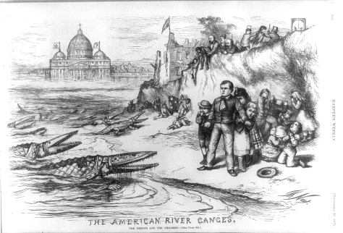
Anti-Catholicism in the US
Thomas Nast, Harper’s Weekly, 1871
The Tree Must Come Down, 1925
Notes:
Then to understand the divide in America, it will focus on Anti-Catholicism and the fear of papal authority in America- not wanting Catholic schools or presidents, the KKK teaming up with protestants to stop Catholics in the early 1900s
This serves as a contrast, realizing there is not public shaming or political war between Catholics and Protestants, which will help us see where division still lies today.
Looking at these two examples, people may think that the divide is gone because we are no longer politically or physically violent against one another, but this just sets the stage for the next part of my research which shows how a social divide still exists.

Slide 12
Strong Voices on Opposing Sides
An outspoken Catholic priest
An outspoken Evangelical pastor
Notes:
Then it will transition into a pastor and a priest who hold very opposing viewpoints. The style of these testimonials and others is formatted like a story- they begin by showing the subject in a neutral location, not revealing what side they are on and as the story progresses, their views do too. In this way, the documentary can paint all subjects in an equal light and helps the audience feel a connection to the sources no matter what their religious views.
Both will be shown in their churches, interacting with people, serving others before the interviews start to put them on the same level and their heart for others. The interviews will cut between the two of them to juxtapose their differing viewpoints.
Then they are both asked about their theological views and the film will cut between the two of them as they clearly show their distaste for the other’s religion. This section reveals some of the key differences, but, more importantly, reveals the way they talk about one another in this harsh juxtaposition.
Example:
The interviewer asks the pastor if he believes Catholics are Christians, and he says no, Catholicism teaches a false Gospel. The video jumps to the priest who is asked if he believes Protestants are Christians, and he says that Protestants have some key fundamentals wrong. The film jumps back to the pastor who expands upon his statement saying Catholicism is a cult. The film jumps back to the priest who expands upon his statement saying Catholicism is the fullness of the faith. The video continues to cut between them as the pastor talks about faith alone, Scripture alone and the atrocities of the Catholic church and the priest talks about the authority of the Catholic church, apostolic succession, and the Eucharist.

Slide 13
Born Again, Again
An Evangelical who became a Catholic
A Catholic who became an Evangelical
Notes:
Then I will look towards applications of this divide. What does this mean for someone considering their faith?
Again, these interviews will be edited to reveal a little about each subject and cutting back and forth to humanize them before diving into their stories.
These characters are based off people I have interviewed who shared their stories with me.
The Evangelical who became Catholic
- Father was a Southern Baptist Pastor, baptized by his father at 10, three semesters of seminary
Drawn to the church by images and tradition, learned about the early church fathers and saw that their church is reflected more in Catholic church
Family troubles made him search and dig deeper into his faith
Had many conversations with a local priest and was always curious about it
Went through the RCIA program at the church and received first communion and confirmation on Easter, becoming Catholic
Afraid to tell his family because of what they might think
Doesn’t worry so much about the way he is feeling, but worships God no matter what- Catholic faith has helped in that
Catholic turned non-denominational
Never liked going to church as a kid
Saw that people didn’t act out what they professed in church
Ran away from all faith
Wife brought him to a protestant church where he reconsidered his upbringing and found a lot of problems he had with Catholic beliefs like Mary and purgatory and the “Jesus plus” gospel
Went back to his family with the evangelical fire but they were turned off by it and realized what mattered most was a relationship with Jesus
Feels freer because he is certain in his salvation
Neither of these characters hate their original faith but see how it pointed them towards Christ in the first place and still see the way it forms their relationship with him for the better.

Slide 14
Other interviews:
Testimonies from people who grew up in Evangelical and Catholic churches
A priest who became Episcopalian and an Evangelical who became a priest

Slide 15
Implications
Protestant: To rescue people out of a false religion is the only loving thing to do
Catholic: Outside the Catholic Church there is no salvation, so they must come to know the truth and obey the church’s authority
Middle View: Forget about the divisions
Notes:
Finally, I will transition to the implications of this research. Each of the people I interview will be asked what they believe about people who claim other denominations and what should be done about the divide. Each have something of the following answers:

Slide 16
A New Perspective
Or we can see the divisions as a way to learn about our Creator and glorify Him.
We don’t need to denounce our convictions, but understand that there is something to be learned from the other perspective that can lead to a rich faith. We need conversation.
Notes:
But the people who switched from Catholic to Protestant and vice versa will provide another perspective. They both understand the two sides and have done seeking and intense conversation with people on both sides to decide where they land. They have a unique perspective that those sticking to their own worldviews never encounter.
What does this mean? How can the church work through divisions? Conversation. In this way, this documentary is a solution to the problem it poses. Neither side needs to concede their convictions but see if they can add and grow in a richer faith.

Slide 17
Next Steps
Receiving a research grant and funding to make the film
Filming interviews, B-roll of churches and the subjects
Distribution to Catholics and Protestants to be played at church events and for private viewing on Amazon
Further research, pre-interviews, location scouting
Notes:
With this framework for how the research can be conducted, the next steps are to do it! To make this documentary a reality, I will need to…

Slide 18
Jesus’ Prayer
“That they may all be one, just as you, Father are in me, and I in you, that they also may be in us, so that the world may believe that you have sent me.” - John 17:21
Notes:
Just like I want to leave the viewers of the documentary, I want to end this presentation with a Bible verse.

