Slide 1
The Rise of Liberalism among the American Youth
Katherine DeTurk

Slide 2
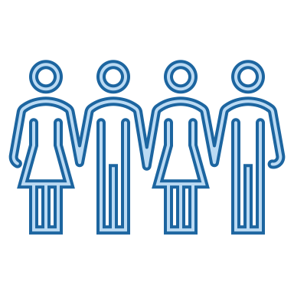
Background
COVID-19
Black Lives Matter Movement
Presidential Election

Slide 3
Goal of Study
To provide a better understanding of the connection between liberal rhetoric and the increase in progressivism among American youth.
Wildman, Sarah. “The Fight for Their Lives.” Foreign Policy Public Thinkers, 2019, https://foreignpolicy.com/gt-essay/the-fight-for-their-lives-parkland-students-gun-violence-united-states/. 2021.
Chase, Matt. “The Wealth of Ideas.” The New York Times, 2014. https://www.nytimes.com/2014/07/27/books/review/liberalism-by-edmund-fawcett.html. 2021.

Slide 4
Literature Review
Neurocognitive Correlates of Liberalism and Conservatism (Amodio, 2007)
Branding, Politics, and Democracy (Marsh & Fawcett, 2011)
Deliberation or Self-Presentation? (Storsul, 2014)
Selling Politics to Young People (White, 2003)

Slide 5
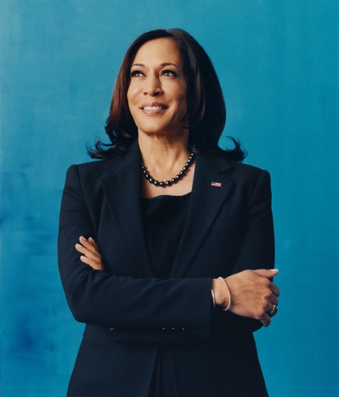
Methodology
Kamala Harris’s language
2020 Vice Presidential debate
Elaboration Likelihood Model (ELM)
Robert E. Petty’s two paths of persuasion
Central Route
Merit of argument
Validity of the message
Peripheral Route
Emotion and aesthetics
Perceived credibility
Falquez, Camila. “Kamala Harris on Joe Biden, Being a ‘First’ and Restoring the Soul of the Nation.” TIME, 2020, https://time.com/5919490/kamala-harris-person-of-the-year-interview/. 2021.

Slide 6
Results
Emotion, emotion, emotion
Focus on the failures
The power player of intersectionality
Spotlight on young adult issues
Horvath, Meghan. “How to cultivate diversity, equity, and inclusion in the workplace.” Curiosity at Work, 2020. https://www.surveymonkey.com/curiosity/how-to-cultivate-diversity-equity-and-inclusion-in-the-workplace/. 2021.
Wong, Alex. “What makes a ‘good’ patriot? Donald Trump may be surprise by an ethicist’s answer.” The Conversation, 2020. https://www.thenationalnews.com/lifestyle/maybe-he-s-born-with-it-donald-trump-claims-his-tan-is-down-to-good-genes-here-s-why-we-disagree-1.821209. 2021.
LaBan, Terry. “The Short Case for Making College Free and a Universal Right.” In these Times, 2019. https://inthesetimes.com/article/free-college-big-idea-higher-education-elizabeth-warren-bernie-sanders. 2021.

Slide 7
Discussion
Improvements
Future research
Why is it relevant?

Slide 8
References
Amodio, D. M., Jost, J. T., Master, S. L., & Yee, C. M. (2007). Neurocognitive Correlates of
Liberalism and Conservatism. Nature Neuroscience, 10(10), 1246–1247. https://doi.org/10.1038/nn1979
Eckstein, K., Noack, P., & Gniewosz, B. (2012). Attitudes toward Political Engagement and Willingness to Participate in Politics: Trajectories throughout Adolescence. Journal of Adolescence, 35(3), 485–495. https://doi.org/10.1016/j.adolescence.2011.07.002
Fisher, E. (2014). ‘You Media’: Audience as Marketing in Social Media. Media, Culture & Society, 37(1), 50–67. https://doi.org/10.1177/0163443714549088
Griffith, E. E., Nolder, C. J., & Petty, R. E. (2018). The Elaboration Likelihood Model: A Meta-Theory for Synthesizing Auditor Judgment and Decision- Making Research. AUDITING: A Journal of Practice & Theory, 37(4), 169-186. doi:10.2308/ajpt-52018
Marsh, D., & Fawcett, P. (2011). Branding, Politics, and Democracy. Policy Studies, 32(5), 515-530. doi:10.1080/01442872.2011.586498
Pruitt, L. (2017). Youth, Politics, and Participation in a Changing World. Journal of Sociology, 53(2), 507–513. https://doi.org/10.1177/1440783317705733
Storsul, T. (2014). Deliberation or Self-Presentation?: Young People, Politics and Social Media. Nordicom Review, 35(2), 17–28. https://doi.org/10.2478/nor-2014-0012
White, C. (2003). Selling Politics to Young People. Young Consumers, 4(2), 41–46. https://doi.org/10.1108/17473610310813799

