Slide 1
Animal-Assisted Therapy: Adjunct therapy for victims of human trafficking
Notes:
Hello, my name is Jesse Mathis and today I am going to be speaking on the use of animal-assisted therapy – specifically canine-assisted therapy or CAT – as an adjunct therapy to trauma informed care for human trafficking survivors.

Slide 2
Introduction
Globally, there are 40 million people who are currently victims of human trafficking (“Human Trafficking,” 2019).
What is human Trafficking?
  According to the Department of Homeland Security (DHS), human trafficking “involves the use of force, fraud, or coercion to obtain some type of labor or commercial sex act” (“Blue Campaign,” n.d.).
  Some of the services they are forced into include but are not limited to forced labor, sexual exploitation, child soldiering, and domestic servitude (Sukach, Castañeda, & Pickens, 2018).
There is a significant need for empirically based treatment approaches.
  According to Hemmings et al. (2016), “crucially, in the face of strong evidence of high prevalence of depression and PTSD among victims of trafficking, experimental studies are urgently needed to test the acceptability and effectiveness of psychological interventions to support the recovery of this vulnerable population” (p. 7; Sukach et al., 2018; Pascual-leone et al., 2017).
Notes:
Human trafficking is a significant social issue that is just now beginning to become more prominently researched. Globally, there are approximately 40 million people who are current victims of human trafficking. So, WHAT IS HUMAN TRAFFICKING? According to the Department of Homeland Security (DHS), human trafficking “involves the use of force, fraud, or coercion to obtain some type of labor or commercial sex act” (“Blue Campaign,” n.d.). There are many services that people are trafficked for which include but are not limited to forced labor, sexual exploitation, child soldiering, and domestic servitude (Sukach, Castañeda, & Pickens, 2018).
WHY IS THIS TOPIC IMPORTANT? These victims are left with social, emotional, physiological, and psychological scars that can handicap them from living healthy, productive lives. As such, it is imperative that within the mental health field, we develop treatment protocols that consist of empirically based tools that will help meet the emotional and psychological needs of trafficking survivors.

Slide 3
Animal-assisted therapy (AAT) has been used with some other traumatized populations.
2 issues to consider:
  First, the use of animal-assisted therapy (AAT) for victims of trauma is still burgeoning.
  Second, there are critical differences between human trafficking victims and other traumatized groups.
Notes:
Animal-assisted therapy is the use of an animal, in the case of this research proposal, canines, in therapy to meet therapy goals. There are some studies that have been conducted utilizing AAT with trauma victims, however, the research is still in the early infancy stages. According to according to Lass-Hennemann and colleagues (2018), they state that “there is a general lack of studies investigating modes of action of animal-assisted interventions and future studies should aim to close this research gap” (p. 9).
Additionally, it would be imprudent to generalize the efficacy of AAT with victims of human trafficking based on other traumatized groups such as domestic violence victims, for instance, because there are several key differences in each subgroup’s trauma experience. Researchers (Hemmings et al. (2016)) who work with trafficking victims have pointed out that generalizations are often made of this population based on what is known of domestic violence victims. This has hindered these victims from receiving the care they need and having their unique needs addressed.
Therefore, research is needed to fill these research gaps which is the purpose of this study.

Slide 4
Literature Review
Dravsnik, Signal, and Canoy (2018) – canine-assisted therapy with childhood sexual abuse victims to increase acceptability of treatment
Hamama et al. (2011) – canine-assisted therapy with traumatized teenagers in Israel
Lass-Hennemann et al. (2018) – the effects of therapy dogs following a traumatic event
Hemmings et al. (2016) - systematic review and qualitative analysis showing the need for research based tools for effective treatment and strong therapeutic alliance
Notes:
Let us look at some of the current research that I briefly referenced before. As I stated previously, it shows promise that AAT using canines might contribute toward more rapid positive results during the treatment process. Dravsnik and colleagues (Dravsnik, Signal, and Canoy (2018)), for example, developed an experimental study to test whether the augmentation of canine assisted therapy (CAT) with trauma focused cognitive behavioral therapy (TF-CBT) might increase the acceptability of therapy amongst trauma-exposed children; particularly those who had experienced childhood sexual abuse (CSA). The results of their study verified their hypothesis that CAT would have a positive impact on the acceptability of treatment. An Israeli researcher, Hamama, and her team conducted a similar study testing the efficacy of CAT with traumatized teenage girls. The results of her study demonstrated a significant decrease in PTSD related symptoms and a reduction in the number of participants at risk of PTSD. This helps to make the case for further application of AAT to other traumatized populations also experiencing PTSD - such as trafficking survivors. Along the same lines, Lass-Hennemann and her team of researchers created a study that showed the presence of a therapy dog following a traumatic event does lower stress and anxiety related symptoms. In a different line, the research conducted by Hemmings and his team showed a reoccurring theme emphasizing the need for developed trust between the trafficking victim and the helping professional which comes with many challenges and can take significant time. This demonstrates a need for supplemental therapy techniques that might facilitate the development of trust more quickly.

Slide 5
Research Question
Is there a positive correlation between the use of animal-assisted therapy (AAT) using canines as an augmented therapy to trauma informed care and the reduction of trauma related psychological dysfunction in victims of human trafficking?
Notes:
Now that we have reviewed some of the current research, I want to get into the details of this particular proposal. This research proposal seeks to answer the following question: Is there a positive correlation between the use of animal-assisted therapy (AAT) using canines as an augmented therapy to trauma informed care and the reduction of trauma related psychological dysfunction in victims of human trafficking? In order to maintain continuity, trauma-focused cognitive behavioral therapy (TF-CBT) will be used as the primary intervention.

Slide 6
Hypotheses
Hypothesis 1: There will be a greater reduction in trauma related symptoms such as PTSD, anxiety, depression, and low self-esteem amongst those in the group who receive AAT and TF-CBT versus those who receive only TF-CBT.
Hypothesis 2: the therapeutic alliance will positively grow more quickly amongst those who receive AAT and TF-CBT than those who receive TF-CBT alone.
Notes:
Based on the current available research, there are two hypotheses that have been made regarding the effects this treatment approach will have on human trafficking survivors. The first hypothesis is that between the two groups, there will be a greater reduction in trauma related symptoms such as PTSD, anxiety, depression, and low self-esteem amongst those in the group that receives AAT and TF-CBT versus those who receive only TF-CBT. Second, with regards to the therapeutic relationship which has been shown to be an imperative component to the overall success of therapy, the second hypothesis is that the therapeutic alliance will positively grow more quickly amongst those who receive AAT and TF-CBT than those who receive TF-CBT alone.

Slide 7
Methodology
Notes:
Let’s now look at the design of study in greater detail.

Slide 8
Population & Sampling
Population – human trafficking survivors receiving outpatient treatment from The Centers for Youth and Families
  Common diagnoses: “symptoms of posttraumatic stress disorder (PTSD), depression, anxiety disorders, dissociative disorders, and substance abuse disorder” (Pascual-leone, et al., p. 53).
  Screening – completed by facility at admission
  Inclusion criteria – between ages 18-35, human trafficking survivor, and current participant in trauma-focused cognitive behavioral therapy (TF-CBT)
  Exclusion criteria – history of animal abuse, allergy to canines, and uncontrolled major psychological disorders
Sampling – voluntary/nonprobability sample
  20 (n = 20) AAT + TF-CBT
  20 (n = 20) matching group – TAU (TF-CBT alone)
Notes:
The population for this proposed study was pulled from human trafficking survivors who are receiving outpatient treatment at The Centers for Youth and Families treatment facilities in Arkansas. In order to be eligible, participants had to be between the ages of 18-35, be a survivor of human trafficking, and be a current participant in TF-CBT. Exclusions to the program would be having a history of animal abuse, allergy to canines, and unmanaged major psychological disorders. The reason for these exclusions is to ensure general psychological consistency amongst study participants and positive interaction with the therapy dogs.
The sample would be taken using a voluntary, nonprobability method. This is an emotionally vulnerable population, so we would want to ensure that involvement is very clearly optional. All potential participants receive two briefs. The first would be done by their individual therapists at the treatment centers. A second in-person brief would be conducted for those who are seriously interested in participating during which they would complete the informed consent process.
Out of the 60 hypothetical eligible participants, 20 agreed to participate in the study and will receive animal-assisted therapy as a part of their treatment plan. Another 20 were recruited to be in a matching group that will continue treatment as usual.

Slide 9
Instrumentation – TSC-40
Trauma Symptom Checklist – 40 – developed by Briere & Runtz (1989)
  Checks for “posttraumatic stress symptoms (e.g., nightmares, flashbacks, dissociations, and sleep disturbance), mood-related symptoms (e.g., depression and anxiety), interpersonal difficulties, sexual problems, and sexual disturbances” (Rizeq et al., 2018, p. 2)
Why use the TSC-40?
  1 instrument instead of several
Purpose: to monitor the trauma-related symptoms during treatment
Notes:
For the purpose of this proposed study, the two primary instruments used were the Trauma Symptom Checklist or TSC-40 and the Working Alliance Inventory Short Form Revised or WAI-SR. The TSC-40 measures the acute and chronic trauma-related symptoms while the WAI-SR measures changes in the therapeutic alliance. Both of these instruments are used globally and are considered to have both high validity and consistency. The TSC-40 is used to measures a range of trauma related symptoms. These include posttraumatic stress symptoms (e.g., nightmares, flashbacks, dissociations, and sleep disturbance), mood-related symptoms (e.g., depression and anxiety), interpersonal difficulties, sexual problems, and sexual disturbances. Since trafficking survivors are often diagnosed with numerous psychological dysfunctions, this instrument is useful because it can cover most of them rather than having the participant take a battery of assessments. It’s purpose in this study, therefore, will be to track whether the adjunct canine-assisted therapy will have a positive impact on reducing the trauma-related symptoms during treatment.

Slide 10
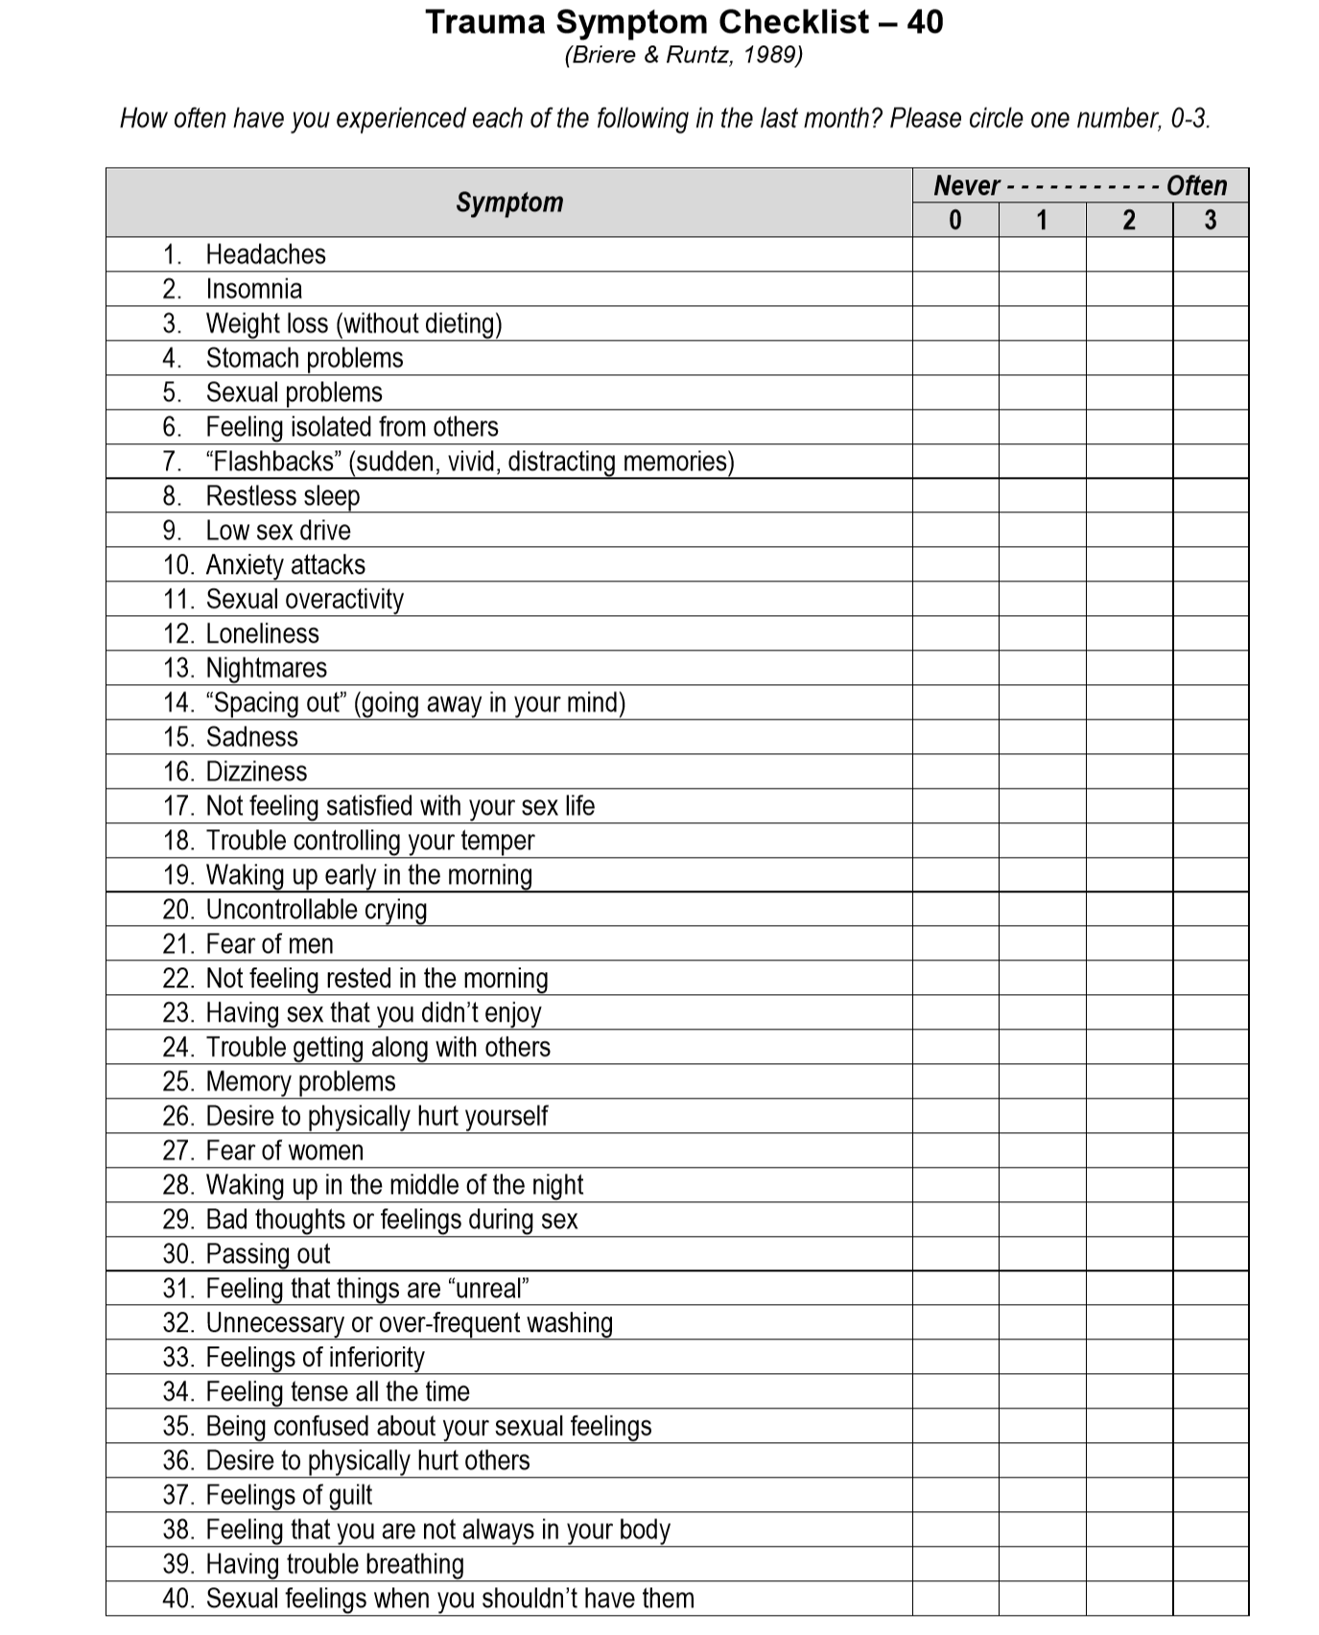
Sample of the TSC-40
Notes:
Here is a sample of the TSC-40.

Slide 11
Instrumentation – WAI-SR
The Working Alliance Inventory Short Form Revised – developed by Hatcher & Gillaspy (2006)
Measures 3 parts of therapeutic relationship (Paap & Dijkstra, 2017)
  1. Goal
  2. Task
  3. Bond
Purpose: to monitor changes in the therapeutic alliance throughout the treatment with AAT
Notes:
The Working Alliance Inventory Short Form Revised (WAI-SR) measures 3 components of the therapeutic alliance. They are “(a) agreement between patient and therapist on the goals of the treatment (Goal); (b) agreement between patient and therapist about the tasks to achieve these goals (Task); and (c) the quality of the bond between the patient and therapist (Bond)”. For the purposes of this study, the WAI-SR will be used to evaluate any changes that might occur in the therapeutic alliance throughout the treatment process with AAT.

Slide 12
Procedure
Group 1: AAT + TF-CBT
Group 2: treatment as usual (TAU) – TF-CBT alone
  Matching group
Independent variable(s): animal-assisted therapy
Dependent variable(s): trauma-related symptomology and therapeutic alliance
Controls:
  4 counselors
  Collaboration between handlers and counselors
Notes:
Similar to the study design of Hamama and her team mentioned previously who studied the effects of CAT with traumatized teenage Israeli girls, there will be two separate groups fort his test. Group one will consist of the 20 human trafficking survivors who are receiving TF-CBT outpatient care and who volunteered to participate and additionally receive AAT with canines as a part of their trauma treatment plan. Group 2 will be a matching group of fellow trafficking survivors from the clinics who are also receiving TF-CBT based outpatient care. They will continue treatment as usual. The second group will be matched based on gender, how long they have been receiving care at the facility, and symptomology.
At the beginning of the study, after all participants have been briefed, they will each be administered the TSC-40 and WAI-SR assessments. The groups will then either continue TAU or begin AAT + TF-CBT. After 6 months, both groups will be administered the same two tests again.
Adding AAT, or CAT more specifically, to the treatment plan for Group 1 will alter the independent variable (treatment). As such, the design of this study is to evaluate changes in the dependent variables which are the therapeutic alliance and trauma-related symptomology. The TSC-40 and WAI-SR are the primary instruments that will be used to measure any changes that occur and therefore to compare the changes between the two groups.
This proposed study was designed to maintain as much consistency as possible. Participants in both groups will see one of four counselors who work at the treatment facilities. There will be an even distribution between the counselors (each counselor will see 10 participants – 5 from each group). 2 canines will be used (1 at each of the 2 treatment facilities). The handlers will meet with the counselors prior to each session that includes canine therapy.

Slide 13
Analysis
Statistical Test: correlated-groups t-test (aka paired sample t-test)
Null Hypothesis:
  H₀: µ_{CAT} - µ_{TAU} = 0
Alternative Hypothesis:
  H_{a}: µ_{CAT} - µ_{TAU} ≠ 0
Notes:
The hypotheses were covered briefly earlier in this presentation. I am going to cover them very briefly here again. First, the null hypotheses for both variables, therapeutic alliance and trauma-related symptomology, is that there will be no difference between the two groups. The alternative hypotheses, therefore, for both dependent variables, is that the changes measured via the TSC-40 and WAI-SR in Group 1 (receiving CAT) will be greater than that of Group 2 or the TAU group. Based on the type of data we will be dealing with and the design of the study, the statistical test we will use is the correlated-groups t-test; also known as the paired sample t-test.
Human trafficking victims are a unique group of traumatized persons and should be treated as such. Research is greatly needed to test the efficacy of various treatment approaches on their group specifically rather than to make generalizations based on the results seen with other traumatized groups. CAT shows great promise as a useful tool for other traumatized groups; therefore, additional research should be conducted to see if it can have a positive impact on the treatment of this population too.

Slide 14
References
Briere, J. N. & Runtz, M. G. (1989). The Trauma Symptom Checklist (TSC-33): Early data on a new scale. Journal of Interpersonal Violence, 4(1), 151-163. DOI: 10.1177/088626089004002002
Dravsnik, J., Signal, T., & Canoy, D. (2018). Canine co‐therapy: The potential of dogs to improve the
acceptability of trauma‐focused therapies for children. Australian Psychological Society, 70(3), 208-216. https://doi-org.ezproxy.liberty.edu/10.1111/ajpy.12199
Hamama, L., Hamama-Raz, Y., Dagan, K., Greenfeld, H., Rubinstein, C., & Ben-Ezra, M. (2011). A
preliminary study of group intervention along with basic canine training among traumatized teenagers: A 3-month longitudinal study. Children and Youth Services Review, 33(10), 1975-1980. Retrieved from https://doi.org/10.1016/j.childyouth.2011.05.021
Hatcher, R. L. & Gillaspy, J. A. (2006-a). Development and validation of a revised short version of the working alliance inventory. Psychotherapy Research, 16(1), 12-25. Retrieved from https://doi- org.ezproxy.liberty.edu/10.1080/10503300500352500
Hemmings, S., Jakobowitz, S., Abas, M., Bick, D., Howard, L. M., Stanley, N., Zimmerman, C., & Oram, S.
(2016). Responding to the health needs of survivors of human trafficking: A systematic review. BMC Health Services Research, 16(320). DOI: 10.1186/s12913-016-1538-8
Human Trafficking: The Facts. (2019). Polaris. Retrieved from https://polarisproject.org/human-
trafficking/facts
Lass-Hennemann, J., Schafer, S. K., Romer, S., Holz, E., Streb, M. and Michael, T. (2018). Therapy dogs as a
crisis intervention after traumatic events? – An experimental study. Frontiers in Psychology, 9(1627). Retrieved from https://doi.org/10.3389/fpsyg.2018.01627

Slide 15
Paap, D. & Dijkstra, P. U. (2017). Working Alliance Inventory – Short Form Revised. Journal of Physiotherapy, 63(2), 118. Retrieved from https://doi.org/10.1016/j.jphys.2017.01.001
Pascual-leone, A., Kim, J., & Morrison, O. (2017). Working with victims of human trafficking. Journal of
Contemporary Psychotherapy, 47(1), 51-59. Retrieved from http://dx.doi.org.ezproxy.liberty.edu/10.1007/s10879-016-9338-3
Rizeq, J., Flora, D. B., & McCann, D. (2018). Construct validation of the Trauma Symptom Checklist-40 total
and subscale scores. Sage, 1-13. DOI: 10.1177/1073191118791042
Sukach, T., Castañeda, N. G., & Pickens, J. C. (2018). Experiences of female sex trafficking survivors: A
phenomenological analysis. The Qualitative Report, 23(6), 1422-1440. Retrieved from http://ezproxy.liberty.edu/login?url=https://search-proquest- com.ezproxy.liberty.edu/docview/2062625796?accountid=12085
The Centers. (n.d.). Human Trafficking Treatment Center. Retrieved from http://www.cfyf.org/programs/human-trafficking/

