Slide 1
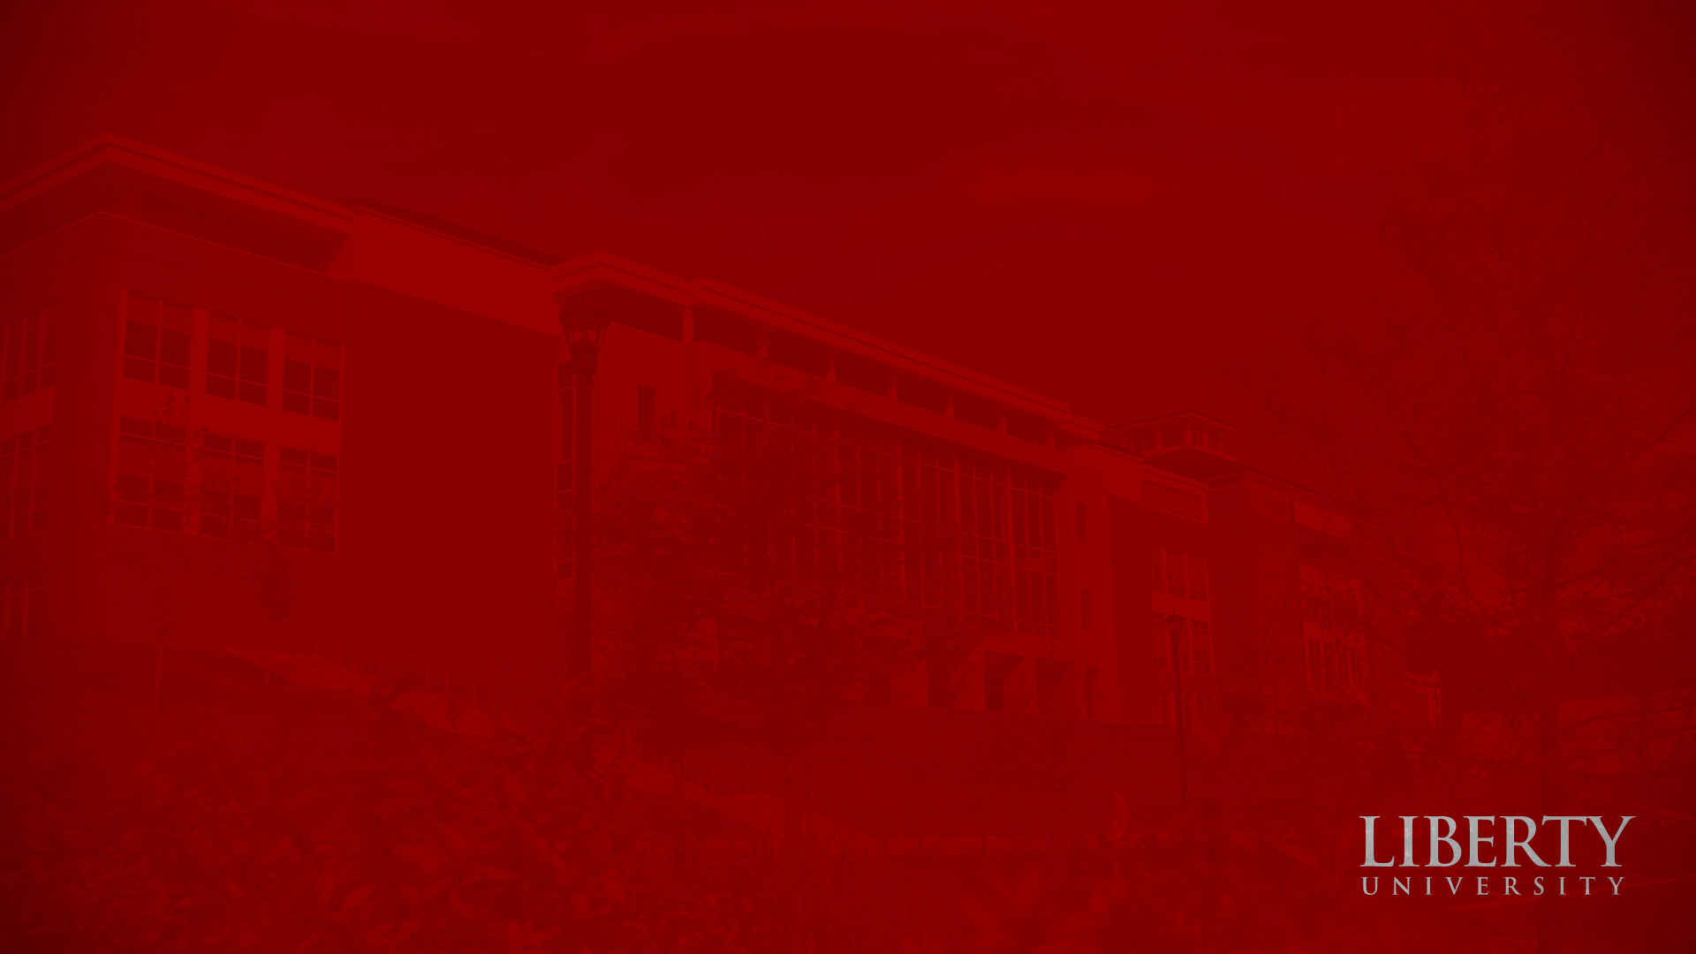
Desire and Beauty: Ancient Philosophy Molding Modern Cinema in Vertigo
Garrett Johnson
Notes:
Prior to immersing ourselves in this idea…

Slide 2
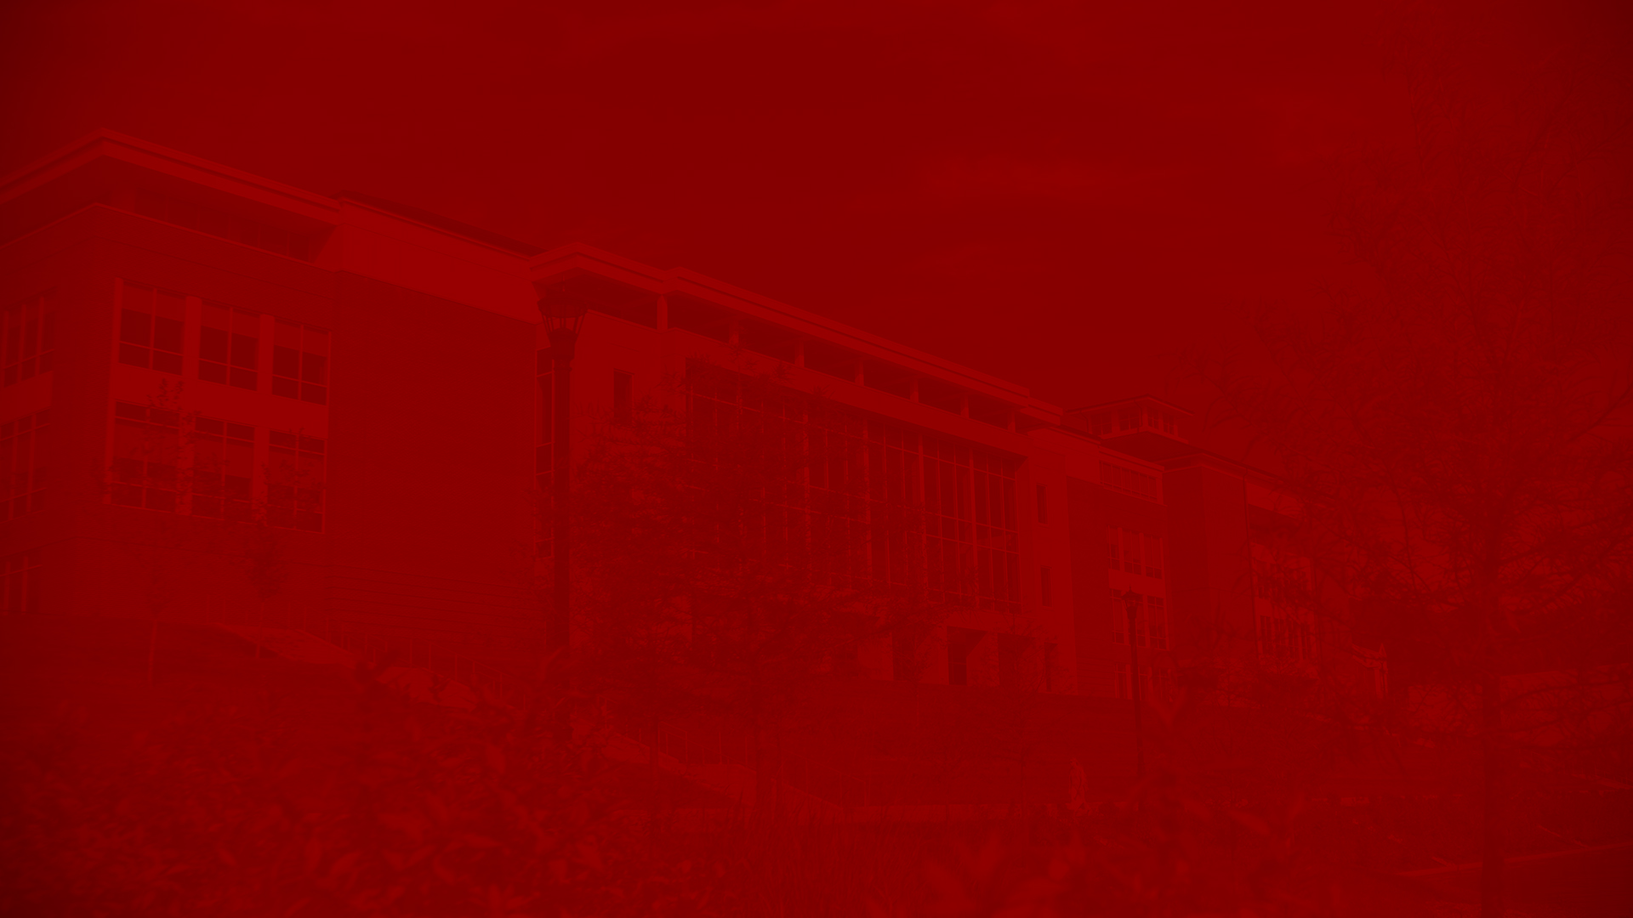
What Do We Desire?
Modern culture lacks a concern with the telos of desire for beauty.
Ancient Platonic philosophy articulates this well
Desire for beauty is an eros, which takes two forms; understanding this philosophy reveals prevailing patterns in Western culture, especially in film.
Notes:
-Modern, western people struggle to articulate an understanding about beauty and desire.
Regardless of the cause, the effect remains—modern culture has lost a concern with the telos, the end goal, of our desire for beauty and the beauty we desire to behold. We no longer understand what desire is, what we perceive to be beautiful, and whether there is a way that we ought to perceive our desires and perceptions of beauty.
-In his dialogue Phaedrus, Plato specifically establishes a philosophical mindset for human desire related to beauty and goodness; this desire, this eros, takes two forms in the text, and a clear understanding of both true eros and corrupted eros in Plato can reveal prevailing patterns in Western culture’s attitudes towards desire today.
-This mindset influences the modern film of Vertigo, where Hitchcock’s film portrays an intentional corruption of the desire for beauty, truth, and goodness, allowing the viewer to retrospectively discover this same corruption of perception within themselves.

Slide 3
What Was Desire?
Plato saw desire as eros, and changed the Greek perception of this word.
Eros encompasses the whole person’s desire for completion and perfection, a telos.
Plato’s telos concerning eros needs to be interpreted in the terms of a formative educational pursuit of truth and ultimate goodness that finds fulfillment in Plato’s Ideals
Notes:
-There are two Greek words used regarding affection and love in this realm of philosophy—eros and philia. Eros does bear some similarities with philia in the sense that both are concerned with a “yearning for the good,” which is cause for some confusion (Muir 237). Plato’s primary concern in Phaedrus, though, was with eros, and not with philia (“The ‘Symposium’” 123). The distinction between the two is that philia to Plato was reciprocal and possessed a more tame, gentle nature, emphasizing a brotherly, scholarly love (Muir 237). Prior to Plato, philia was the word Greek philosophers used to describe love in conjunction with education for the person’s good (Vlastos 10-11).
-Regarding eros, Greek literature had generally used the term to describe “any intense desire aroused by the stimulus of beauty” (“The ‘Symposium’” 122). Plato chose to maintain this emphasis of a desire to beauty in his use of eros, but instead focused on individual beings, using eros specifically with people instead of objects. Furthermore, Plato used eros in Phaedrus to describe desire and longing in an educational sense, feeling the need to emphasize the “longing and urgent desire for completion and perfection;” this was more in line with how Plato conducted his educational pursuits. This eros, this desire, encompassed the whole person, their soul, and their desire for completion (Muir 237-38).
-While this perspective is idealistic, Plato does not deny that eros can fall short of the pursuit of the good and truth—rather, Plato shows how this desire falls prey to corruption all too often:
. . . having had their hearts turned to unrighteousness through some corrupting influence, they may have lost the memory of the holy things which they once saw. Few only retain an adequate remembrance of them; and they, when they behold here any image of that other world, are rapt in amazement; but they are ignorant of what this rapture means, because they do not clearly perceive . . .
. . . Now he who is not newly initiated or who has become corrupted, does not easily rise out of this world … he looks only at her earthly namesake, and instead of being awed at the sight of her, he is given over to pleasure, and like a brutish beast he rushes on to enjoy and beget…”

Slide 4
Reclaiming Eros
Eros helps humans recall their visions of the good, and true eros will lead beyond indulgent self-pleasure to the Form of Beauty
Reason governs, or fails to govern, eros.
True eros will lead us towards Beauty.
Notes:
Three perceptions of eros: a level of individual unique human experience, a general class or kind of beauty, and the ultimate idea beyond both individual and class that extents to Plato’s Ideals (Muir 239). Plato sees pure, uncorrupted eros as “a divinely inspired mania and as a rational force indispensable for . . . philosophic life” (Muir 239; Giannapoulou 157). To receive this inspiration, true eros comes from visions of earthly beauty in immanent particulars that allow the lover to recollect the Form of Beauty, moving closer to the Ideals of Plato (Muir 239; Giannapoulou 157). In receiving enlightenment from viewing the image of the Ideals in another person, eros has the potential power to educate the subject in perceiving ultimate goodness and Beauty (Underwood 34; Vlastos 31).
- Charioteer Metaphor (give explanation of metaphor BEFORE): In the metaphor, the obstinate horse strains against the master, Reason, driving away from the Ideals, while true eros is held in check by the vision of love that will lead towards the Ideals. In this case, the obedient horse is an ally of reason, which is a good, true eros; on the other hand, the disobedient horse represents a corrupted eros that seems to simply seek sexual gratification, a “left-handed,” twisted form of eros (Sheffield 226).

Slide 5
Problems Pursuing Beauty
People become objects, means to the end of achieving true Beauty.
Humans must pursue a two-sided exchange of loving desire leading to a transformation in the perceiver.
Overwhelmed by Beauty, not power over the beautiful.
Notes:
Too storybook—there are no problems, but there actually are many.
-In ascending towards the Ideal of Beauty, one must transcend earthly beauty, creating a paradox within a loving, interpersonal relationship—to love Beauty is to reject the human relationship between the lover and the beloved.
-Fix problem: For lovers in pursuit of beauty and happiness, beauty must be desired in a right way—not for power over the beloved, but for a transformation in one another’s perceptions in pursuing the ultimate good.
-The perceiver of beauty should be overwhelmed by the beautiful rather than seizing power over beauty (Scarry 33). One who is not overpowered by their encounter with the image of Beauty likely has not perceived beauty at all, and instead has fallen short of an encounter with the beautiful (Scarry 34). Beauty, then, is a compact between the immanent beauty and the perceiver. “As the beautiful being confers on the perceiver the gift of life in the image of Beauty, so the perceiver confers on the beautiful being the gift of life” (Scarry 39). While the desire for the Beautiful will outlast our perception of it in an immanent particular, the beautiful person should incite within us a desire for the Ideal of Beauty and truth in an equal exchange, not in a one-sided, damaging gaze (Scarry 26, 34). Beauty should be reciprocal, a “fairness” between both parties.

Slide 6
Beauty and Corrupted Eros
The corrupted eros, then, is the antithesis of a true desire in pursuit of Beauty
It is an irrational desire from within oneself for a particular beauty that maintains one’s current perception of beauty without any greater transformation, leading to a base desire often objectifying the other that typically leads to seeking fulfillment through sexual gratification.
Notes:
-What of a being who falls short of an encounter with the beautiful? If Beauty motivates the obedient horse, then a “false” beauty must motivate the corrupted eros.
-This beauty is not false in the sense that it does not exist—it is false in the sense that it does not lead to Plato’s Ideal Form of Beauty.
-If the charioteer, Reason, is the guide of both desires, then there is a failing of Reason when the black horse metaphorically draws the charioteer downward.
-In this case, Plato believes the perceiver will seek to transform and refashion the other after its own image.

Slide 7
Applying Philosophy to Vertigo
Hitchcock’s personal background regarding his eros.
Vertigo is a reproof of the corrupted eros.
Notes:
Film relishes in the constructed image, but not all film debases Beauty.
In illustrating how Hitchcock reveals the corruption of Plato’s eros, the quote from Plato’s Phaedrus provides an initial connection between the dialogue and Hitchcock’s film: “My dear Phaedrus, whence come you, and whither are you going?” (Plato 29). Plato via Socrates is not just inquiring about the physical location of his student—he is trying to discern his student’s condition, to reveal his past perceptions and discover the ultimate destination of Phaedrus. This quote is mirrored in Hitchcock’s Vertigo, where Kim Novack, playing the imposter Madeline, says to Jimmy Stewart, playing the detective Scottie, “One is wandering, two is going somewhere.” Scottie wanders like Phaedrus, but his wandering is more dangerous—he wanders believing he is safe, not knowing how his corrupted eros will lead him after a false fantasy.

Slide 8
Perception and Subjectivity
Hitchcock uses the inherent voyeurism of cinema and heightens this with film technique.
The subjective perspective intentionally leads the audience to be complicit with Scottie’s viewing.
Notes:
-In the film industry, the conditions of the cinema establish an illusion for the viewing audience that they are looking into a private world (Mulvey 17).
-The title itself, Vertigo, refers to a distorted awareness, a loss of balance, and an inability to trust one own’s perception.
The audience then views most of Vertigo through the eyes of Scottie, creating a predominately subjective point of view (Mulvey 24). The audience tracks and follows Madeline through Scottie’s perspective, and the audience is pulled into a three-in-one mechanism of director/camera, character, and audience, staring with voyeuristic fascination (Barr 20-21).
-The audience sees what Scottie sees or fails to see, and they become unconscious participants in his growing erotic obsession and fetishistic scopophilia with Madeline (Mulvey 22, 24-25).
-The audience is in Scottie’s view. We cannot help but gaze intently at the image of Madeline, unintentionally idolizing her image with our viewing.
-In this relationship, there is no exchange of perception, no mutual compact, only a silent watching Hitchcock/Scottie/audience. This is not true eros, but a corruption, a desire for only the beauty and not a vulnerability.

Slide 9
Observing Beauty
The relationship between Scottie and Madeline exemplifies a corrupted eros at work.
Scottie is lead to objectify Madeline.
Moving from watching to participating only intensifies Scottie’s desire for Madeline.
Notes:
-When Scottie is first introduced to Madeline, he silently observes her, as it is his job to investigate her for Elster from a distance. Madeline is an object of beauty, but whether she possesses the image of Beauty that can transform Scottie remains obscure.
-By the end, Scottie dominates the relationship and is not transformed—more on that later.
-From changing her clothes while she slept to waiting on her with rapt attention, he displays a fixation with her beauty (Barr 75).

Slide 10
Possessing Beauty
Scottie is possessed by his own obsession.
A lustful desire to possess Madeline, a false image of Beauty in two senses.
Notes:
At first, Scottie attempts to save Madeline from danger and determine the cause of her “possession.” However, as the film progresses, Scottie becomes the truly endangered party as he falls prey to the captivating image of Madeline and capitulates to his corrupted eros.
-Danger intensifies as he pursues an illicit romantic relationship with Madeline, the spouse of his friend (Barr 74-75). He develops a romantic obsession with the enigma of Madeline, trying to possess the feminine object of his directed gaze (Barr 22, Mulvey 22).
-He abandons rational caution and devotes himself to Madeline’s particular, false beauty.

Slide 11
False Beauty
Madeline is a crafted persona that posesses both Scottie and Judy.
Scottie intentionally recreates Madeline’s image against Judy’s wishes, demonstrating domination.
Notes:
This persona becomes a possessive identity, taking Judy’s clothing, her hair, her identity, and eventually her life (Barr 74). This persona also possesses the very mind of Scottie, who feels a relentless obsession to possess the beauty of Madeline. When bereft of her beauty, he becomes significantly silent, unable to speak in the same way Madeline was voiceless in the early portions of the film (Barr 81) .
-The beauty is false as well. Long shot at end of film, describe how they get there.

Slide 12
Inversion of Beauty
Hitchcock intentionally lets the viewers and Scottie pursue the false beauty.
Scottie glorifies a deception, taking the true image of Judy’s love and conforms her into the physical appearance of his fetishistic scopophilia to appease his voyeuristic, corrupted eros.
Notes:
-To Plato, a person experiencing pure eros should be struck dumb by the reflected image of Beauty that would lead to a rational remembrance and transformation within the perceiver; a corrupted eros would come from an individual human experience that would draw one’s perception further into their desire for possession of beauty without transformation. (Discuss transformation briefly).
-There is a gradual acceptance of Scottie’s voyeurism which is later jarringly distorted for the audience when the audience sees Judy recreated as Madeline, Scottie’s ideal beauty.
-The inversion of Plato’s Ideals, though, is that Scottie wants to fulfill his voyeuristic desire rather than encounter Beauty, to gratify his corrupted eros in Judy-become-Madeline rather than pursue true eros. Judy may express a loving desire towards Scottie, but this is overwhelmed by the influence Scottie exerts over Judy to change her into Madeline and restore his twisted perception of Beauty.
-This does not mean that beauty could not be found in the particulars of Madeline or Judy in how they imaged true Beauty. To focus on this would misconstrue the fundamental concern—what is the telos of Scottie’s desire, and why does he desire the false image? Scottie finds himself enslaved to his corrupted eros that pursues the false image of Madeline, allowing his harmful, voyeuristic gaze to turn into a fetish scopophilia. He reduces the character of Judy to an object to satisfy his pleasures (Powell 10).
-Scottie’s telos is in the desire itself, and he never ascends toward pursuing the ultimate good for himself or Judy.

Slide 13
Impact
Hitchcock’s film portrays an intentional corruption of the desire for beauty, truth, and goodness, allowing the viewer to retrospectively discover this same corruption of perception within themselves.
My research will hopefully create a space for applying ancient philosophy to modern Western thought, forming connections between a philosophy and practice.
My research also leads the reader to question the telos of their desires, much like Hitchcock does in his film.
Notes:
-From Vertigo’s opening credits, Hitchcock asks the audience to question the telos of their eros. This fundamental question hearkens back to Plato’s philosophy in Phaedrus, where he imparts a clear understanding of what humans desire, how they desire it, and what they should desire. Any reader of Phaedrus or viewer of Vertigo can discern that we desire what we find beautiful; only those who look closely and question their own perception can discover that their perceptions too often fall short of Plato’s Ideal Beauty, instead satisfying themselves with lesser, particular beauties that prove to be unsatisfactory, false, and deceiving. In an interview with Kim Novak, the actress discussed why she chose to take on the role of Madeline/Judy, and she stated the following: “‘I related to the resentment of being made over and to the need for approval and the desire to be loved. I really identified with the story because to me it was saying, Please come see who I am. Fall in love with me, not a fantasy’” (Aulier 25).
-This is Hitchcock’s message that finds correspondence in Plato: See the corrupted eros for what it is. Fall in love with true Beauty that transforms the perceiver, not a fantasy that empowers destructive madness. When one learns to desire rightly, to seek after Beauty and pursue the truth with one’s entire being, then the reader has reclaimed their corrupted desires with their Reason and ordered their perceptions.

Slide 14
Works Cited
Aulier, Dan. Vertigo: The Making of a Hitchcock Classic. St. Martin’s Press, 1998.
Barr, Charles. Vertigo. 2nd ed., Palgrave Macmillan, 2012.
Giannopoulou, Zina. “Enacting the Other, Being Oneself: The Drama of Rhetoric and Philosophy in Plato’s Phaedrus.” Classical Philology, vol. 105, no. 2, 2010, pp. 146-161. JSTOR, https://www.jstor.org/stable/10.1086/651715. Accessed 1 November 2020.
Gkaleas, Konstantinos. “Ἔρως and Γυμναστική in the Platonic Corpus: The Quest for the Form of Καλόν.” Looking at Beauty to Kalon in Western Greece: Selected Essays from the 2018 Symposium on the Heritage of Western Greece, edited by Reid, Heather L. and Tony Leyh, Parnassos Press – Fonte Aretusa, 2019, pp. 123-132. JSTOR, https://doi.org/10.2307/j.ctvcmxpn5.12. Accessed 1 November 2020.
Jaeger, Werner, and Gilbert Highet. Paideia. Volume III, The Conflict of Cultural Ideals in the Age of Plato : the Ideals of Greek Culture. Oxford University Press, 1971. ProQuest Ebook Central, https://ebookcentral-proquest-com.ezproxy.liberty.edu/lib/liberty/detail.action?docID=716713. Accessed 1 November 2020.
Kamtekar, Rachana. “Speaking with the Same Voice as Reason: Personification in Plato’s Psychology.” Plato and the Divided Self, edited by Barney, Rachel, et al., Cambridge University Press, 2012, pp. 77-101. ProQuest Ebook Central, https://ebookcentral-proquest-com.ezproxy.liberty.edu/lib/liberty/detail.action?docID=833430 . Accessed 1 November 2020.
Muir, D. P. E. “Friendship in Education and the Desire for the Good: An Interpretation of Plato’s Phaedrus.” Educational Philosophy and Theory, vol. 32, no. 2, 2000, pp. 233-247. Taylor and Francis Online, doi: 10.1111/j.1469-5812.2000.tb00446.x. Accessed 1 November 2020.
Mulvey, Laura. Visual and Other Pleasures. 2nd ed., Palgrave Macmillan, 2009.
Pappas, Nickolas. “Telling Good Love from Bad in Plato’s Phaedrus.” Proceedings of the Boston Area Colloquium in Ancient Philosophy, vol. 32, no. 1, University Press of America, July 2017, pp. 41–58, doi:10.1163/22134417-00321P05.

Slide 15
Works Cited
Plato. Phaedrus. E-book, Trajectory Classics, 2014.
Powell, Samuel M. “Reason and Emotion in Classical Philosophy.” The Impassioned Life: Reason and Emotion in the Christian Tradition. 1517 Media, 2016, pp. 7-47. JSTOR, doi: 10.2307/j.ctt17mcs8j. Accessed 1 November 2020.
Scarry, Elaine. On Beauty and Being Just. E-book, Princeton UP, 2013.
Sheffield, Frisbee. “Eros before and after Tripartition.” Plato and the Divided Self, edited by Barney, Rachel, et al., Cambridge University Press, 2012, pp. 211-237. ProQuest Ebook Central, https://ebookcentral-proquest-com.ezproxy.liberty.edu/lib/liberty/detail.action?docID=833430 . Accessed 1 November 2020.
---. “The ‘Symposium’ and Platonic Ethics: Plato, Vlastos, and a Misguided Debate.” Phronesis, vol. 57, no. 2, 2012, pp. 117-141. JSTOR, https://www.jstor.org/stable/23249126. Accessed 1 November 2020.
Underwood, Harry. “Platonic Deisre.” The Experience of Beauty: Seven Essays and a Dialogue. McGill-Queen’s UP, 2016, pp. 29-54. JSTOR, www.jstor.org/stable/j.ctt1dnncbp. Accessed 1 November 2020.
Vlastos, Gregory. Platonic Studies. 2nd ed., Princeton UP, 1981.
Zistakis, Alexander. “Beauty and Desire Ancient and Modern.” Looking At Beauty to Kalon in Western Greece: Selected Essays from the 2018 Symposium on the Heritage of Western Greece, edited by Reid, Heather L. and Toney Leyh, Parnassos Press – Fonte Aretusa, 2019, pp. 271-284. JSTOR, https://www.jstor.org/stable/j.ctvcmxpn5.23. Accessed 1 November 2020.

