Slide 1
Tsars, Soviets, and Saints
A Historical Examination of the Physical Distribution of Protestants in Russia

Slide 2
Geographic Distribution

Slide 3
Protestant Distribution
The Volga Region
The Caucasus Region
Urban areas (St. Petersburg and Moscow)
Siberia and the Far East

Slide 4
Map of Russia. (n.d.). Britannica. https://www.britannica.com/place/Russia.

Slide 5
Geographic trends

Slide 6
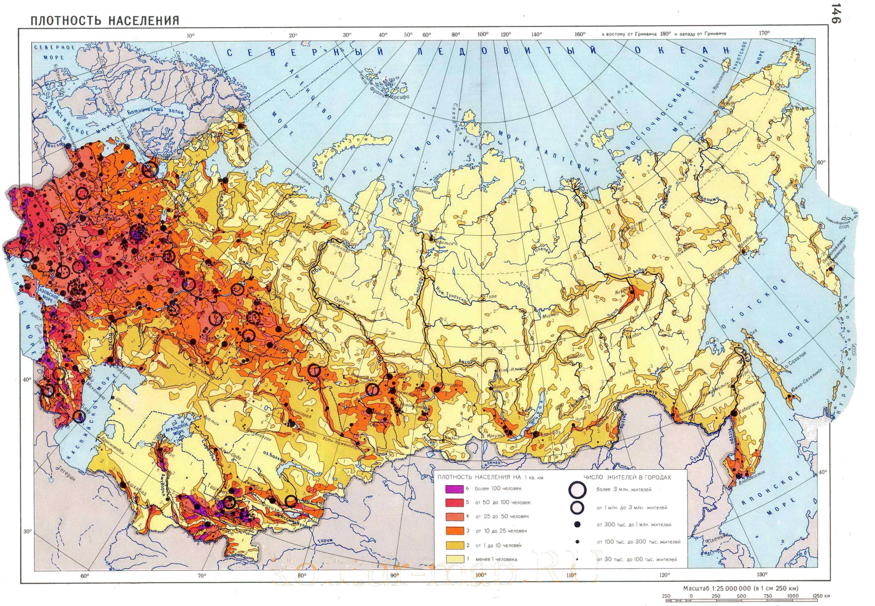
General Distribution
Russia Population Density Map. Maps-Russia. https://maps-russia.com/russia-population-density-map.

Slide 7
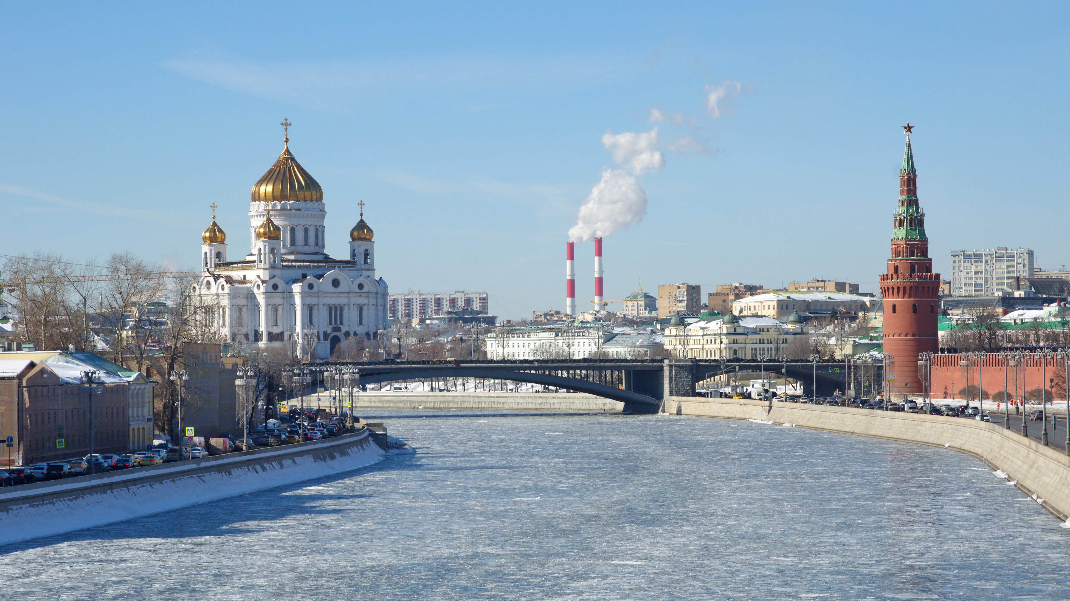
Urbanization
Urbanization
iStock/Getty Images. Moscow in Winter. The Culture Trip. https://theculturetrip.com/europe/russia/articles/how-to-make-the-most-of-24-hours-in-moscow-in-winter/

Slide 8
Historical Analysis

Slide 9
Key Themes
Government Intervention
Personal Faithfulness

Slide 10
“At that time a great persecution arose against the church which was at Jerusalem; and they were all scattered throughout the regions of Judea and Samaria … Therefore those who were scattered went everywhere preaching the word.”
- Acts 8:1,4 (NKJV)

Slide 11
Catherine II and German Immigrants
1763 - Catherine II invites foreigners to Russia
Germans settle along the Volga River
Brompton, Richard. Catherine II. (1782.) Britannica. https://www. britannica.com/biography/Catherine-the-Great/images-videos.

Slide 12
Baptists in the Caucasus
1867 - Nikita Voronin baptized by a Lithuanian Christian
Foreign believers from England, Syria, and Lithuania played a role in Voronin’s conversion.

Slide 13
1830 - Nicholas I exiles religious dissidents
Impact of the Baptist movement disputed by historians
Nicholas I. (n.d.). Britannica. https://www.britannica.com/ biography/Nicholas-I-tsar-of-Russia/images-videos.

Slide 14
“Pashkovism” in St. Petersburg
Lord Radstock
Colonel Pashkov
Beginnings of organized Baptist movement

Slide 15
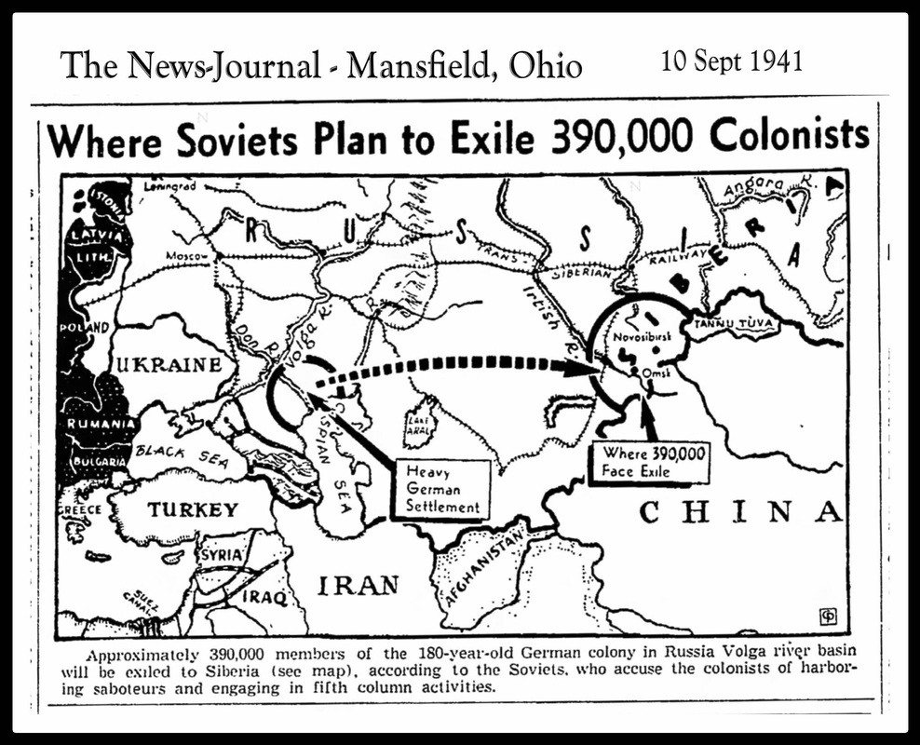
Growth in Siberia and the Far East
Deportation of Russian Germans during World War II
1956 – freedom to travel re-established
Impact on Russian Protestants
Where Soviets Plan to Exile 390,000 Colonists. (September 10, 1941). NorkaRussia. https://www. norkarussia.info/deportation-1941.html

Slide 16
Conclusion

