Slide 1
Reminiscent of Revivalism:
Three Anglican Evangelical Clergymen in Eighteenth-Century Virginia

Slide 2
Eighteenth-Century Virginia
Church was the center of religious and social life
Taxes had to be paid to the church by law
“Virtuous Happiness” was preached in most parishes
Anglican ministers often bored their parishioners
https://northamanglican.com/sober-delight-and-rational-exaltation-why-18th-century-anglicanism-matters/
Blosser, Jacob M. "Pursuing Happiness in Colonial Virginia: Sacred Words, Cheap Print, and Popular Religion in the Eighteenth Century." The Virginia Magazine of History and Biography 118, no. 3 (2010): 211-45.
Blosser, Jacob M. "Unholy Communion: Colonial Virginia’s Deserted Altars and Inattentive Anglicans." The Virginia Magazine of History and Biography 127, no. 4 (2019): 266-99.
Upton, Dell. Holy Things and Profane: Anglican Parish Churches in Colonial Virginia. New Haven: Yale University Press, 1997.

Slide 3
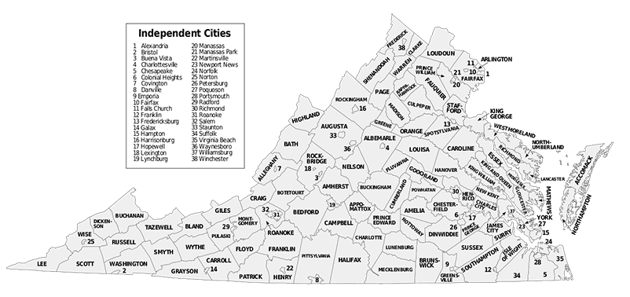
Who were Devereux Jarratt, Archibald McRobert, and Charles Clay?
Distinct from other Anglican ministers
Revivalists
This image by Lasunncty is licensed under CC BY-SA 3.0

Slide 4
What is a Revivalist?
“intense periods of unusual response to gospel preaching linked with unusual efforts at godly living”
- Mark Noll
Evangelical
A person who holds, promotes, or presides over religious revivals
Specific to the time period:
Tendency towards “fiery” preaching
Holds to certain theological concepts common during the Great Awakening
What is a Revival?
Noll, Mark A. The Rise of Evangelicalism: The Age of Edwards, Whitefield and the Wesleys. Illinois: InterVarsity Press, 2010.
https://unsplash.com/photos/yhEgkxZqkkk?utm_source=unsplash&utm_medium=referral&utm_content=creditShareLink

Slide 5
The Virginian Fear of Revivalism
This image from the British Museum is licensed under CC BY-NC-SA 4.0

Slide 6
These three men were different:
Societally
Different Backgrounds
Unique Ministerial Training
Behaviorally
Unusual Motivations
Fiery Preaching
Theologically
Justification by Faith Alone
Necessity of the New Birth
Clay, Charles. Papers. Section 2, 1745-1820. Virginia Museum of History and Culture, Richmond, VA.
Jarratt, Devereux. A Solemn Call to Sleeping Sinners. Philadelphia: Johnson & Justice, 1792.
Jarratt, Devereux. The Life of the Reverend Devereux Jarratt. New York: Arno Press, 1969.
Virginia Argus, 16 Oct. 1807, Chronicling America: Historic American Newspapers. Lib. of Congress, https://chroniclingamerica.loc.gov/lccn/sn84024710/1807-10-16/ed-1/seq-3/.
https://chrisherd.medium.com/why-being-a-black-sheep-is-the-only-way-to-become-a-billionaire-b0096025b75e
http://www.joethorn.net/blog/2013/7/2/preaching-past-our-comfort
https://unsplash.com/photos/BQXOcE3ZM9c?utm_source=unsplash&utm_medium=referral&utm_content=creditShareLink

Slide 7
George Whitefield
This image from the National Portrait Gallery is licensed under CC BY-NC
Evangelical Anglican
A “catalyst” for revivals in the colonies
Preached the importance of the New Birth and Justification by Faith Alone

Slide 8
Why are Jarratt, McRobert, and Clay important?
Long First Great Awakening
George Whitefield = Colonies
Jarratt, McRobert, Clay = Southern VA
Shared Characteristics with Evangelical Dissenters
https://www.amazon.com/Great-Awakening-Evangelical-Christianity-Colonial/dp/0300158467
http://www.emersonkent.com/map_archive/american_colonies_1775.htm
https://www.congregationalconsulting.org/death-of-denominations/

Slide 9
Primary Sources
Clay, Charles. Papers. Section 2, 1745-1820. Virginia Museum of History and Culture, Richmond, VA.
Jarratt, Devereux. A Solemn Call to Sleeping Sinners. Philadelphia: Johnson & Justice, 1792.
Jarratt, Devereux. Sermons on various and important subjects, in practical divinity, adapted to the plainest capacities, and suited to the family and closet. By the Rev. Devereux Jarratt, rector of Bath, in the state of Virginia. Raleigh: Glendinning, 1805.
Jarratt, Devereux. The Life of the Reverend Devereux Jarratt. New York: Arno Press, 1969.
Virginia Argus, 16 Oct. 1807, Chronicling America: Historic American Newspapers. Lib. of Congress, https://chroniclingamerica.loc.gov/lccn/sn84024710/1807-10-16/ed-1/seq-3/.
Whitefield, George. A brief and general account, of the first part of the life of the Reverend Mr. George Whitefield, from his birth, to his entring [sic] into holy-orders. Philadelphia: Bradford, 1740.
Secondary Sources
Bebbington, David W. “The Nature of Evangelical Religion.” In Evangelicals: Who They Have Been, Are Now, and Could Be, edited by Mark A. Noll, David W. Bebbington, and George M. Marsden, 31-55. Grand Rapids: William B. Eerdmans Co, 2019.
Blosser, Jacob M. "Pursuing Happiness in Colonial Virginia: Sacred Words, Cheap Print, and Popular Religion in the Eighteenth Century." The Virginia Magazine of History and Biography 118, no. 3 (2010): 211-45.
Blosser, Jacob M. "Unholy Communion: Colonial Virginia’s Deserted Altars and Inattentive Anglicans." The Virginia Magazine of History and Biography 127, no. 4 (2019): 266-99.
Gundersen, Joan R. The Anglican Ministry in Virginia, 1723-1776: A Study of a Social Class. New York: Garland Pub, 1989.Kidd, Thomas. George Whitefield: America’s Spiritual Founding Father. New Haven & London: Yale University Press, 2014.
Kidd, Thomas. The Great Awakening: The Roots of Evangelical Christianity in Colonial America. New Haven & London: Yale University Press, 2007.
Meade, William. Old Churches, Ministers and Families of Virginia. Vols. 1 and 2. Philadelphia: J. B. Lipponcott Company, 1910.
Nelson, John K. A Blessed Company Parishes, Parsons, and Parishioners in Anglican Virginia, 1690-1776. Chapel Hill: University of North Carolina Press, 2002.
Noll, Mark A. The Rise of Evangelicalism: The Age of Edwards, Whitefield and the Wesleys. Illinois: InterVarsity Press, 2010.
Noll, Mark A., David W. Bebbington, and George M. Marsden, eds. Evangelicals: Who They Have Been, Are Now, and Could Be. Grand Rapids: William B. Eerdmans Co, 2019.
Parr, Jessica M. Inventing George Whitefield: Race, Revivalism, and the Making of a Religious Icon. Jackson: University Press of Mississippi, 2015.

