Slide 1
Synthesis of a Substance for the Selective and Sensitive Sorption of Perfluoroctanoic Acid
James M. Davis and Alicia M. Loucks
Dr. Stephen T. Hobson, Ph.D.
Liberty University
Department of Biology and Chemistry

Slide 2
Presentation Overview
Introduction to PFOAs
Background on MIPs
Research Objective
Experimental Methods
Results
Future Tasks

Slide 3
Molecule of Interest: PFOA
PFOA part of class of molecules called PFASs
Applications
  stain repellents, polishes, paints, paper, metal plating and household products
Environmental introduction through manufacturing and consumer usage
  Global emissions estimated at 3200-7300 tons (1951-2004)

Slide 4
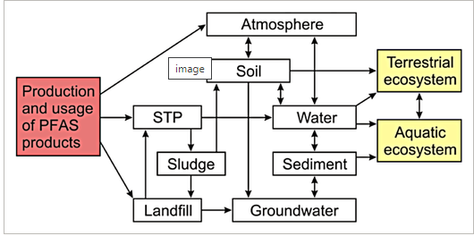
Harmful Results of Environmental Release
High accumulation in aquatic environments
  Algae cell membranes → trophic cascade
  Generational mortality and histopathological alterations
Effects on human populations:
  Obesogenic, Diabetogenic, Preeclampsia, Cancer
US Environmental Protection Agency PFOA Stewardship Program
Ahrens, L., Bundschuh M. (2014). Fate and effects of poly- and perfluoroalkyl substances in the aquatic environment: A review. Environmental Toxicology and Chemistry 33(9), 1921-1929.

Slide 5
Background on MIPs

Slide 6
What is a molecularly-imprinted polymer?
Molecularly-imprinted polymers (MIPs) are processed in a matrix which leaves cavities to bind certain template molecules (similar to antibodies)
  Cavities formed from non-covalent interactions in pre-polymerization complex between crosslinking monomer and template
Result = cavity with specific 3D shape in MIP that is selective for the analyte
"Mold" to molecule of interest

Slide 7
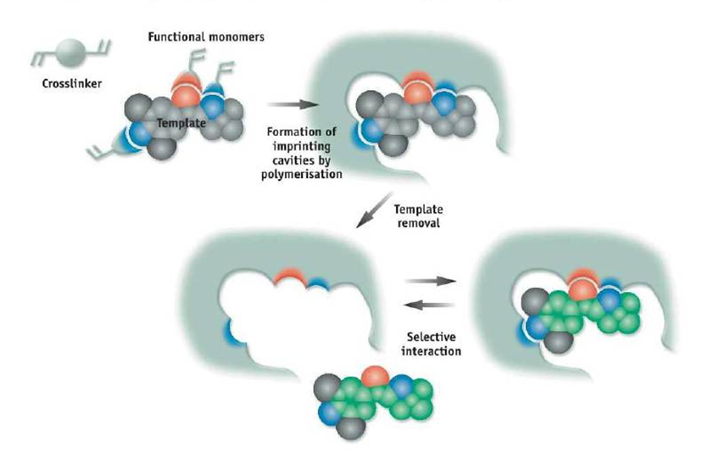
MIP Polymerization Process
Garcia Calzon, J.A., Diaz-Garcia, M.E. (2007). Charicterization of binding site in molecularly imprinted polymers. Sensors and Actuators B: Chemical, 123(2), 1180-1194.

Slide 8
History of MIPs
Alexander Markovich Polyakov (1931)
  noted effect on silica when polymerized with benzene and derivatives
"Dickey's method"(1941)
  Sodium silicate polymerization in presence of one of four dyes; silica would adsorb the pattern dye preferentially over the other three
Merck Co.
  Patent of nicotine filter for cigars and cigarettes; bound 10.7% more nicotine than non-imprinted silica
Notes:
-Silica had different load capacities as an adsorbent when polymerized in the presence of different solvents. In a sense it seemed to "imprint" itself around the structure that was present before drying it, changing its adsorptive properties. ​
-The process of imprinting gained attention in the commerical world when Merck Co. Patented a filter made of nicotine-imprinted silica

Slide 9
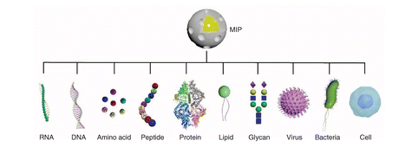
Use of MIPs
El-Schich Z., Zhang Y., Feith M., Beyer S., Sternbaek L., Ohlsson L., Stollenwerk M., Wingren AG. (2020). Molecularly imprinted polymers in biological applications. Biotechniques 69(6).
Analytical chemistry, pharmaceutical analyses, and medicine
MIP nanoparticles for drug and protein analysis in body fluids
Drug-of-abuse detection
Gas sensing applications (e.g., emission of volatile organic compounds)

Slide 10
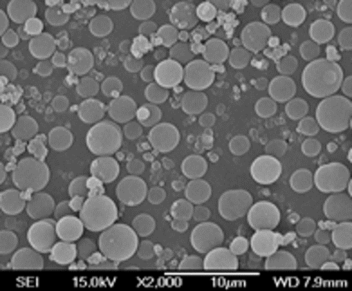
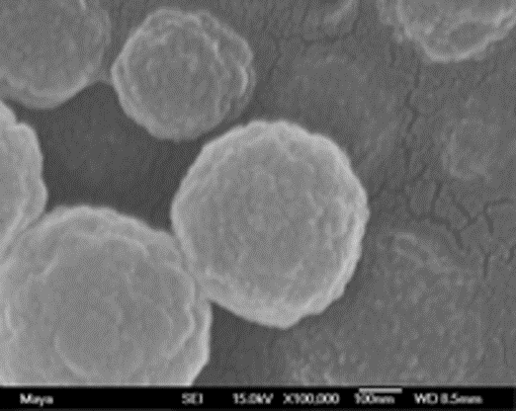
SEM of MIP Nanoparticle
SEMs of MIP nanoparticle prepared against a tetrapeptide
(Scale bar: Left = 10 μm, Right = 100 nm)
SEM micrographs courtesy of Dr. David Spivak, Louisiana State University

Slide 11
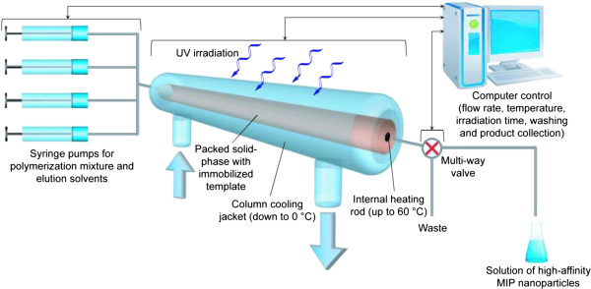
MIP Nanoparticle Synthesis Selective for Vancomycin
Muzyka, K., Karim K., Guerreiro A., Poma A., Pilestky S. (2014). Optimization of the synthesis of vancomycin-selective molecularly imprinted polymer nanoparticles using automatic photoreactor. Nanoscale Res Lett. 31(9), 154.

Slide 12
Research Objective
Synthesize Monomer
Coupling Reactions
Novel synthesis of fluorinated compound
Polymerization
FMIP
MIP
Characterization and Analysis
Batch Rebinding Assay with PFOA
Binding Isotherm
Peer-Review Publication of Results

Slide 13
Experimental Methods

Slide 14
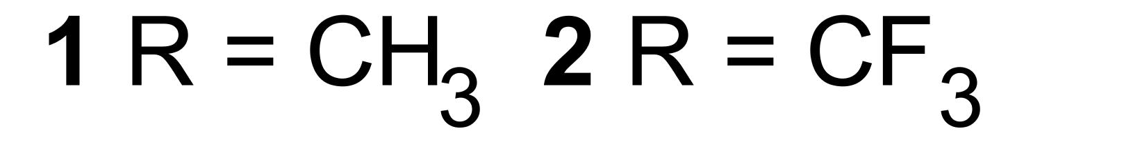
Monomer Synthesis: Method #1
COMU → coupling agent
TPGS → nanoreactor
Example of Green Chemistry
COMU
TPGS-750-M

Slide 15
Monomer Synthesis: Method #2
DCC
DMAP
DCC → activates carboxylic acid group
DMAP → coupling agent

Slide 16
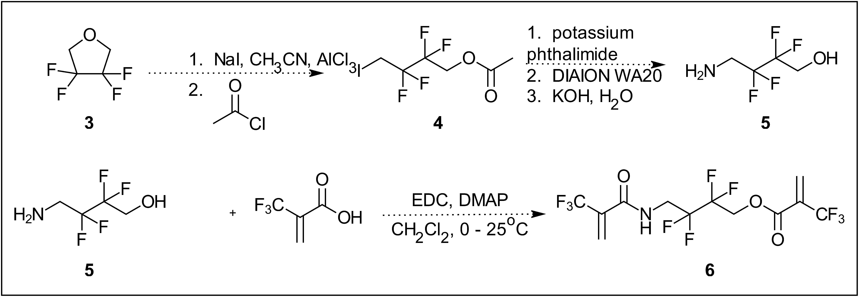
Monomer Synthesis: Method #3
Ring opening reaction
Product used for polymerization → contains desired number of fluorine atoms

Slide 17

Work-Up Procedure
Extraction o f Organic Phase
Silica Plug
ROTAVAP
FINAL PRODUCT
TLC
FTIR
Melting Point
H-NMR

Slide 18
Results

Slide 19
Yield of Monomers
Product | Scheme | Yield (g) | Percent Yield
STH 87 | R = CH₃ | 1.718 | 70.54%

Slide 20
Yield of Monomers cont.…
DCC
DMAP
Product | Scheme | Yield (g) | Percent Yield
STH 91 | R = CH₃ | 2.426 | 67.70%
STH 92 | R= CF₃ | 2.216 | 50.83%

Slide 21
Analyzing Compound Purity – FTIR and NMR
STH 91 – FTIR
(R = CH₃ )
C-H
Amide
Ester

Slide 22
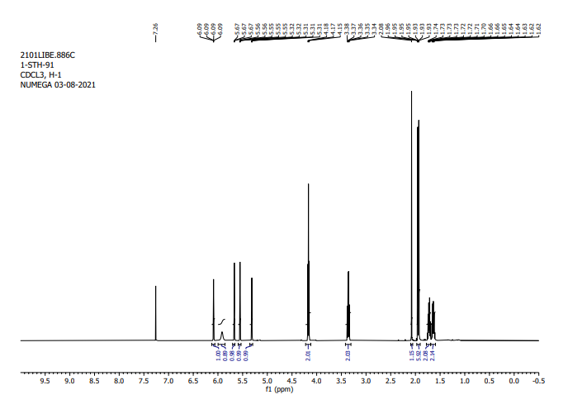
Analyzing Compound Purity cont...
STH 91 – NMR
(R = CH₃ )

Slide 23
Future Tasks

Slide 24
Polymerization

Slide 25
Polymerization
PFOA (template) dissolved in ACN
AIBN added to initiate
Purged with Nitrogen (g)
Heat to 60⁰C for 24 hr
Centrifuge to collect polymers
Wash with acetone/ACN
Precipitation
Polymerization …
Characterization with FTIR
Scanning Electron Microscopy for particle size
Polymerization of NIP = Same process – template addition

Slide 26
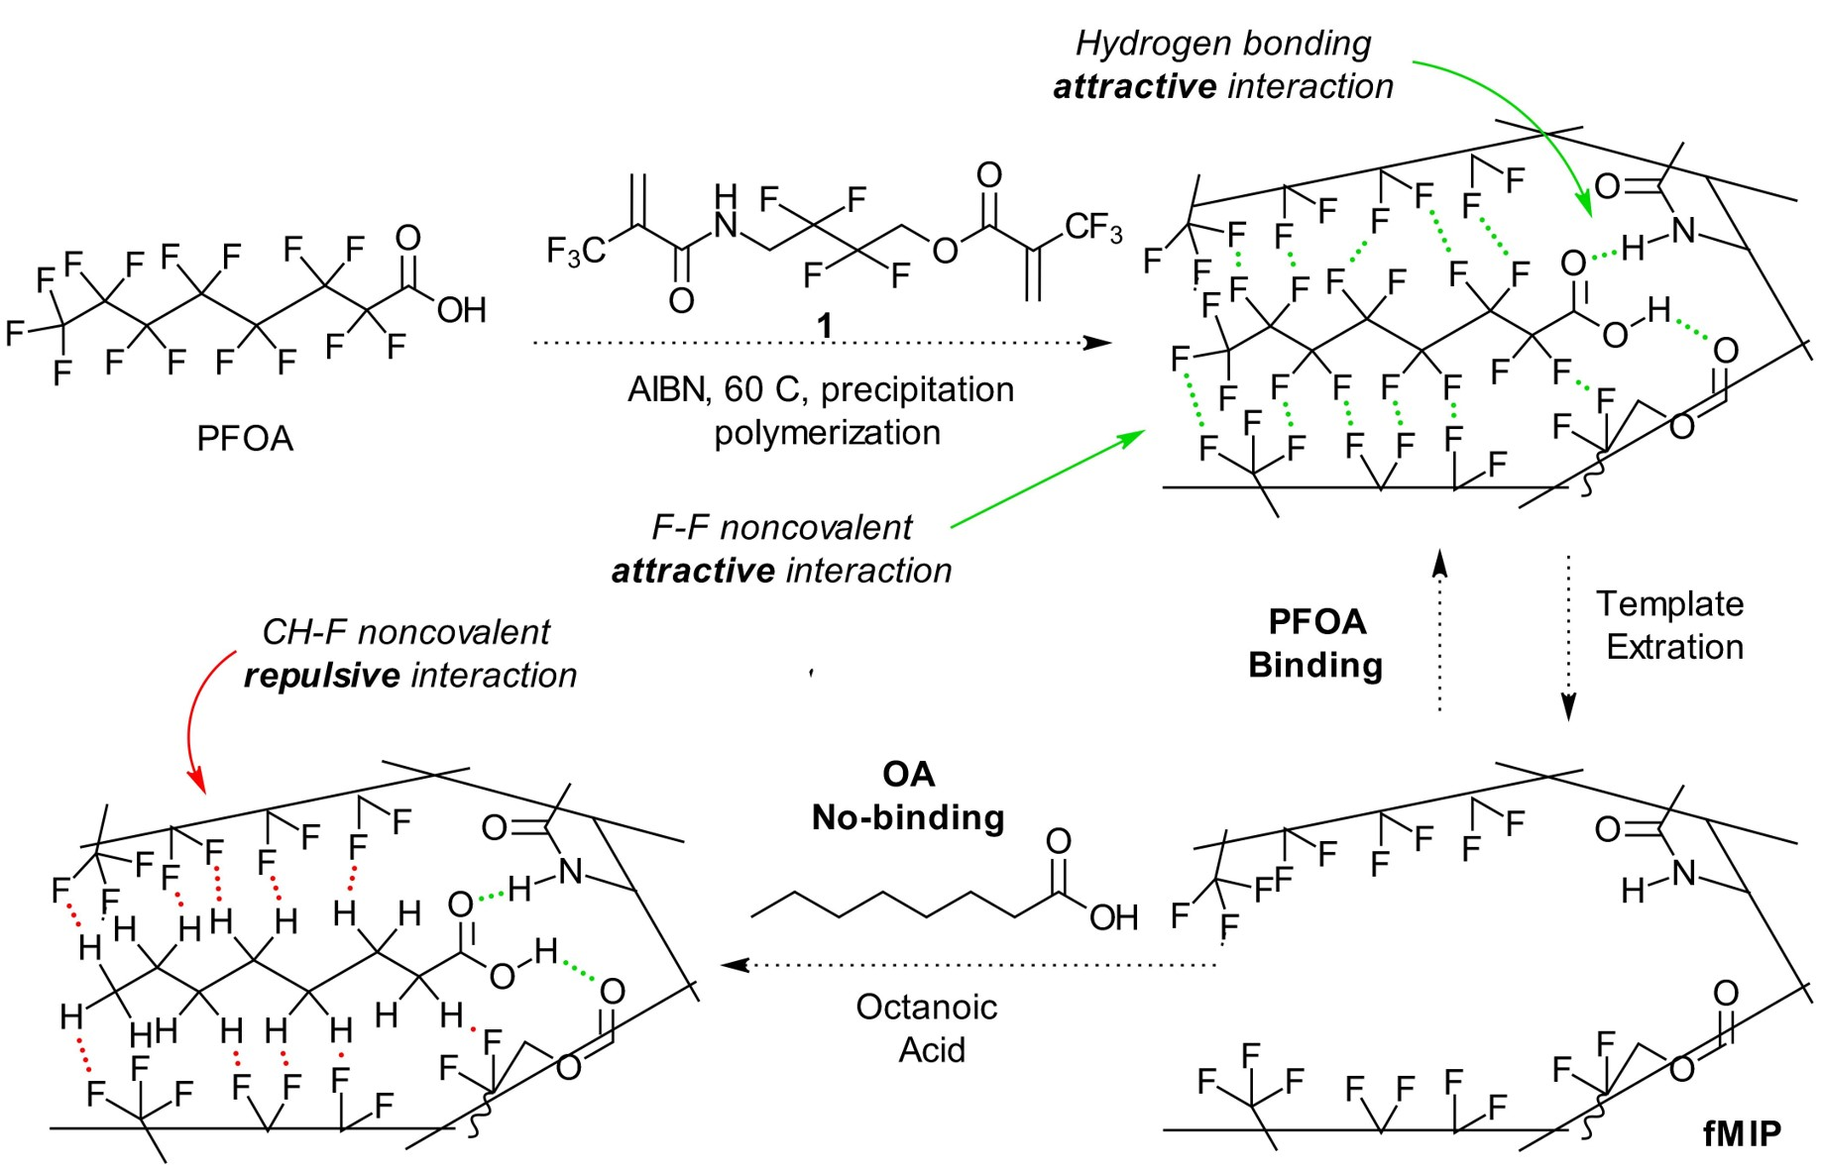
MIP

Slide 27
Batch-Rebinding Studies
Study binding capabilities of MIP and NIP
Polymer concentrations the same … increase PFOA concentrations
Derivatize free template in batch with 2,4-difluoroaniline for GC-MS
Mass spectrometric calibration curve to quantify free (unbound) template

Slide 28
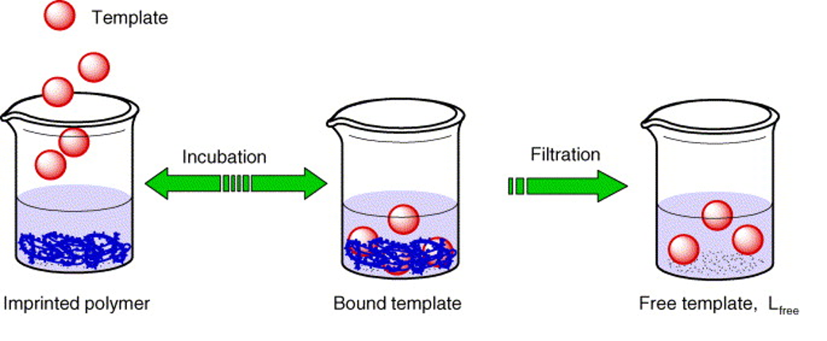
Batch-Rebinding Studies
Garcia Calzon, J.A., Diaz-Garcia, M.E. (2007). Charicterization of binding site in molecularly imprinted polymers. Sensors and Actuators B: Chemical, 123(2), 1180-1194.

Slide 29
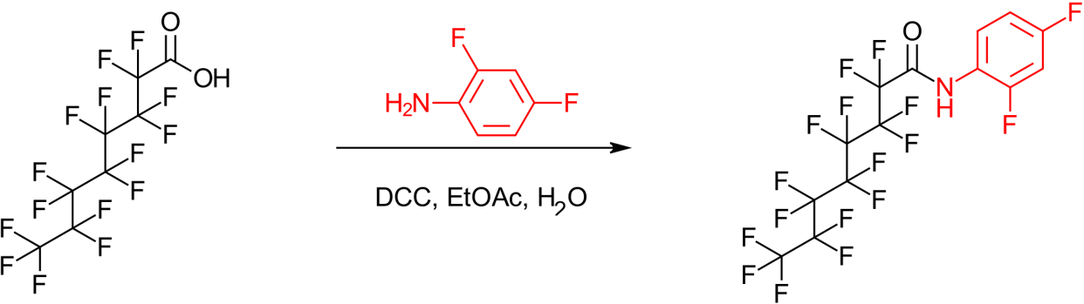
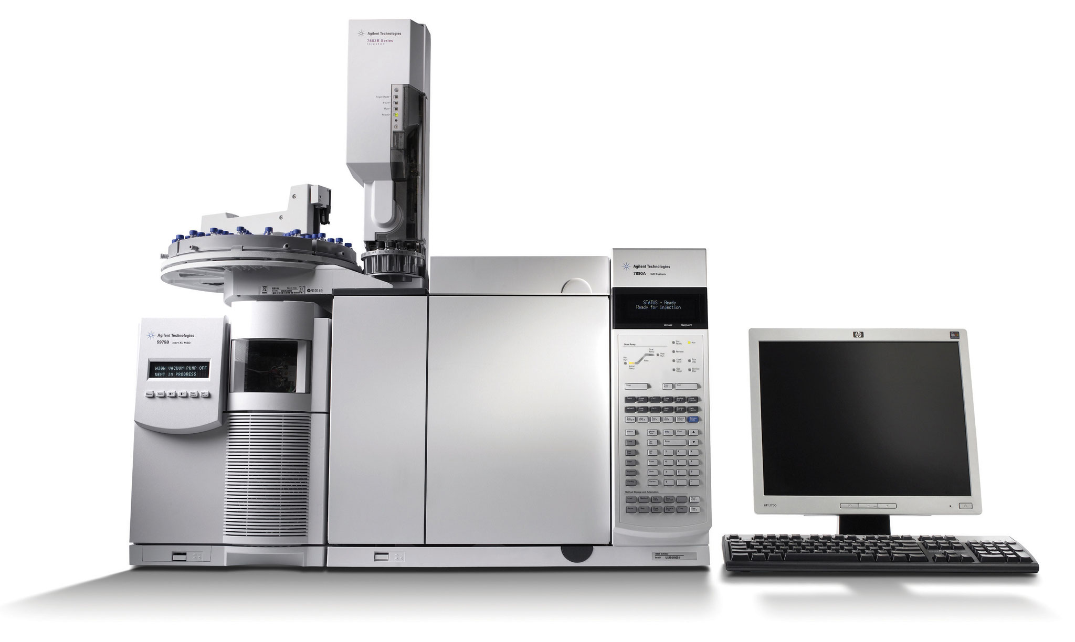
Derivatization with 2,4-difluoroaniline and GC-MS Analysis
Image Courtesy of Moore Analytical

Slide 30
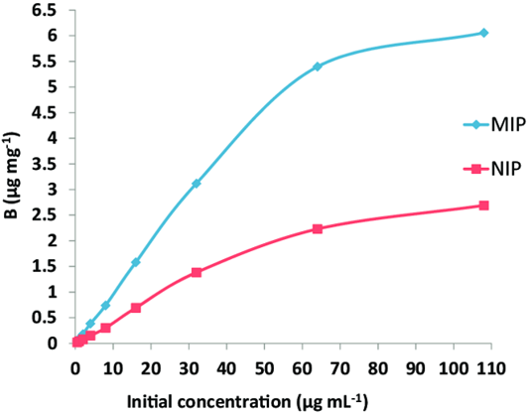
Binding Isotherm
Notes:
A useful way to characterize analyte binding is to measure free analyte concentration F and from that calculate bound analyte concentration B and plot; the plot of B vs analyte concentration gives a binding isotherm, the capacity of the MIP to bind a substance.
Isotherm means constant temperature, as temperature changes binding capability of the polymer. Ideally the model should have as many data points as possible, and for high analyte concentration the best-fit curve flattens. This means that the MIP is saturated, with all imprinted sites being occupied by analyte.
-The milestone for success is a large difference between the MIP and NIP isotherm curves.

Slide 31
Figures of Merit for Final Results
Imprinting Factor (IF): Sensitivity
IF = D_{MIP}/D_{NIP} = [B_{MIP}/F_{MIP}]/[B_{MIP}/F_{NIP}]
Selectivity Factor (α)
α_{competitor} = D_{analyte, MIP}/D_{competitor, MIP}

Slide 32
References
Ahrens, L., Bundschuh M. (2014). Fate and effects of poly- and perfluoroalkyl substances in the aquatic environment: A review. Environmental Toxicology and Chemistry 33(9), 1921-1929.
Ansell, R. J. Characterization of the Binding Properties of Molecularly Imprinted Polymers. White Rose University Consortium, 2015 from Molecularly Imprinted Polymers in Biotechnology
Belbruno, J. Molecularly Imprinted Polymers. Chem. Rev. 2019, 119, 94-119
Muzyka, K. Karim, K. Piletsky, S. Optimisation of the synthesis of vancomycin-selective molecularly imprinted polymer nanoparticles using automatic photoreactor. Nanoscale Res lett. 2014; 9(1): 154
Sun, Q., Zong, G., Valvi, D., Nielsen F., Coull B. et al. (2018) Plasma Concentration of Perfluoroalkyl Substances and Risk of Type 2 Diabetes: A Prospective Investigation among U.S. Women. Environmental Health Perspectives (online) 126(3).

