Slide 1
Battlefield to the Civilian Workforce Dr. Frank Hernandez Jr.
This Photo by Unknown Author is licensed under CC BY

Slide 2
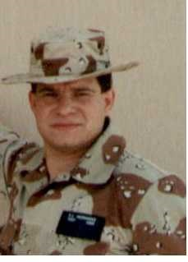
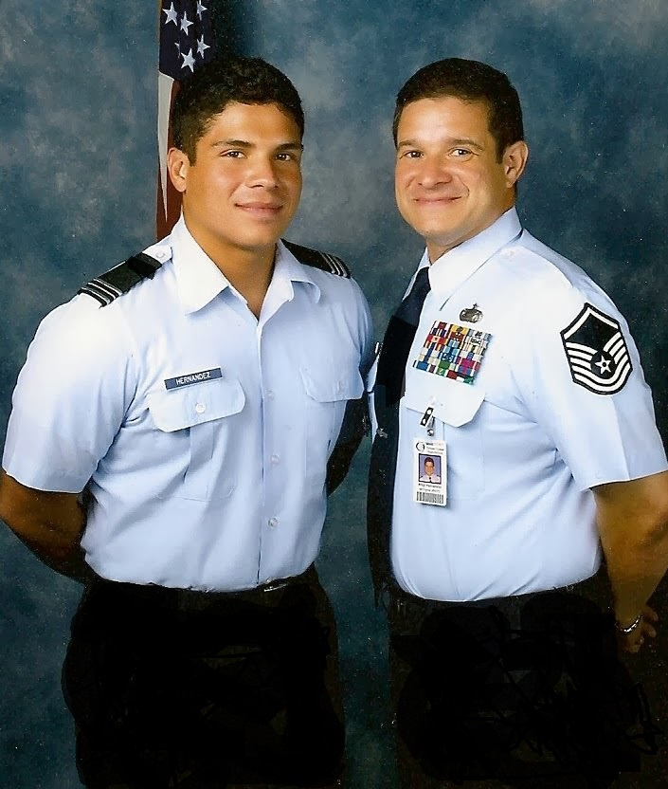
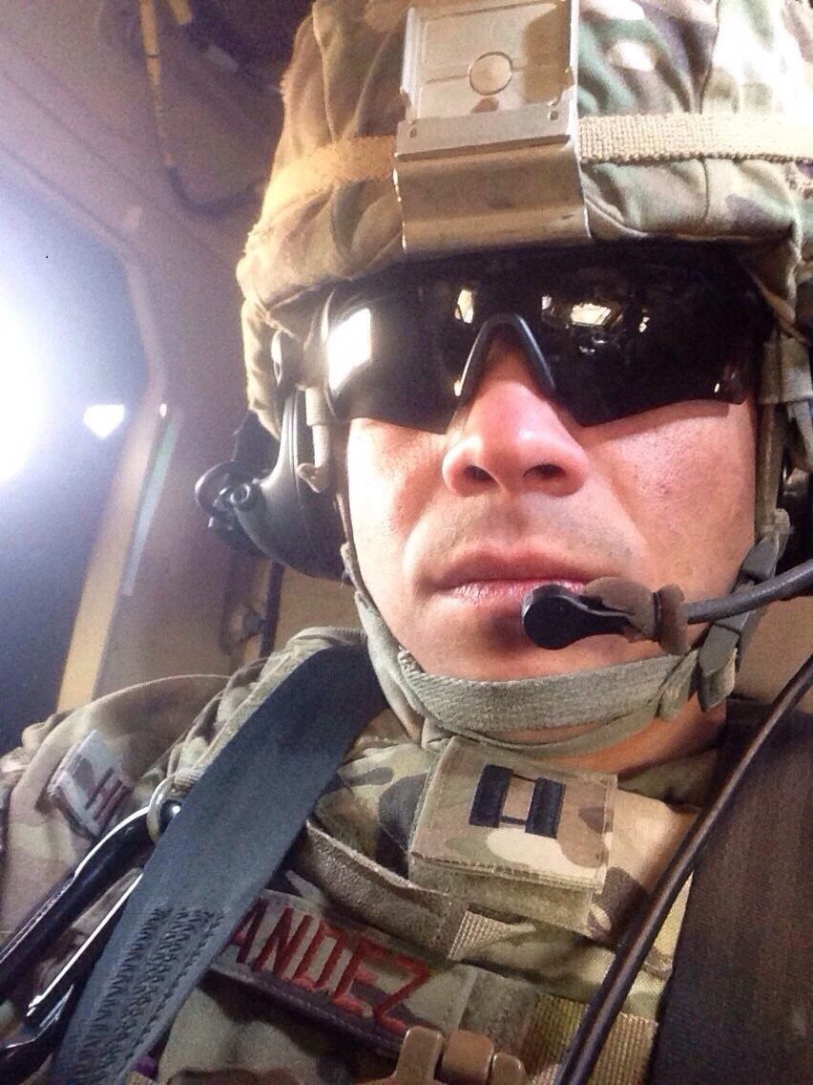
My Backstory Served in the United States Air Force 1979-2005 Director, Military Affairs at Saint Leo University Three Generations of Service in the Air Force

Slide 3
Background
The purpose of this research was to explore and understand the difficulties and barriers that thousands of combat veterans have encountered in their reintegration into society and the civilian workforce. These difficulties and barriers have resulted in the inability of civilian organizations to capitalize on the extensive leadership skills, talents, and abilities of combat veterans. The Transition Assistance Program (TAP) is of little help to veterans.

Slide 4
Unique Challenges
Loss of Identity (McAllister, Hackney, and Perrewe, 2015)
Misunderstanding and Bias (Minnis, 2017)
Suicidal Ideation (Sayer, Carlson, and Frazier, 2014)
Post-Traumatic Stress Disorder (Purcell, Koenig, Bosch, and Maguen, 2016)
Traumatic Brain Injury (Ahern, Worthen, Lippman, Ozer, and Moos, 2015)
Purpose and Meaning (Kato, Jinkerson, Holand, and Soper, 2016 )

Slide 5
Loss of Identity
Millions of combat veterans are struggling with the loss of their identity.
Confused about who they are.
Impact of deployment.
Where do they fit in (McAllister, Hackney, and Perrewe, 2015)?

Slide 6
Suicide
Approximately fifty percent of combat veterans have considered suicide.
Twenty percent have a plan to kill themselves.
Army and Marine suicide have increased (Reger, Smolenski, Skopp, Metzger-Abamukang, Kang, Bullman, Perdue, and Gahm, 2015).
This Photo by Unknown Author is licensed under CC BY-ND

Slide 7
Post-Traumatic Stress Disorder (PTSD)
Stigma associated with mental disorder.
Perceptions of the American population.
Four times more likely to commit suicide (Elbogen, Johnson, Wagner, Sullivan, Taft, and Beckham, 2014).

Slide 8
Traumatic Brain Injury
Signature injury.
Memory loss.
Cognitive and physical injuries (Combs, Berry, Pape, Babcock-Parziale, Smith, Schleenbaker, Shandera-Ochsner, Harp, and High, 2015).

Slide 9
Research Questions
RQ1. What were the lived experiences of combat veterans as they transitioned from military service to civilian employment?
RQ2. What were the challenges and difficulties that combat veterans experienced when seeking civilian employment?
RQ3. What perceptions do human resource managers have about combat veterans and their transferable skills?

Slide 10
Purpose and Meaning
Important
Job
Pride
Respect (Kato, Jinkerson, Holland, and Soper, 2016).

Slide 11
Method and Design
Method: Qualitative (Patton, 2015)
Design: Phenomenological (Moustakas, 1994)

Slide 12
Data Analysis Techniques
Transcription of Interviews
Member Checking to ensure Accuracy
In-Depth Interviews: One-on-one, open-ended questions, flexible, follow-up questions to extend responses.
Read and Re-read transcribed interviews
Line by Line Coding
Transcribed interviews were entered into NVivo to identify emerging themes and understand the lived experiences of combat veterans (Creswell, 2016).
Researcher respected and protected the integrity of the perspectives of participants (Dierckx de Casterlé, Gastmans, Bryon, and Denier, 2012).

Slide 13
Findings of the Study
Themes
Depression
Self-Medication
Loss of Identity
PTSD
Suicidal Ideation
Education
Waste of Time
Ignorance and Discrimination

Slide 14
Recommendations For Future Study
Conduct a similar study with female combat veterans
Conduct a similar study with an even number of non-commissioned and commissioned officers
Conduct a similar study in the Northeast, Southeast, Northwest, and Southwest sections of the USA

Slide 15
Questions?
Notes:
Wasn’t that easy? Lol…

Slide 16
References
Ahern, J., Worthen, M., Masters, J., Lippman, S. A., Ozer, E. J., & Moos, R. (2015). The challenges of Afghanistan and Iraq veterans’ transition from military to civilian life and approaches to reconnection. PloS One, 10(7), e0128599-e0128599, 1-13.
Combs, H. L., Berry, D. T. R., Pape, T., Babcock-Parziale, J., Smith, B., Schleenbaker, R., . . . High, W. M. (2015). The effects of mild traumatic brain injury, post-traumatic stress disorder, and combined mild traumatic brain Injury/Post-traumatic stress disorder on returning veterans. Journal of Neurotrauma, 32(13), 956-966.
Creswell, J. (2016). Research design: Qualitative, quantitative, mixed methods approaches. Sage Publications.
Creswell, J. (2018). Research Design: Qualitative, Quantitative, and Mixed Methods Approaches (5th ed.). Sage Publications.
Dierckx de Casterlé, B., Gastmans, C., Bryon, E., & Denier, Y. (2012). QUAGOL: A guide for qualitative data analysis. International Journal of Nursing Studies, 49(3), 360-371.
Elbogen, E. B., Johnson, S. C., Wagner, H. R., Sullivan, C., Taft, C. T., & Beckham, J. C. (2014). Violent behavior and post-traumatic stress disorder in US Iraq and Afghanistan veterans. The British Journal of Psychiatry, 204(5), 368-375.
Kafle, N. P. (2013). Hermeneutic phenomenological research method simplified. Bodhi: An Interdisciplinary Journal, 5(1), 181–200.
Kato, L., Jinkerson, J. D., Holland, S. C., & Soper, H. V. (2016). From combat zones to the classroom: Transitional adjustment in OEF/OIF student veterans. The Qualitative Report, 21(11), 2131-2147.
McAllister, C. P., Mackey, J. D., Hackney, K. J., & Perrewé, P. L. (2015). From combat to khakis: An exploratory examination of job stress with veterans. Military Psychology, 27(2), 93-107.
Minnis, S. E. (2017). Preface: Veterans in career transition and employment. Advances in Developing Human Resources, 19(1), 3-5.
Moustakas, C. (1994). Phenomenological Research Methods (1st ed.). Sage Publications.
Patton, M. Q. (2015). Qualitative research & evaluation methods: Integrating theory and practice (4th ed.). Sage Publications.
Purcell, N., Koenig, C. J., Bosch, J., & Maguen, S. (2016). Veterans’ perspectives on the psychosocial impact of killing in war. The Counseling Psychologist, 44(7), 1062-1099.
Reger, M. A., Smolenski, D. J., Skopp, N. A., Metzger-Abamukang, M. J., Kang, H. K., Bullman, T. A., Perdue, S., & Gahm, G. A. (2015). Risk of suicide among US military service members following Operation Enduring Freedom or Operation Iraqi Freedom deployment and separation from the US military. JAMA Psychiatry, 72(6), 561-569.
Sayer, N. A., Carlson, K. F., & Frazier, P. A. (2014). Reintegration challenges in U.S. service members and veterans following combat deployment. Social Issues and Policy Review, 8(1), 33-73.

