Slide 1
Liberty University Research Week 2021
Hugo Bridges Albergaria
Doctor of Philosophy - Ph.D. Student, History

Slide 2
The Resurgence of Republicanism with Civic Humanism: the Contributions of Leonardo Bruni
Historical Context
Hans Baron's Renaissance Humanism – Baron’s thesis
The Resurgence of Republicanism with Civic Humanism
Scholarly Literature

Slide 3
The Republican Tradition
Ancient Greece and Rome
Republican Values
Civic Humanist Thinkers

Slide 4
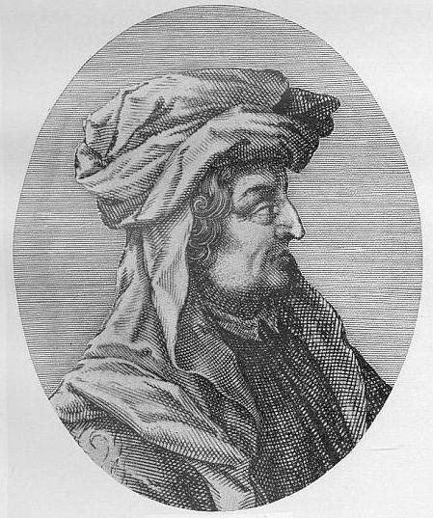
Leonardo Bruni (1370-1444)
Florentine Humanist
Bruni’s most notable works
Panegyric to the City of Florence (c.1403-4) and The Oration for the Funeral of Nanni Strozzi (1427-28)
Bry, Theodor de. “Leonardo Bruni.” Alfred Gudeman: Imagines Philologorum, 1911, S. 1. URL https://en.wikipedia.org/wiki/Leonardo_Bruni#/media/File:Leonardo_Bruni_-_Imagines_philologorum.jpgAceessed on March 18, 2021.

Slide 5
Laudatio Florentinae Urbis or Panegyric to the City of Florence (c.1403-4)
Petrini, Francesco, and Raffaello Petrini. Lav Veduta della Catena, Palazzo Vecchi Museum, 1887. URL https://www.italianartsociety.org/2018/11/la-veduta-della-catena-florences-chain-map/. Accessed on March 18, 2021.

Slide 6
“Therefore, under these magistracies this city has been governed with such diligence and competence that one could not find better discipline even in a household ruled by a solicitous father. As a result, no one here has ever suffered any harm, and no one has ever had to alien ate any property except when he wanted to. The judges, the magistrates are always on duty; the courts, even the highest tribunal is open. All classes of men can be brought to trial; laws are made prudently for the common good, and they are fashioned to help the citizens. There is no place on earth where there is greater justice open equally to everyone. Nowhere else does freedom grow so vigorously, and nowhere else are rich and poor alike treated with such equality.”
Bruni, Leonardo. "Panegyric to the City of Florence." The Earthly Republic: Italian Humanists on Government and Society (1978): 135.

Slide 7
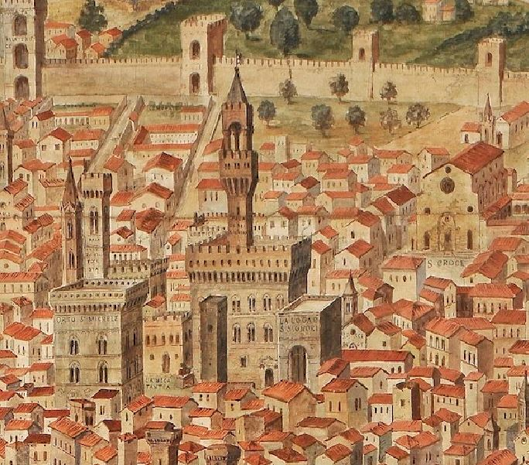
The Oration for the Funeral of Nanni Strozzi (1427-28)
Petrini, Francesco, and Raffaello Petrini. Lav Veduta della Catena, Palazzo Vecchi Museum, 1887. URL https://www.italianartsociety.org/2018/11/la-veduta-della-catena-florences-chain-map/. Accessed on March 18, 2021.

Slide 8
“Our form of governing the state aims at achieving liberty and equality for each and every citizen. Because it is equal in all respects, it is called a popular government. We tremble before no lord nor are we dominated by the power of a few. All enjoy the same liberty, governed only by law and free from fear of individuals. Everyone has the same hope of attaining honors and improving his condition provided he is industrious, has talent and a good sober way of life.”
Leonardo Bruni's Funeral Oration for Nanni Strozzi, 1427, in Kohl, Benjamin G., and Alison Andrews Smith, eds. Major Problems in the History of the Italian Renaissance. DC Heath and Company, 1995: 280, 281.

Slide 9
Christian Worldview Integration
Liberty, Equality, and Justice
James 1:25
“But the one who looks into the perfect law, the law of liberty, and perseveres, being no hearer who forgets but a doer who acts, he will be blessed in his doing.”
Leviticus 19:15
“You shall do no injustice in court. You shall not be partial to the poor or defer to the great, but in righteousness shall you judge your neighbor.”

Slide 10
Liberty University Research Week 2021
Thank you!

