Slide 1
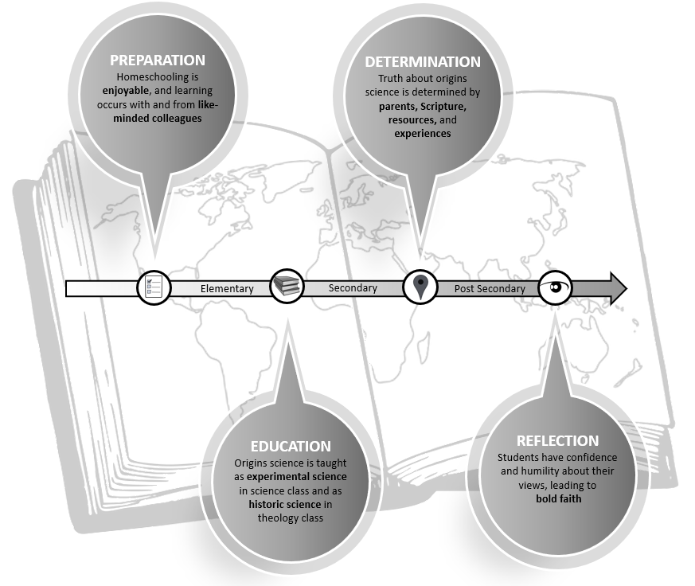
Biblical Worldview Development While Learning Origins Science
Dr. Charleton King
Abstract
Results
This study sought to determine how homeschooled high school students integrate origins science into a biblical worldview
Biblical worldview development is the process of faith development in either form or content through an individual’s understanding and application of the Bible
The theoretical framework guiding this study was Fowler’s faith development theory as it relates an individual’s physical, mental, and moral growth to the development of their worldview
How do homeschooled high school students describe the relationship between the Bible and science?
Every participant viewed experimental science as agreeing with interpretations of the Bible, while historic science does not
Because they dismissed historic science, most participants learned about origins science from a theological perspective
How do homeschooled high school students describe the process of changing or sustaining their beliefs about origins science?
No changes, all participants have grown in confidence in what they have always believed
How do homeschooled high school students perceive others with whom they disagree about origins science?
Non-Christians have different beliefs because of worldview differences
Christians have different beliefs because of ignorance, suppression of truth, or pride
Research Questions
Central Research Question
How do homeschooled high school students integrate origins science into a biblical worldview?
Sub-Questions
How do homeschooled high school students describe the relationship between the Bible and science?
How do homeschooled high school students describe the process of changing or sustaining their beliefs about origins science?
How do homeschooled high school students perceive others with whom they disagree about origins science?
Future Work
More old-earth and evolutionary creationist participants
Catholic or Eastern Orthodox participants could be used to determine the effect of religious affiliation on views of origins science
Inclusion of public or private school students in future research would make the model more general and applicable
Methods
References
Qualitative Analysis
Worldview development requires close interactions with participants
Phenomenology
I sought to understand the lived experience of participants learning origins science and integrating it into a biblical worldview
Hermeneutic
It describes the phenomena objectively and then interprets it subjectively for the participants
Free word association
To understand how participants have stored memories of origins science terms
Semi-structured interviews
Consistency
Focus group
Member checking of results
Corbin, J., & Strauss, A. (2015). Basics of qualitative research:
Techniques and procedures for developing grounded theory (4th ed.).
Sage Publications.
Creswell, J. W., & Poth, C. N. (2018). Qualitative inquiry & research
design: Choosing among five approaches (4th ed.). Sage Publications.
Fowler, J. W. (1981). Stages of faith: The psychology of human
development and the question for meaning. HarperCollins Publishers.
Naugle, D. K. (2002). Worldview: The history of a concept. Wm. B.
Erdmans Publishing Co.
Pearcey, N. (2004). Total truth: Liberating Christianity from its cultural
captivity. Wheaton, IL: Good News Publishers.
Sire, J. W. (2015). Naming the elephant: Worldview as a concept (2nd
ed.). InterVarsity Press.

