Slide 1
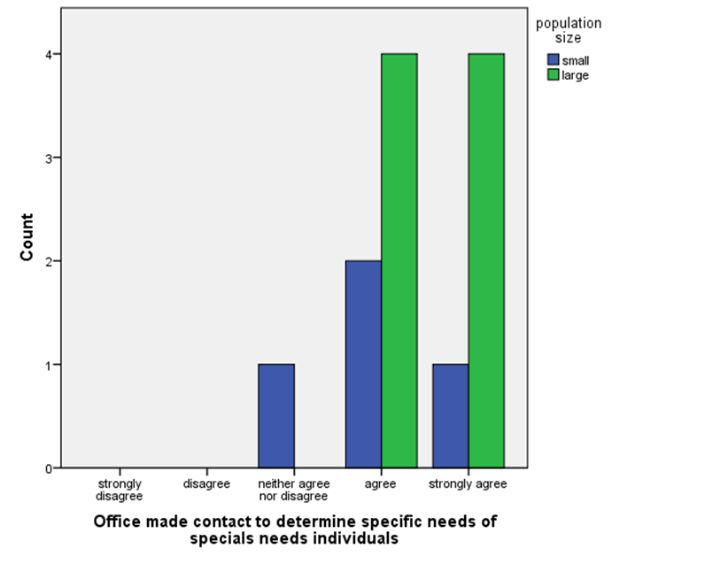
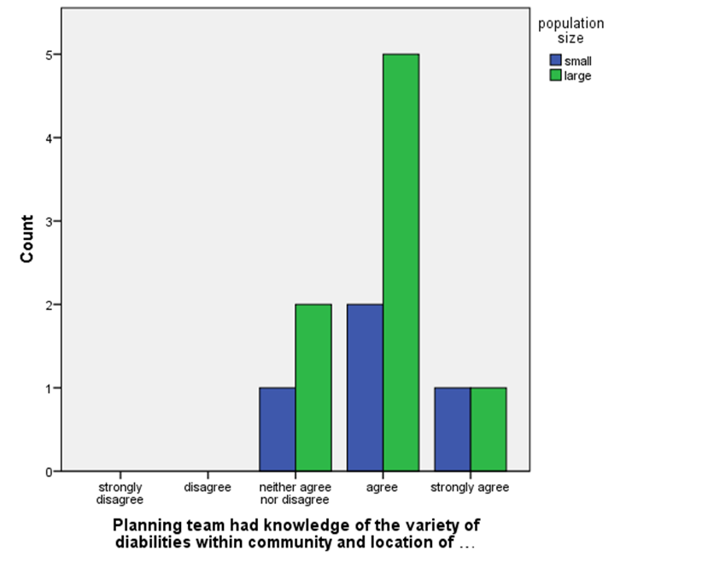
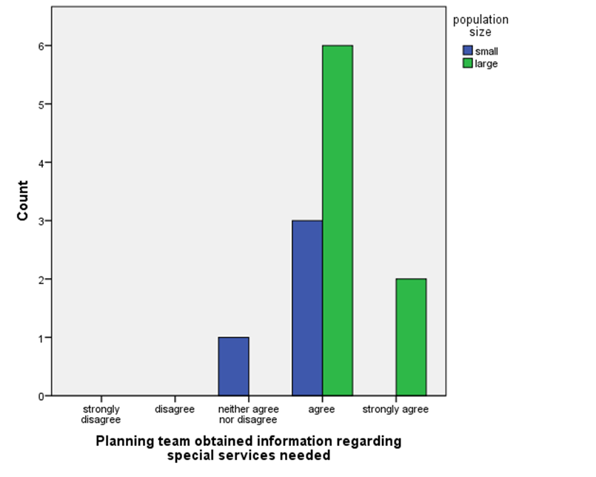
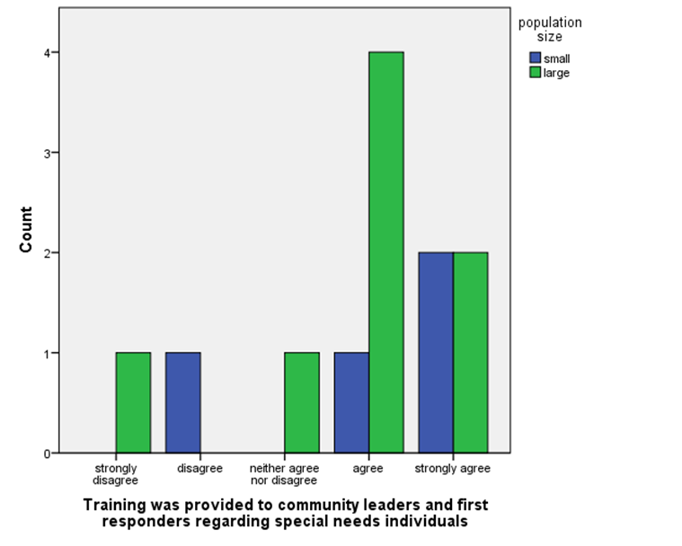
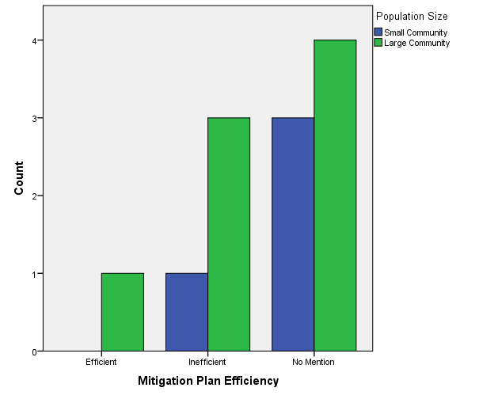
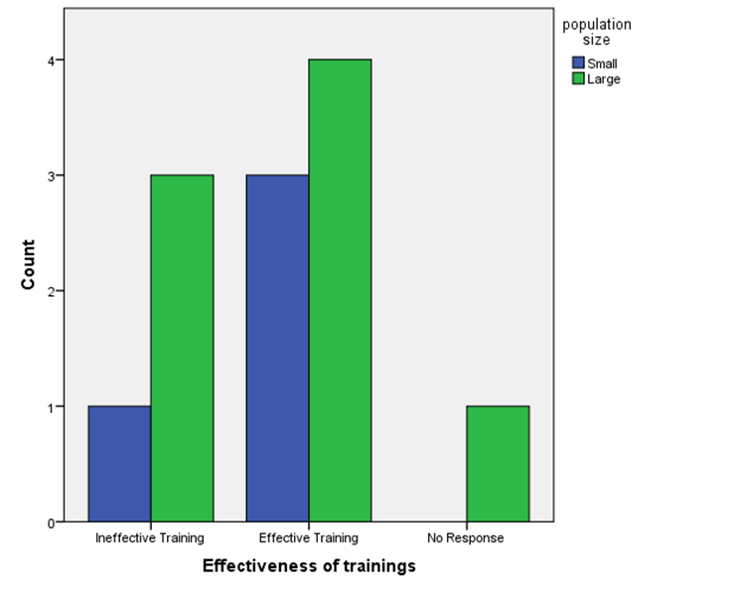
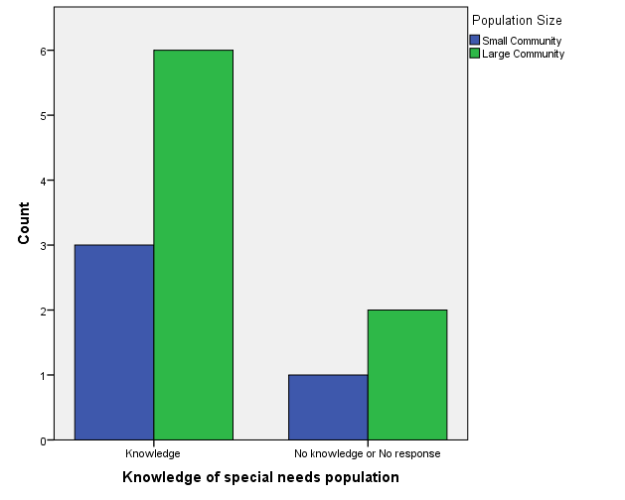
Emergency Management: A Case Study of Special Needs Populations and Disaster Preparedness
Jessica Windsor
Abstract and Background
Results and Conclusion
Background
• Individuals in the special needs population are more likely to be impacted by disaster.
• This may be due to difficulties with mobility, medication regimes, and self-care.
• Study focus: how emergency managers knowledge of the special needs population affects mitigation plans for respective locales.
• Are action plans developed to assist the special needs population?
Methods
mixed-methods research approach in which quantitative research was conducted utilizing a survey, and qualitative research through examination of mitigation plans.
Results
• Emergency managers agreed that information is obtained regarding special needs population.
• There was further agreement found regarding adequate training that concerns the special needs population.
• Lack of evidence found in mitigation plans to support emergency managers responses.
Conclusions
Evidence suggests emergency managers have more confidence regarding their knowledge of the special needs population than found in mitigation plans.
Results
Question 1: Asks if the specific needs of the special needs populations have been determined. Majority of respondents agree with the statement.
Question 2: Asks if emergency managers had knowledge of location of individuals with special needs. Majority of respondents agree with the statement.
Question 3: Asks if the emergency managers obtained the necessary information concerning the special needs population. Majority of respondents agree with the statement.
Question 4: Asks if trainings are provided to first responders concerning the special needs population. Responses varied from strongly disagree to strongly agree.
Conclusions
Emergency managers believe their training and mitigation plans provide for communities adequately.
Mitigation plans failed to show recognition of special needs population.
More information should be obtained concerning the special needs population.
This should include the disabilities, location of individuals, and the necessary assistive equipment.
B
A
Standard deviation: .669
Standard deviation: .651
Introduction and Research Question
Future Work
Conduct similar study with larger sample size that includes participants from an even distribution of community sizes.
Survey special needs individuals or families to assess their experiences in emergencies.
Assess the ways that hazard mitigation developers for locales determine the special needs population within the area, the needs of those individuals, and how it is determined to the self-care they can provide without outside assistance.
What effect does knowledge of the needs of special populations have on disaster planning specific to these populations?
• Communities must be prepared to assist community members for disasters, especially the special needs population
• In 2010, there were 56.7 million people, or 19% of population reported to have a disability.
• From 2005-2010, this was an increase of 2.2 million people.
• For research, disaster is defined as major accident or incident in which there is a high number of individuals that are killed or seriously injured and there is damage to the environment or property.
• For research, special needs populations are defined as the homeless, children and the elderly, individuals with mental and physical disabilities, and individuals that do not speak the local common language.
Figure 3. Competitive fitness advantage.
Quantification of fitness was based on the direct comparison of log CFUs of one species to another. There was a significant fitness advantage of group A, if not even more with group B through overcoming colonization resistance.
Standard deviation: 1.267
Standard deviation: .515
MG1655
B
1 2 3 4 5 6 7 8 9 10 11 12 13 14
A
B
References
Bernstein, R. (2012, July 25). Nearly 1 in 5 People Have a Disability in the U.S., Census Bureau Reports. Retrieved from United States Census Bureau: https://www.census.gov/newsroom/releases/archives/miscellaneous/cb12-134.html
FEMA. (2018, January 3). Disasters Affected 8% of U.S. Population in 2017, FEMA Notes in Review of Historic Year. Retrieved from Insurance Journal: https://www.insurancejournal.com/news/national/2018/01/03/476001.htm
Hoffman, S. (2009). Preparing for Disaster: Protecting the Most Vulnerable in Emergencies. Case Western Reserve University School of Law Scholarly Commons, 1491-1547.
Laakso, K., & Palomaki, J. (2013). The Importance of a Common Understanding in Emergency Management. Technological Forecasting & Social Change, 1703-1713.
Methods
• Mixed Methods research compared the quantitative data found from a survey to the qualitative data found within mitigation plans.
• Study conducted by distribution of emailed surveys utilizing Likert Scale.
• An additional three questions were posed utilizing subjective views on training and mitigation plans that are accurate for each participant’s respective area.
• Mitigation plans were obtained by researcher for each respondent’s location.

