Slide 1
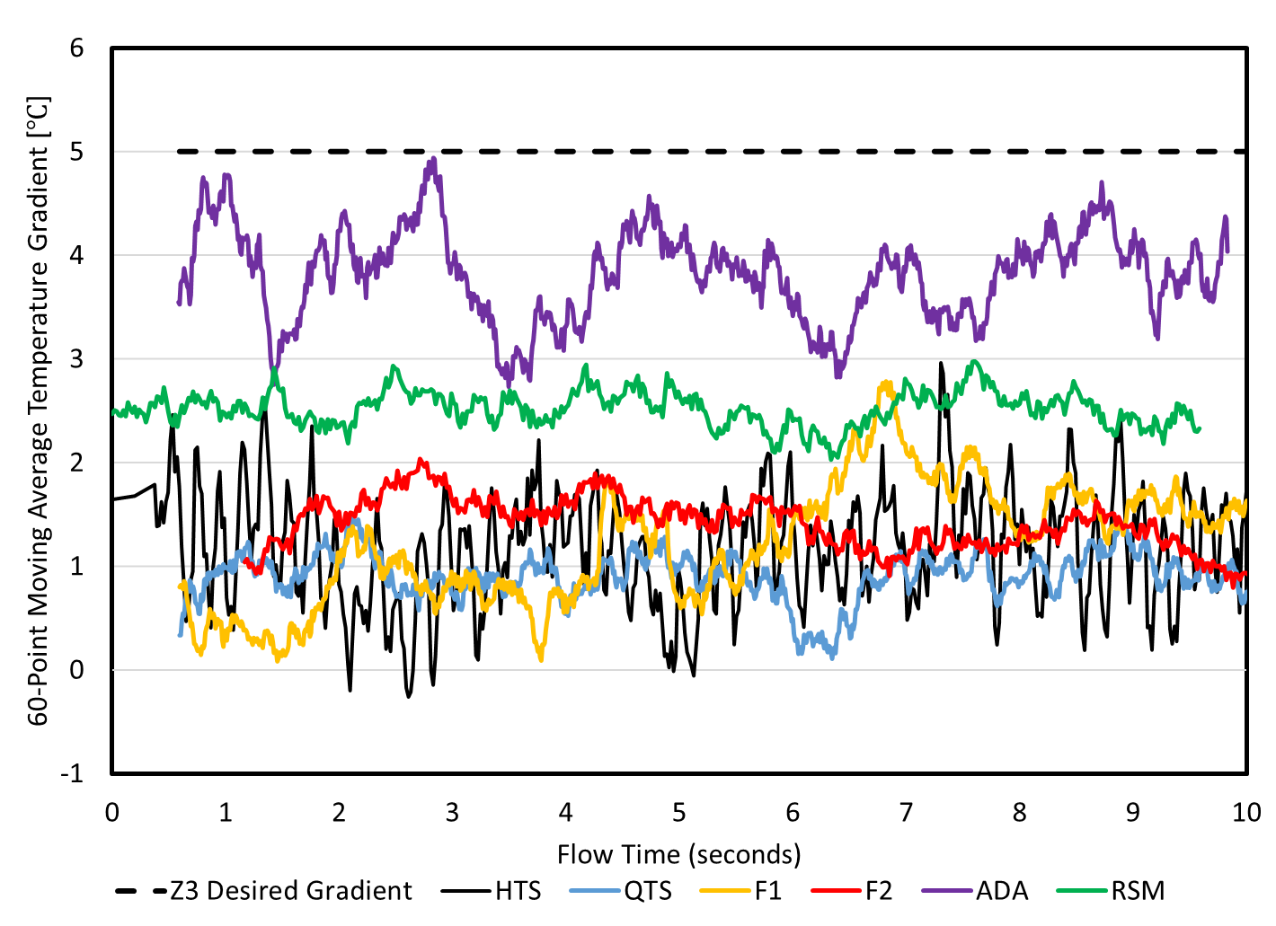
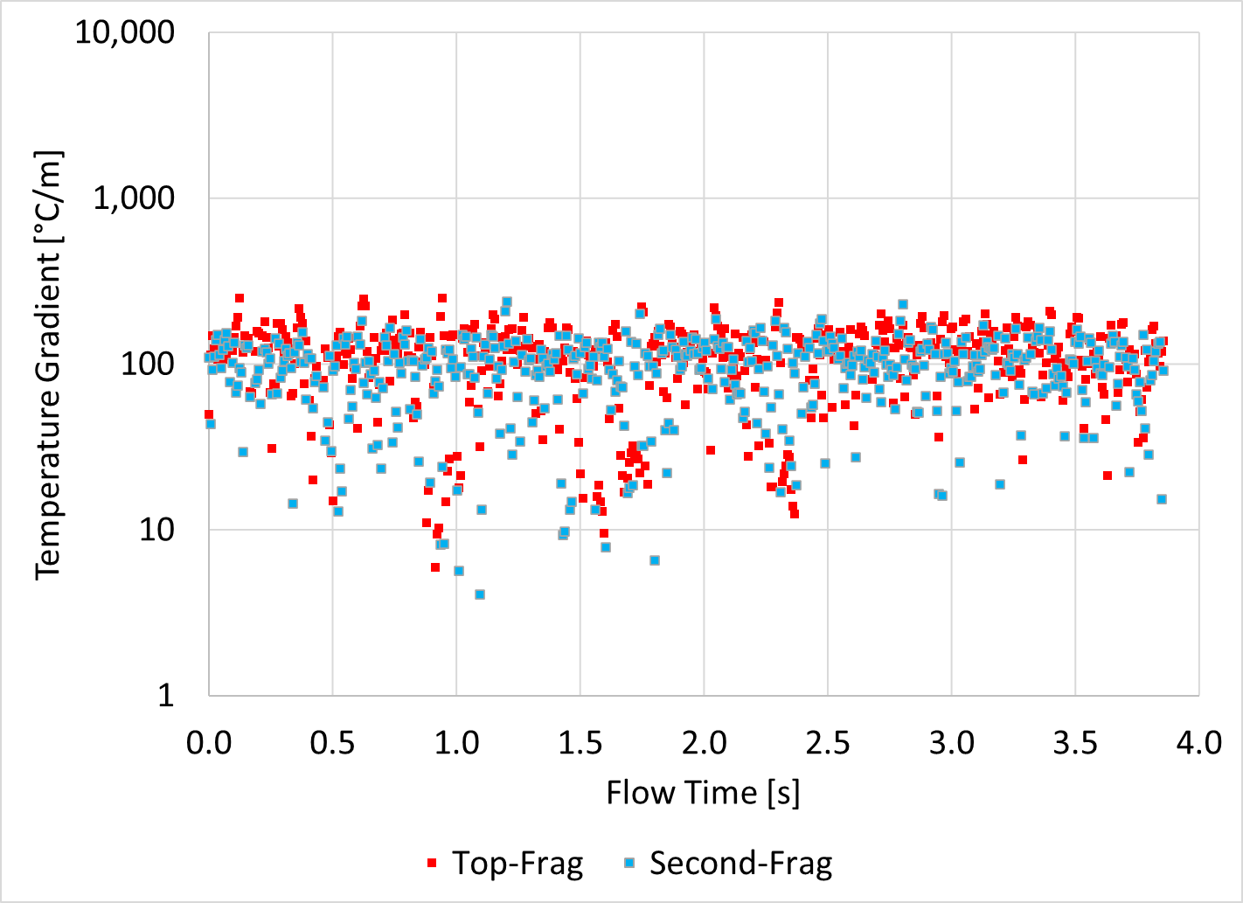
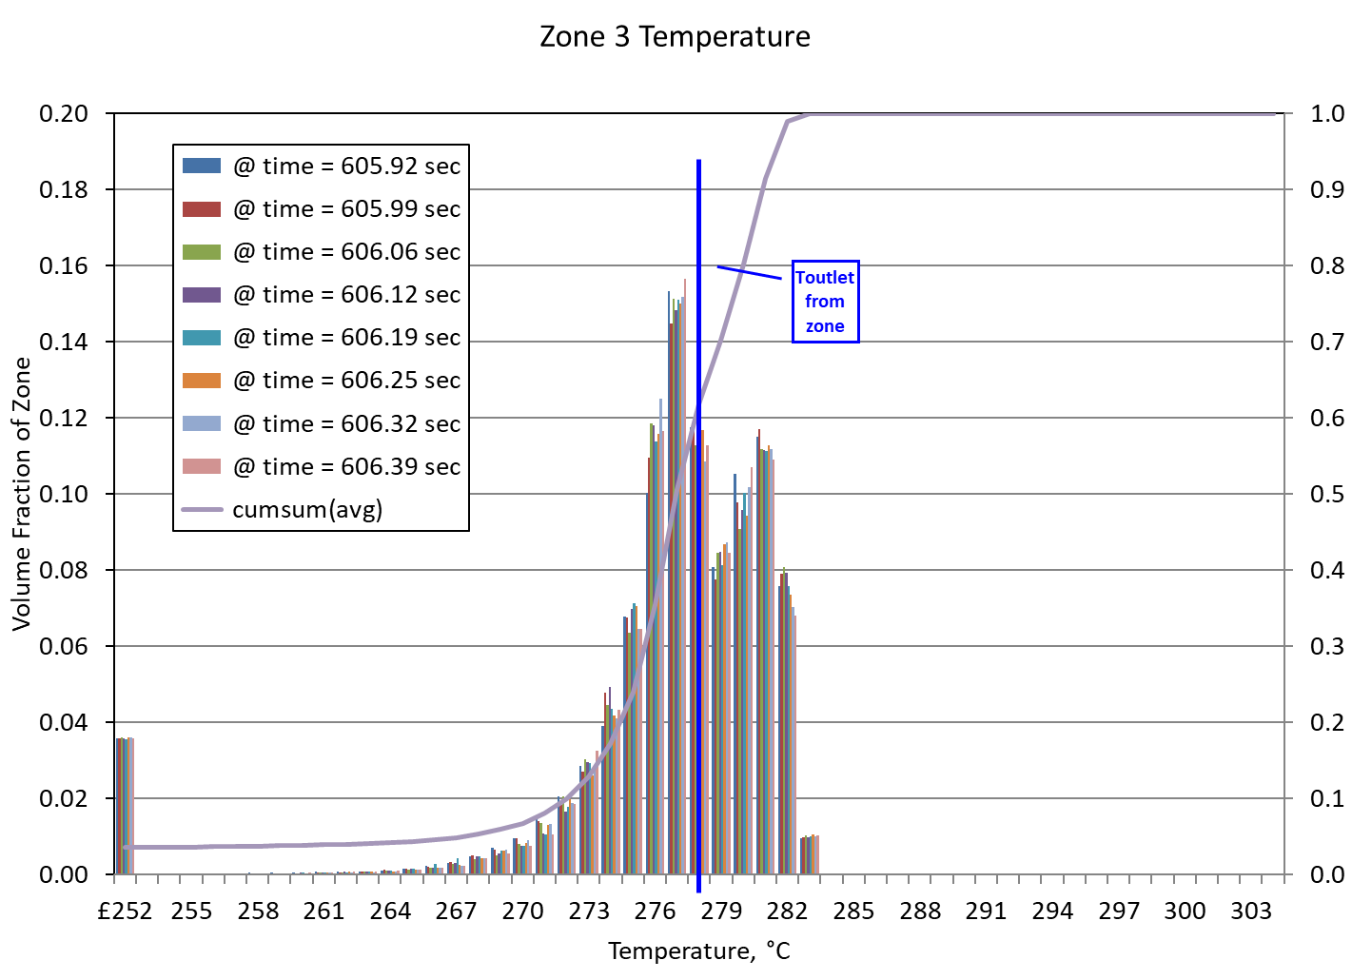
Developing Accurate Simulations of Chemical Reactors
Eric Turman Advisor: Dr. Wayne Strasser Check out our research @ FLUIDgroup.org
Background
Model Name | Time Step Size [seconds] | Mesh Size [Million Elements] | Turbulence Model | Catalyst Efficiency Function
HTS | 0.00066 | 5.7 | SST | Constant efficiency
QTS | 0.00033 | 5.7 | SST | Constant efficiency
ADA | 0.00033 | 40 | SST | Constant efficiency
F1 | 0.00033 | 5.7 | SST | Spatially dependent
F2 | 0.00066 | 5.7 | SST | Temperature dependent
RSM | 0.00066 | 5.7 | RSM | Constant efficiency
Results and Conclusions
Industrial Autoclave Reactors are used to produce low density polyethylene (LDPE)
LDPE is widely used in many common products such as foams, clear plastics, film and more.
The process involves injecting initiator, monomer, and catalyst into a reactor with temperatures ranging from 200-300℃ to create a polymer.
The basic steps involved in polymerization are initiation, propagation, and termination.
Initiation: begins the polymer chain
Propagation: grows the polymer chain
Termination: completes the polymer chain to stop growth
The process is very dependent on temperature. If the reactor is too hot or cold, the entire system is shut down as the polymer cannot be produced outside of the working temperature window.
The reactors are prone to overheating due to the exothermic (heat releasing) characteristics of the reactions taking place.
The decomposition of ethylene (monomer) can cause the entire reactor to shut down due to the high temperatures.
Reactors have internal mixing geometries designed to reduce the likelihood of hot regions forming within the reactor which can lead to overheating and a rise in pressure which shuts down the reactor.
1) Validating CFD methods on such a computationally expensive model is a delicate and long process. Figure 4 represents 1 metric used to evaluate the models and yielded the following conclusions:
The differences in data for HTS and QTS are close enough to tell us the time step does not need to be decreased to smaller than 0.00066.
The efficiency functions F1 and F2 do not provide any benefit to the model and can be dismissed at this time.
The RSM is improving the data readings in TC7-13.
The ADA model data is different enough compared to QTS telling us the 5.7 million element mesh is not refined enough to provide the most accurate results.
2) Hotspots in the reactor were studied to determine their potential for forcing the reactor to shutdown. Characteristics of the 2 largest clumps were studied and it was shown that the temperature gradient for the largest 2 fragments were not different despite the difference in volume.
3) Internal flow currents revealed gear points within Zone 1 where opposing currents meet, mesh together similar to gears, and invert each other’s axial motion. This affirms that the CFD model is correctly modeling internal flow patterns and that there is a level of accuracy with current models in predicting flow behavior.
4) Figure 5 showed the wall baffles decreased the temperature distribution within a zone and increased the mixing within the reactor. This decreases the likelihood of elevating internal temperature and pressure within the zone so that a histogram of temperature showed that it was centralized around the desired output temperature.
Figure 1: The reactor is composed of 4 zones each separated by a zone baffle
The reactor shaft rotates paddles and the zone baffles in the reactor.
Fresh reactant feeds and catalyst feeds inject material into the reactor.
Thermocouples are physically modeled to track the temperatures within each zone.
Table 1: The 6 most recent models are detailed in this table. Changes to each model are carefully documented to track the changes to the reactor model.
Figure 2: The reactor stirrer shaft consists of zone baffles and paddles to separate the zones and to stir the material.
Meshing in CFD refers to breaking a geometry into smaller parts called cells [1]
Each cell is then used to calculate the fluid motion
Introduction
Computational fluid dynamics (CFD) is an engineering simulation tool used in the field of fluids research.
CFD consists of breaking a geometry up into a mesh and solving partial differential equations for each element within the mesh in 3 dimensions to predict the behavior of the flow.
CFD is a delicate process and often contains errors and bad models. Accurately modeling a reactor in CFD requires:
Dividing the geometry into smaller elements called a mesh
Separating the mesh into rotating and stationary elements to account for the spinning shaft.
Selecting a time step, or how much time passes between each calculation.
Selecting a turbulence model, or a mathematical estimate of what chaotic currents are affecting the flow.
Implementing automatic controllers to keep internal temperatures within a working window.
5 independent proportional integral derivative (PID) controllers are implemented throughout the model to control the reaction rates throughout 3 of the 4 zones.
Including a way to simulate the chemical reactions taking place to note the change in density and temperature resulting from the polymerization process.
Figure 4: Each model is evaluated by taking the temperature reading at TC11 and subtracting it from TC10. This zonal gradient is then compared to a desired temperature gradient in Zone 3.
The smaller time step QTS did not show a change to the gradient compared to HTS therefore showing the model is timestep independent
The smaller mesh and different turbulence model of ADA and RSM respectively are showing the best improvement to the gradient with the refined mesh performing the best.
F1 and F2 did not deviate much from HTS and QTS therefore showing new approaches in the catalyst efficiency function did not yield a positive result for increasing the gradient.
Future Work
The goal CFD models is to remove uncertainty within the numerical methods used in the calculations. Examples include the time step size, mesh size, and turbulence model. From a numerical standpoint future work includes:
Determine a small enough mesh size that will provide the most accurate solution. This will require a further refined mesh beyond the 40 million element model.
Test a third turbulence model (ILES) to determine its impact on the solution and compare the 3 models tested to determine which model results in the most accurate solution.
There also exist opportunities to improve the chemistry and rheological properties of the fluid within the reactor.
Expand on the current set of kinetics (initiation, propagation, termination) to include effects such as chain transfer, backbiting, and scission [2].
Apply functions to alter the viscosity of different species (initiator, monomer, and polymer) within the reactor to account for changes to the flow structures resulting from variable viscosity.
Lastly, the model will be optimized for high performance computing platforms to ensure the fastest run times are maintained with minimal cost.
Figure 3: Offending volumes above 300℃ pose a danger for elevating the temperature in autoclave reactors.
The 2 largest clumps in the reactor are tracked to evaluate their threat to overheating the zone.
The plot shows the temperature gradient for the 2 largest frags or clumps over a 4-second period.
1 2 3 4 5 6 7 8 9 10 11 12 13 14
Figure 5: Studies of the reactor showed that installing a wall baffle in the reactor results in a net decrease in temperature throughout a zone. Flow is counterclockwise in the contours.
Contour A shows an increase in mixing following the baffle.
Contour B shows that a hot stream of material hitting the wall baffle is cooled downstream as a result of the mixing.
The Zone 3 temperature histogram below shows the temperature distribution is centered around the target outlet temperature. A previous study without the wall baffles resulted in a 10℃ higher temperature distribution in Zone 3.
Methods
The reactor model has been developed with specific changes implemented overtime. See Table 1.
The model itself is so large that it takes at least 30 days of continuous running on 120 high performance computing cores to evaluate if a single change results in a better or worse model.
80 different metrics describe conditions within the model to evaluate changes to the model.
Any clump of hot material above 300℃ is defined as an offending volume. This is the expected temperature threshold and states anything hotter could lead to overheating and shutdowns.
Offending volumes have 16 variables tracked to characterize the nature of the hot clumps of material.
Data from the model is evaluated when quasi steady state (QSS) is reached.
QSS occurs when the average value of a variable is constant at some time scale. Randomness can exist, but if the average is constant QSS is determined.
Data from new models is then compared to previous runs using all data collected to validate or revert the latest set of changes (Figure 4)
References & Acknowledgements
The authors acknowledge Westlake Chemical for the support provided for this project. In particular, we appreciate the assistance and expertise provided by Westlake’s Dr. Jimmy Salmon, Stephen Coe P.E., and Dr. Victor Lin.
References:
[1] Strasser, Wayne, Gregory Feldman, Wilkins Casey, and Leylek James. “TRANSONIC PASSAGE TURBINE BLADE TIP CLEARANCE WITH SCALLOPED SHROUD: PART II – LOSSES WITH AND WITHOUT SCRUBBING EFFECTS IN ENGINE CONFIGURATION.” IMECE, 2004, 1–11.
[2] Wells, G. J., & Ray, W. H. (2005). Prediction of Polymer Properties in LDPE Reactors. Macromolecular Materials and Engineering, 290(4), 319–346. https://doi.org/10.1002/mame.200400128
Figure 4: Axial velocity plots detail upwards (positive values) and downward flow (negative values) within the reactor.
This view of Zone 1 depicts a flow characteristic called a “gear point,” where two opposing flows meet and invert each others direction. This is like one gear meshing with another hence the name.
Figure 6: The wall baffle cross section is shown along with a histogram showing the temperature distribution in Zone 3 when the wall baffle has been installed.

