Slide 1
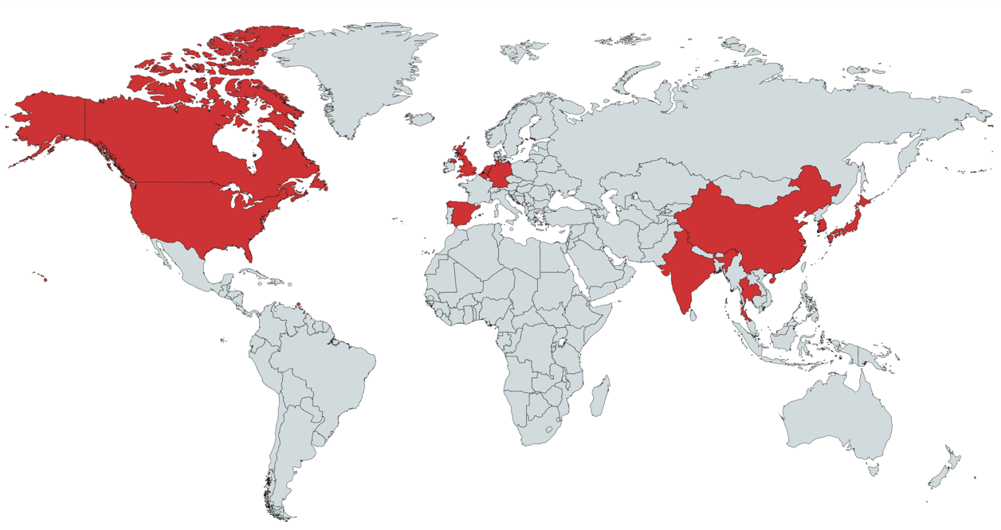
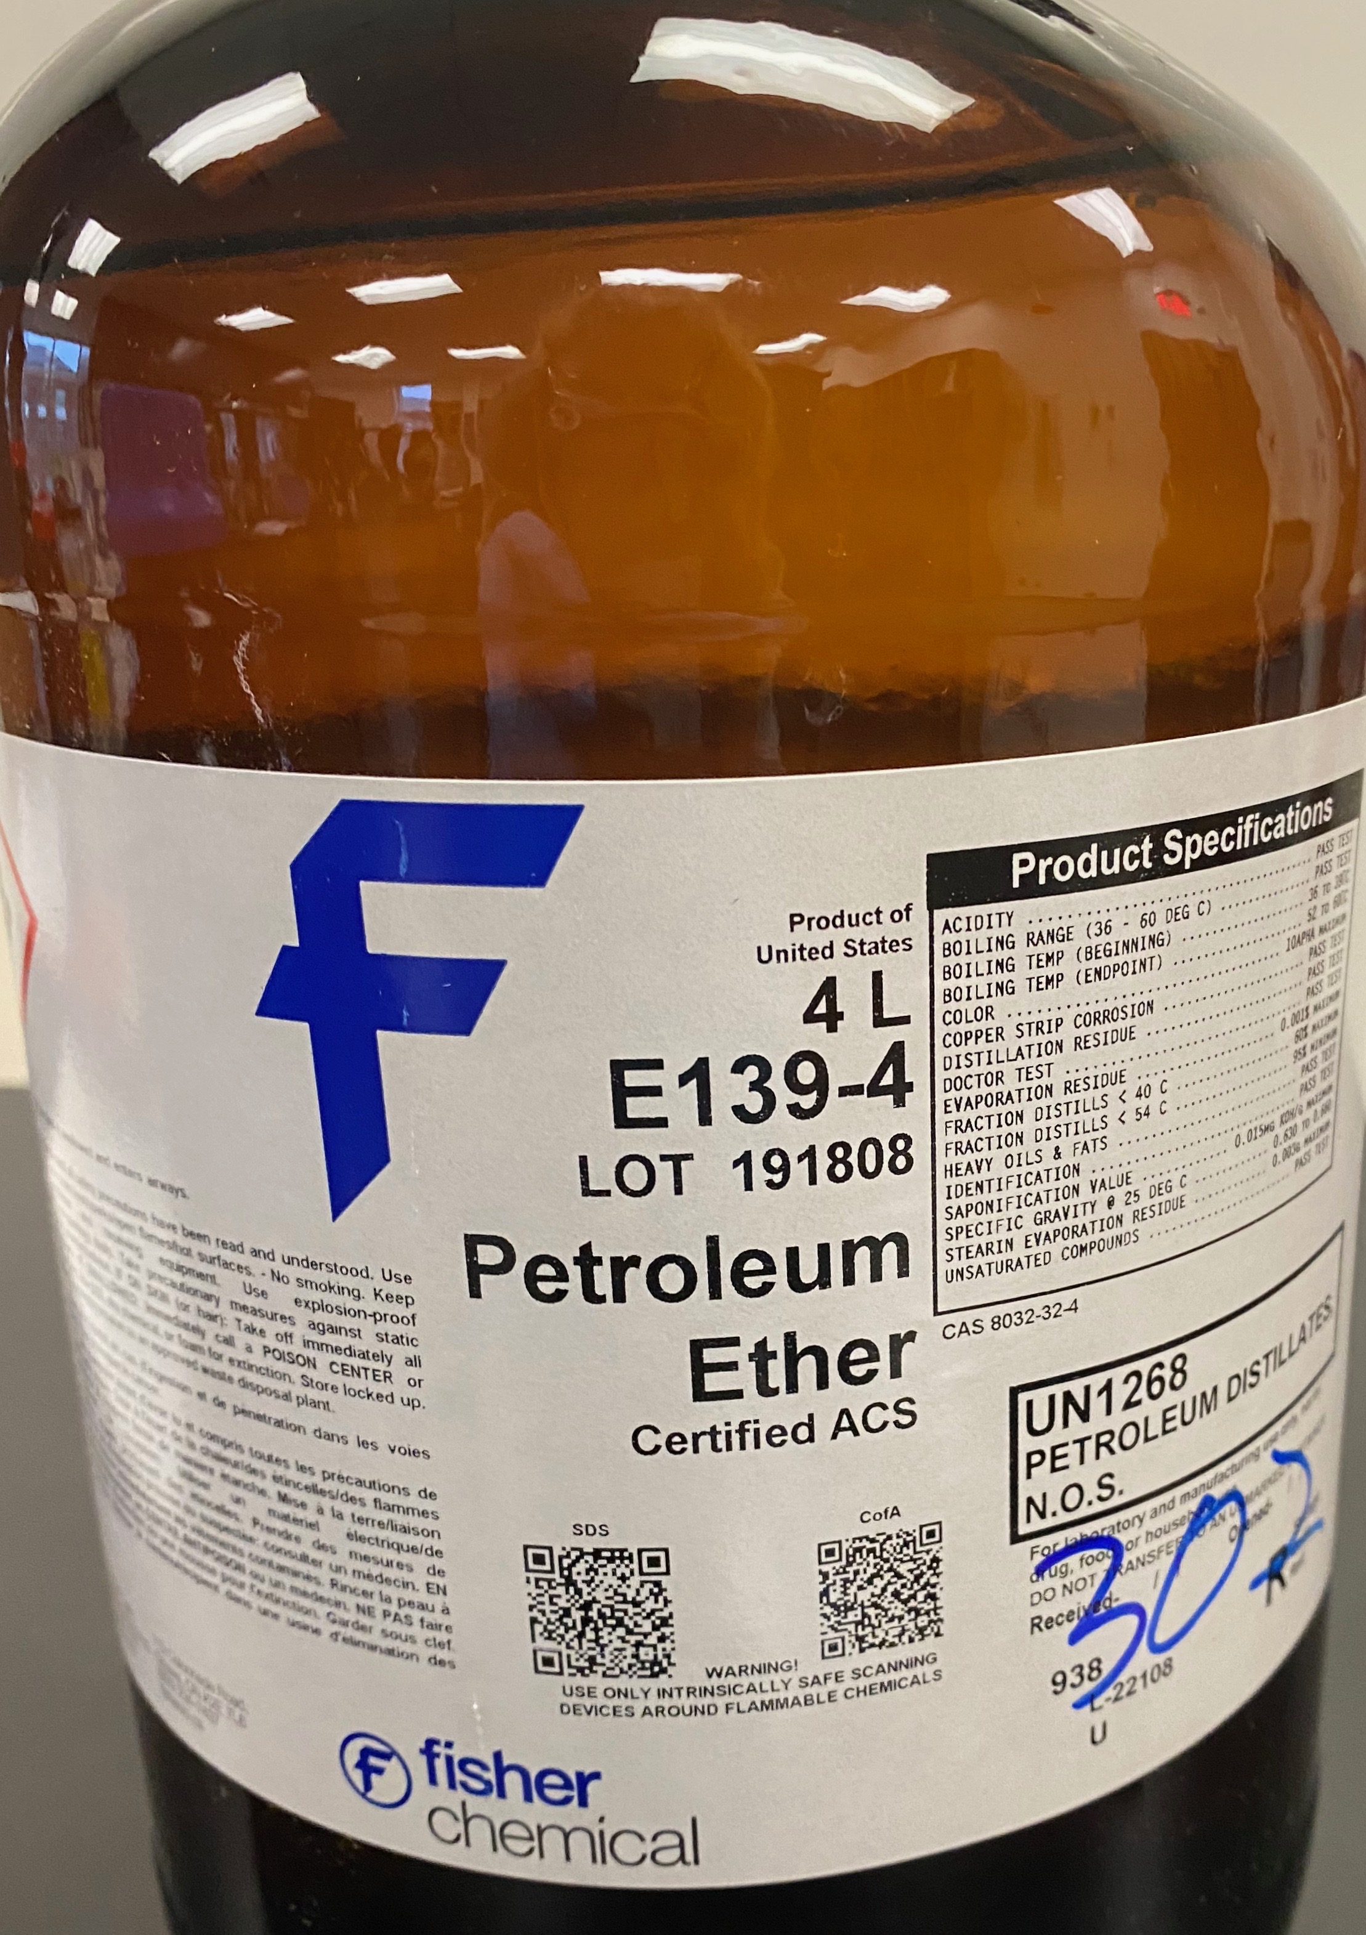
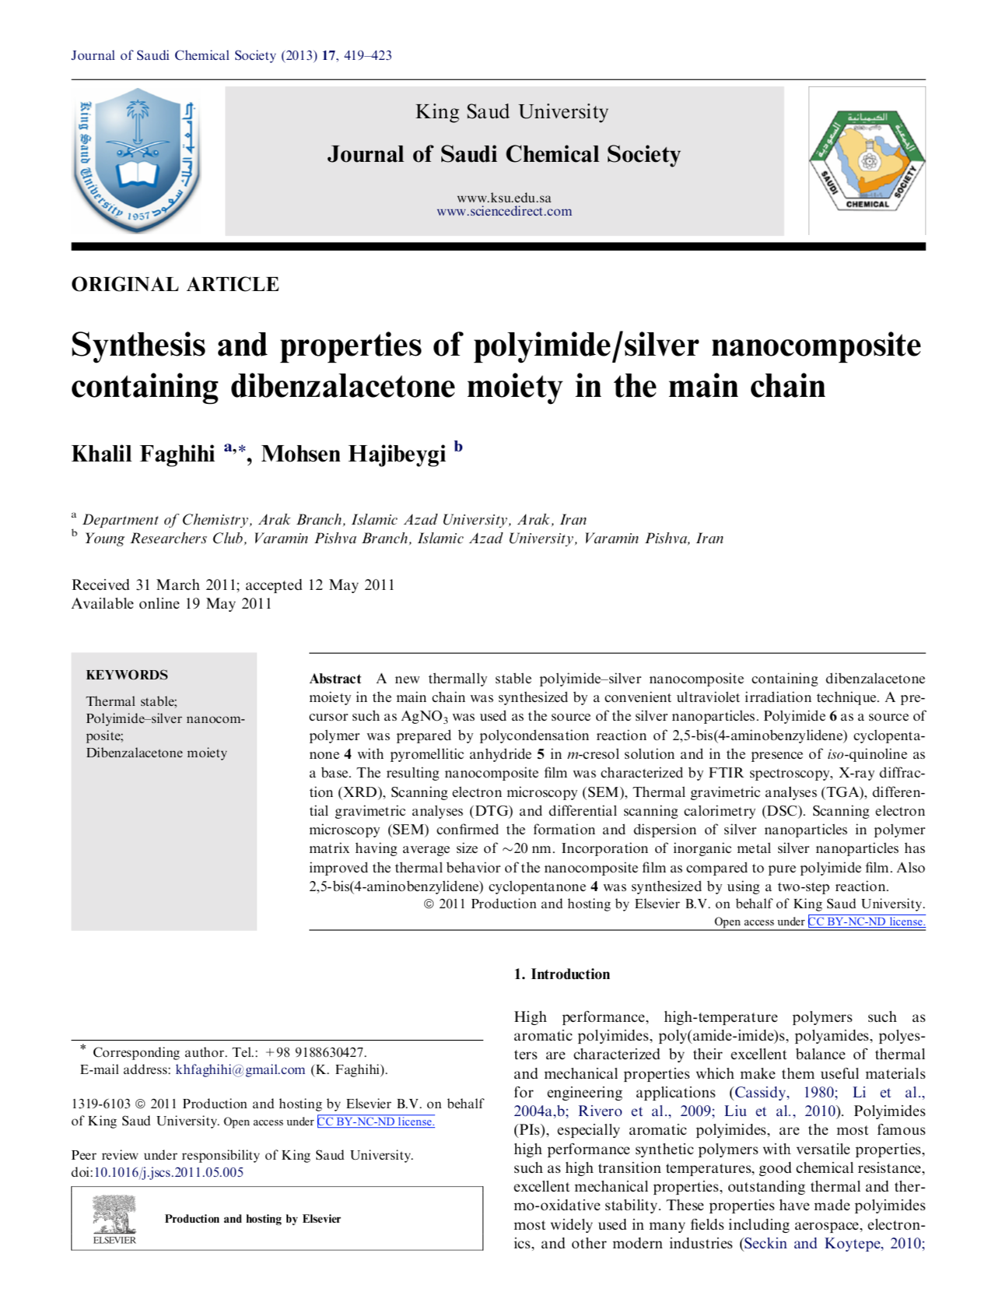
Raising Global Awareness and Internationality
in the Undergraduate Organic Chemistry Laboratory
Marissa Scilley and Dr. M. Korn*
Abstract and/or Background
Results and/or Conclusion
Results
During the Fall 2020 semester, students in Dr. Korn’s undergraduate organic chemistry II lab were given the option to take a survey regarding their experience with the global chemistry activities utilized throughout the laboratory aspect of the course. In totality, the country of origin and/or top exporting country of 53 chemicals from the laboratory were compiled along with their corresponding number of evangelicals throughout the course. Out of approximately 20 students enrolled in the course, 15 students submitted the end-of-course global survey. The survey contained the question: “If you participated in the global chemistry extra credit, did you learn anything from it? Please share.” Of the 15 students that listed their participation, 6 students expanded on the fact that they learned more about the unreached people within the world and their awe regarding the low percentage of evangelicals in many countries. An additional 4 students expanded on the fact that these activities taught them about the wide array of chemical manufacturing companies and the diversity of compound origins in the organic chemistry laboratory. Personally, I enjoyed these activities throughout the semester, as they reminded me of the importance of international evangelism and the opportunity to use the talents and passions that God has given us, even through organic chemistry, to tell others what He has done for us. It should be noted that not everyone in the course participated in the global assignments throughout the semester. The reasoning behind this has yet to be thoroughly analyzed. Based on the survey results, it has been concluded that these activities did raise awareness for some students, but not for all.
In the future, other methods of global awareness will be incorporated. Overall, these activities have been incorporated into the laboratory component of the undergraduate organic chemistry course with the goal of providing global emphasis in a course that does not appear to be global.
Assignments and discussion regarding global awareness and internationality, though not typical discussion topics in the undergraduate organic chemistry laboratory, are important for the development of well-rounded students. Optional assignments introducing globality have been incorporated into the coursework for the undergraduate organic chemistry laboratory. These assignments deal with the compilation of the origin of global chemicals used in the laboratory as well as the corresponding percentage of evangelicals in those countries, with the goal of increasing global awareness.
B
Businesses
Figure 1. Global map of all manufacturing and/or main exporting countries of the chemicals used in the Organic Chemistry II laboratory (Fall 2020) highlighted in red.¹
Figure 3. Top exporters for chemicals used in the undergraduate organic chemistry laboratory (Spring 2020).
Introduction and/or Research Question
Figure 2. Reagent bottles of chemicals used in the undergraduate organic chemistry laboratory displaying listed country of origin.
More than one million international students were enrolled at a US-based institution of higher education in 2019/20, with about 50% of them pursuing a degree in a STEM field.² This number represents about 5% of the total US student population. About 1.5% of US students (350 thousand) studied abroad (data for 2018/19), not counting short, international trips.³
How can we assist our science students, those who have international experience and those who have not yet, develop a greater awareness of today’s global realities? One way we chose to do so was by embedding a global chemical component in our organic chemistry laboratory course.
A
Figure 2. Colonization of MG1655 and MG1655∆qseC
(A) Colonization of MG1655 and MG1655∆qseC fed low at 10⁵ CFU. Showing the competitive advantage without the receptor QseC.
(B) Colonization resistance of MG1655. MG1655∆qseC with 10⁵ CFU was able to overcome the colonization resistance of the wild type MG1655 at 10⁸ CFU.
Table 1. Organic Chemistry II Laboratory Chemicals (Fall 2020) and Their Corresponding Countries
Figure 4. Student survey results from the undergraduate organic chemistry laboratory (Fall 2020) when asked if they participated in the global chemistry extra credit.
Chemical Name | Manufacturing Country | Main Exporting Country
acetone acetic acid acetic anhydride 4-acetoxy-3-methoxybenzaldehyde acetylferrocene activated charcoal adipoyl chloride p-anisaldehyde p-anisic acid p-anisyl alcohol anthracene 9-anthraldehyde benzaldehyde benzocaine bleach brine bromocresol green, water bromoethane calcium methoxide ε-caprolactone carbethoxymethylene triphenylphosphorane β-cyclodextrin deionized water diethyl ether | Spain United States United States United States United States Netherlands India Belgium United States China United States Belgium United States United States China United States Great Britain China United States Germany | India¹ India² Netherlands³ India⁴
DNP stain ethanol ethyl acetate ferrocene glycerol hexane 1,6-hexanediamine hydrochloric acid (2N) magnesium sulfate, anhydrous magnesium turnings maleic anhydride methanol methyl orange naphthacene petroleum ether phenolphthalein phthalic anhydride sand, white quartz silica gel sodium acetate sodium bicarbonate sodium borohydride sodium hydroxide TEMPO tetrahydrofuran triethylamine vanillin xylenes | United States United States China United States United States United States Japan United States South Korea Japan United States Italy United States Canada Belgium Thailand China United States United States United States United States | Germany⁵ Trinidad and Tobago⁶ India⁷ China⁸ China⁹
Methods
For each chemical experiment throughout the semester, students are given the opportunity to turn in a list of the manufacturing origin (country) of each chemical as found on the reagent bottle.
Along with this, students are asked to provide the number of corresponding evangelicals in that country of origin.
During various times of the semester, students in the undergraduate laboratory are also tasked with finding a research article related to a specific laboratory experiment and presenting those findings in front of the class. The student is not only tasked with reading and understanding the article, but also exploring the authors, the location of the research conducted, and the number of evangelicals within that country.
Upon completion of the semester, students can choose to compile a list of all the countries for all chemicals used during the semester and summarize their findings regarding the global sources of origin of the compounds used. Alternatively, students who did not record the country of origin for a chemical as printed on the bottle, could provide a list of countries that were the major global producers of such chemicals.
The various tasks (1)-(4) were chosen to raise global awareness in undergraduate students by connecting their day-to-day lab chemicals with a global perspective.
Upon completion of the lab, students are given a survey to complete, allowing them to voice their opinions on the assignments and any suggestions they may have regarding the improvement of raising global awareness throughout the undergraduate organic laboratory.
Figure 5. Origin of international students studying in the state of Virginia during the 2019/2020 academic year.⁴
Figure 6. Location of United States students that studied abroad during the 2018/2019 academic year.³
Future Work
MG1655
s
1. Future work will include the continued incorporation of activities/assignments that bring global awareness to students in the undergraduate organic chemistry laboratory/course.
2. Short biographies of chemists relevant to lecture/lab content will be implemented into the undergraduate organic chemistry course as lecture sides, similar to the image shown in Fig.7.
3. Coordination of an LU Send trip to historic sites where much of the taught chemistry occurred/was discovered.
4. Extra credit assignments related to the ranking of Nobel Prizes in Chemistry or chemistry related fields by nations/nationality.
B
1 2 3 4 5 6 7 8 9 10 11 12 13 14
A
B
Figure 7. Example Powerpoint slide containing information about Dr. Barry Sharpless, displayed during the teaching of Sharpless oxidation chemistry.⁵
References
(1) https://mapchart.net/world.html (accessed December-02-2020)
(2) https://opendoorsdata.org/data/international-students/ (accessed March-05-2021)
(3) https://opendoorsdata.org/fast_facts/fast-facts-2020/ (accessed March-05-2021)
(4) https://opendoorsdata.org/fact_sheets/virginia/ (accessed March-05-2021)
(5) Powerpoint slide provided by Dr. M. Korn; resources used for the slide are referenced on the actual slide.
(6) Faghihi, K.; Hajibeygi, M. Synthesis and properties of polyimide/silver nanocomposite containing dibenzalacetone moiety in the main chain. Journal of Saudi Chemical Society 2013, 17, 419-423.
Table 2. Top Five Chemical Countries and their Corresponding Percentage of Evangelicals
Figure 8. Example research article for the undergraduate organic chemistry II laboratory for analysis of the origin of research, corresponding percentage of evangelicals, and dibenzalacetone chemistry.⁶
Top Five Countries in Descending Order | % Evangelicals
United States China India Belgium Japan, Germany, Netherlands (tied) | 28.9%¹⁰ 5.7%¹¹ 2.2%¹² 1.2%¹³ 0.5%¹⁴, 2.1%¹⁵, 4.3%¹⁶

