Slide 1
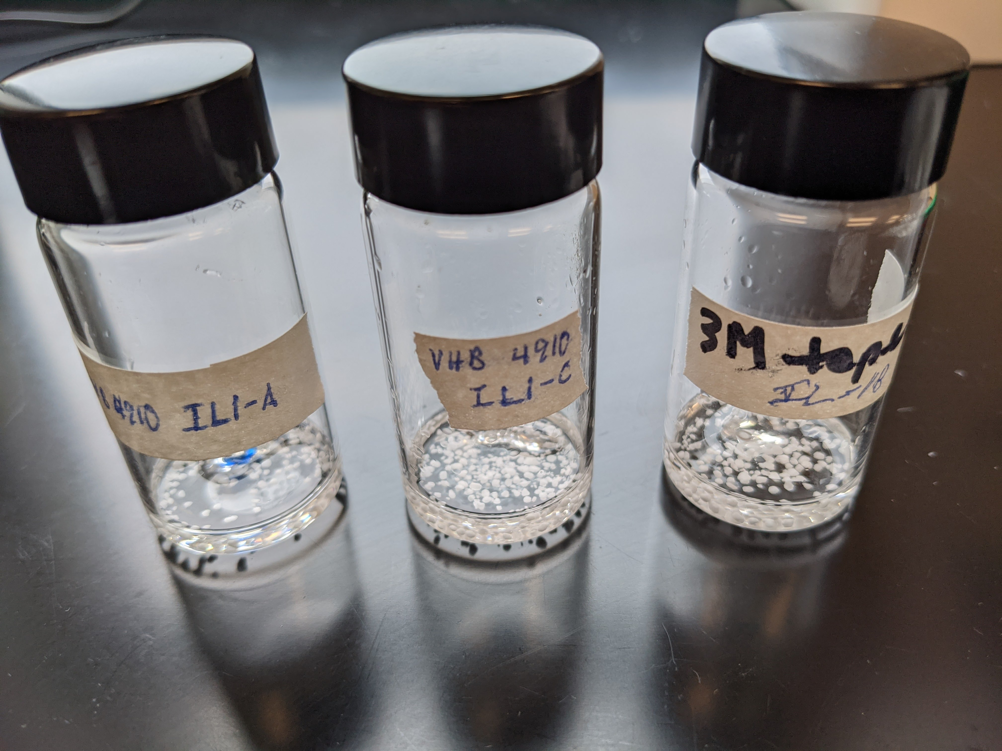
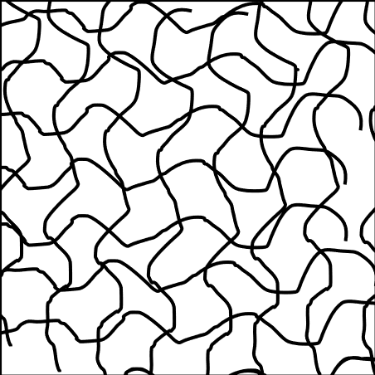
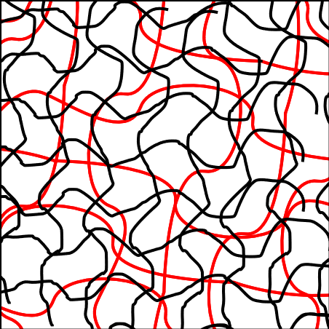
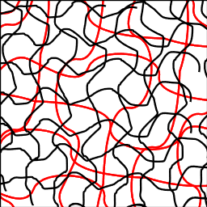
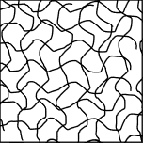
Observations on the Use of Chemical Treatment for the of Dielectric Elastomer’s Mechanical Properties: A Work in Progress
Dr. Hector Medina
Isaac Liu
Introduction
Preliminary Observations
Rationale: To develop an elastomer for use in dielectric elastomer actuators that does not require supporting structure or pre-stretch, increasing opportunities for existing and novel DEA applications
Question: Does increasing cross-linking density enhance dielectric elastomer actuator performance?
Research hypothesis: Increasing cross-linking will improve dielectric elastomer strength but at the cost of increased stiffness.
Independent variables: amount of initiator and type of cross-linking initiator
Dependent variables: visual and sensory feedback of treated elastomer in comparison to untreated elastomer
Initial Results
AIBN can effectively serve as an initiator in lieu of benzoyl peroxide – as induces more cross-linking at with less mass used.
For the initiator to be absorbed by the VHB 4910 (and thus for cross-linking to occur), one must use an intermediate solvent that can both dissolve the initiator and mix with TMPTMA. Else, results such Figure 1 occur.
Ethyl acetate can serve as an inexpensive and non-toxic intermediate solvent.
Material properties vary greatly depending on level of cross-linking. Results can be like Styrofoam (Figure 2), internally soft and externally hard (Figure 3), or like untreated VHB 4910 (Figure 5).
To achieve good cross-linking without excessive stiffening, the optimum ratio of AIBN to VHB 4910 seems to be 1:20.
There is some initial indication that the ratio of VHB 4910 to AIBN matters as well as the ratio of TMPTMA to AIBN.
Analysis of masses before and after baking process indicates cross-linking did take place.
Challenges
Swelling can increase the effect of sample edge imperfections – that adversely affects material properties
VHB 4910 cross-linked with TMPTMA is stickier than untreated VHB 4910. Although it is not impossible to remove from the glass plates or non-stick paper, removing it may cause deformations or introduce pre-stretch.
Background
Figure 1. Initial test using benzoyl peroxide, TMPTMA, and VHB 4910. The mass ratio of TMPTMA to benzoyl peroxide to VHB 4910 was 10:1:1. Heated for two hours at 70 degrees. As seen above, the benzoyl peroxide did not dissolve and what resulted was polymerized TMPTMA with VHB 4910 hardened within it.
Figure 2. Brittle results from VHB 4910 cross-linked with an AIBN to TMPTMA mass ratio of 1:10.
The Potential
Dielectric transducers (DETs) have the capability to revolutionize multiple fields, from soft robotic actuators to wave energy generation [3]
Their basic function stem from capacitors, but one that can convert pressure to voltage and vice versa—that means dielectric transducers can convert electrical energy to mechanical force and vice versa [3]
The elastomer part of the DET is a rubber-like macro material that deforms under load
The ideal elastomer must be able to 1) Stretch several times its original length 2) Return to its original length upon release of stretching 3) Have high electromechanical conversion efficiency 4) Withstand large electric fields [3]
VHB 4910 is among the most common elastomer, as it is commercially available, exhibits high electromechanical deformations, has high elastic energy density, and has high electromechanical conversion efficiency [1]
The Problem
These remarkable properties only can be achieved in VHB 4910’s stretched state which must be maintained with complex supporting structures, which add weight and complexity to dielectric elastomer transducers [1]
The stretched state of VHB 4910 also increases crack propagation and limits performance [2]
This significantly limits application of dielectric elastomers—longevity and durability critical to widespread market adoption
The Proposal
Research indicates interpenetrating VHB 4910 with trimethylolpropane trimethylacrylate (TMPTMA) can eliminate the need for structures to support the pre-stretched state [1]
But too much cross-linking increases stiffness of the elastomer, limiting its stretchability. Balance is key.
More recent research suggests such cross-linking alone improved electromechanical performance, meaning interpenetration could potentially remove the need for pre-stretch altogether [2].
There is some possibility TMPTMA cross-linked VHB 4910 obtains some of the properties of silicone elastomers—a superior but more expensive DET elastomer [2].
Yet understanding of such phenomena is limited and knowledge of optimum amount and method of cross-linking is sparse.
Future Work
Use IR spectroscopy and equilibrium swelling test to test for cross-linking. IR spectroscopy involves comparing the IR graphs of polymerized TMPTMA, untreated VHB 4910, and the sample. Equilibrium swelling allows for mathematical calculation of cross-link density after swelling the samples in anhydrous toluene [2].
Bake the treated samples on a Teflon-coated plate to avoid damaging the material when removing it.
Perform mechanical testing on the treated VHB 4910 – generate stress-strain diagrams and calculate the modulus of elasticity, the strain energy, and the modulus of toughness.
Use laser cutter for uniform cuts – eliminate effect of edge deformities
Investigate the possibility proper amount of initiator depends on mass of VHB 4910
Investigate heating at different temperatures and rates and that effect on cross-linking density.
Use scanning electron microscope to gain a visual intuition of the cross-linking (confirm Figure 6).
Figure 3. Results from VHB 4910 cross-linked with AIBN to TMPTMA mass ratio of 1:100, or 1:10 AIBN to VHB 4910 mass ratio. The outside of the modified VHB 4910 is hardened, though there is some flexibility on the inside.
Figure 4. More promising results from VHB 4910 cross-linked with Benzoyl Peroxide to TMPTMA mass ratio of 1:100, or 1:10 TMPTMA to VHB 4910 mass ratio.
1 2 3 4 5 6 7 8 9 10 11 12 13 14
1 2 3 4 5 6 7 8 9 10 11 12 13 14
Figure 5. Stretching VHB 4910 cross-linked with AIBN. The AIBN to VHB 4910 mass ratio was 1:20, but the AIBN to TMPTMA mass ratio was also 1:100 AIBN. The samples can experience 200 percent a and return to its original length.
References and Acknowledgments
Methods
Initial Results
[1] S. M. Ha, W. Yuan, Q. Pei, R. Pelrine and S. Stanford, "Interpenetrating networks of elastomers exhibiting 300% electrically-induced area strain," Smart Materials and Structures, vol. 16, p. S280, 2007.
[2] D. Sahu, R. K. Sahu and K. Patra, "Effects of crosslink density on the behavior of VHB 4910 dielectric elastomer," Journal of Macromolecular Science, Part A, vol. 56, p. 821–829, 2019.
[3] S. M. Ha, W. Yuan, Q. Pei, R. Pelrine and S. Stanford, "Interpenetrating networks of elastomers exhibiting 300% electrically-induced area strain," Smart Materials and Structures, vol. 16, p. S280, 2007.
Acknowledgements
Dr. Michael Korn contributed significantly by supervising laboratory work.
Carson Farmer helped by taking pictures and gave general background knowledge on DEAs.
To increase understanding in that area, we cut several samples of VHB 4910 and soaked them in an TMPTMA solution.
The solution contained TMPTMA , ethyl acetate, and one of two initiators: benzoyl peroxide or azobisisobutyronitrile (AIBN).
The ratio of TMPTMA to VHB 4910 was 10:1.
The amount of initiator varied as the independent variable—theoretically more initiator induces more TMPTMA to cross-link which increases the cross-link density.
As neither AIBN nor benzoyl peroxide directly dissolve in TMPTMA, we used ethyl acetate as an intermediary solvent
We cut pieces of VHB 4910, measured their mass, and placed them in each solution with the lid covered.
After 24 hours, we placed the samples under the fume hood for 0.5 to 3 hours to allow the ethyl acetate to evaporate.
We then baked the samples at 70 degrees Celsius for an hour, starting from room temperature.
Swelling
Cross-linking
Cross-linking
A
B
C
D
Figure 6. Graphical illustration of interpenetration process. State A is the unmodified VHB 4910. State B is the VHB 4910 after swelling with the ethyl acetate, initiator, and TMPTMA solution. After it is placed within the oven, the state changes from B to C to D as ethyl acetate evaporates.

