Slide 1
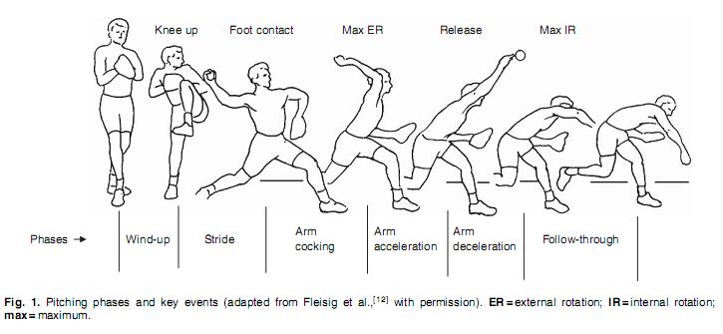
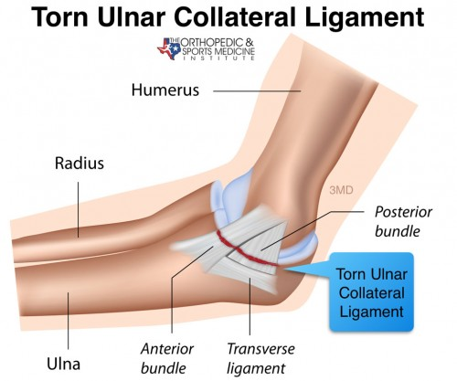
8-Week Post-Operative Rehabilitation for a Collegiate Baseball Pitcher with UCL Reconstruction
Kinder, C. G.; Bonser, R. J.; & Coots, J. G. – Liberty University – 2021
Background
Conclusion
A 19-year-old male baseball player (right-handed pitcher), reported that he began to feel pain in his right elbow while throwing during practice. While pitching in the bullpen he felt a pull/tear. Prior to this feeling in practice, he was experiencing intermittent tightness in his biceps brachii and forearm. Upon evaluation, the athlete presented with guarding of the elbow and was reluctant to perform normal range of motion (ROM). Patient was positive with valgus stress test—more at 30+ degrees than at full extension and with the dynamic valgus stress test. Pain through VEO test—most significant from 20-40 degrees of flexion. Reported of a clicking sensation during active pronation. Patient had a history of recurrent elbow injuries but had not been diagnosed with a UCL tear.
The case study had to be ended at week eight due to the athlete being halted in rehabilitation because of medial elbow pain. At this point, the athlete is still in the early rehabilitation phase and will be re-evaluated as needed. The athlete’s progress was right on track when compared to the rehabilitation plans discussed in other articles dealing with a post-operative UCL tear. During the first eight weeks the main focus was on decreasing pain and edema, restoring range of motion, and slowly introducing strengthening. The patient continuously progressed in flexion and extension and, at week six, he was able to remove his immobilization during activities of daily living. Strengthening began at the shoulder and exercises only used body weight. At week five isometric exercises were added to the rehabilitation program.
Introduction
Future Work
Patient had a previous history of injury to this area about a year prior to this incident. When this previous incident occurred, the athlete took off pitching for eight weeks and went through rehabilitation. For this injury, the patient was throwing a bullpen in practice and felt a pull/tear sensation while pitching that caused a sharp pain. During evaluation, the patient was reluctant to go into full ROM and experienced pain at the end ranges. The positive valgus stress test is indicative of a UCL tear in the elbow. The patient was seen by a physician for confirmation of a UCL tear by MRI. The MRI provided evidence for a UCL tear of the anterior bundle.
Have an outcome measure to track daily progress with rehabilitation using a health-related quality of life questionnaire .
Extend the study past eight weeks into later phases of rehabilitation.
References
1 2 3 4 5 6 7 8 9 10 11 12 13 14
1 2 3 4 5 6 7 8 9 10 11 12 13 14
1. Erickson, B. J., Harris, J. D., Chalmers, P. N., Bach, B. R., Verma, N. N., Bush-Joseph, C. A., Romeo, A. A., & Bach, B. R., Jr. (2015). Ulnar Collateral Ligament Reconstruction: Anatomy, Indications, Techniques, and Outcomes. Sports Health: A Multidisciplinary Approach, 7(6), 511–517.
2. Griffith, T. B., & Duralde, X. A. (2019). Successful Performance After Ulnar Collateral Ligament Reconstruction: An Analysis of 88 Drafted Professional Baseball Pitchers With a Matched Comparison Cohort. Orthopaedic Journal of Sports Medicine, 7(11), 1–5. https://doi.org/10.1177/2325967119880820
3. Lightsey, H. M., Trofa, D. P., Sonnenfeld, J. J., Swindell, H. W., Makhni, E. C., & Ahmad, C. S. (2019). Rehabilitation Variability After Elbow Ulnar Collateral Ligament Reconstruction. Orthopaedic Journal of Sports Medicine, 7(3), 1–7. https://doi.org/10.1177/2325967119833363
4. Lyle Cain Jr, E., & McGonigle, O. (2016). Return to Play Following Ulnar Collateral Ligament Reconstruction. Clinics in Sports Medicine, 35(4), 577–595. https://doi.org/10.1016/j.csm.2016.05.004
5. Vitale, M. A., & Ahmad, C. S. (2008). The outcome of elbow ulnar collateral ligament reconstruction in overhead athletes: A systematic review. The American Journal of Sports Medicine, 36(6), 1193-1205. doi:10.1177/0363546508319053
Wilk, K. E., Arrigo, C. A., Dugas, J. R., Cain, E. L., & Andrews, J. R. (2017). Rehabilitation and Return-to-Play Criteria Following Ulnar Collateral Ligament Reconstruction. Operative Techniques in Sports Medicine, 25(3), 154–171.
A
B
C
Methods
All information was obtained through my own evaluation, evaluation by ATC, and evaluations by doctors.
”Torn Ulnar Collateral Ligament.” Core Physical Therapy, June 6, 2018, https://www.coreptclinics.com/blog/basics-of-an-ucl-tear-aka-tommy-john-by-sarah-shivley-otr-l-mot-wcc/. March 15, 2021.

