Slide 1
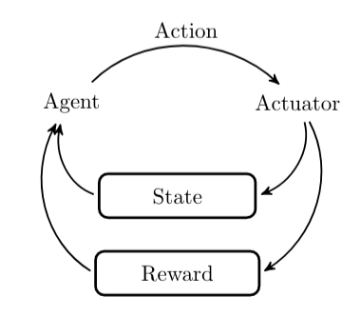
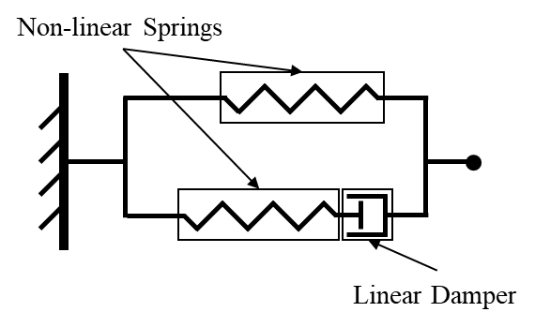
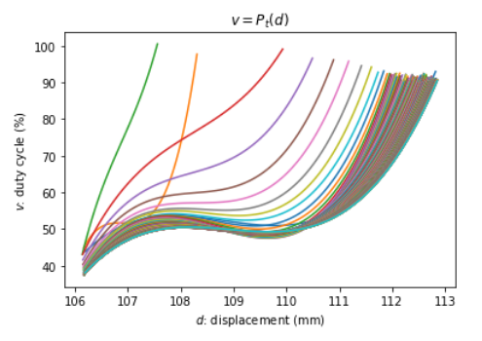
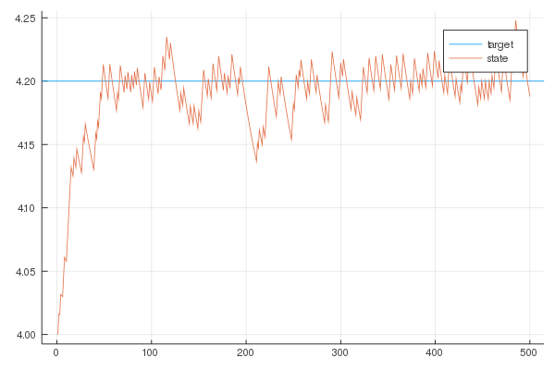
Preliminary Results on the Use of Machine Learning for Advanced Controls of a Dielectric Elastomer Actuator
Nathanael Gentry, Carson Farmer, and Dr. Hector Medina
Background
D
Methods
Background: Dielectric elastomer actuators (DEAs) have shown much promise as soft robotic actuators. However, accurately controlling such actuators has proven problematic given their highly nonlinear and hysteretic behavior. As opposed to traditional proportional–integral–derivative (PID) controller or an empirical model, neural network-based reinforcement learning controllers have shown themselves to be a more versatile and robust control strategy once a satisfactory model has been learned. Reinforcement learning models how biological brains master new skills, by maximizing the reward function received from performing given tasks. Challenges: However, due to the quasi-Markovian partial observability of the hysteretic material, traditional Markov decision process methods must be adapted applied to learn hysteretic dynamics. The current approaches to controlling hysteretic materials have relied upon small discrete action spaces to fine-tune a time-limited empirically fit model. Deploying DEAs in robotic applications, however, requires a more self-supporting control strategy. Methods: Over the COVID-19 pandemic, we have researched applying the machine learning techniques of Q-learning and differentiable programming to accurately control a planar DEA along a randomly-generated trajectory. There are many applications of such control, and we have studied placing machine learning-controlled DEAs to stabilize freestanding laser communication systems against environmental vibrations. Conclusions: In an important contribution to DEA control research, we developed a planar elastomer simulator from data presented in the literature to perform rapid model prototyping and hyperparameter tuning. We expect continued research into model development for a planar elastomer will yield a control strategy that is able to compensate for aging effects upon the elastomer, as well as provide valuable insight for future research into developing artificial intelligence control for a double-cone elastomer.
In spring 2020, the researchers sought to establish a non-recurrent deep learning model by following the example in [1], which achieved model-free learning by first starting with a fourth-order empirical polynomial approximation of desired displacement against required voltage at each modeled time-step. Then, a deep neural network fine-tuned the approximation provided by a small action space of adjustments to the approximation. A time step of 0.1 seconds proves sufficient for simulating continuous control (Figure E). Gathering data for this step entailed detailed data-collection of elastomer behavior. Digital commands sent to an ESP-32 microcontroller controlled the pulse-width modulation (PWM) of signal sent to the elastomer. The elastomer's actuation was measured with an optoNCDT 1320 laser distance sensor (Figure D). The ESP-32 and the laser optical sensor connected to the host computer with standard UART-to-USB connections. Code was shared among the collaborators via GitLab. COVID-19 forced lab closures, but work was continued remotely over the JupyterLab interface [6].
In fall 2020, the shortcoming of the previous approach was realized: Once the elapsed time exceeds the number of modeled timesteps, control accuracy diminshes. Thus, the code necessary for a truly deep recurrent approach like that implemented in [7] was developed. In any machine learning development cycle, tuning hyperparameters (e.g. network depth and learning rate) presents the most challenging step. The desired learning environment must be run many times (episodes) to tune these values. Even with good hyperparameters, model-free deep reinforcement learning takes significant experience to converge [8]. Thus, existing models were taken and a simulator created (Figure C). The simulator utilized a modified version of the standard linear solid (SLS) model. The traditional SLS model uses linear springs and dampers to approximate the time-dependent stress in a material. With the significant viscoelastic effects, the SLS model was modified to include non-linear springs which used the Gent hyperelastic model to approximate the stress [10]. The modified SLS model was found to be accurate for linear displacement. The simulation helped achieve preliminary results of teaching a controller toward maintaining constant actuation (Figure F).
Figure A: A comparative hierarchy of machine learning strategies. Techniques toward the left solve more difficult problems. there are three fundamental models of machine learning: unsupervised, supervised, and reinforcement. Unsupervised learning can discern clustering in datasets, while supervised learning can perform classification. Reinforcement learning (RL), however, enables live control in a Markov decision process. Rather than providing a direct classification, as in supervised learning, RL determines the right balance of exploration and exploitation. This type learns an optimal policy -- a deterministic mapping from time-state to action -- by optimizing the reward provided by the environment over some time.
Research Question
How can deep recurrent Q-networks be applied to establish an adaptable control strategy for DEAs?
Figure A presents an introduction to the various approaches to machine learning. The environment of a reinforcement learning system (Figure B) is modeled as a Markov decision process (MDP). Described as a discrete-time control process, MDPs allow modeling systems having an agent whose decisions might be stochastically overridden by the environment. The quality-value function (Q-function) maps a state and action to respective real output, the quality. This mapping can occur via parameterization by a function approximator such as neural network, or a more exotic choice like a Gaussian mixture model.
Deep Q-learning. When the Q-function is parameterized by a deep (multi-layered) neural network, the learning system is called a deep Q-network. A simple deep Q network sufficed for a short control period over a relatively good approximation [1], but from-scratch learning over longer time intervals requires an important refinement:
Many experimental setups do not explicitly measure velocity information; they rely solely upon an optical sensor to measure elastomer displacement at any instant. Accurately controlling the elastomer requires some memory over time, because the dynamics of the process are only partially observable. Indeed, the hysteresis means the controller's state space is not truly Markovian [2].
A solution could be forced by ensuring the network keeps a fixed number of past states in memory, but this does not provide long-term planning or optimizing use of the memory [3]. However, there is a single powerful solution: the deep recurrent Q-network (DRQN) [5].
DRQNs. Originally developed for state dependent and flickered-screen Atari games, a DRQN incorporates a recurrent neural network (RNN) rather than a standard feedforward network. These recurrent networks keep a hidden and time-dependent state that contextualizes new information [5]. However, researchers have not applied DRQNs to DEA control; they have instead used existing non-recurrent approaches over a limited time span. However, we sought a more robust control strategy.
Figure B: Process diagram of reinforcement learning control, showing the interplay between actions and rewards
Figure C: The non-linear material simulation utilized the standard linear solid model with the spring being non-linear hyperelastic.
Future Work
Implement a model-free deep Q-network to track arbitrary trajectories.
Investigate value of hysteretic recurrent neural networks (HRNNs).
Base a control strategy on physics-informed neural networks (PINNs) to use existing models as machine learning accelerators [9].
Apply field-programmable gate arrays (FPGAs) for hardware acceleration.
Develop a conical elastomer simulator to complement the planar one.
Employ differentiable programming a simulator model for faster learning.
Analyze control performance in continuous action spaces.
Compliant Electrodes
Laser Transmitter
Dielectric Elastomer
High Voltage Controller
Ultraviolet Laser
Laser Receiver
References
1 2 3 4 5 6 7 8 9 10 11 12 13 14
Figure D: Diagram of a laser communication stabilizer systems, the proposed application for implemented machine-learning control
1 2 3 4 5 6 7 8 9 10 11 12 13 14
Li, L., Li, J., Qin, L., Cao, J., Kankanhalli, M. S., & Zhu, J. (2019). Deep Reinforcement Learning in Soft Viscoelastic Actuator of Dielectric Elastomer. IEEE Robotics and Automation Letters, 4(2), 2094–2100. https://doi.org/10.1109/LRA.2019.2898710
Kirkpatrick, K., Valasek, J., & Haag, C. (2013). Characterization and Control of Hysteretic Dynamics Using Online Reinforcement Learning. Journal of Aerospace Information Systems, 10(6), 297–305. https://doi.org/10.2514/1.49261
Osman, H. E. (2011). On Reinforcement Memory for Non-Markovian Control. In M. Bramer, M. Petridis, & A. Hopgood (Eds.), Research and Development in Intelligent Systems XXVII (pp. 179–192). Springer London. https://doi.org/10.1007/978-0-85729-130-1_13
Hausknecht, M., & Stone, P. (2017). Deep Recurrent Q-Learning for Partially Observable MDPs. ArXiv:1507.06527 [CS]. http://arxiv.org/abs/1507.06527
Liu, V., Adeniji, A., Lee, N., Zhao, J., & Srouji, M. (2019). Recurrent Control Nets for Deep Reinforcement Learning. ArXiv:1901.01994 [Cs, Stat]. http://arxiv.org/abs/1901.01994
Medina, H., Gentry, N., & Farmer, C. (2021, March 9). Remote Laboratory For Machine Learning Training of A Soft Actuator’s Control: A Case Study. 2021 ASEE-SE Annual Meeting. https://papers.asee-se.org/openconf/modules/request.php?module=oc_program&action=summary.php&id=24
Massenio, P. R., Rizzello, G., Comitangelo, G., Naso, D., & Seelecke, S. (2020). Reinforcement Learning-Based Minimum Energy Position Control of Dielectric Elastomer Actuators. IEEE Transactions on Control Systems Technology, 1–15. https://doi.org/10.1109/TCST.2020.3022951
Abbeel, P., Quigley, M., & Ng, A. Y. (2006). Using inaccurate models in reinforcement learning. Proceedings of the 23rd International Conference on Machine Learning - ICML ’06, 1–8. https://doi.org/10.1145/1143844.1143845
Raissi, M., Perdikaris, P., & Karniadakis, G. E. (2019). Physics-informed neural networks: A deep learning framework for solving forward and inverse problems involving nonlinear partial differential equations. Journal of Computational Physics, 378, 686–707. https://doi.org/10.1016/j.jcp.2018.10.045
Chiang Foo, C., Cai, S., Jin Adrian Koh, S., Bauer, S., & Suo, Z. (2012). Model of dissipative dielectric elastomers. Journal of Applied Physics, 111(3), 034102.
Medina H., & Farmer C.W. (2019, Dec). Improved Model for Conical Dielectric Elastomer Actuators with Fewer Electrical Connections. Journal of Mechanisms and Robotics, 9:1-5.
Farmer, C. & Medina, H. (2020). Dimensionless parameter-based numerical model for double conical dielectric elastomer actuators. Engineering Research Express, 2(3), p.35020.
A
B
C
Results
Replicated the polynomial-based results of Li et al. (2019) and developed a planar DEA simulator for future fast model testing.
Learned industry-standard AI frameworks – Flux (Julia), Pytorch and Tensorflow (Python), and JupyterLab.
Developed a systematic approach to using dielectric elastomers as vibration controllers for laser communication systems (Figure D).
Implemented a lab framework to allow for testing remotely during the height of the COVID-19 pandemic.
Figure E: Convergence of polynomial-based displacement prediction over time, in the manner of Li et al (2017), with fit data gathered from real-time planar elastomer.
Figure F: Initial results of epsilon-greedy deep recurrent Q-learning strategy to maintain a constant desired actuation against the impacts of hysteresis, with fit data gathered from elastomer simulator.
Notes:
1

