Slide 1
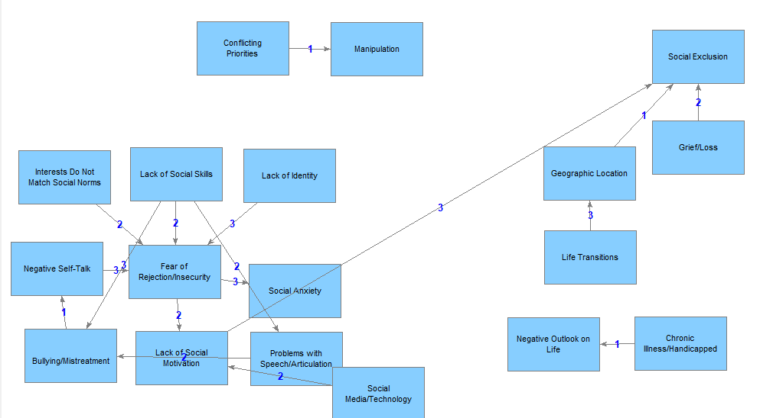
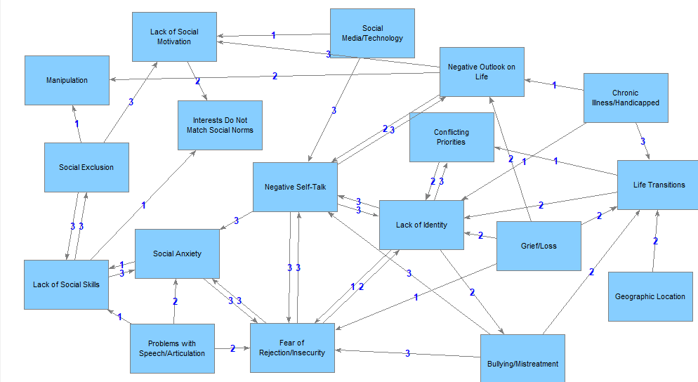
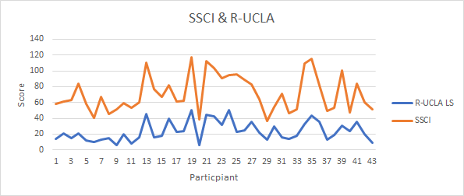
An Analysis of Loneliness and the Contributing Factors Among College Students
Blake Fraser, Abigail Taber, Jessica Eason, Hayden Goff, Rachel Goodall, and Elizabeth Moffitt
Abstract and/or Background
Sample Concept Maps
Results and/or Conclusion
Background: Loneliness, while subjective, is widespread and associated with poor mental health outcomes, including anxiety, depression, and suicidal ideation. Feelings of loneliness occur when one’s perception of social relationships does not meet their desired level of social connectedness. Through extensive review of the literature, contributing factors to loneliness were condensed into 18 overall categories, such as life transitions, social anxiety, conflicting priorities, and social exclusion. Most populations experience these factors to some extent; however, due to the intensity of exposure brought on by a transition into college, university students are widely susceptible to experiencing these factors. Considering the potential negative outcomes regarding loneliness, it is pertinent to understand the students’ perspectives. The purpose of the present study is to better define and understand the concept of loneliness both in terms of degree and causal factors. Methods: The participants must take two loneliness instruments, the R-UCLA Loneliness Instrument as well as the Student Social Capital Instrument (SSCI) and then create a concept map of the causal variables of loneliness. Results: The study is ongoing and in the data collection and analyses stages; therefore, results are pending. Conclusion: Potential implications include developing a more consistent operational definition for the concept of loneliness, validating the SSCI, and identifying individuals who pose a higher risk for experiencing increased levels of loneliness. Based on the findings of the present study, it is recommended that further research attempts to establish the reliability and validity of the SSCI as well as work to develop loneliness interventions.
Results
Anticipated Results: The research study is currently ongoing and awaiting complete data analysis and results. The anticipated analysis includes the correlation between the R-UCLA LS and the SSCI, the descriptive statistics of both instruments as well as the concept map, a nonparamteric Wilxoxon test to determine if there is a statistical difference between how lonely vs non-lonely people rank-order the contributing factors to loneliness in the concept map, and a correlation between the contributing factors on the SSCI stated explicitly and the contributing factors on the concept map stated implicitly.
Conclusions: After the appropriate data analysis and results are done, the conclusions will be listed. The possible conclusions gained from the research study will touch on the how many people are lonely according to both of the loneliness instruments, whether or not the SSCI has internal and external validity, some of the improvements to be made to the SSCI, the relationship between level of loneliness and how people rank-order their concept maps, and the correlation between the contributing factors presented explicitly in the SSCI and implicitly in the concept map.
Rank | Score | Contributing Factor
1 | 396886.5 | Lack of Social Skills
2 | 76014.5 | Problems with\nSpeech/Articulation
3 | 15863 | \nBullying/Mistreatment
4 | 4905.5 | Lack of Identity
4 | 4905.5 | Negative Self-Talk
5 | 3270.5 | Interests Do Not\nMatch Social Norms
6 | 353 | Fear of\nRejection/Insecurity
7 | 330.5 | Social\nMedia/Technology
8 | 180.5 | Life Transitions
9 | 23 | Lack of Social\nMotivation
10 | 15.5 | Grief/Loss
12 | 8 | Geographic Location
12 | 8 | Chronic\nIllness/Handicapped
12 | 8 | Conflicting\nPriorities
13 | 0.5 | Social Anxiety
13 | 0.5 | Social Exclusion
13 | 0.5 | Manipulation
13 | 0.5 | Negative Outlook on\nLife
Rank | Score | Contributing Factor
1 | 3.50388E+13 | Negative Self-Talk
2 | 3.09282E+13 | Lack of Identity
3 | 2.98311E+13 | \nBullying/Mistreatment
4 | 2.90559E+13 | Fear of\nRejection/Insecurity
5 | 1.83467E+13 | Grief/Loss
6 | 1.47824E+13 | Social\nMedia/Technology
7 | 1.32131E+13 | Social Anxiety
8 | 1.28436E+13 | Problems with\nSpeech/Articulation
9 | 9.92167E+12 | Life Transitions
10 | 9.92059E+12 | Chronic\nIllness/Handicapped
11 | 9.85495E+12 | Negative Outlook on\nLife
12 | 8.6985E+12 | Conflicting\nPriorities
13 | 6.78471E+12 | Lack of Social Skills
14 | 2.86406E+12 | Social Exclusion
15 | 2.7903E+12 | Geographic Location
16 | 15.5 | Lack of Social\nMotivation
17 | 0.5 | Interests Do Not\nMatch Social Norms
17 | 0.5 | Manipulation
Introduction and Research Questions
Loneliness is a well-known feeling that individuals are likely to experience at some point in their life; however, loneliness that is severe and persistent poses risks to an individual's mental health. For this reason, this research aims to gain a greater understanding of the concept of loneliness by identifying factors that contribute to loneliness the most. The study's purpose is to measure the subjective and explicit levels of loneliness within the participants. There are three main research questions being investigated:
1) What is the prevalence of loneliness amongst Liberty University students?
2) How do Liberty University students implicitly define loneliness and rank its causal variables?
3) Do lonely and non-lonely people differ in their conception, definition, and beliefs about loneliness?
Future Work
Determine physiological correlates of loneliness using galvanic skin response (GSR) and cortisol output.
Develop an individualized intervention for implementation at Liberty University.
Compare concept maps of professionals in the behavioral health field, education, and church with concept maps of individuals with high levels of loneliness.
Extend the research to other contexts and populations.
Methods
Currently, the data gathered represents a sample of 57 undergraduate students [at Liberty University]; however, the data collection phase is ongoing, and the sample size is expected to grow. To be included in the study, students had to be 18 years of age or older, a residential student, and enrolled in a residential, undergraduate psychology course.
This study utilizes a quantitative, cross-sectional survey research design. Students were recruited through brief presentations given by researchers in psychology classrooms. Data collection began in the semester of Fall 2020 and is ongoing. Students were asked to come to a residential research lab, where they would first submit their electronic informed consent. Then, the participants completed a brief demographics survey, as well as the Revised UCLA Loneliness Scale (R-UCLA) and the Student Social Capital Instrument (SSCI). Following completion of the surveys, they students were asked to construct a concept map with the Concept Builder (CB) software. Once finished, students were able to ask additional questions or leave the research lab. Participants received compensation in the form of three psychology activity credits.
The R-UCLA and SSCI are employed to measure explicit data on feelings of loneliness. The concept mapping activity via the CB software gives students an opportunity to make connections between perceived causal factors of loneliness from an individual perspective. The goal of this activity is to obtain implicit data.
1 2 3 4 5 6 7 8 9 10 11 12 13
A
B
References and/or Acknowledgments
C
Hayley, A. C., Downey, L. A., Stough, C., Sivertsen, B., Knapstad, M., & Øverland, S.
(2017). Social and emotional loneliness and self‐reported difficulty initiating and maintaining sleep (DIMS) in a sample of Norwegian university students. Scandinavian Journal of Psychology, 58(1), 91-99. doi:10.1111/sjop.12343
Kim, N. S. & Park, E. Y. (2009). ConceptBuilder: An open-source software tool for measuring, depicting, and quantifying causal models. The Psychonomic Society 41(1), 128-136. doi:10.3758/BRM.41.1.128
Lee, C.S., and Sara E.G. (2016). Loneliness, stress, and social support in young adulthood: Does the source of support matter? Journal of Youth and Adolescence 45(3), 568–80. doi:10.1007/s10964-015-0395-9
Moeller, Robert W., and Martin Seehuus. (2019). Loneliness as a mediator for college students’ social skills and experiences of depression and anxiety. Journal of Adolescence 73, 1–13. doi:10.1016/j.adolescence.2019.03.006
Stickley, A., & Ai, K.(2016). Loneliness, common mental disorders and suicidal behavior: Findings from a general population survey. Journal of Affective Disorders 197, 81–87. doi:10.1016/j.jad.2016.02.054
We would like to acknowledge the contribution of Dr. Brian M. Kelley, the faculty advisor of this project.

