Slide 1
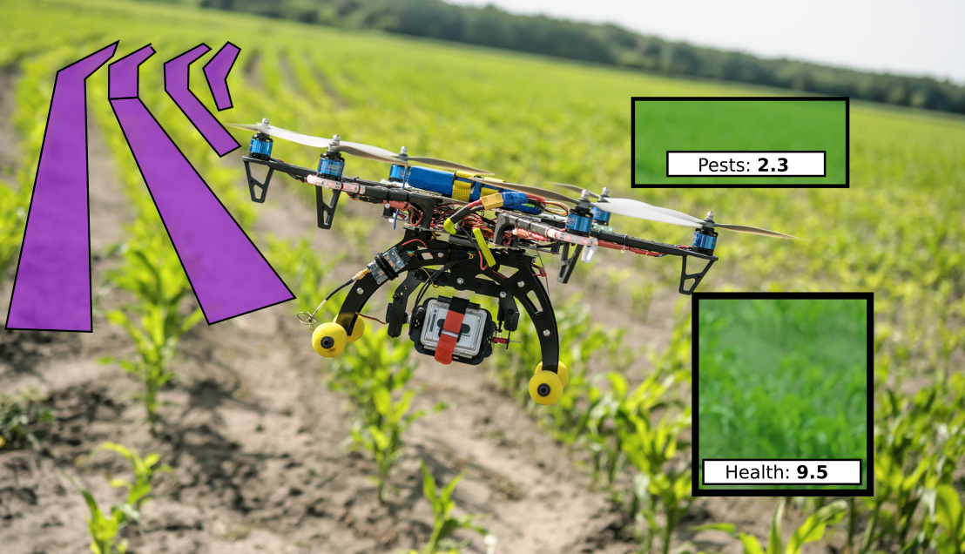
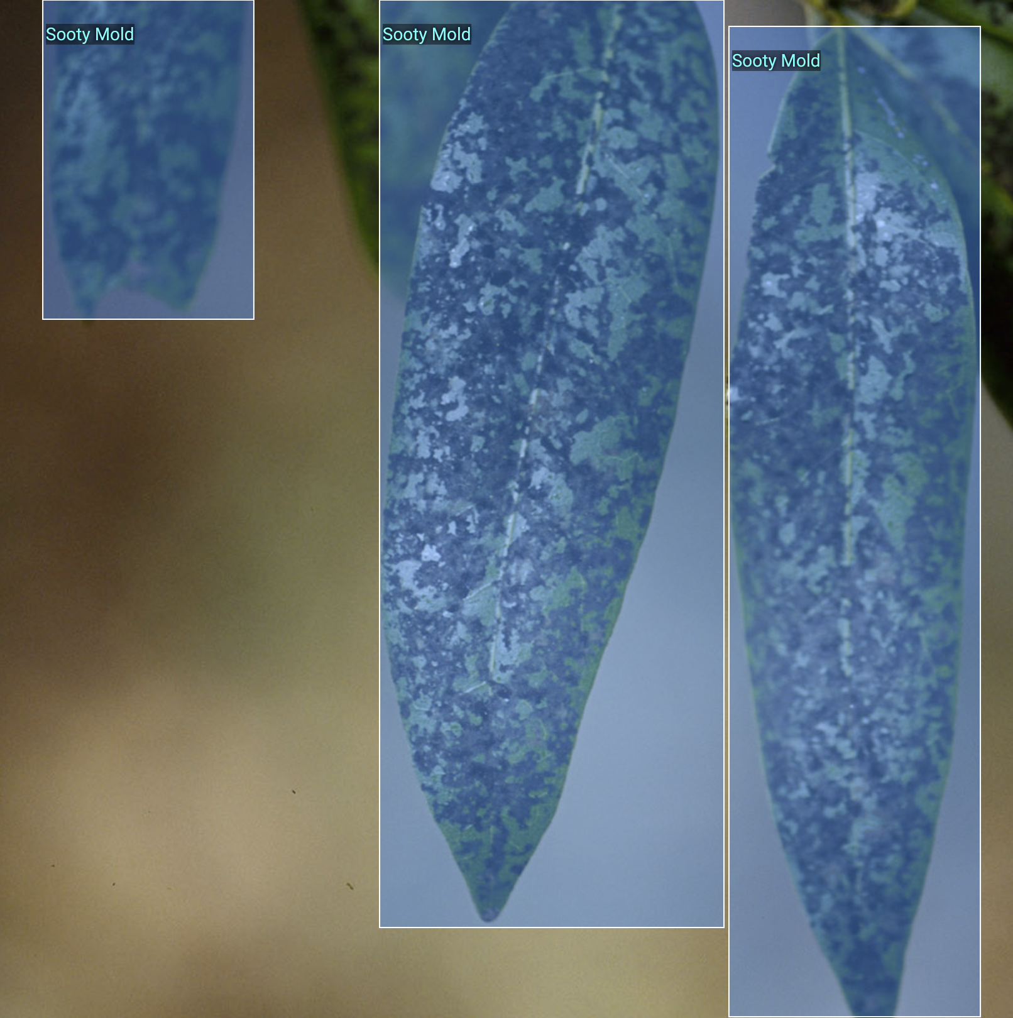
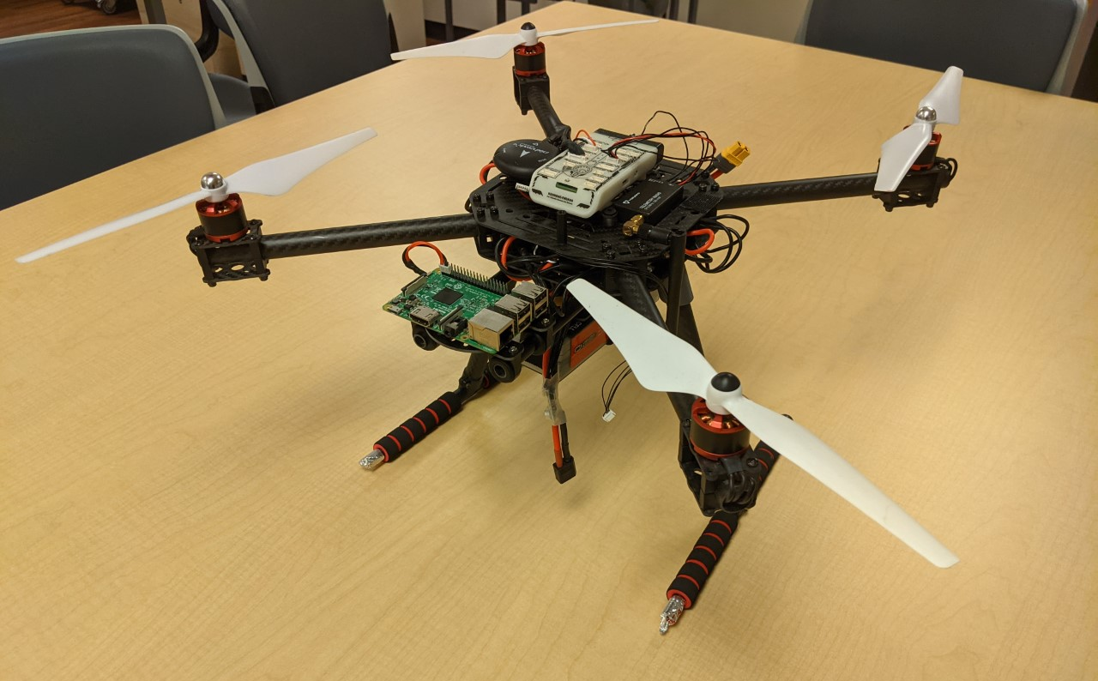
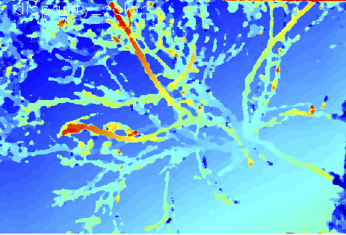
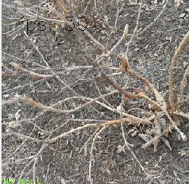
Drones and Spatial Artificial Intelligence
for Improving Crop Yield: An Implementation Concept
Carson Farmer and Dr. Hector Medina
Abstract
Bochkovskiy, A., Wang, C.Y. and Liao, H.Y.M., 2020. Yolov4: Optimal speed and accuracy of object detection. arXiv preprint arXiv:2004.10934.
Expected Challenges and Results
With the expected total agricultural yield expected to increase by 50%-100% by the year 2050, agricultural producers are looking for innovative methods for increasing crop yield. By utilizing computer vision and artificial intelligence, researchers have shown that computer algorithms can recognize weeds from crop growth. With recent innovations in low-cost hardware allowing for depth perception alongside high resolution imaging, new network architectures capable of detecting and recognizing­ weeds, pests, and other potential crop issues are in development. The solution we are proposing to develop utilizes a vision processing unit to perform accelerated machine learning on camera images` to achieve near real-time results without incurring extra computational time on the host computer. The system allows for off-network or edge applications to be developed which are capable of performing object recognition and classification without the use of powerful computers. Furthermore, with the average farm in Virginia being approximately 180 acres, autonomous mapping and planning is required for accurate estimation of crop health. With this application, a prior unmanned aerial vehicle (UAV), which was used for social distance monitoring, provides a suitable vehicle for performing autonomous mapping and crop analysis of the field. Combining the autonomous UAV with the advanced camera system, achieving accurate crop health information is now in the realm of possibility. Furthermore, farmers will benefit from the additional crop information provided by the system and can implement custom pest prevention and herbicide deployment protocols. With these new advances, future improvements to how farming is conducted are expected. The results expected to be achieved are shown in Fig. 1.
Flight Direction
Sooty Mold
Sooty Mold
Sooty Mold
Expected Challenges:
Diverse Dataset and Annotation/Labeling: With the research focuses on directly helping farmers, considerations for the types of crop, possible pest and diseases, and the variety of weeds needs to be accounted for when designing the system. The training data developed for the system will require a diverse grouping of different plants and diseases to be present. An issue that could arise is having a dataset too small where the network is not able to be trained to accurately recognize the disease or inaccurately characterizes plants. In performing data gathering flights, images from the camera can be directly taken and stored. The human aspect of the project will involve a manual process of annotating each image and labels plants, diseases, weeds, and pests for detection. The labeled images will look similar to Fig. 2. Furthermore, the fusion of depth data with the optical image will be introduced which will requires further logging of information alongside the images (see Fig. 4).
Route Planning and Navigation: With the drone flying over different fields and crop types, a suitable navigation system is required. The implementation of the navigation scheme will need to make use of visual cues from the field to determine crop boundaries. Since UAVs have a tradeoff between battery life and weight, achieving optimal flight paths will allow for coverage of the field while minimizing the flight time of the drone.
Data Interpretation: After a neural network similar to Fig. 5 has proceed the image and depth data from the drone, the actions and recommendations to the farmer need to be determined. These actions are formulated from a combination of analysis of historical data informed by a literature review of the appropriate methods mitigating the loss incurred.
Expected Results:
Informed Decision Process for Mitigating Crop Losses: Ultimately, the research aims to produce an integrated system capable of determining the impacts of external factors on crop growth. Furthermore, the system will be designed to be scalable to a large number of producers to aid in increasing crop yield. With the informed decision process, producers are expected to see an increase in total yield as a result of targeted actions
Crop Type, Pest, Disease, and Weed Dataset with Depth Information: A byproduct of the research will be a dataset containing information on different crop types, pests, diseases, and weeds correlated with depth information gathered from the cameras. The new dataset will be required for training the neural networks responsible for determining the locations, sizes, and shapes of the external factors.
Large-Scale Crop Management System: The process of deploying the neural network demonstrates a new era in integrating HPC and cloud resources into agriculture. The crop management system developed provides a key milestone for producers in seeing an increase in crop yield from technological interfaces.
Background and Introduction
Figure 1. Visual Representation of Drone-based Spatial AI for Crop Improvement
Combining cutting-edge low-power computer vision hardware and autonomous flight, the goal of the research is to develop a flight system capable of gathering large amount of information from a field for processing on an HPC to provide insight to farmers on the best actions to take to produce an increase in total yield.
In Virginia, a significant amount of income results from agriculture and related industries [1]. According to the Virginia Department of Agriculture and Consumer Services, agriculture comprises approximately $70 billion of the total state income and provides more than 334,000 jobs in the Commonwealth of Virginia [1]. Five of the top ten nationwide agricultural commodities are produced in Virginia [1]. With recent interests in increasing the total yield of farms to meet growing demand around the world, farmers are beginning to turn to “smart” techniques to further improve their total yield [2, 3, 4]. With artificial intelligence (AI) and computer vision (CV) becoming more accessible and deployable, the agriculture industry is beginning to utilize these advances in unique ways [5-7]. One such example is the Microsoft project Farmbeat [6]. The Farmbeats project combined advances in wireless communication with distributed sensors to determine soil moisture levels for farms [6]. From examining other external factors on crop growth and yield, weeds were shows to have a significant impact on the growth of plants and distribution of nutrients and have developed metric for measuring the impact of weeds [8]. These metrics predict that as the density of weeds in the field increases, then the total crop yield will rapidly decrease. Likewise, it has been shown that the influence of rodents can decrease crop yield by at least 12% [9]. Furthermore, diseases, such as Sooty Mold, have been found to create widespread losses to farms (see Fig. 2) [10]. While these “smart” systems have proven useful in creasing total yield, the average farm in Virginia is 181 acres [1], which creates a challenge in deploying sensors and cameras to monitor the whole field. The use of a drone and additional information about crops will be able to benefit farmers by helping them increase the total yield. In utilizing autonomous drones, the research aims to combine the power of advanced computer vision and machine learning to autonomous systems to gather information about the field and distribution of plant diseases, weeds, and insects.
Figure 2. Annotations of Sooty Mold on Leaves
In performing the research, a diverse dataset will be gathered which will include annotations of plant type, disease, pest, and weeds. The diverse dataset will be a challenge for the research to both gather and annotate the images for training. With recent advances in annotation software, the process and be easily done but human interaction will be required to process a large number of images.
Methods
Conclusion
Major Milestone:
Dataset Creation
Field Navigation
Model Architecture Selection and Training for Images and Long-Term Yield
Development of Crop Treatment Recommendations
Deployment for User Testing
Description of Milestones
Dataset Creation: Resulting from an extensive literature review of plant diseases and crop changes, a dataset of labelled and annotated images will be created. Furthermore, the dataset needs to include images of the host plant and crop. These images will aid in locating the individual plants from aerial images.
Field Navigation: To limit power consumption of the drone while achieving optimal field coverage, the drone will be required to identify the planting direction of the crop and create an optimal flight path while covering the area. The design of the algorithm provides a method for performing full field navigation autonomously in locations where GPS coordinates may not be known for the field. The drone used for the tests in shown in Fig. 3.
Model Architecture Selection and Training for Images and Long-Term Yield: With a dataset of crop images along with weeds, pests, and diseases, the implementation of a neural network trained to recognized the key characteristics is required. In modern CV, the problem is decomposed into two tasks: object detection and classification (see Fig. 5). With several major models existing to accomplish these tasks, the training of such a model for the agriculture application will require multiple iterations and testing to achieve an accurately trained model.
Development of Crop Treatment Recommendations: After using a machine learning approach on the large-scale data collected from the drones, a target set of actions, such as the application of pesticides and fertilizers to specific areas will be produced. The goal of the actions will be help farmers actively work to increase crop yield during the growing cycle. The information from the 3rd Milestone will determine the appropriate actions to be taken to improve the overall yield.
Deployment of User Testing: The final stage of the research involves incorporating all of the prior milestones into a coherent user interface that is accessible to the farmer. As part of the research, the plan is to connect both local and international farms to the proposed system to receive feedback on the system. In processing the data of multiple farms of varying sizes high performance computing (HPC) along with cloud-based resources will be utilized to provide farm and field specific corrective actions. The deployment of the functional system will provide new opportunities for crop providers to improve crop yield during the growth cycle.
Figure 3. Currently Developed Drone
The drone that is currently being used by TRACER Labs was developed for detection of people for enforcing social distancing at outdoor gatherings. Drawing from the lessons learned during the prior research, the future agriculture project builds upon the drone by adding low-power computer vision modules for gathering depth and image information.
Figure 4. Depth Map (left) and Image (right) of a Bush.
The advanced camera system to be mounted on the drone is capable of capturing 4k image along with performing stereoscopic depth calculations in close to real-time. Moreover, the camera is equipped with a vision processing unit which can perform convolutional neural network calculation in close to real-time on the images and depth data. These advances allow for the drone to autonomously navigate and capture images of the field and log areas of interest.
As a result of the research, innovations in the agriculture industry are expected. With producers experiencing an increased demand, measure to improve the total crop yield are required. By combining low-power cutting-edge computer vision hardware and autonomous drones, the work is expected to produce a trained neural network for locating plants, weeds, diseases, and pests from aerial images. Moreover, a machine learning approach for determining appropriate actions to improve an increase in crop yield. As the system is deployed, user testing and feedback will aid in further refinement of the system to produce actionable information for the producers. The entire process is part of a new revolution in agriculture where technology and traditional farming methods are merging to produce informed and improved agricultural processes.
1 2 3 4 5 6 7 8 9 10 11 12 13 14
A
B
C
4 4.5 5 5.5 6 6.5 7
References and/or Acknowledgments
[1] Agriculture facts and figures. Virginia Department of Agriculture and Consumer Services, 2021.
[2] Navin Ramankutty, Zia Mehrabi, Katharina Waha, Larissa Jarvis, Claire Kremen, Mario Herrero, and Loren H Rieseberg. Trends in global agricultural land use: implications for environmental health and food security. Annual review of plant biology, 69:789–815, 2018.
[3] Muhammad Ayaz, Mohammad Ammad-Uddin, Zubair Sharif, Ali Mansour, and El-Hadi M Aggoune. Internet-of-things (iot)-based smart agriculture: Toward making the fields talk. IEEE Access, 7:129551–129583, 2019.
[4] N Suma, Sandra Rhea Samson, S Saranya, G Shanmugapriya, and R Subhashri. Iot based smart agriculture monitoring system. International Journal on Recent and Innovation Trends in computing and communication, 5(2):177–181, 2017.
[5] Mang Tik Chiu, Xingqian Xu, Yunchao Wei, Zilong Huang, Alexander G Schwing, Robert Brunner, Hrant Khachatrian, Hovnatan Karapetyan, Ivan Dozier, Greg Rose, et al. Agriculture-vision: A large aerial image database for agricultural pattern analysis. In Proceedings of the IEEE/CVF Conference on Computer Vision and Pattern Recognition, pages 2828–2838, 2020.
[6] Deepak Vasisht, Zerina Kapetanovic, Jongho Won, Xinxin Jin, Ranveer Chandra, Sudipta Sinha, Ashish Kapoor, Madhusudhan Sudarshan, and Sean Stratman. Farmbeats: An iot platform for data-driven agriculture. In 14th USENIX Symposium on Networked Systems Design and Implementation (NSDI17), pages 515–529, 2017.
[7] Maanak Gupta, Mahmoud Abdelsalam, Sajad Khorsandroo, and Sudip Mittal. Security and privacy in smart farming: Challenges and opportunities. IEEE Access, 8:34564–34584, 2020.
[8] HDJ Van Heemst. The influence of weed competition on crop yield. Agricultural Systems, 18(2):81–93,1985.
[9] Peter R Brown, Neil I Huth, Peter B Banks, and Grant R Singleton. Relationship between abundance of rodents and damage to agricultural crops. Agriculture, ecosystems & environment, 120(2-4):405–415, 2007.
[10] Tedders, W. L., & Smith, J. S. (1976). Shading effect on pecan by sooty mold growth. Journal of Economic Entomology, 69(4), 551-553.
[11] Bochkovskiy, A., Wang, C.Y. and Liao, H.Y.M., 2020. Yolov4: Optimal speed and accuracy of object detection. arXiv preprint arXiv:2004.10934.
Figure 5. Network Architecture for Object Detection and Classification in Image Only Convolutional Neural Networks.
The process of creating a image processing neural network involves taking the input image and first determining regions of interest. Next the regions of interest are combined with a predictor to determine if the region is a classifiable object or the background. Then, depending on the type of detector, a final stage can be added to performed for advanced predictions on the image at the cost of increasing the number of training parameters and computational time. With the research being conducted, the depth data can be formatted as an extra channel in the image. Image from [11]

