Slide 1
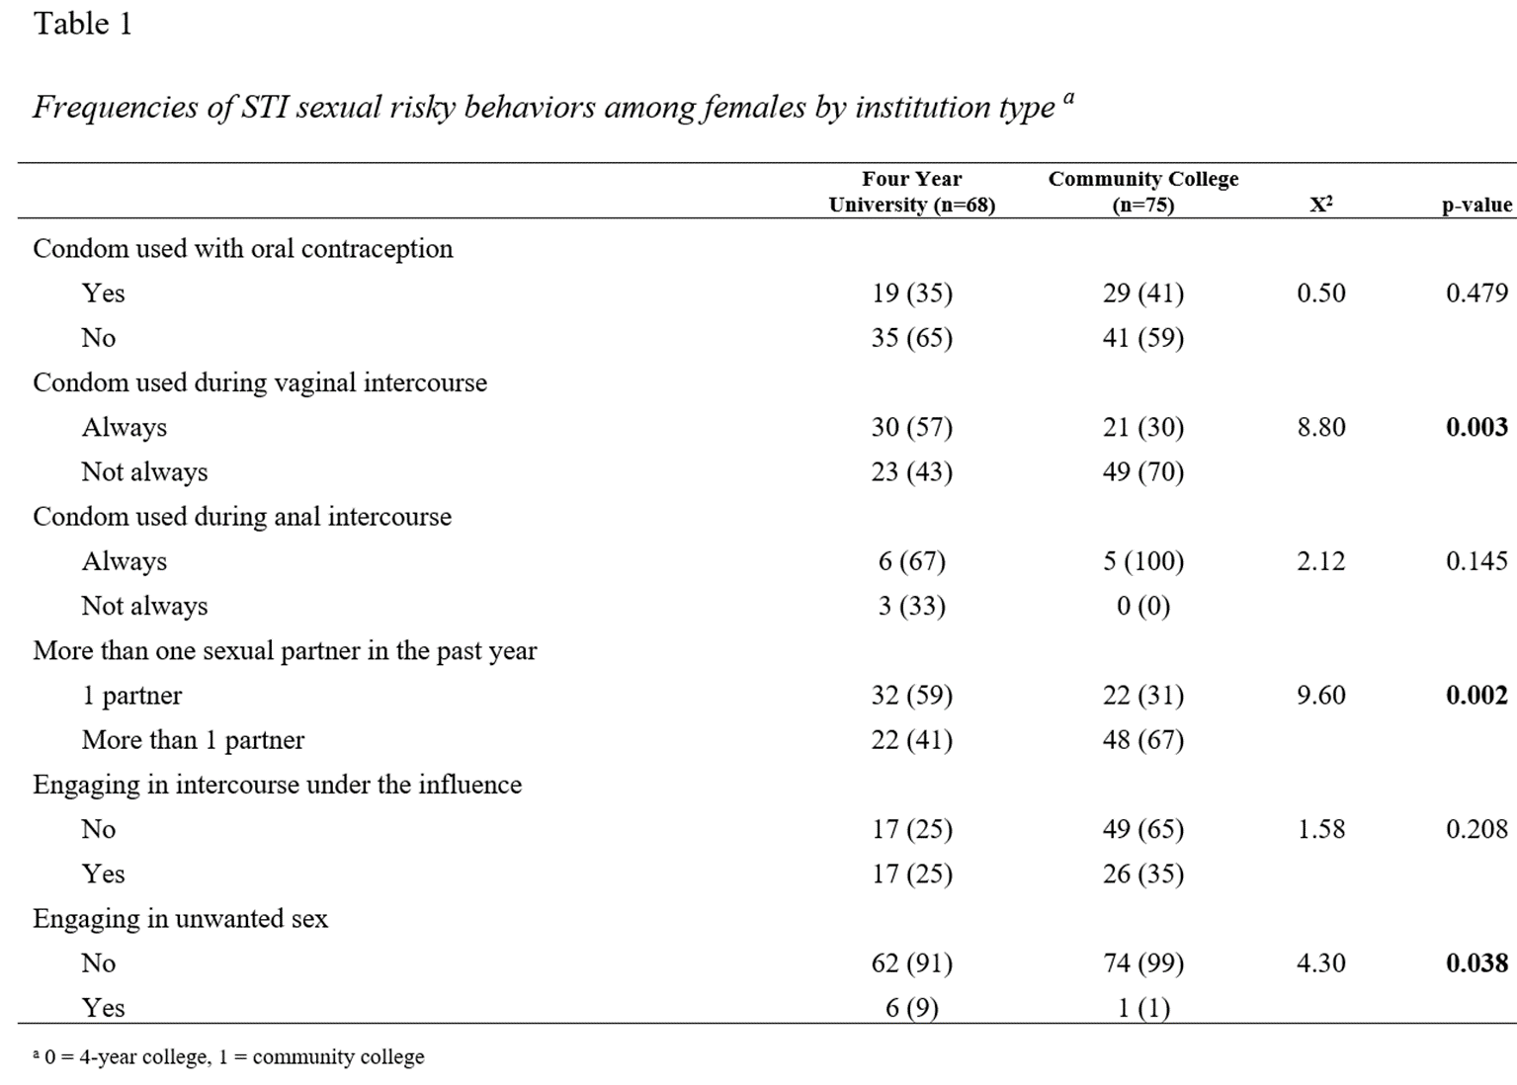
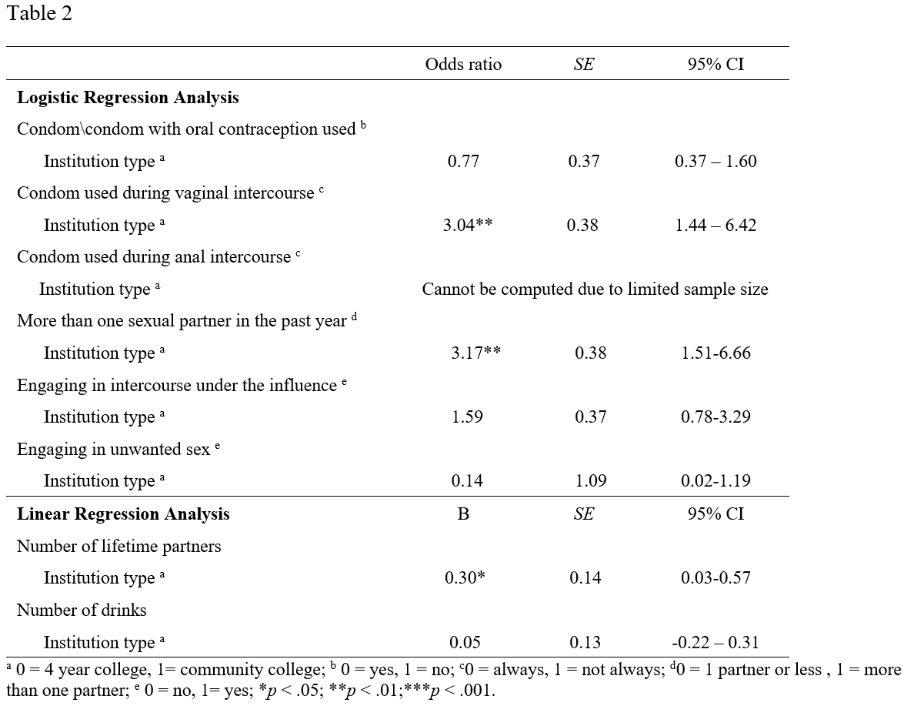
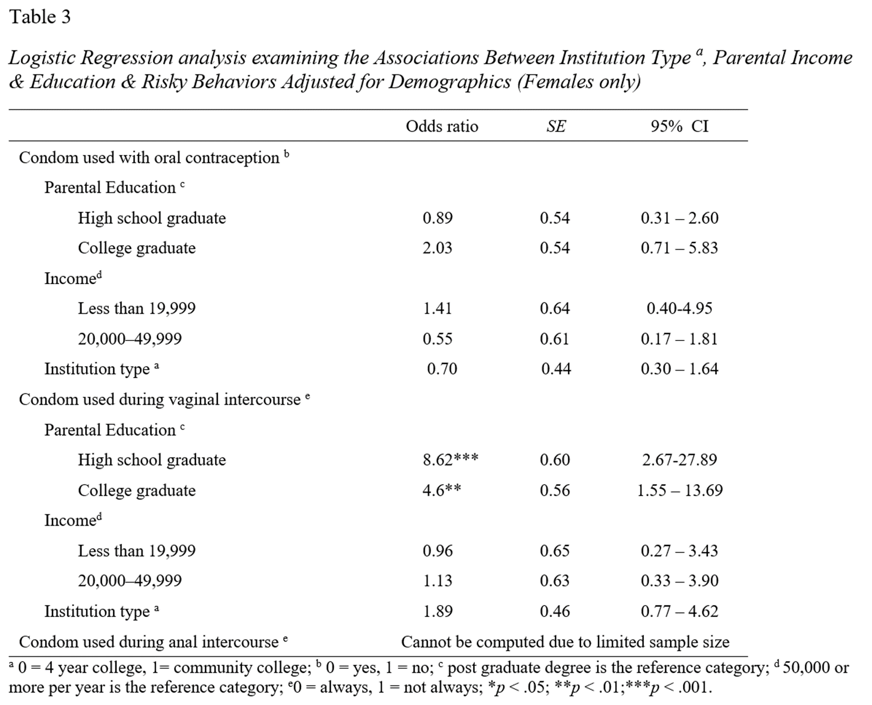
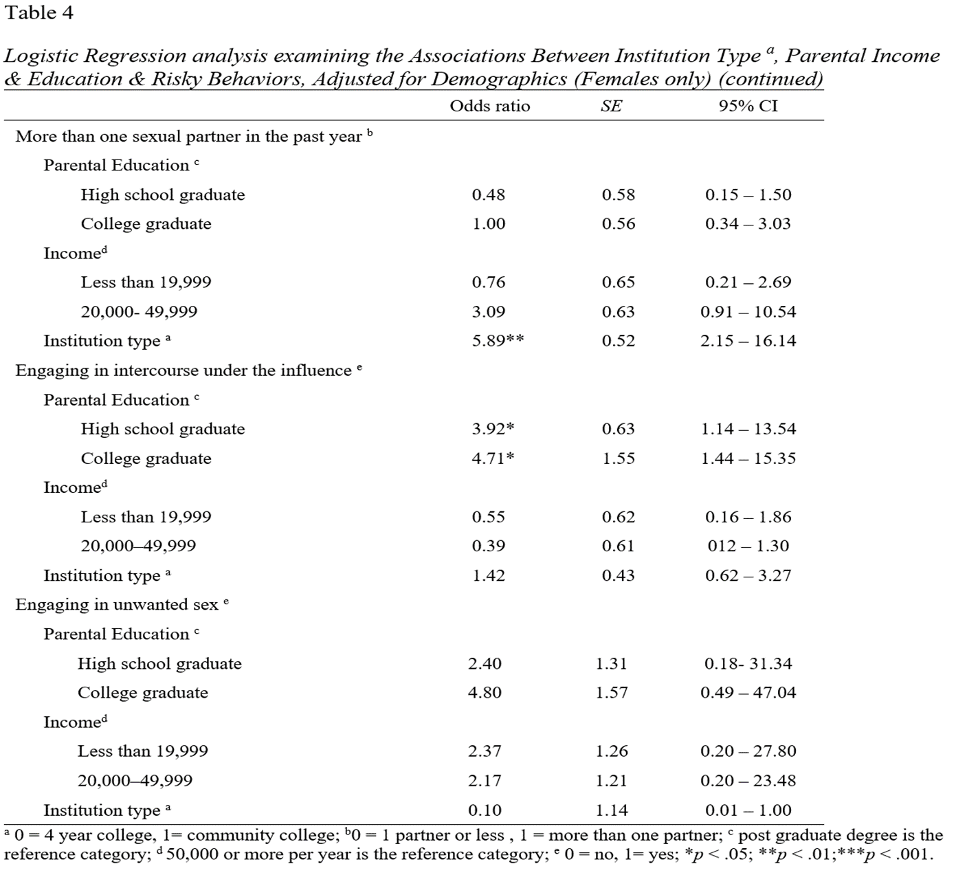
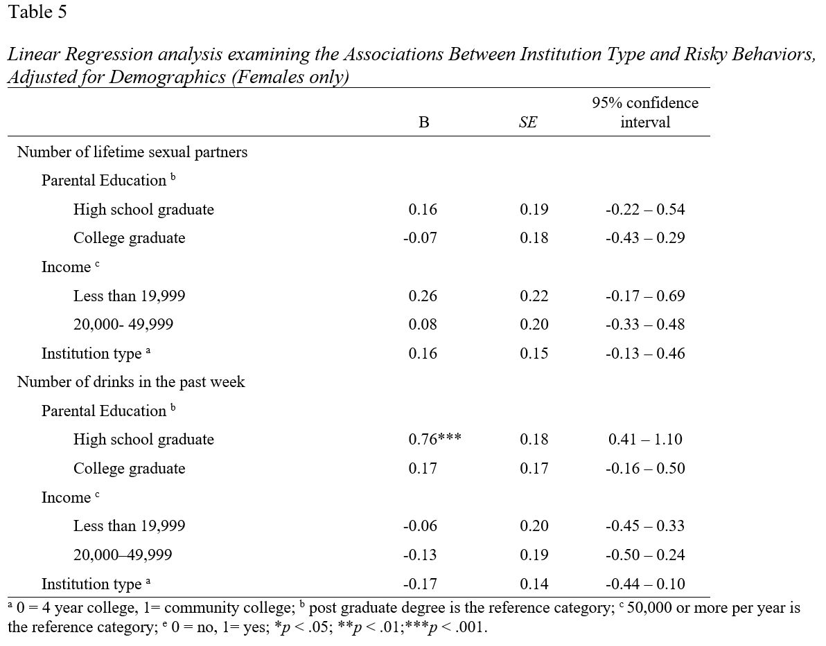
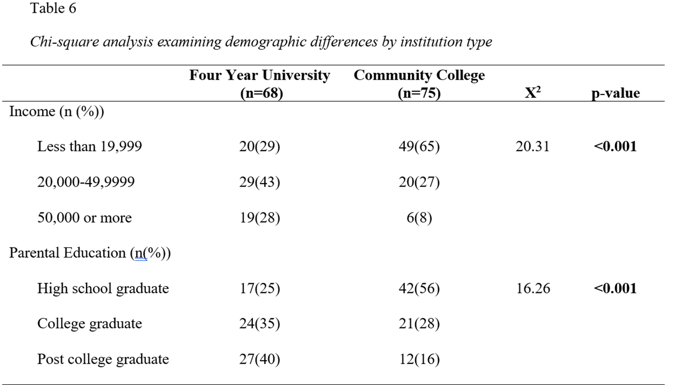
Social and Behavioral Risk Factors of Sexually Transmitted Infections in Community College and University Female Students
Olufunmilayo .A. Babarinde MPH Candidate, Ewa Makowka MPH Candidate, Oswald Attin, PhD
Abstract
Results & Discussion
Background
The United States of America experiences rise in sexually transmitted infections (STIs), especially among young adults. According to the Centers for Disease Control and Prevention, an estimated 26million new cases of STI were reported for the year 2018 and almost 50% of these were college-age young adults. Whereas college environments foster behaviors favorable for STI contraction, there is limited research comparing risky sexual behaviors between institution types.
Methods
This study compares students’ engagement in behavioral risk factors for STIs between a 4-year university and 2-year community college and determines the impact of institutional setting on risky sexual behavior using a cross-sectional study design. A sample size of 143 female students aged 18 -24 years were recruited from a local college and university in central Florida. Self-administered questionnaires were used to collect data on socioeconomic and behavioral risk factors associated with high incidence of STIs among college-age students. Descriptive statistics was used to obtain summaries of demographics and risky behaviors. Chi-square test and multiple regression analyses were performed to examine the association between research variables.
Results
Females from the community college were more likely to have parents with less educational attainment and lower family income than females from the university; the difference was statistically significant at p<0.001. Further, students whose parents’ highest educational level was a high school diploma were more likely to report not always using condoms during vaginal intercourse in comparison to students whose parents have a post graduate degree (OR:8.62; 95%CI:2.67 – 27.89, P<0.001).
Discussion and Conclusion
Students within the community college reported lower parental income and education attainment in addition to more sexual partners and alcohol consumption. This study findings suggest a potential correlation between low socioeconomic status and STI contraction which would be useful to inform future research aimed at designing targeted interventions for young adults.
Table 1: A frequency analysis of sexual behavior risk factors showed that 35% (n = 19) of females in the 4-year university used condoms compared to 41% (n = 29) of females in a 2-year community college (p = 0.479)
Table 2: A logistic regression analysis was performed to examine the association between institution type and risky behaviors.
Females enrolled in a community college were three times more likely to report not always using a condom during vaginal intercourse (OR: 3.04; 95% CI: 1.44-6.43; p<0.01) than those enrolled in a 4-year university
Results:
More females from the 4-year university used condoms (57%, n = 30) for vaginal intercourse compared to those attending a 2-year community college (30%, n = 21; p < 0.003).
Females in the 4-year university engaged in more unwanted sex (n = 6) compared to community college students (n = 1; p = 0.038).
Fewer 2-year female community college students (n = 22) had more than one partner in the past year as compared to their counterparts (n = 32)
Students whose parents were college graduates were 4.6 times more likely to not always use condoms during vaginal intercourse in comparison to the same group with a post graduate degree (OR: 4.6, 95% CI: 1.55-13.69, p<0.01).
Compared to females whose parents achieved a post graduate degree, those whose parents had a high school diploma were nearly four times more likely to engage in intercourse under the influence (OR: 3.92, 95% CI: 1.14 – 13.54, p<0.05) while those whose parents had a college degree were 4.5 times more likely (OR: 4.71, 95% CI: 1.44 – 15.35, p<0.05).
Females 18-to-24 years of age enrolled in a 2-year community college were more likely to have parents with lower income and lower educational attainment than those enrolled in a 4-year university.
65% of females from the 2-year community college had parents that were more likely to have lower income (e.g. less than $19,999) than parents of students from a 4-year university.
Discussion
The results showed that female students from both institutions, whether 2-year community college or 4-year university, displayed risky sexual behaviors that increase the probability of contracting STIs.
Additionally, female community college students had parents with a lower SES and lower degree of education in comparison to the 4-year university females.
Among students whose parents had a low educational attainment (i.e., high school diploma), the results indicated that condoms were not always used during vaginal intercourse, which demonstrates the effect of socioeconomic status on STI contraction. Several studies also highlight a lack of consistent condom usage among college students and is potential association with low income.^{9,10,11}
B
A
Table 3: After controlling for socioeconomic status, no significant differences were observed between females attending community college and those attending 4-year universities for reported condom use.
Parental educational attainment was found to be a significant predictor of condom use during vaginal intercourse, (OR: 8.62; 95% CI: 2.67-27.89, p<0.001)
Table 4: After controlling for parental socioeconomic status, females enrolled in a community college were nearly six times more likely to report more than one sexual partner within the past year (OR: 5.89; 95% CI: 2.15-16.14, p<0.01)
Neither parent’s educational attainment nor income status was a significant risk factor for number of sexual partners in the past year
Background
An estimated 26million new cases of STI were reported in the United States for the year 2018 and almost 50% of these were young adults aged between 15 and 24years. ^{1,2}
Even though this age group accounts for only 27% of the population that is sexually active, they are disproportionately affected by STIs in comparison to other age groups.^{2,3}
The college years account for most of this time frame and, for many biological, behavioral, and cultural reasons, this age group is at a much higher risk of STI infection.
Studies have shown an increase in STIs among university students across genders; females are particularly susceptible to sexual intimacy, they are faced with pressure from males and were often prone to regret their decisions.^{4,5}
Although female African American students displayed a knowledgeable awareness about STIs and their consequences, they still engaged in risky sexual behaviors and were more likely to contract an STI.⁶
Whereas college environments foster behaviors favorable for STI contraction, limited research compare risky sexual behaviors between institutional type.
The purpose of this study is to:
compare female students’ engagement in behavioral risk factors for STIs between a 4-year university and a 2-year community college to determine the impact of institutional setting on risky sexual behavior.
Figure 3. Competitive fitness advantage.
Quantification of fitness was based on the direct comparison of log CFUs of one species to another. There was a significant fitness advantage of group A, if not even more with group B through overcoming colonization resistance.
Conclusion & Future Work
A potential correlation between student engagement in risky sexual behaviors and parents’ low socioeconomic status is depicted by study findings.
More in-depth studies could also identify specific risk factors of each institution such as low condom use, multiple sexual partners, and poor drinking habits.
Programs to increase students’ awareness of STIs are essential in college institutions to tackle the STI problem among young adults.
Findings would be useful to inform future research and interventions aimed at designing targeted primary, secondary and tertiary preventive measures for reducing burden of STIs among young adults.
MG1655
B
1 2 3 4 5 6 7 8 9 10 11 12 13 14
A
B
References
United States Centers for Disease Control and Prevention. CDC Fact Sheet: incidence, prevalence, and cost of sexually transmitted infections in the United States. Available at www.cdc.gov/nchhstp/newsroom/docs/factsheets/2018-STI-incidence-prevalence-factsheet.pdf. Accessed March 14th, 2021.
Collado A, Johnson PS, Loya JM, Johnson MW, Yi R. Discounting of condom-protected sex as a measure of high risk for sexually transmitted infection among college students. Arch. Sex. Behav. 2017;46(7):2187-2195. doi: 10.1007/s10508-016-0836-x.
Subbarao NT, Akhilesh A. Knowledge and attitude about sexually transmitted infections other than HIV among college students. Indian J. Sex. Transm. Dis. AIDS. 2017;38(1):10-14. doi: 10.4103/2589-0557.196888.
Bontempi JB, Mugno R, Bulmer SM, Danvers K, Vancour ML. Exploring gender differences in the relationship between HIV/STD testing and condom use among undergraduate college students. Am. J. Health Educ.2009;40(2): 97-105. doi: 10.1080/19325037.2009.10599084.
Naghavi P, Rotonda K, Stewart C, Tattersall B, Winkler R. Sexual culture on a college campus: how sex education and communication affects safe sex. Chapman University Communication Studies Undergraduate Research J. 2012;2(1): 1-28.
Vasilenko SA, Lefkowitz ES, Maggs JL. Short-term positive and negative consequences of sex based on daily reports among college students. J. Sex Res., 49(6), 558-569. doi: 10.1080/0224499.2011.589101.
Attin, O. M. (2012). Comparing two-year community college and four-year university student social and behavioral sexually transmitted infection risk factors (doctoral dissertation). Walden University. Available from ProQuest Dissertations and Theses database. (UMI No. 3518537)
Lewis LM, Melton RS, Succop PA, Rosenthal SL. Factors influencing condom use and STD acquisition among African American college women. J Am Coll Health. 2000;49(1):19-23. doi: 10.1080/07448480009596278.
Fehr SK, Vidourek RA, King KA, Nabors, LA. Perceived barriers and benefits to condom use among college students. AJHS. 2017;32(4):219-233.
Fehr SK, Vidourek RA, King KA, Nabors LA. Relationship factors’ impact on condom use among college students. Sex Cult. 2018;22(1):724-739. https://doi.org/10.1007/s12119-018-9503-9.
Harling G, Subramanian SV, Barnighausen T, Kawachi I. Socioeconomic disparities in sexually transmitted infections among young adults in the United States: examining the interaction between income and race/ethnicity. STD. 2013;40(7): 575-581. doi:10.1097/OLQ.0b013e31829529cf.
Methods
A cross-sectional study design was adopted for this study and a sample size of 143 female students aged 18 -24 years were recruited from a community college (n=68) and 4-year university (n=75) in central Florida.
Self-administered questionnaires were used to collect data on socioeconomic and behavioral risk factors associated with high incidence of STIs among college-age students.
Validation of the self-developed questionnaire utilized had been done through a prior study and distribution was done to participants in sealed envelopes.^{7,8}
Survey questions focused on identifying socioeconomic and behavioral risk factors associated with high incidence of STIs among college-aged students.
Descriptive statistics was used to obtain summaries of demographics and risky behaviors. Chi-square test and multiple regression analyses were performed to examine the association between research variables. The Statistical Product and Service Solution (SPSS) software 20.0 was employed to analyze the results.

