Slide 1
The characterization of the microbiome for the Northern two-lined salamander (Eurycea bislineata) and its ecological interactions with the pathogen Batrachochytrium dendrobatidis
Kristen Enns
SVL
Notes:
Ur-a-see-a
Bis-lin-e-a-ta

Slide 2
Northern two-lined Salamander
First described in Virginia at the Peaks of Otter in 1874
Brownish yellow in color and each side is bordered with a dark brown black stripe that continue down towards the tail before the pattern dissipates at the base of the tail
Plethodontidae family, which translates to mean ‘lungless salamander’
Photo by Dave Huth
Notes:
2. Range includes southeastern Canada into Virginia, which is considered to be the southernmost point of its range
5. Largest family of salamander on the planet
6. In some habitats, this family of salamander are the dominant vertebrate according to biomass statistics
Trans: However, amphibian species around the world have been on decline

Slide 3
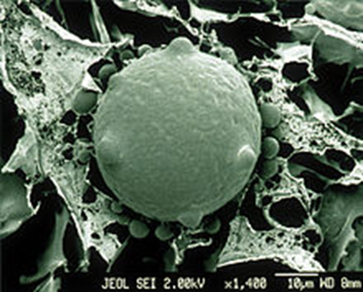
Batrachochytrium dendrobatidis (Bd)
Bd is a highly virulent chytrid fungus that has been linked to population decline in amphibian populations around the world
Leads to the development of chytridiomycosis
Causes disruption of the exchange of many vital
molecules such as oxygen, carbon dioxide, and ions
Photo by CSIRO
Notes:
Batrachochytrium dendrobatidis (Bd) is a highly virulent chytrid fungus that has been linked to the decimation of amphibian populations around the world. Because of the risk and spread of this pathogen, it is important to study and monitor potentially at-risk species and their possible defenses against infection.​
2. Infects by rooting their spherical thalli into the amphibian’s keratinized epidermal layer of their skin
5. Because many amphibians are “lungless” they rely solely on their skin for gas and ion exchange
6. They then suffocate or die from cardiac arrest due to ion imbalance

Slide 4
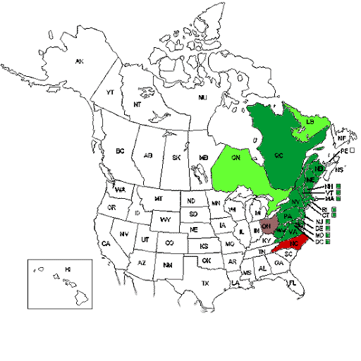
Research Background
The Northern two-lined salamanders range spans from central Virginia to Canada. Bd has been detected in several populations of this species at low-levels. ​
This study aims to characterize the microbiome of the two-lined salamander and its role in protecting the organism from pathogens like Bd.
Photo by NatureServe Explorer

Slide 5
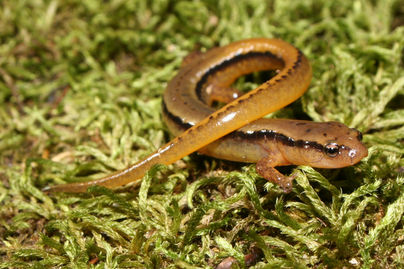
Microbiome
Consists of all microbial communities living in a symbiotic relationship on or in an organism
Focus is the cutaneous microbiome
Resident microbes have been intricately
linked to pathogen-host interactions
Symbiotic microbiome
Bacterial diversity
Photo by Jason Polston
Notes:
4. It influences the organism's metabolism, immune system, and has a direct effect on host’s health and ability to survive
6. This is known as a symbiotic microbiome, where both the bacteria and the salamander benefit from the relationship
8. Diversity is the measure of how many unique bacterial colonies we got when we grew up the samples on R2A plates
9. Greater cutaneous bacterial diversity has been shown to protect many organism around the world for many different pathogens

Slide 6
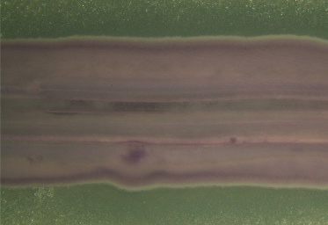
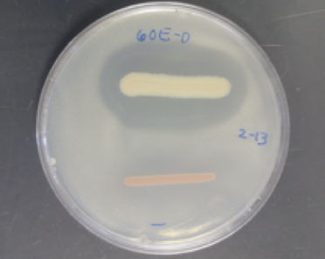
Microbiome and Bd
Symbiotic microbiome
Previous research has shown that microbiome is one of the major factors in determining defense against Bd and the survival rate of the salamander
Microbiome against Bd in vitro
Each bacterial isolate can used in a challenge assay against Bd
Goal is to find bacteria that inhibit the growth of Bd
Photos by Matthew Becker
Notes:
3. The bottom pictures shows “bacterial diffusion test” which plates bacterial isolates on a plate of Bd, just as an antibiotic would be placed on a lawn of bacteria to test for sensitivity
6. Cell-free supernatant (CFS) is a future study that will take the supernatant from an isolated bacterial culture, which will contain any of the antimicrobial peptides/molecules and run a challenge assay to quantify to what extent Bd is inhibited by the secretion from a particular bacterial culture.

Slide 7
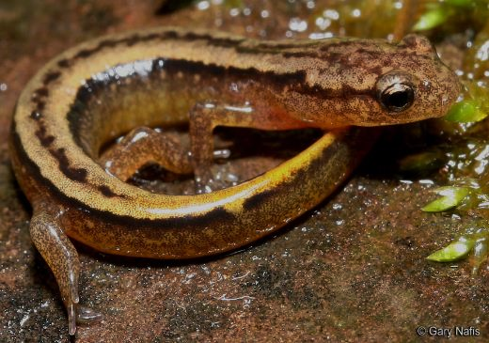
Research Questions
What bacteria are found on the skin of the Northern two-lined salamander?
What role do these bacteria play in the defense against the pathogen?
Why are some amphibian species driven to extinction while other species are left relatively unaffected?
Photo by Gary Nafis
Notes:
4. So with this in mind, these are our three main questions we wanted to answer in this project

Slide 8
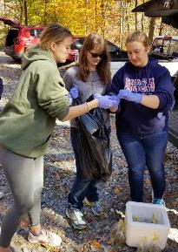
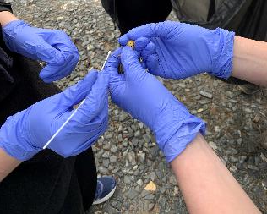
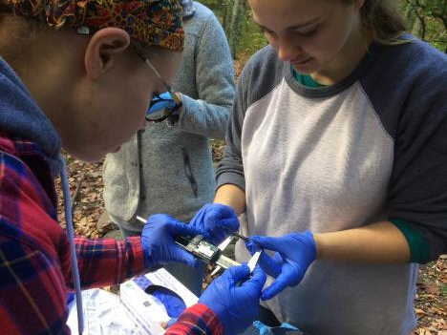
Sample Collection
Sampling
Twelve individuals were sampled near Watson’s pond
They were captured with sterile gloves, rinsed to remove transient bacteria, swabbed twice, tail-clipped, and released on site
The individuals were also weighed and measured for length. ​
Photo by Catherine Read
Notes:
Two-lined salamanders were caught via gloved hand from a stream in the Peaks of Otter region of the Blue Ridge Mountains of Virginia and placed in sterile bags.​
Individuals were then washed with sterile water to remove any transient microbes, swabbed once to characterize the microbiome. ​
The individuals were also weighed and measured for length. ​
Which is located within the Jefferson National Forest, along the Blue Ridge Parkway
4. Mass and snout-vent length was taken of each individual

Slide 9
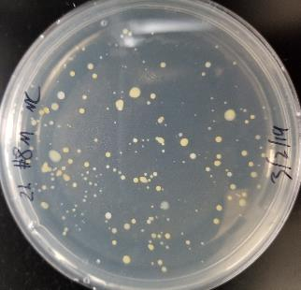
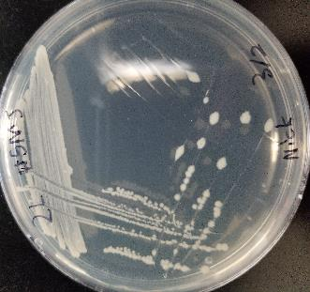
Isolating the Cultures
Isolating the Cultures
Each swab was cultured on R2A media
Each unique bacterial morphology was isolated using a streak for isolation
The microbiome swabs were used to inoculate R2A plates and incubated at room temperature.​
Notes:
The microbiome swabs were used to inoculate R2A plates and incubated at room temperature.​
Colonies were separated and streaked for isolation based on different morphologies on new R2A agar plates.
2. R2A media was used as it is nutrient depleted, meaning it evens the playing field for bacteria to ensure that a few, fast growing bacteria do not overtake the plate before all the other colonies can be isolated
3. The top picture shows an example of our mass culture plate with the many different colony morphologies present
5. The streak for isolation is seen in the bottom picture and is necessary to ensure a pure culture before extraction and PCR

Slide 10
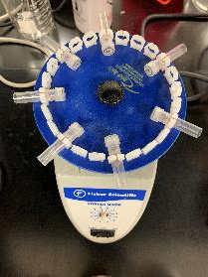
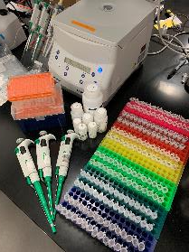
Extraction and Analysis
Once isolated, DNA was extracted from each morphotype which contained a pure isolated microorganism
The cultures were then amplified with primers via PCR
Sanger Sequencing was performed using the 16S ribosomal RNA gene to determine their identity
Notes:
DNA was extracted from each pure isolated microorganism, the 16s rRNA was amplified with primers via PCR, and then sequenced to determine their identity.​

Slide 11
Field Data
Average = 0.67 g
Average = 33.98 mm
Notes:
Mass and SVL data was obtained from each salamander to observe for any correlations between body condition, bacterial diversity, antifungal capacity of the cutaneous microbiome.

Slide 12
Unique Microbial Morphotypes
Average = 9.67
Notes:
Pure cultures were differentiated by the unaided eye into distinct microbial morphotypes. There was an average of 9.7 morphotypes per salamander.​
116 morphotypes with an average of 9.67 morphotypes per salamander
Microbial includes all bacteria and fungi grown up on the mass culture plates. Size, color, texture, and margin were used to determine qualitative different species of bacteria. Difference were only observed by the unaided eye
The high variation between the individuals is most likely due to the selectivity of the R2A media. It is estimated that only around 2% of all bacteria are culturable on a given agar medium
So just because nothing grew does not mean there was no bacteria on their skin. It just means that their core microbiome might be unculturable on that specific type of medium.

Slide 13
Bacterial Richness (OTUs)
Average = 7.14
Notes:
The DNA of the unique microbial types were sequenced, and each species was identified. Duplicates were combined into one operational taxonomic unit. ​
50 OTUs were the result when the entire process was complete
In order for a microbial morphotype to be considered a bacterial OTU the following must occur
DNA must be extracted and amplified via 16s rRNA PCR (this rules out fungi)
Must have a thick enough band on a gel to confirm the presence of DNA
Must give a successful hit on the BLAST database
Must not be a genetically identical duplicate of bacterial from the same salamander

Slide 14
Prevalence of Bacterial Genera
Notes:
Sequences were blasted against the Genbank database to determine the identity of each isolate. The graph contains 7 individuals with 5 yet to contribute to the data of species diversity.​
This is a breakdown of all 50 bacterial OTUs and the genus in which they come from
Microbacterium, pseudomonas , and bacillus were the most common
It appears that most of the salamanders in this study had a core of very common genera and then an array of unique bacterial genera that were not found on any of the other 11 salamanders
This data is consistent with other members of our research team that are sampling other species of salamander in central Virginia
Individual 5 and 7 had one or more OTU from each of the three common genera
Only two salamanders, 9 and 12, had no bacterial OTUs from the “core three”
19 anti-Bd from Acinetobacter
17 anti-Bd from Pseudomonas
5 anti-Bd from Chryseobacterium
HOWEVER, just because no previous study has found success with a specific genera does not mean we will not

Slide 15
Conclusions
Moving forward, we will continue to sequence the 16S rRNA genes of each bacterial isolate to compose a more complete characterization of the microbiome within the two-line salamanders. ​
We plan to conduct co-culture challenge assays to identify which microbes present have antifungal properties that inhibit Bd. We hypothesize that some of the strains will demonstrate antifungal capabilities allowing further testing to determine potential probiotic treatments to mitigate the effects of chytridiomycosis in infected amphibian populations.

Slide 16
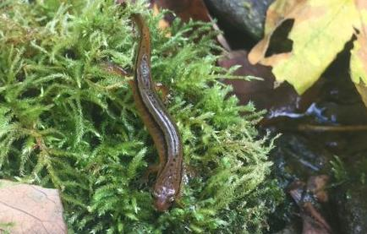
Future Work
Unknown bacteria
Bacterial isolates can be used in a challenge assay against Bd in hopes of finding bacterial strains that inhibit the fungal pathogen
The final goal of Becker lab, and labs around the world is to find a “microbial cure” for Bd in hopes of preserving amphibians
Photo by Catherine Read
Notes:
The Northern two-lined salamander appears to be widely unaffected by Bd even though other research has reported infected individuals in Virginia
The goal is to understand if the cutaneous microbiome of the Northern two-lined salamander plays a role in its defense against a infection of Bd
Three unknown bacteria that had a complete 16s rRNA gene yet had a great than 4% different to any of the known species in the databases. This could mean we have new species/strains of species of bacteria as they have a discrepancy in their 16s rRNA gene greater than 2%.
EZ BioCloud is an online database where we cross references our sequences and they suggest anything less than 98.6% similarity has the possibility to be a new species of bacteria. This is exciting as by their threshold, we possibly have 6 new bacterial species, three of which come from individual #12

Slide 17
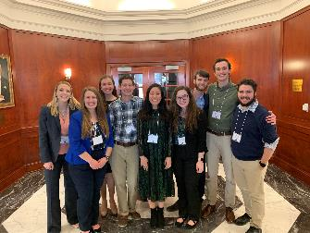
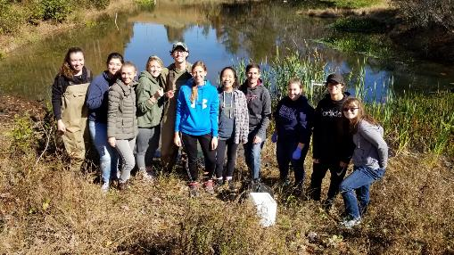
Acknowledgements
Funding
Liberty University Center for Research and Scholarship
Virginia Herpetological Society
Additional thank you to…
Dr. Matthew Becker
Our fellow research students in the Becker Lab
Notes:
We would like to thank the Liberty University Department of Biology and Chemistry , the Center for Research and Scholarship, and the Virginia Herpetological Society for funding and support. We would also like to thank the other members of Dr. Becker’s Research Team.

Slide 18
Any Questions?
Photo by Dave Huth

