Slide 1
Kudzu Leaf (Pueraria montana)
Peroxidase Activity
Dr. Raner and Kathryn Briley

Slide 2
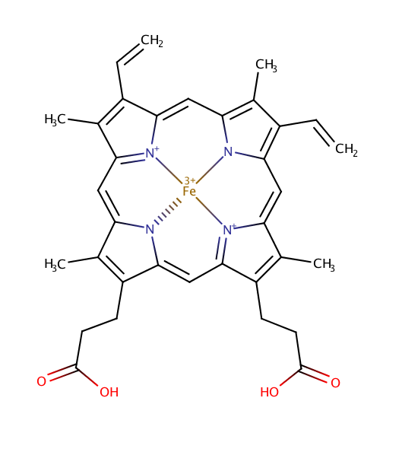
Peroxidase Enzymes
Industrial and biotechnological applications
  Ease of purification
  Broad range of chemical activities
  Low cost for use
Potential problem: poor selectivity

Slide 3
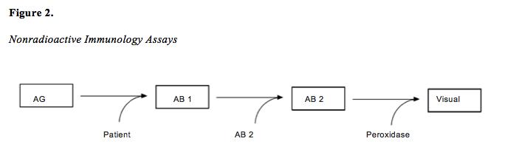
Diagnostic Abilities
Note. AG represents antigen, AB 1 the antibody from the patient’s blood, and AB 2 the secondary antibody bound to a substrate.

Slide 4
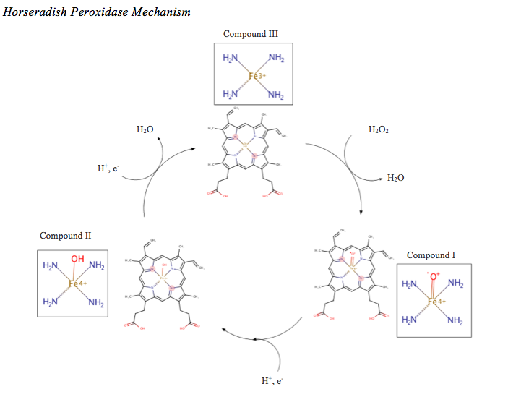

Slide 5
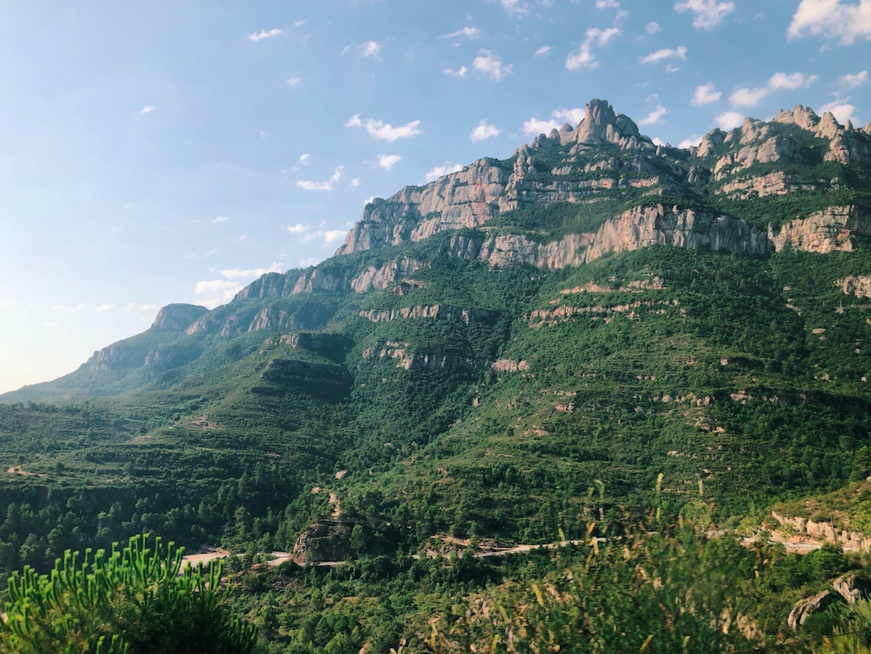
Common Enzyme Sources
Enzymes produced by a large percent of plant and fungal organisms
  Varying levels of activity
  Horseradish

Slide 6
Research Goals
Broad goal- explore peroxidase activities from a large sampling of plants
Specific goal - to determine the enzyme stability, optimal pH conditions, and possible novel chemical activities for kudzu

Slide 7
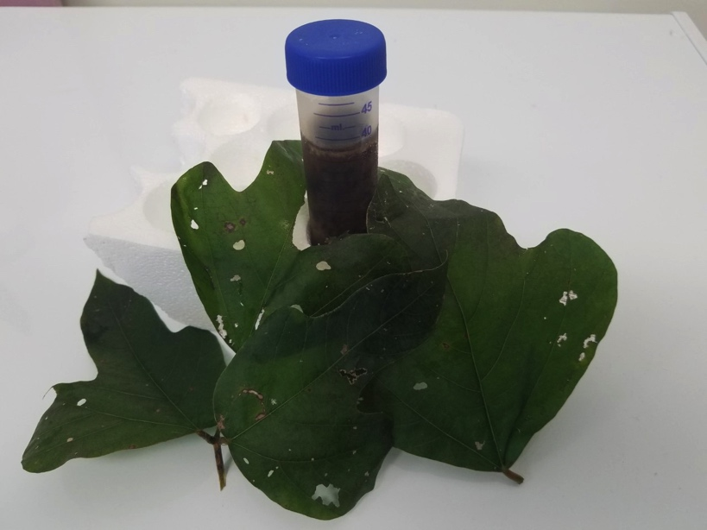
Kudzu: Pueraria montana
Invasive species
High catalytic activity
Notes:
Tube has crude sample or 40-70% precipitate

Slide 8
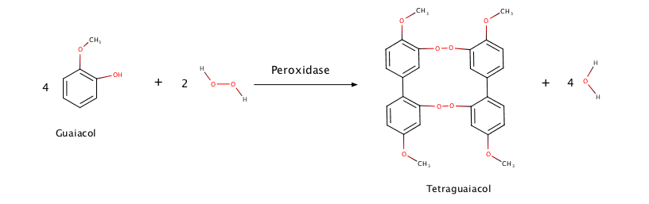
Guaiacol Reaction

Slide 9
Guaiacol Analysis
Notes:
reaction mixture composed of 4 mM guaiacol, 4 mM hydrogen peroxide, 50 mM phosphate buffer pH 7.5, and deionized water

Slide 10
Purification
Extraction
Centrifuge
.
Saturation
.
.
Dialysis
Column Chromatography
Notes:
Extraction
Centrifuge
Saturation with Ammonium Sulfate
Column Chromatography
(abnormal)
Saturated solution was passed through a DEAE Sephacel column
Dialysis

Slide 11
Pursuit of Optimal pH
Notes:
Same rxn mixture

Slide 12
Peroxidase Quantification via Heme Analysis
If a value for y is discovered, then the x (heme concentration) value can be calculated
Notes:
METHOD:
Concentration measured by absorbance in the spectrometer and using the known extinction coefficient for HRP
1:1 dilution
M₁V₁=M₂V₂, with M and V representing molarity and volume
HPLC was used to measure the amount of heme activity in the samples (rxn mixture of 50% acetonitrile, 50% deionized water, and 0.1% trifluoroacetic acid)

Slide 13
Kudzu Heme Analysis
Integration Value = 4
(the y value)
Heme peak
y = 43.82x - 15.167
Heme concentration = 0.44 mM
Notes:
Same rxn mixture

Slide 14
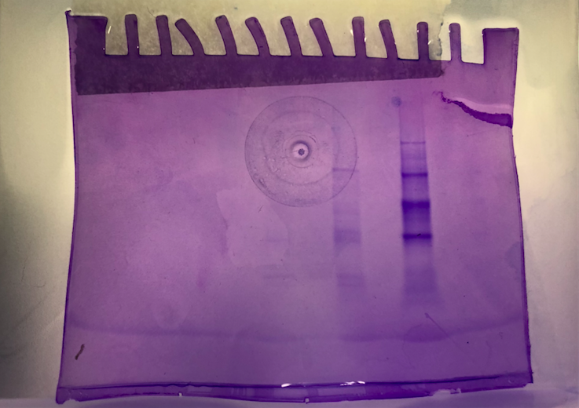
Purification Assessment
Lane A- Purified Peroxidase
Lane B- Crude Kudzu
Lane C – Protein Ladder
Peroxidase protein size: approximately 30,000 or significantly below
A
B
C

Slide 15
Future Research
Efficient purification method
Determining specificity for industrial use
  Optimal pH
  Guaiacol screening with varying temperatures
  Determination of variance from unique harvest locations

