Slide 1
The Alienation of W.E.B. Du Bois
Tanesha Higgins

Slide 2
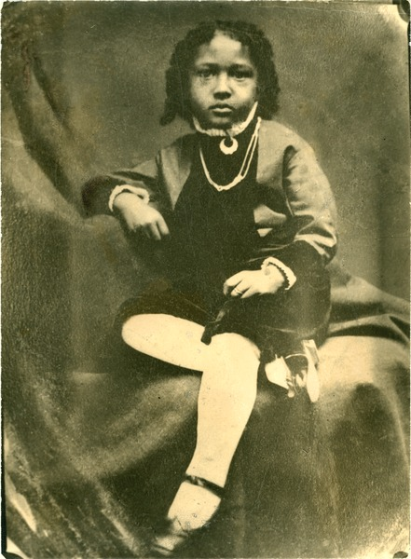
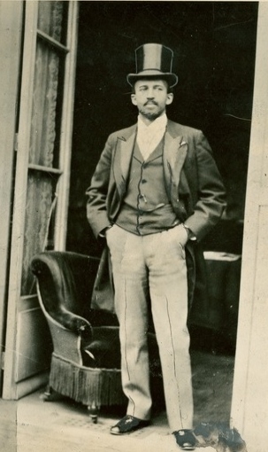
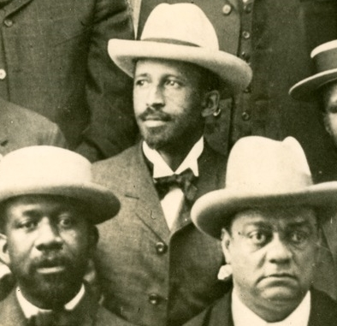
Background on Du Bois
Notes:
W. E. B. Du Bois at Paris International Exposition, 1900. W. E. B. Du Bois Papers (MS 312). Special Collections and University Archives, University of Massachusetts Amherst Libraries
Niagara Movement founders, 1905. W. E. B. Du Bois Papers (MS 312). Special Collections and University Archives, University of Massachusetts Amherst Libraries

Slide 3
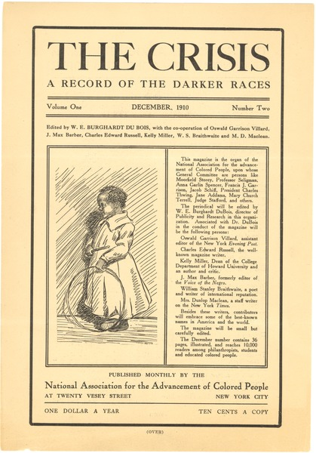
Leftist Activities
The Crisis
Black Reconstruction (1935)
International Travel
FBI – WWII
Communist? No. File Closed
1910 Flyer for the Crisis

Slide 4
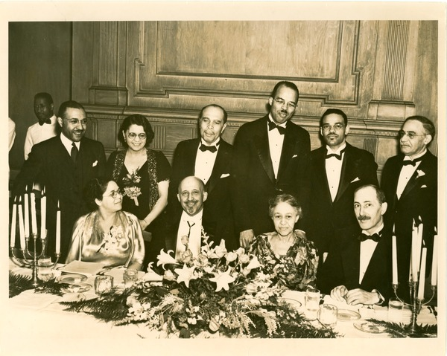
Place within American Society
Before the Cold War, Du Bois solidified himself as a controversial yet respected and accepted figure
Du Bois with friends and family at his 70th birthday at Atlanta University

Slide 5
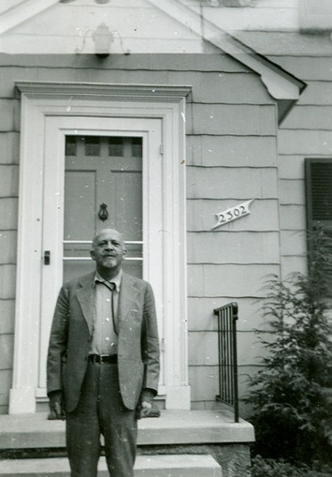
Cold War
“Witch Hunt” - Some restraint
Congresses and Organizations
Pointed Speech
FBI File Reopens
Du Bois outside of his Baltimore home in 1945

Slide 6
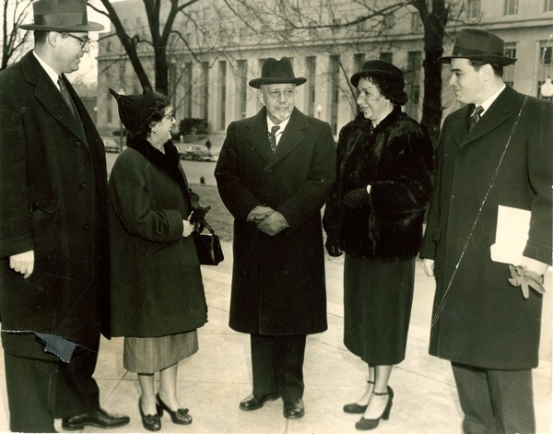
Justice Department
Peace Information Center (PIC)
Agent of Foreign Principle
Trial
Du Bois and his co-defendants await their trial

Slide 7
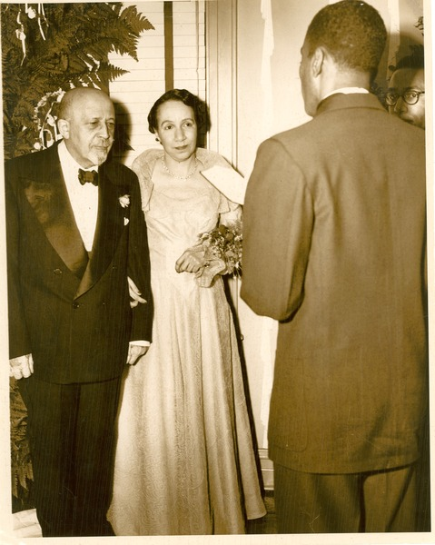
Mid-Trial
Senatorial Campaign
Shirley Graham
Support From the Left
Abandonment
Du Bois and Graham’s wedding ceremony

Slide 8
Aftermath
Acquitted of charges
Irreparable Alienation
“once a national audience, black and white, heard his plea for negro equality. Now few listen, and few still heed him.”
Maintains leftist connections
Brochure for Du Bois’ Battle for Peace

Slide 9
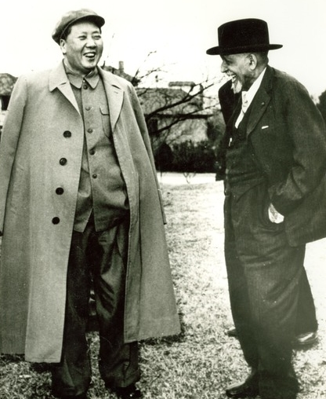
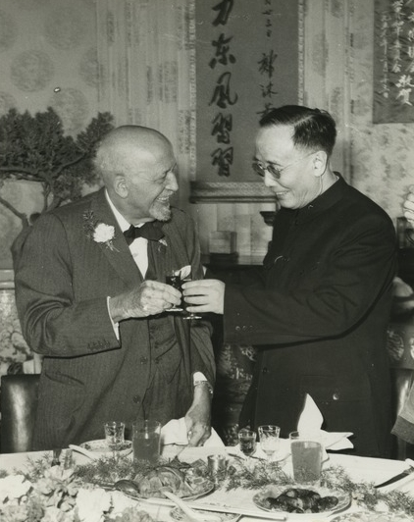
State Department
Enduring “Punishment”
Several missed international engagements
Refusal to sign anti-communist affidavit
Struggle for the passport lasts for nearly a decade
Revoked once more before final reinstatement
Du Bois spent his 91st birthday in the company of prominent Chinese officials such as Mao Tse-Tung (left) and Guo Moruo (Right)

Slide 10
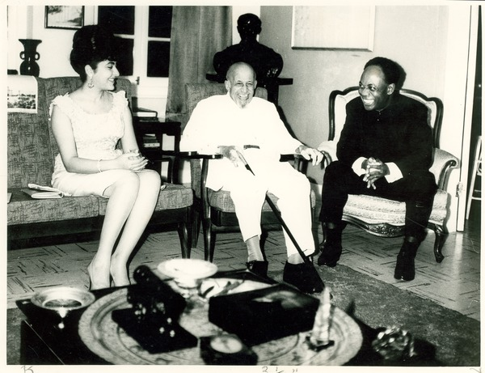
Ghana and Death
Physical Alienation
Celebrated figure abroad
Final Years
Encyclopedia Africana
His loss was felt internationally
Du Bois spends his 93rd and final birthday with President Kwame Nkrumah and his wife, Fathia Nkrumah.
Notes:
W. E. B. Du Bois on his 95th birthday with President Kwame Nkrumah and Madame Nkrumah, Accra, Ghana, February 23, 1963. W. E. B. Du Bois Papers (MS 312). Special Collections and University Archives, University of Massachusetts Amherst Libraries

Slide 11
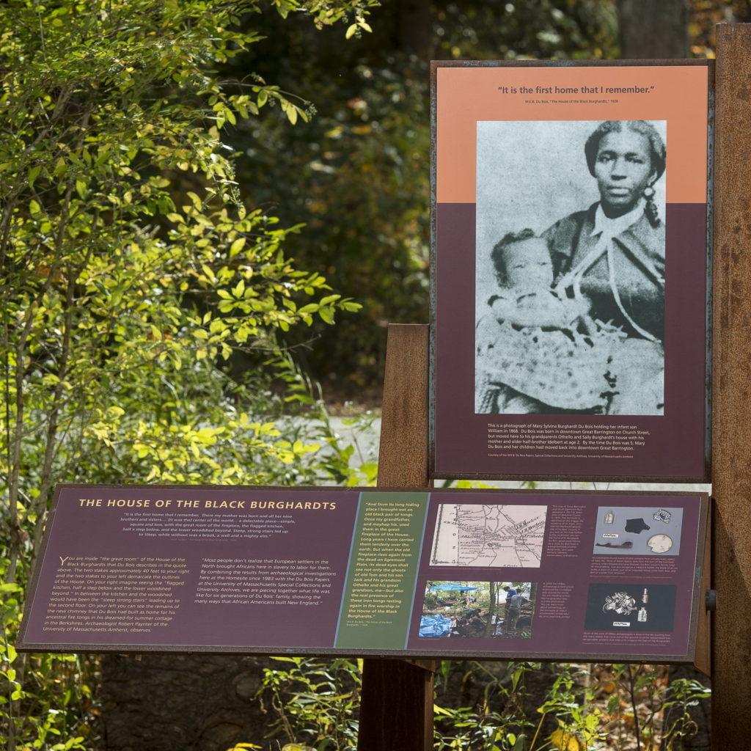
Legacy
Great Barrington
Memorial
Du Bois Papers
Information marking a trail outside of Du Bois’ memorial center in Great Barrington.

Slide 12
Bibliography
Baldwin, Kate. Beyond the Color Line and the Iron Curtain: Reading Encounters between Black and Red, 1922-1963. Durham: Duke University Press, 2002.
Bass, Amy. Those about Him Remained Silent: The Battle over W.E.B. Du Bois. Minneapolis, MN: University of Minnesota Press, 2009.
Bennett Jr., Lerone. “From Booker T. to Martin L.” Ebony, November 1962. https://books.google.com/books?id=Mz8uGcoeLZQC&pg=PA153&dq=du+bois&hl=en&sa=X&ved=2ahUKEwjktqfV-qHtAhXfSjABHdsNDBIQ6AEwBHoECAMQAg#v=onepage&q=du%20bois&f=false
Brown, J. Patrick, B.C.D. Lipton, and Michael Morisy, ed. Writers Under Surveillance: The FBI Files. Cambridge: Massachusetts Institute of Technology Press, 2018.
Carey, Joy Gleason. Blacks, Reds, and Russians: Sojourners in Search of the Soviet Promise. New Brunswick: Rutgers University Press, 2008.
Carlisle, Rodney. The Roots of Black Nationalism. Port Washington: Kennikat Press, 1975.
Du Bois, Shirley G. His Day is Marching On: A Memoir of W.E.B Du Bois. Philadelphia: J.B. Lippincott Company, 1971.
Du Bois, W.E.B. Darkwater: Voices from within the Veil. New York: Oxford University Press, 2007.
Du Bois, W.E.B. In Battle for Peace: The Story of my 83rd Birthday. New York: Oxford University Press, 2007.
Du Bois, W.E.B. The Autobiography of W. E. B. DuBois: A Soliloquy on Viewing My Life from the Last Decade of Its First Century. New York: Oxford University Press, 2007.
Du Bois, W.E.B. The Souls of Black Folk. New York: Oxford University Press, 2007.
Du Bois, W.E.B. The Suppression of the African Slave Trade to the United States of America, 1638-1870. New York: Oxford University Press, 2007.
Du Bois, W.E.B. The World and Africa: Color and Democracy. New York: Oxford University Press, 2007.
Du Bois Papers. Coll. MS 312. Special Collections and University Archives, University of Massachusetts Amherst Libraries.
Du Bois, W.E.B. W.E.B. Du Bois: A Recorded Autobiography, Interview by Moses Asch. Folkways Records, 1961, MP3. https://open.spotify.com/album/6jvNmgzwiWc6R1TI6cjXhQ?si=NfZ4YD2dRaWiE-Jhus2lOA
Du Bois, W.E.B. W.E.B. Du Bois on Asia: Crossing the World Color Line. Jackson: University Press of Mississippi, 2005.
“Du Bois Speech Barred: A.L.P. Desegregation Rally Slated for Levittown.” New York Times (New York). March 15, 1956. http://ezproxy.liberty.edu/login?qurl=https%3A%2F%2Fwww.proquest.com%2Fdocview%2F113489188%3Faccountid%3D12085
“Du Bois Tells Harlem Only U.S. Wants War.” New York Times (New York), October 6, 1950. http://ezproxy.liberty.edu/login?qurl=https%3A%2F%2Fwww.proquest.com%2Fdocview%2F111422692%3Faccountid%3D12085
Federal Bureau of Investigation. E.B. (William) Dubois: Parts 1 through 5, 1942-1959. FBI Records: The Vault. https://vault.fbi.gov/E.%20B.%20%28William%29%20Dubois
Lewis, David Levering. W.E.B. Du Bois: The Fight for Equality and the American Century: 1919-1963. New York: Henry Holt and Co, 2000.
Horne, Gerald. Black and Red: W.E.B. Du Bois and the Afro-American Response to the Cold War, 1944-1963. Albany: State University of New York Press, 1986.
Marable, Manning. W.E.B. Du Bois: Black Radical Democrat. New York: Taylor and Francis Group, 1987.
Roman, Meredith L. Opposing Jim Crow: African Americans and the Soviet Indictment of U.S. Racism, 1928-1937. Lincoln: University of Nebraska Press, 2012.
Schultz, Bud, and Ruth Schultz. The Price of Dissent: Testimonies to Political Repression in America. Berkeley, CA: University of California Press, 2001.
UMass Amherst Libraries. “Randolph Bromery: WEB DuBois Paper – Part 2.” Published on March 12, 2010. Video. 6:13. https://www.youtube.com/watch?v=w21l7Hfks2U.
University of Massachusetts Amherst. “The 40th Anniversary of the W.E.B. Du Bois Papers at UMass Amherst.” Published on September 22, 2020. Video. 35:01. https://www.youtube.com/watch?v=iahE0syg1T8
Zeigler, James. Red Scare Racism and Cold War Black Radicalism. Jackson: University Press of Mississippi, 2015.

Slide 13
Image Sources
Slide 1
W. E. B. Du Bois as child, 1872. W. E. B. Du Bois Papers (MS 312). Special Collections and University Archives, University of Massachusetts Amherst Libraries
W. E. B. Du Bois at Paris International Exposition, 1900. W. E. B. Du Bois Papers (MS 312). Special Collections and University Archives, University of Massachusetts Amherst Libraries
Niagara Movement founders, 1905. W. E. B. Du Bois Papers (MS 312). Special Collections and University Archives, University of Massachusetts Amherst Libraries
Slide 2
National Association for the Advancement of Colored People. Flier of The Crisis, December 1910. W. E. B. Du Bois Papers (MS 312). Special Collections and University Archives, University of Massachusetts Amherst Libraries
Slide 3
Reeves Studios. W. E. B. Du Bois, 70th birthday dinner, Atlanta University, 1938. W. E. B. Du Bois Papers (MS 312). Special Collections and University Archives, University of Massachusetts Amherst Libraries
Slide 4
W. E. B. Du Bois in front of Baltimore home, ca. 1945. W. E. B. Du Bois Papers (MS 312). Special Collections and University Archives, University of Massachusetts Amherst Libraries
Slide 5
W. E. B. Du Bois with fellow defendants during trial in Washington, D.C., November 1951. W. E. B. Du Bois Papers (MS 312). Special Collections and University Archives, University of Massachusetts Amherst Libraries
Slide 6
Philips, I. Henry. Wedding ceremony of W. E. B. Du Bois and Shirley Graham Du Bois, February 27, 1951. W. E. B. Du Bois Papers (MS 312). Special Collections and University Archives, University of Massachusetts Amherst Libraries
Slide 7
Masses and Mainstream. In battle for peace brochure, ca. June 1952. W. E. B. Du Bois Papers (MS 312). Special Collections and University Archives, University of Massachusetts Amherst Libraries
Slide 8
W. E. B. Du Bois and Shirley Graham Du Bois viewing the May Day parade in Moscow's Red Square, May 1, 1959. W. E. B. Du Bois Papers (MS 312). Special Collections and University Archives, University of Massachusetts Amherst Libraries
W. E. B. Du Bois with Mao Tse-tung in a garden, Lake Country, Central China, March 1959. W. E. B. Du Bois Papers (MS 312). Special Collections and University Archives, University of Massachusetts Amherst Libraries
W. E. B. Du Bois, toasting with Guo Moruo at 91st birthday celebration, ca. February 1959. W. E. B. Du Bois Papers (MS 312). Special Collections and University Archives, University of Massachusetts Amherst Libraries
Slide 9
W. E. B. Du Bois on his 95th birthday with President Kwame Nkrumah and Madame Nkrumah, Accra, Ghana, February 23, 1963. W. E. B. Du Bois Papers (MS 312). Special Collections and University Archives, University of Massachusetts Amherst Libraries
Slide 10
Photo taken from https://www.duboisnhs.org/visit/

