Slide 1
Bridging the Cultural Gap Between
First and Second Generation of Korean Americans in the Church
Weon Deok Seo

Slide 2
Silent Exodus
In 1996 Christianity Today’s article
Asian Churches in the United States are simultaneously loosing their next generation.
The next generation are leaving not only the home churches, but perhaps their Christian faith as well.
Source: Christianity Today

Slide 3
Silent Exodus
“Many in younger generations either immigrated with their parents at a very early age or were born in the United States, placing them in a stressful bicultural context of balancing the oft-conflicting Asian parental and American cultural influences...”
(Christianity Today, 1996).

Slide 4
Silent Exodus
"The second generation is being lost. They are the mission field we need to focus on.“
Allen Thompson,
coordinator for multicultural church planting in the PCA
(Christianity Today, 1996)

Slide 5
Silent Exodus
After 25 years…
The church community still have faced these problems.

Slide 6
Three Elements for Solution
Cultural Element: Understanding cultural differences between first and second generation of Korean Americans
Biblical Element: Equipping “Christ-centered identity” with the biblical foundation.
Spiritual Element: Checking your relationship between God and you.

Slide 7
Cultural Element
The first step is to recognize a big cultural gap between them.
A better understanding of intercultural communication will help to bridge the gap between the first and the second generation of Korean Americans.

Slide 8
Cultural Element
Korean Traditions
Indirect Communication
Collectivism
Hierarchical Structure
American Cultures
Direct Communication
Individualism
Horizontal/Freedom Structure
Frist-Generation
Second-Generation

Slide 9
Cultural Element
Frist-Generation
Second-Generation
Hierarchical Structure
Horizontal/Freedom Structure
The second-generation experiences identity conflict

Slide 10
Cultural Element
Frist-Generation
Second-Generation
Hierarchical Structure
Horizontal/Freedom Structure

Slide 11
Biblical Element
Terrance Kim points out “Christ-centered identity” as having a brave to move the next step to go for the next generation in the church, rather than that as removing our all cultural identity.
Terence Kim, "Terry Kim on the Podcast: Do I Have a Christ-Centered Worldview?" The Advancing Native Missions Podcast, The Advancing Native Missions, March 19, 2019, audio, 51:00, https://www.iheart.com/podcast/269-the-advancing-native-missi-49463354/episode/terry-kim-on-the-podcast-do-49466717/

Slide 12
Biblical Element
The New Testament Period already experience the cultural difference.
  Jewish vs. Gentile
    Food
    The Old Testament Law
    The Old Testament vs. Hellenistic Philosophy (Act 17)

Slide 13
Biblical Element
So in Christ Jesus you are all children of God through faith, for all of you who were baptized into Christ have clothed yourselves with Christ. There is neither Jew nor Gentile, neither slave nor free, nor is there male and female, for you are all one in Christ Jesus (Galatians 3:26-28).

Slide 14
Biblical Element
“…all of them may be one, Father, just as you are in me and I am in you. May they also be in us so that the world may believe that you have sent me” (John 17:21)
“….so that they may be brought to complete unity. Then the world will know that you sent me and have loved them even as you have loved me” (John 17:23)

Slide 15
Biblical Element
“Just as a body, though one, has many parts, but all its many parts form one body, so it is with Christ” (1 Corinthians 12:12).
“For we were all baptized by one Spirit so as to form one body—whether Jews or Gentiles…” (v.13).
“Even so the body is not made up of one part but of many” (v.14).

Slide 16
Biblical Element
For he himself is our peace, who has made the two groups one and has destroyed the barrier, the dividing wall of hostility (Ephesians 2:14)

Slide 17
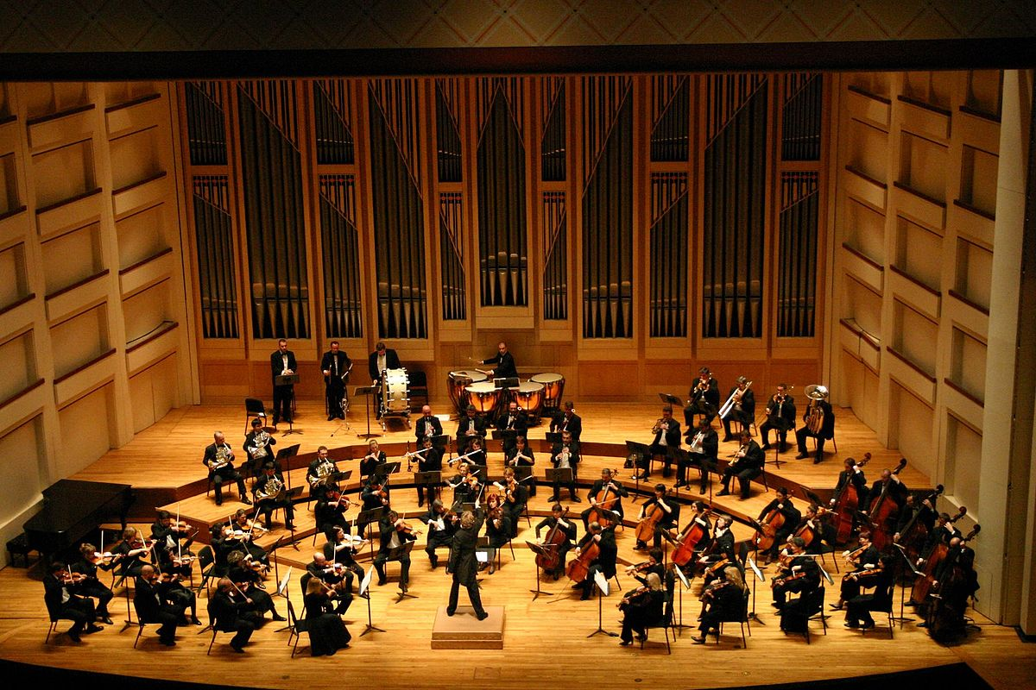
Biblical Element
Source: Dublin Philharmonic Orchestra in performance, Tchaikovsky 4th Symphony., https://upload.wikimedia.org/wikipedia/commons/1/19/Dublin_Philharmonic_Orchestra_performing_Tchaikovsky%27s_Symphony_No_4_in_Charlotte%2C_North_Carolina.jpg

Slide 18
Biblical Element
Seong Eun Kim claims the biblical view (such as Ephesians 6:1-3) can create better Parent-Child Relationship between first-, 1.5-, and second-generation Korean-Americans.
Kim suggests that “churches can encourage and better connect its members who are from different generations, ethnicities, cultures, and traditions, by using special well-developed and designed worship services or programs-such as a sports day or retreats for all generations.”
Kim, Seong Eun. 2013. “The Relationship of Parental Attachment and Christian Spirituality with Intergenerational Conflict between Korean-American Young Adults and Their Parents.” Journal of Psychology & Theology 41 (3): 189–99.

Slide 19
Spiritual Element
In the research, Kim points out young adults' Christian Spirituality. Kim said, “Those who have a good relationship with God would seek a good relationship with their parents, and vice versa.”
Kim, Seong Eun. 2013. “The Relationship of Parental Attachment and Christian Spirituality with Intergenerational Conflict between Korean-American Young Adults and Their Parents.” Journal of Psychology & Theology 41 (3): 189–99.

Slide 20

Spiritual Element
God
Biblical Element
Cultural Element
You

Slide 21
Spiritual Element
God
Biblical Element
Cultural Element
Spiritual Element
You

Slide 22
Spiritual Element
God
Biblical Element
The Gap
Cultural Element
You

Slide 23
Spiritual Element
God
God
Biblical Element
Spiritual Element
Cultural Element
The Gap
You
You

Slide 24
Summary
God
Biblical Element
Cultural Element
Spiritual Element
You

Slide 25
Bibliography
Dhingra, Pawan. “‘We’re Not a Korean American Church Any More’: Dilemmas in Constructing a Multi-Racial Church Identity.” Social Compass 51, no. 3 (September 2004): 367–79. https://doi.org/10.1177/0037768604045636.
Goranson, Sarah, Maria S Wong, and Joey Fung. “The Influence of Cultural and Generational Differences on the Ministry Experience of Chinese American Church Leaders.” Pastoral psychology. 69.1 (2020): 11–28. Web.
Kim, Eunjung, and Seth Wolpin. "The Korean American family: Adolescents versus parents acculturation to American culture." Journal of Cultural Diversity 15, no. 3 (2008): 108.
Kim, Henry H., and Ralph E. Pyle. “An Exception to the Exception: Second-Generation Korean American Church Participation.” Social Compass 51, no. 3 (September 2004): 321–33. https://doi.org/10.1177/0037768604045633.
Kim, Sharon. A Faith of Our Own : Second-Generation Spirituality in Korean American Churches. New Brunswick: Rutgers University Press, 2010.
Kim, Sharon. "Hybrid Spiritualities: The Development of Second Generation Korean American Spirituality." Human Architecture : Journal of the Sociology of Self - Knowledge 4 (Summer, 2006): 225-38.
Kim, Seong Eun. 2013. “The Relationship of Parental Attachment and Christian Spirituality with Intergenerational Conflict between Korean-American Young Adults and Their Parents.” Journal of Psychology & Theology 41 (3): 189–99.

Slide 26
Bibliography
Kim, Terence. "Terry Kim on the Podcast: Do I Have a Christ-Centered Worldview?" The Advancing Native Missions Podcast, The Advancing Native Missions, March 19, 2019, audio, 51:00, https://www.iheart.com/podcast/269-the-advancing-native-missi-49463354/episode/terry-kim-on-the-podcast-do-49466717/
Hong, Joann J., and Steve Hong. "The Korean American Family: Assimilation and Its Toll." Development 21: 121-143.
Huyser-Honig, Joan Korean. “American Churches: From generation to generation,” Calvin Institute of Christian Worship, July 5, 2005. https://worship.calvin.edu/resources/resource-library/korean-american-churches-from-generation-to-generation/
Kang, S. Steve, and Megan A. Hackman. "Toward a broader role in mission: how Korean Americans' struggle for identity can lead to a renewed vision for mission." International Bulletin of Missionary Research 36, no. 2 (2012): 72-77.
Lee, Helen. “Silent Exodus,” Christianity Today, August 12, 1996. https://www.christianitytoday.com/ct/1996/august12/6t9050.html
Lingenfelter, Sherwood G. Leading Cross-Culturally: Covenant Relationship for Effective Christian Leadership. Grand Rapids: Baker Academic, 2008.
Livermore, David. Leading with Cultural Intelligence: The Real Secret to Success. New York: American Management Association, 2015.
Moreau, A. Scott, Campbell, Evvy Hay, and Greener, Susan. Effective Intercultural Communication (Encountering Mission) : A Christian Perspective. Grand Rapids: Baker Academic, 2014.

Slide 27
Bibliography
Nguyen, Vanthanh. “Dismantling Cultural Boundaries: Missiological Implications of Acts 10:1–11:18.” Missiology 40, no. 4 (October 2012): 455–66. https://doi.org/10.1177/009182961204000406.
Park, Jerry Z. "Second-Generation Asian American Pan-Ethnic Identity: Pluralized Meanings of a Racial Label." Sociological Perspectives 51, no. 3 (2008): 541-61. doi:10.1525/sop.2008.51.3.541.
Priebe, Duane A. “Engagement with Cross-Cultural and Global Dimensions.” Currents in Theology and Mission 38, no. 5 (October 2011): 367–71.
Ting-Toomey, Stella, and Leeva C. Chung. Understanding Intercultural Communication. New York: Oxford University Press, 2012.
Tomson. Peter " Table Fellowship of Jews and Gentiles". In Paul and the Jewish Law, (Leiden, The Netherlands: Brill, 1990) doi: https://doi.org/10.1163/9789004275140_008
Toy, Vivian S. “Working to Prevent a 'Silent Exodus'” The New York Times, April 11, 1999. https://www.nytimes.com/1999/04/11/nyregion/working-to-prevent-a-silent-exodus.html
Young, Jacob Yongseok. 2012. Korean, Asian, or American? : The Identity, Ethnicity, and Autobiography of Second-Generation Korean American Christians. Lanham, MD: UPA.
Zylstra, Sarah Eekhoff. “How the Second Generation of Korean-American Presbyterians Are Bridging the Gap.” The Gospel Coalition. August 3, 2017. https://www.thegospelcoalition.org/article/how-the-second-generation-of-korean-american-presbyterians-are-bridging-the-gap/

