Slide 1
Why Hope Matters: : Fostering Resilience, Well-being, and Success in Students
Cathleen G. Beachboard
School of Psychology

Slide 2
Introduction-Importance of the Problem
According to health insurance data from 41 million health records released by Blue Cross and Blue Shield (2020), “Major depression is on the rise among Americans from all age groups, but is rising fastest among teens and young adults.”
COVID- 19 has the potential to further negatively impact student mental health.

Slide 3
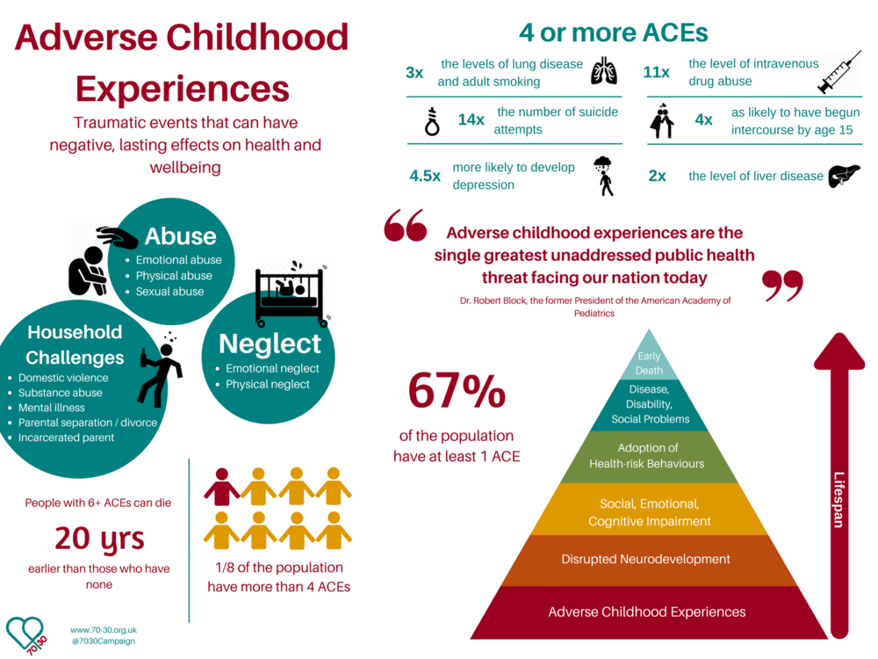
Graphic used with permission from www.70/30.org now https://www.acesconnection.com/blog/the-70-30-campaign not for reproduction and intended for educational purposes only.

Slide 4
Connection with Education
Results confirm that there is a graded relationship between ACEs and timely bachelor’s degree attainment—an additional ACE decreases the odds of timely bachelor’s degree attainment by about 17%, even after accounting for other related factors (Otero, 2021).
High ACE scores were also coorelated with low GPA’s (Otero, 2021).

Slide 5
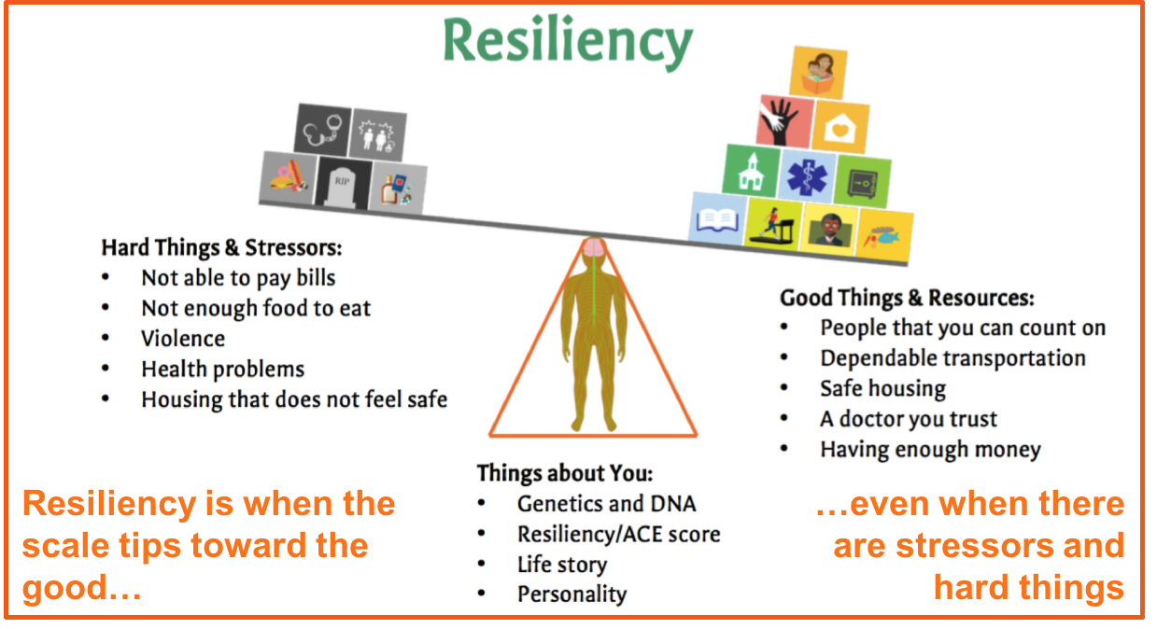
Used with permission from graphics copyrighted for my upcoming book from Corwin Publishing. Not for reproduction or publication outside of this presentation.

Slide 6
Applied Research- A Solution of Hope
Hope uniquely predicted the number of enrolled semesters, whether students returned for the 2nd semester of college, whether students graduated in 4 years, and students’ GPAs across 4 years of college (Gallagher et al., 2016; Day et al., 2010).
Results therefore indicate that hope was the most robust predictor of academic achievement in college after controlling for educational history (Gallagher et al., 2016; Day et al., 2010; Marques et al., 2015).

Slide 7
Applied Research- A Solution of Hope
“A greater sense of hope was associated with: better physical health and health behavior outcomes on some indicators (e.g., reduced risk of all cause-mortality, the fewer number of chronic conditions, lower risk of cancer, and fewer sleep problems), higher psychological well-being (e.g., increased positive affect, life satisfaction, and purpose in life), lower psychological distress, and better social well-being” (Long et al., 2020, p. 1).
This Photo by Unknown Author is licensed under CC BY

Slide 8
Applied Research-The Power of Hope
Paul talks about hope stating, “we also glory in our sufferings, because we know that suffering produces perseverance; perseverance, character; and character, hope” (New International Version, 2011, Romans 5:3-5)
Hope is a confident belief that God will guide a person through the trials of life to get then to the ultimate goal of fulfilling God’s will and reaching eternal life with Him.
This Photo by Unknown Author is licensed under CC BY-NC-ND

Slide 9
Applied Research-The Power of Hope
Used with permission from graphics www.mappalicious.com. Not for reproduction or publication outside of this presentation.

Slide 10
Applied Research-Hope in action
Goals
(What Power)
In hope theory, Snyder and Lopes (2007) defined hope in quantifiable terms as a positive cognitive process in which a person has goal-directed thinking that uses both pathways (the capacity to find routes to their desired goals) and agency (the necessary motivation to use those routes).
Using hope research and biblical accounts of hope could inform future studies on hope as a preventative measure in schools, counseling, and with families to help people reach their full God-given potential.
HOPE
Agency
(Will Power)
Pathways
(Way Power)

Slide 11
Safety Before Hope
Consistency- Co-Creation of Rules and Procedures.
Control- Self -Care Plans-Grounding Techniques, Analyzing, and Progress Building
Communication- Mental Health Check-In’s (Herman, 2002)
Used with permission from graphics https://www.edutopia.org/article/focusing-student-well-being-times-crisis . Not for reproduction or publication outside of this presentation.

Slide 12
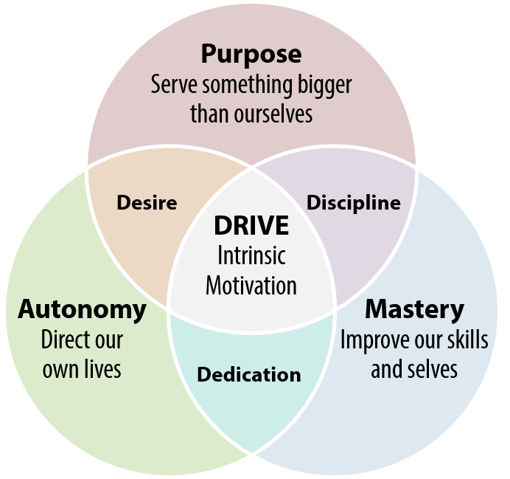
Applying Research-Hope in action
Hope Testing- Tiered Intervention with addressing low hope
Addressing Agency, Pathways, and Goals
Providing Support/purposeful connection
This Photo by Unknown Author is licensed under CC BY

Slide 13
Discussion- Recommendations
Testing students annually for hope to improve academic outcomes for all students.
Identify students with low hope and provide intervention for low hope.
Self-care plans to quickly strengthen hope.
Advisors provide tools for agency, pathways, and goal setting.

Slide 14
Conclusion
Through monitoring student hope scores, utilizing hopeful practices with students and creating powerful connections educators can improve educational attainment, life satisfaction, and the well-being for all students (Marques et al., 2015).

Slide 15
References
Blue Cross Blue Shield. (2020) The Health of America. https://www.bcbs.com/the-health-of-america
Day, L., Hanson, K., Maltby, J., Proctor, C., & Wood, A. (2010). Hope uniquely predicts objective academic achievement above intelligence, personality, and previous academic achievement. Journal of Research in Personality, 44(4), 550–553. https://doi.org/10.1016/j.jrp.2010.05.009
Duggal, D., Sacks-Zimmerman, A. Liberta, T. (2016). The Impact of Hope and Resilience on Multiple Factors in Neurosurgical Patients. Cureus. https://doi.org/10.7759/cureus.849
Gallagher, M. W., Marques, S. C., & Lopez, S. J. (2016). Hope and the Academic Trajectory of College Students. Journal of Happiness Studies, 18(2), 341–352. https://doi.org/10.1007/s10902-016-9727-z
Hellman, C. M., & Gwinn, C. (2016). Camp HOPE as an Intervention for Children Exposed to Domestic Violence: A Program Evaluation of Hope, and Strength of Character. Child and Adolescent Social Work Journal, 34(3), 269–276. https://doi.org/10.1007/s10560-016-0460-6
Leeson, P., Ciarrochi, J., & Heaven, P. C. (2008). Cognitive ability, personality, and academic performance in adolescence. Personality and Individual Differences, 45(7), 630–635. https://doi.org/10.1016/j.paid.2008.07.006
Long, K. N., Kim, E. S., Chen, Y., Wilson, M. F., Jr, E. L. W., Vanderweele, T. J. (2020). The role of Hope in subsequent health and well-being for older adults: An outcome-wide longitudinal approach. Global Epidemiology, 2, 100018. https://doi.org/10.1016/j.gloepi.2020.100018
Martin, K., & Stermac, L. (2009). Measuring Hope. International Journal of Offender Therapy and Comparative Criminology, 54(5), 693–705. https://doi.org/10.1177/0306624x09336131

Slide 16
References cont.
Marques, S. C., Lopez, S. J., Fontaine, A. M., Coimbra, S., & Mitchell, J. (2015). How Much Hope Is Enough? Levels Of Hope And Students’ Psychological And School Functioning. Psychology in the Schools, 52(4), 325–334. https://doi.org/10.1002/pits.21833
Merkaš, M., & Brajša-Žganec, A. (2011). Children with Different Levels of Hope: Are There Differences in Their Self-esteem, Life Satisfaction, Social Support, and Family Cohesion? Child Indicators Research, 4(3), 499–514. https://doi.org/10.1007/s12187-011-9105-7
Munoz, R. T., Quinton, K. A., Worley, J. A., & Hellman, C. M. (2018). Locus of Hope: External Hope in Parents/Guardians as an Antecedent of Adolescents’ Internal Hope and Life Satisfaction. Child Indicators Research, 12(3), 1107–1124. https://doi.org/10.1007/s12187-018-9566-z
New International Version. (2011). BibleGateway.com. www.biblegateway.com/versions/New-International-Version-NIV-Bible/#booklist
Otero, C. (2021). Adverse Childhood Experiences (ACEs) and Timely Bachelor’s Degree Attainment. Social Sciences, 10(2), 44. https://doi.org/10.3390/socsci10020044
Snyder, C. R., & Lopez, S. J. (2007). Positive psychology: The scientific and practical explorations of human strengths. Thousand Oaks, CA, US: Sage Publications
Stoddard, S. A., Mcmorris, B. J., & Sieving, R. E. (2010). Do Social Connections and Hope Matter in Predicting Early Adolescent Violence? American Journal of Community Psychology, 48(3- 4), 247–256. https://doi.org/10.1007/s10464-010-9387-9
Wong, S. S., & Lim, T. (2009). Hope versus optimism in Singaporean adolescents: Contributions to depression and life satisfaction. Personality and Individual Differences, 46(5-6), 648–6 52. https://doi.org/10.1016/j.paid.2009.01.009

